Slide 1
SỞ GIÁO DỤC VÀ ĐÀO TẠO BÌNH ĐỊNH
TRƯỜNG THPT LÝ TỰ TRỌNG
-----------------------------
HOAI NHON, 20 ^{TH} SEPTEMBER 2023
KẾ HOẠCH BÀI DẠY _MÔN: TIẾNG ANH 11 _ NĂM HỌC: 2023-2024
UNIT 1 A LONG AND HEALTHY LIFE _ SECTION VI: WRITING
GIÁO VIÊN: tRẦN THỊ THU HOÀI
tổ: TIẾNG ANH
--------

Slide 3
Unit
1
A long and healthy life
Unit
FAMILY LIFE
LESSON 6
WRITING
A short message

Slide 4
LESSON 6
WRITING
WARM-UP
Kahoot
PRE-WRITING
Task 1. Put the parts in the correct order.
Task 2. Write a sentence to express each message below. Begin with the words given.
Task 3. Write a short message to reply to the one in Task 1.
WHILE-WRITING
POST-WRITING
Peer review
Wrap-up
Homework
CONSOLIDATION

Slide 5
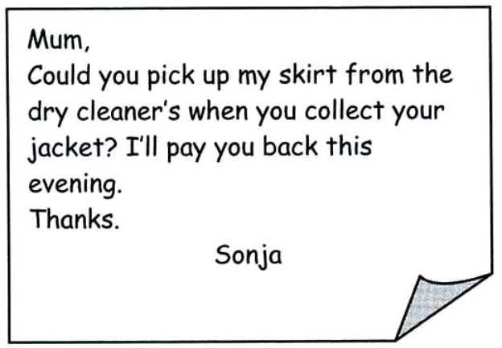
PRE-WRITING
How many parts are there in the message?
How to write a short message?

Slide 6
PRE-WRITING
1
Below is a short message. Put the parts in the correct order.
Key: B - D - C - A - E - F

Slide 7
PRE-WRITING
Greeting
Hi Linda,
Thanks for lending me the book about healthy cooking tips. It’s great!
How about coming to my house this Sunday to try some recipes from the book? Don’t forget to bring some fresh fruits from your garden. We’ll need them for some recipes.
See you soon,
Mai
Message/ main body
Closing

Slide 8
PRE-WRITING
Useful expressions
Greeting | Message | Closing
+ Hi, + Hello, + Dear …, | + Thank you for … + How about … + What about … + Why don’t we … + Shall we … + Remember to … + Don’t forget to … + I would like to invite you to … + Do you want to … | + See you again, + See you soon, + Write back soon, + Bye, + Love,

Slide 9
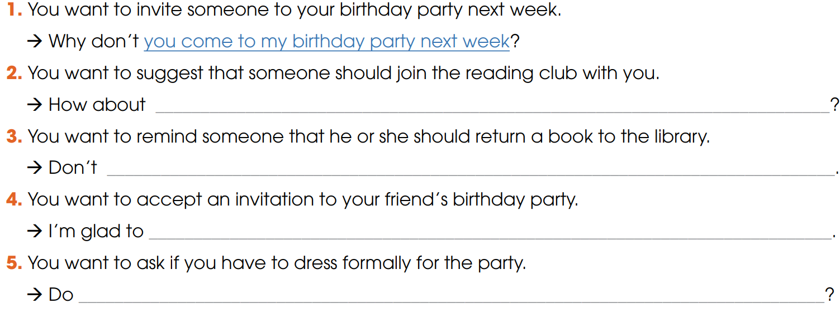
WHILE-WRITING
2
Write a sentence to express each message below. Begin with the words given.
joining the reading club with me
forget to return the book to the library
come to your birthday party
I have to dress formally for the party

Slide 10
WHILE-WRITING
3
Write a short message to reply to the one in Task 1
Suggested answer
Hi Mai,
Thank you for inviting me to your house this Sunday.
I am so glad to come to try some recipes from the book with you. Shall we meet at 10 a.m? Please tell me if I need to buy something in advance to prepare for the meal.
See you soon,
Linda.

Slide 11
POST-WRITING
4
Exchange your writing with your friend for peer review.
Writing rubric
Organization: …/10
Legibility: …/10
Ideas: …/10
Word choice: …/10
Grammar usage and mechanics: …/10
TOTAL: …/50

Slide 12
CONSOLIDATION
1
Wrap-up
What have you learnt today?
How to write and respond to a short message
Apply structures to express suggestions, invitation or acceptance, etc.

Slide 13
CONSOLIDATION
2
Homework
Do exercises in the workbook.
Prepare for Lesson 7 - Unit 1.

Slide 14
Website: hoclieu.vn
Fanpage: facebook.com/www.tienganhglobalsuccess.vn

