Slide 1
SỞ GIÁO DỤC VÀ ĐÀO TẠO BÌNH ĐỊNH
TRƯỜNG THPT LÝ TỰ TRỌNG
-----------------------------
HOAI NHON, 20 ^{TH} SEPTEMBER 2023
KẾ HOẠCH BÀI DẠY _MÔN: TIẾNG ANH 10 _ NĂM HỌC: 2023-2024
UNIT 3 MUSIC _ SECTION III: READING
GIÁO VIÊN: tRẦN THỊ THU HOÀI
tổ: TIẾNG ANH
----------

Slide 3
Unit
3
1
Unit
FAMILY LIFE
MUSIC
LESSON 3
READING

Slide 4
Unit
1
1
FAMILY LIFE
Family Life
Unit
OBJECTIVES
Read for specific information in a text about a famous TV music show;
Guess the meaning of words/phrases in context;
Talk about reasons why they want or don’t want to participate in a music competition.

Slide 5
LESSON 3
READING
Unit
GETTING STARTED
WARM-UP
Crossword
PRE-READING
* Vocabulary
Task 1: Look at the pictures and discuss the following questions.
Task 2: Match the highlighted words and phrases in the text to the meaning below.
Task 3: Choose the best answers.
WHILE-READING
POST-READING
Task 4: Discuss whether you want to participate in Vietnam Idol. Give your reasons.
Wrap-up
Home work
CONSOLIDATION

Slide 6
LESSON 3
READING
Unit
GETTING STARTED
WARM-UP
Crossword

Slide 7
WARM-UP
CROSSWORD
Rules:
Choose a random number.
Read the clue and guess the word.
The number of the letters is the point you gain.
The down word equals 40 points.
The winner is the team with the most points.

Slide 8
WARM-UP
KEY WORD
1
M
U
S
I
C
S
H
O
W
T | R | U | M | P | E | T
2
J | U | D | G | E
3
A | R | T | I | S | T
4
I | D | O | L
5
A | U | D | I | E | N | C | E
6
S | I | N | G | L | E
7
S | E | A | R | C | H
Clue: the person who watch, read or listen to the same thing
Clue: to dance, sing or play music in order to interest or please people
Clue: a brass musical instrument made of a curved metal tube that you blow into, with three valves for changing the note
Clue: a person who decides on the results of a competition
Clue: a person who is a professional singer, dancer, actor, etc
Clue: a person or thing that is loved and admired very much
Clue: a music recording that has one song
Clue: an attempt to find somebody/something, especially by looking carefully for them/it
Clue: an occasion when a video is watched online
8
P | E | R | F | O | R | M
9
V | I | E | W

Slide 9
LESSON 3
READING
Unit
GETTING STARTED
WARM-UP
Crossword
PRE-READING
* Vocabulary
Task 1: Look at the pictures and discuss the following questions.

Slide 10
VOCABULARY
reality (n)
/riˈæləti/
using real people (not actors) in real situations, presented as entertainment
thực tế

Slide 11
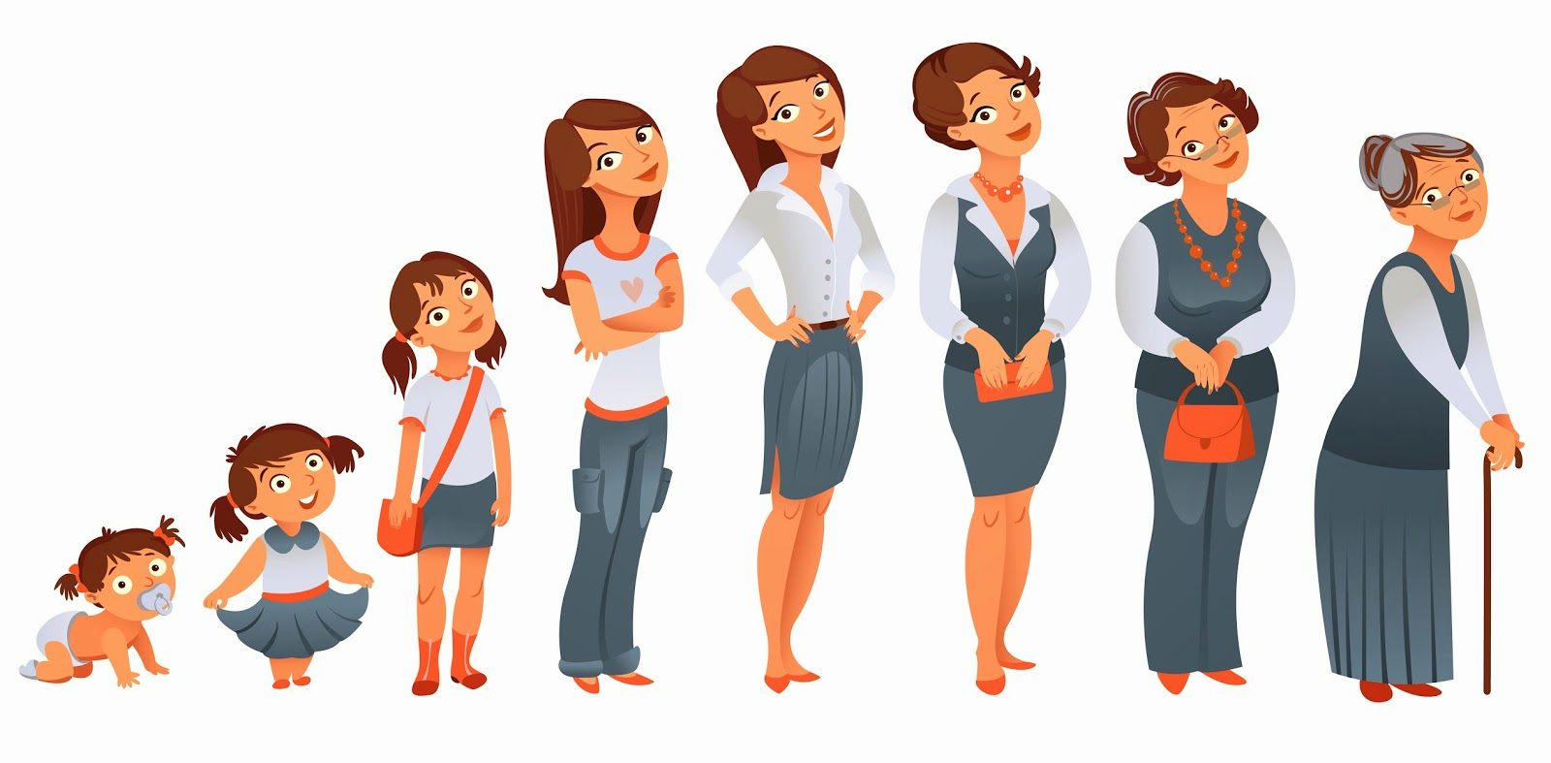
VOCABULARY
stage (n)
/steɪdʒ/
a period or state that something/ somebody passes through while developing or making progress
giai đoạn, thời kì

Slide 12
VOCABULARY
semi-final (n)
/ˌsemi ˈfaɪnl/
one of the two games or parts of a sports competition that are held to decide who will compete in the last part
bán kết

Slide 13
VOCABULARY
play a role in (idiom)
/pleɪ ə rəʊl ɪn /
be involved in or have an effect on
đóng vai trò
Ex: Deciding to travel instead of going straight to college after high school played a major role in my life.

Slide 14
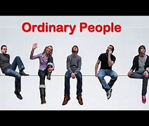
VOCABULARY
ordinary (adj)
/ˈɔːdnri/
not unusual or different in any way
thông thường, bình thường
E.g. Readers of the magazine said they wanted more stories about ordinary people and fewer stories about the rich and famous.

Slide 15
VOCABULARY
New words | Pronunciation | Meaning
reality (n) | /riˈæləti/ | using real people (not actors) in real situations, presented as entertainment
stage (n) | /steɪdʒ/ | a period or state that something/somebody passes through while developing or making progress
semi-final (n) | /ˌsemi ˈfaɪnl/ | one of the two games or parts of a sports competition that are held to decide who will compete in the last part (the final)
play a role in (idiom) | /pleɪ ə rəʊl ɪn / | be involved in or have an effect on
ordinary (adj) | /ˈɔːdnri/ | not unusual or different in any way

Slide 16
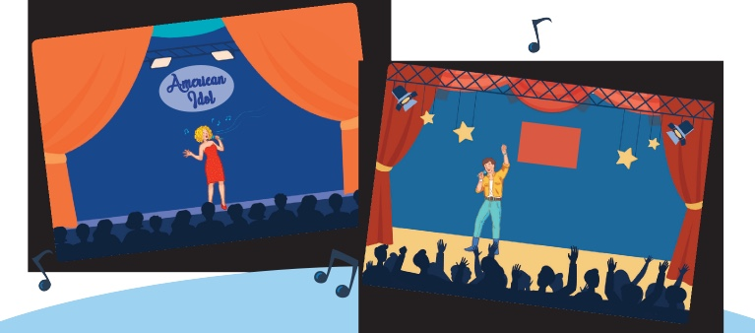
PRE-READING
1
Work in pairs. Look at the pictures and discuss the following questions.
What are these shows? What do you know about them?

Slide 17
PRE-READING
1
Work in pairs. Look at the pictures and discuss the following questions.
What are these shows? What do you know about them?
American Idol: a famous TV music show...
The X Factor: a television singing competition originated in the United Kingdom. Competitors go through weeks of auditions before judges until the winner is decided by a public vote. The prize is usually a recording contract. In addition to giving comments on the contestants’ performance, the judges help them choose the songs and style of their songs. The format of the X Factor has been adopted in many countries around the world.

Slide 18
LESSON 3
READING
Unit
GETTING STARTED
WARM-UP
Crossword
PRE-READING
* Vocabulary
Task 1: Look at the pictures and discuss the following questions.
Task 2: Match the highlighted words and phrases in the text to the meaning below.
Task 3: Choose the best answers.
WHILE-READING

Slide 19
WHILE-READING
2
Read a text about a famous music show. Match the highlighted words and phrases in the text to the meanings.
feel that they are similar to and can understand them
a set of TV or radio programmes on the same subject
removed from the competition
looking for
identify with
series
eliminated
in search of

Slide 20
WHILE-READING
3
Read the text again and choose the best answers.
1. What is American Idol?
A game show on TV
A TV singing contest
A live dancing competition
2. Which if the following statements is correct?
A. From the semi-final, singers who can go to the next stage are decided by the audience vote.
B. The judges choose as many singers as they can.
C. People around the world can vote for the songs they like.
3. Who wins American Idol?
A. The singer with the highest number of the votes on the final night.
B. The singer with the highest number of votes and highest scores from the judges.
C. The singer with the highest scores from the judges.
4. Which of the following statements about the judges is NOT mentioned?
A. They give comments after each live performance.
B. They have different views about the singers’ performances.
C. They are not in favour of choosing ordinary people.
5. What can be inferred about the competition in Viet Nam?
A. The audience decides who makes it to the final stage.
B. All the singers will be famous.
C. It can help develop participants’ singing careers.
6. When was American Idol shown for the first time on television?
A. twenty-four years ago B. in 2002 C. in 2007
7. Who can vote for their preferred singers in American Idol?
A. People who are over thirteen
B. People who live in the US, Puerto Rico or the Virgin Islands
C. People living in the US, Puerto Rico or the Virgin Islands and over thirteen

Slide 21
WHILE-READING
3
Read the text again and choose the best answers.
1. What is American Idol?
A. A game show on TV
B. A TV singing contest
B. A TV singing contest
GIVE OR TAKE
-5
C. A live dancing competition

Slide 22
WHILE-READING
3
Read the text again and choose the best answers.
2. Which of the following statements is correct?
A. From the semi-final, singers who can go to the next stage are decided by the audience vote.
A. From the semi-final, singers who can go to the next stage are decided by the audience vote.
GIVE OR TAKE
+8
B. The judges choose as many singers as they can.
C. People around the world can vote for the songs they like.

Slide 23
WHILE-READING
3
Read the text again and choose the best answers.
3. Who wins American Idol?
A. The singer with the highest number of the votes on the final night.
A. The singer with the highest number of the votes on the final night.
GIVE OR TAKE
+2
B. The singer with the highest number of votes and highest scores from the judges.
C. The singer with the highest scores from the judges.

Slide 24
WHILE-READING
3
Read the text again and choose the best answers.
4. Which of the following statements about the judges is NOT mentioned?
A. They give comments after each live performance.
GIVE OR TAKE
+6
B. They have different views about the singers’ performances.
C. They are not in favour of choosing ordinary people.
C. They are not in favour of choosing ordinary people.

Slide 25
WHILE-READING
3
Read the text again and choose the best answers.
5. What can be inferred about the competition in Viet Nam?
A. The audience decides who makes it to the final stage.
GIVE OR TAKE
-2
B. All the singers will be famous.
C. It can help develop participants’ singing careers.
C. It can help develop participants’ singing careers.

Slide 26
WHILE-READING
3
Read the text again and choose the best answers.
6. When was American Idol shown for the first time on television?
A. Twenty-four years ago
GIVE OR TAKE
-6
B. In 2002
B. In 2002
C. In 2007

Slide 27
WHILE-READING
3
Read the text again and choose the best answers.
7. Who can vote for their preferred singers in American Idol?
A. People who are over thirteen
GIVE OR TAKE
+3
B. People who live in the US, Puerto Rico or the Virgin Islands
C. People living in the US, Puerto Rico or the Virgin Islands and over thirteen
C. People living in the US, Puerto Rico or the Virgin Islands and over thirteen

Slide 28
WHILE-READING
3
Extension: Make questions
Rules:
2 teams;
Prepare 6 - 8 quiz questions based on the reading text and write them on a piece of paper;
Take turns to ask the other team;
2 points for each correct question or answer;
The winner is the team with most points.

Slide 29
LESSON 3
READING
Unit
GETTING STARTED
WARM-UP
Crossword
PRE-READING
* Vocabulary
Task 1: Look at the pictures and discuss the following questions.
Task 2: Match the highlighted words and phrases in the text to the meaning below.
Task 3: Choose the best answers.
WHILE-READING
POST-READING
Task 4: Discuss whether you want to participate in Vietnam Idol. Give your reasons.

Slide 30
POST-READING
PRACTICE
4
Work in pairs. Discuss whether you want to participate in Vietnam Idol. Give your reasons.

Slide 31
LESSON 3
READING
Unit
GETTING STARTED
WARM-UP
Crossword
PRE-READING
* Vocabulary
Task 1: Look at the pictures and discuss the following questions.
Task 2: Match the highlighted words and phrases in the text to the meaning below.
Task 3: Choose the best answers.
WHILE-READING
POST-READING
Task 4: Discuss whether you want to participate in Vietnam Idol. Give your reasons.
Wrap-up
Home work
CONSOLIDATION

Slide 32
CONSOLIDATION
1
Wrap-up
A text about a famous music show: American Idol

Slide 33
CONSOLIDATION
2
Homework
Search for more music shows on the Internet, take note the regulations and the prizes and post them on the Facebook/ Zalo group of your class.
Prepare for the Speaking lesson

Slide 34
Website: sachmem.vn
Fanpage: facebook.com/sachmem.vn/

