Slide 1
LY TU TRONG HIGH SCHOOL
TO OUR CLASS
TEACHER : HO THI THU TRANG
CLASS : 11 A1,6

Slide 3
Unit
2
The generation gap
Unit
FAMILY LIFE
LESSON I
GETTING STARTED
What is a generation gap?

Slide 4
LESSON I
GETTING STARTED
WARM-UP
GAME: Listing game
PRESENTATION
Vocabulary
Task 1: Listen and read.
Task 2: Tick the true information about Mark and Mai.
Task 3: Find the words or phrases.
Task 4: Choose the modal verbs to complete the sentences.
PRACTICE
PRODUCTION
Role play
Wrap-up
Homework
CONSOLIDATION

Slide 5
WARM-UP
LISTING GAME
Work in 2 groups.
Each group is given a board pen
Write as many words connected to the theme “ A long and healthy life” as possible ( each student writes one word/ phrase)
- The team with more correct word is the winner.

Slide 6
PRESENTATION
generation gap (n.ph.)
/ ˌdʒenəˈreɪʃn ɡæp/
the difference in attitude or behaviour between young and older people that causes a lack of understanding

Slide 7
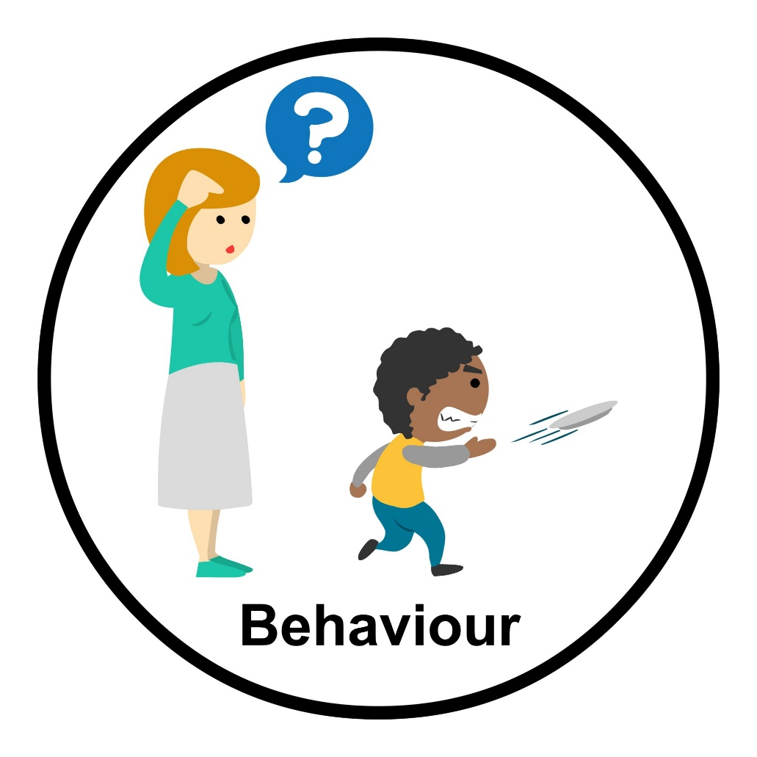
PRESENTATION
behaviour (n)
/bɪˈheɪvjə(r)/
the way that somebody behaves, especially towards other people

Slide 8
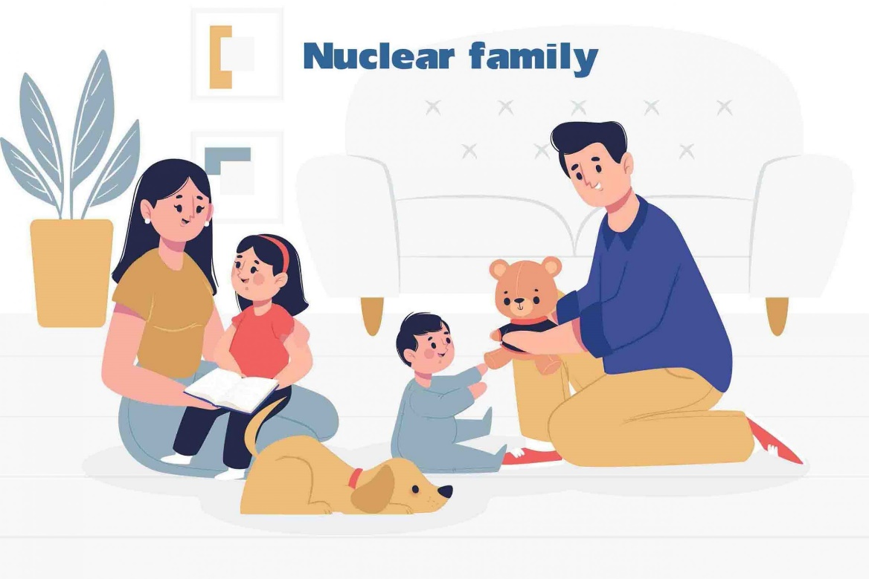
PRESENTATION
nuclear family (n.ph.)
/ˌnjuːkliə ˈfæməli/
a family that consists of father, mother and children, when it is thought of as a unit in society

Slide 9
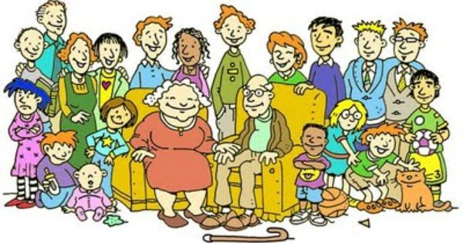
PRESENTATION
extended family (n.ph)
/ɪkˌstendɪd ˈfæməli/
a family group with a close relationship among the members that includes not only parents and children but also uncles, aunts, grandparents, etc.

Slide 10
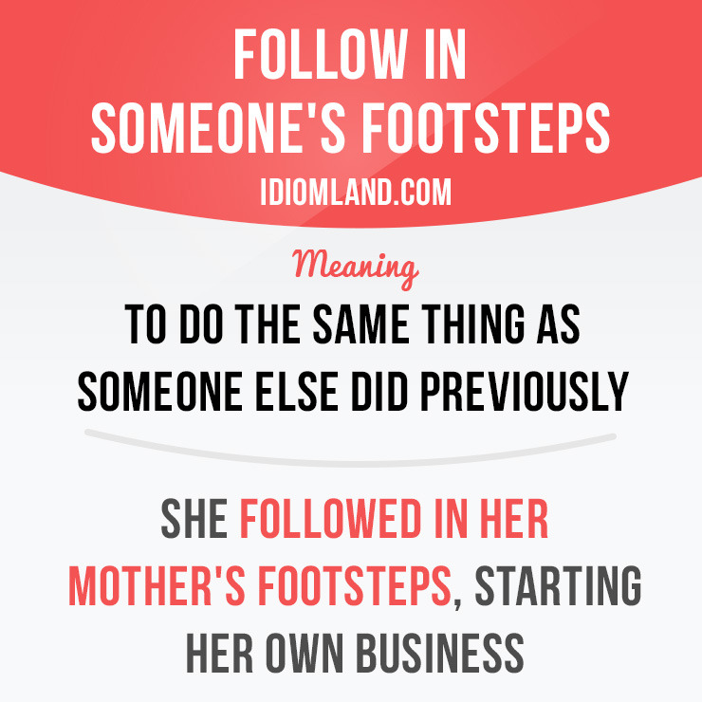
PRESENTATION
follow in somebdy’s footsteps (idiom)
to do the same job, have the same style of life, etc. as somebody else, especially somebody in your family

Slide 11
PRESENTATION
Form | Pronunciation | Meaning | Vietnamese equivalent
1. generation gap (n.ph.) | / ˌdʒenəˈreɪʃn ɡæp/ | the difference in attitude or behaviour between young and older people that causes a lack of understanding | khoảng cách thế hệ
2. behaviour (n) | /bɪˈheɪvjə(r)/ | the way that somebody behaves, especially towards other people | hành vi
3. nuclear family (n.ph.) | /ˌnjuːkliə ˈfæməli/ | a family that consists of father, mother and children, when it is thought of as a unit in society | gia đình hạt nhân
4. extended family (n.ph) | /ɪkˌstendɪd ˈfæməli/ | a family group with a close relationship among the members that includes not only parents and children but also uncles, aunts, grandparents, etc. | gia đình nhiều thế hệ
5. follow in somebody’s footsteps (idiom) |  | to do the same job, have the same style of life, etc. as somebody else, especially somebody in your family | nối nghiệp/ kế nghiệp ai

Slide 12
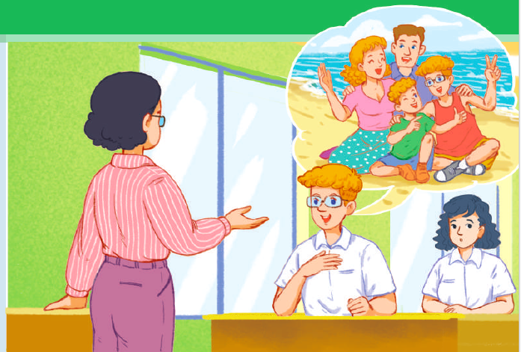
PRESENTATION
1
Listen and read.

Slide 13
PRESENTATION
1
Listen and read.
Ms Hoa: | Good morning, class. Today, we’ll talk about the generation gap. So, what is the generation gap?
Mark: | Well, I think it’s the difference in beliefs and behaviour between young and older people.
Ms Hoa: | You’re right, Mark. So, is there a generation gap in your family?
Mark: | Not really, Ms Hoa. I live in a nuclear family with my parents and brother. We understand each other quite well though we still argue over small things.
Ms Hoa: | Right. We can’t avoid daily arguments. What about you, Mai?
Mai: | Well, I live with my extended family, and I have to learn to accept the differences between the generations.
Ms Hoa: | That’s a good point. Can you give us an example?
Mai: | Well, my grandparents hold traditional views of male jobs and gender roles. For example, my grandfather wants my brother to be an engineer, but my brother hopes to become a musician. And my grandmother thinks women have to do all the housework.
Ms Hoa: | How about your parents? Do they share your grandparents’ views?
Mai: | No, they don’t. They think that we should follow our dreams. They give us advice, but never force us to follow in their footsteps.
Ms Hoa: | Thank you, Mai, for sharing your experiences. You must respect your parents and grandparents, but you should also express your opinion. Now let’s continue our discussion with ….

Slide 14
PRACTICE
2
Read the conversation again. Tick (✓) the true information about Mark and Mai.
 |  | Mark | Mai
1. | has some arguments over small things with family members
2. | lives with grandparents who have traditional views
3. | lives in a nuclear family
4 | has parents who don’t force their children to follow in their footsteps.
✓
✓
✓
✓

Slide 15
PRACTICE
3
Find words or phrases in 1 that have the following meanings.
1. all people who were born at about the same time | __________
2. a family that consists of a father, a mother, and children | __________
3. a family that includes not only parents and children but also uncles, aunts, grandparents, etc. | __________
4. disagreements about things | __________
generation
(a) nuclear family
(an) extended family
arguments

Slide 16
PRACTICE
4
Complete the text based on the conversation in Task 1. Use the correct form of the verbs in brackets.
1. Mai lives with her extended family, and she has to/ should learn to accept the differences between the generations.
2. Mai’s grandmother thinks women have to/ should do all the housework.
3. Mai’s parents believe that children must/ should follow their dreams.
4. Ms Hoa thinks that children have to/ must respect their parents and grandparents.

Slide 17
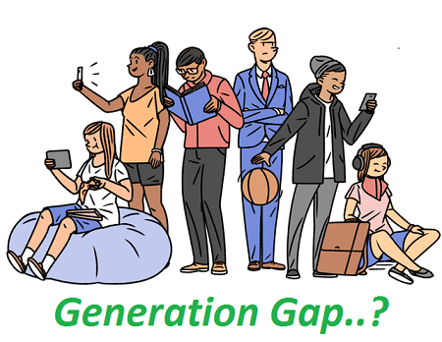
PRODUCTION
Role play
- Ss work in groups of 5.
- In each group, one student plays the role of grandparent , two students play the role of parents and two students plays the role of children
- Each group thinks about a situation ( clothes choice/ music taste, ect.) that shows the differences among generation and creates a short role play about the differences with suitable solutions.
- 3 minutes to prepare for the role play
- 2 minutes for a performance

Slide 18
CONSOLIDATION
1
Wrap-up
What have you learnt today?
Some lexical items about the generation gap
Reading for specific information
Modal verbs

Slide 19
CONSOLIDATION
2
Homework
Do exercises in the workbook.
Prepare for Lesson 2 - Unit 2.
Prepare materials for the project in lesson 8

Slide 20
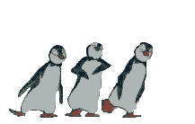
Thanks for your joining .

