Slide 2
LESSON 9
REVIEW

Slide 3
Vocabulary review
No | Word | Meaning
1
coal(n)
than
2
energy (n)
Năng lượng
3
cause (v)
Gây ra, gây nên
4
hydropower(n)
Thuỷ điện
5
natural gas (n)
Khí tự nhiên
6
non-renewable (n)
Không thể tái tạo
7
oil (n)
Dầu
8
solar power (adj)
Năng lượng mặt trời
9
source (n)
Nguồn

Slide 4
Vocabulary review
No | Word | Meaning
10
wind power(n)
Năng lượng gió
11
affect (v)
Tác động, ảnh hưởng
12
build(v)
Xây dựng
13
cheap(adj)
Rẻ
14
clean (adj)
Sạch sẽ
15
create (n)
Tạo ra
16
dangerous (adj)
Nguy hiểm
17
electric (adj)
Điện
18
expensive (adj)
Đắt

Slide 5
Vocabulary review
No | Word | Meaning
19
microwave oven(n)
Lò vi sóng
20
mix (n)
Hỗn hợp
21
noisy (n)
Ồn ào
22
nuclear power (n)
Năng lượng hạt nhân
23
power plant (n)
Nhà máy điện
24
run(v)
Chạy, vận hành
25
solar panel (n)
Tấm pin năng lượng mặt trời
26
wind turbine(n)
Tua bin gió
27

Slide 6
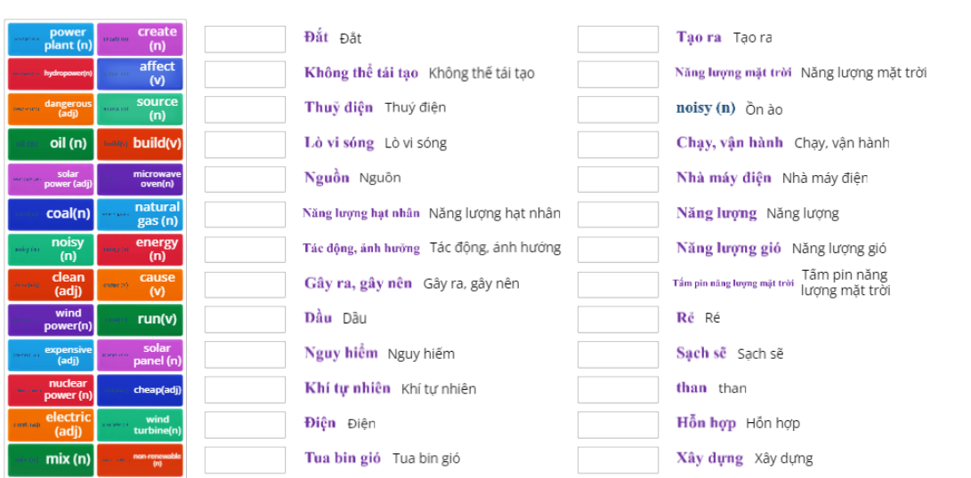
PRACTICE ONLINE VOCABULARY
Ms Phương
Zalo: 0966765064

Slide 7
Ms Phương
Zalo: 0966765064
GRAMMAR REVIEW

Slide 8
There are more girls than boys in our class.
There are less boys than girls in our class.
So sánh 2 đối tượng hơn/kém
More + danh từ+ than…
Less + danh từ + than…..

Slide 9
Conjunction: but, and
We use “but”
to add similar ideas
We use “and”
to add different information

Slide 10
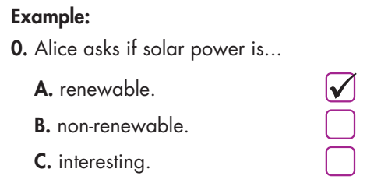
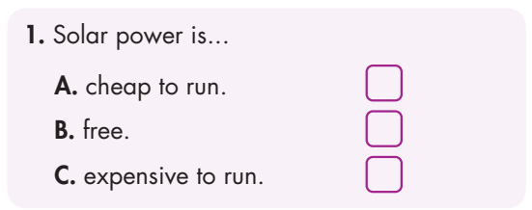
✓

Slide 11
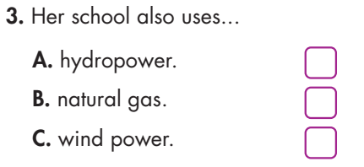
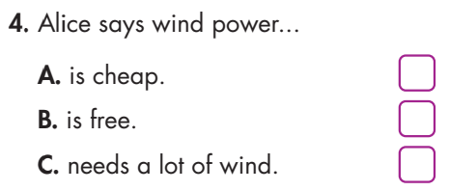
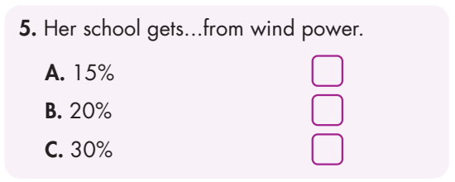
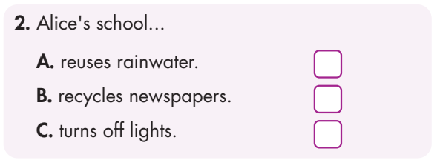
✓
✓
✓
✓

Slide 12
Alice: What are those things on your roof, Steve?
Steve: Oh, they're solar panels.
Alice: Ah, interesting. Is solar power a renewable energy source?
Steve: Yes, it is.
Alice: What happens if the panels fall o the roof?
Steve: They won't fall! It's OK, they're not dangerous.
Alice: Are they expensive?
Steve: They're expensive to buy, but solar power is cheap to run.
Alice: We try to save energy at our school, too.
Steve: How does your school save energy? Do you reuse rainwater? Or recycle newspapers?
Alice: No, we make sure to turn o lights to save power.
Steve: That's a good idea!
Audio Scripts

Slide 13
Audio Scripts
Alice: Our school also uses renewable energy.
Steve: Oh, that's good. Do you use power from natural sources, like hydropower?
Alice: We use wind power.
Steve: Oh, that's good. Wind power is clean to run!
Alice: Yes. It's clean, but it needs a lot of wind.
Steve: How much power does your school get from wind power?
Alice: Erm...Let's see. It gets thirty percent from natural gas and fifteen percent from solar power. Ah, it gets about twenty percent from wind power.
Steve: Wow, that's great.

Slide 14
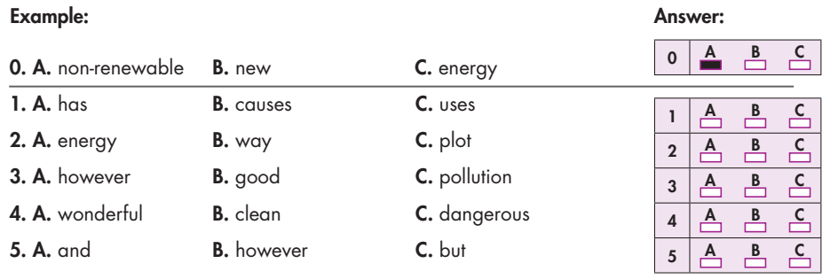
Reading
Read the text about Midnight City. Choose the best word (A, B, or C) for each space.

Slide 15
1. ______________ are expensive to buy, but they save a lot of money by taking energy from the sun. 2. He works at a coal ______________. It produces the electricity for Springfeld Town. 3. The good thing about ______________ energy like solar power is that it never runs out. 4. Non-renewable energy sources like coal causes a lot of ______________ which is bad for the environment.
Solar panels
power plant
renewable
pollution

Slide 16
1. Coal isn't very clean. It keeps us warm in the winter. Coal isn't very clean, but it keeps us warm in the winter 2. Natural gas is cheap. It is excellent for cooking. 3. The power plant is big. It provides enough power for the whole town.
Natural gas is cheap and it is excellent for cooking.
The power plant is big and it provides enough power for the whole town.
4. The solar panels are expensive to buy. They save money in electricity bills later.
5. My father loves a coal fire. I hate it. 6. I don't think we should use nuclear power. My brother thinks using it is a good idea.
The power plant is big and it provides enough power for the whole town.
My father loves a coal fire, but I hate it.
I don't think we should use nuclear power, but my brother thinks using it is a good idea.

Slide 17
pronunciation
a. Circle the word that has the underlined part pronounced differently from the other.
a. Circle the word that differs from the other three in the position of primary stress in each of the following questions.

Slide 18
Homework
Review vocabulary, grammar of unit 10.
- Do the exercises in WB: Review of Unit 10 (page 71).
- Do exercises in Tiếng Anh 7 i-Learn Smart World Notebook: Review Units 6-10 (pages 66 & 67).
- Do the Semester 2 Test in Tiếng Anh 7 i-Learn Smart World Notebook (pages 70, 71 & 72).
- Have good preparation for the second semester test.

