Slide 2
LESSON 8
WRITING
SPEAKING

Slide 3
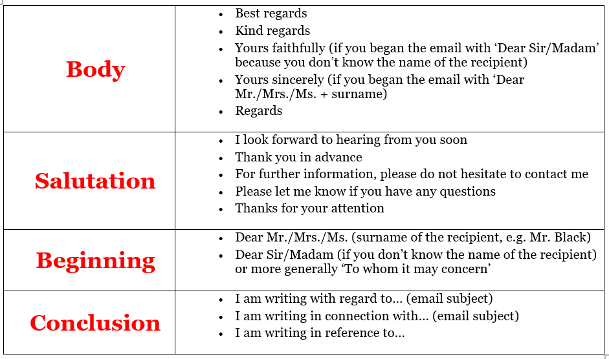
Read and match.

Slide 4
a. Read the notes on writing formal emails. Use the following sentences to replace the formal parts in Elizabeth’s email on page 82.

Slide 5
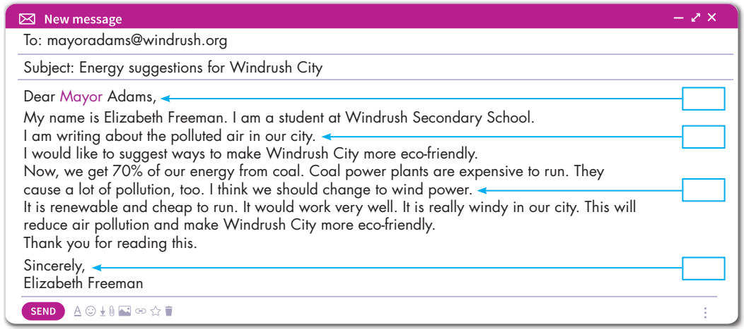
Hi Mayor Adam!
I wanted to say that Windrush City isn’t very clean.
Coal isn’t the best energy to use. Let’s use wind power.
See you.

Slide 6
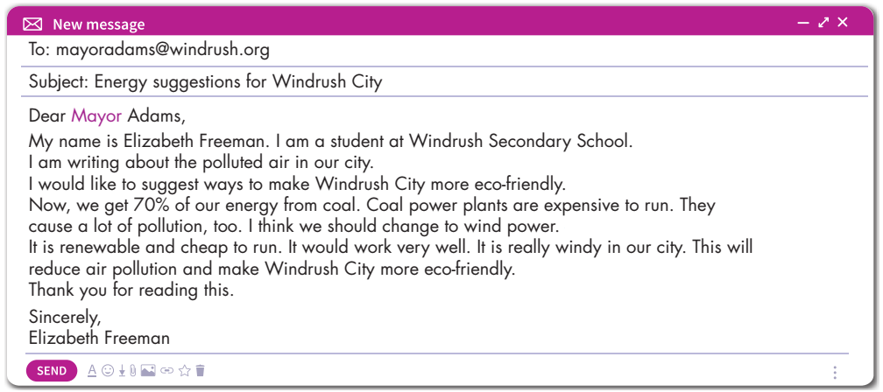
Parts of an email.
Subject line
Greetings
Intro
Body
Closing

Slide 8
b. Read the email below and underline the informal language. Rewrite them in formal language in your notebook. Use the Writing Skill box to help you.

Slide 9
Rewrite
Dear Mr. Scott, My name is Peter Jones. Blackstone Town should stop using coal. It is expensive and causes pollution. We should change to renewable energy. I think we should use wind power. It is so windy here in fall and winter. Sincerely, Peter Jones

Slide 10
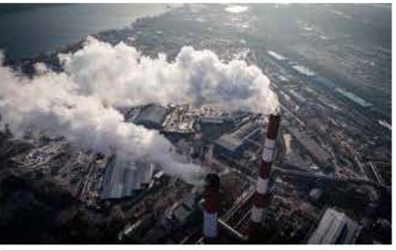
a. You're talking about how to make Blackstone Town greener. In pairs: Read about Blackstone Town. Discuss which energy sources the town should use more or less.

Slide 11
I think we should use more solar power. The city is very sunny.
I think we should also use more wind power. Because it is cheap and clean.
I think we should use less coal. Because it causes a lot of pollution.
I think we should also use less oil. It causes lots of air pollution, too.

Slide 12
Now, write an email to the mayor of Blackstone Town to suggest changing energy sources. Write 60 to 80 words.
To: mayor@blackstone.gov
Subject: Pollution problem in Blackstone Town
Dear Mr. Mayor, My name is Duy Nguyễn and I am writing about the pollution problem in Blackstone Town. The city uses too much coal power. It causes a lot of pollution. It also uses a lot of oil. This causes air pollution, too. I think we should use more solar power. The city is very sunny. We should also use wind power. It is cheap and clean. Sincerely, Duy Nguyễn

Slide 13
Unit 10
ENERGY SOURCES
Lesson 8: Speaking + Writing
-
Writing:
- Understand steps to write a formal email
Practice writing a formal email
Speaking:
- Talk about using more good energy sources and less bad ones
Ms Phương
Zalo: 0966765064

Slide 14
HOMEWORK
Ms Phương
Zalo: 0966765064
Do the Writing skill on page 61 WB (About Frostwich)
Complete the writing notes in Tiếng Anh 7 i-Learn Smart World Notebook on page 63
Prepare Review Unit 10 (page 110 SB)

