Slide 2
PRONUNCIATION
LESSON 6
SPEAKING

Slide 3
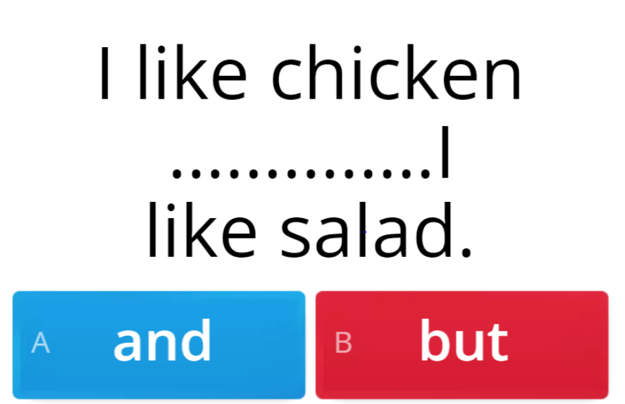
WARM UP
Online game

Slide 5
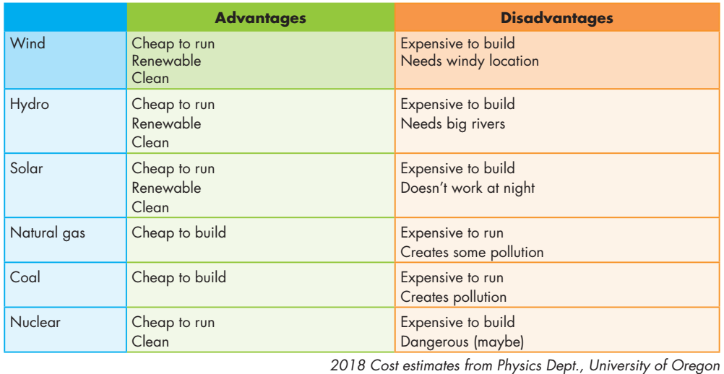

Slide 6
Can you tell me about wind power?
It’s clean and cheap to run. It’s also renewable.
Are there any disadvantages?
Yeah, it’s expensive to build and needs windy location.

Slide 7
Can you tell me about hydro power?
It’s clean and cheap to run. It’s also renewable.
Are there any disadvantages?
Yeah, it’s expensive to build and needs big rivers.

Slide 8
Can you tell me about natural gas?
It’s cheap to build.
Are there any disadvantages?
Yeah, it’s expensive to run and creates some pollution.

Slide 9
Can you tell me about solar power?
It’s clean and cheap to run. It’s also renewable.
Are there any disadvantages?
Yeah, it’s expensive to build and doesn’t work at night.

Slide 10
Can you tell me about coal?
It’s cheap to build.
Are there any disadvantages?
Yeah, it’s expensive to run and creates pollution.

Slide 11
Can you tell me about nuclear power?
It’s clean and cheap to run.
Are there any disadvantages?
Yeah, it’s expensive to build and maybe dangerous.

Slide 12
Discuss the advantages and disadvantages of the energy sources, and say why each would be good or bad for your city/town.

Slide 13
Disadvantages
Advantages
Cheap to run
Renewable
Clean
Expensive to build
Doesn’t work at night

Slide 14
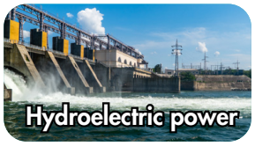
Disadvantages
Advantages
Cheap to run
Renewable
Clean
Expensive to build
Dangerous

Slide 15
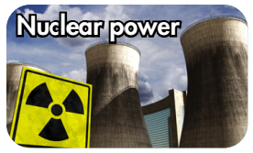
Disadvantages
Advantages
Cheap to run
Clean
Expensive to build
Needs big rivers

Slide 16
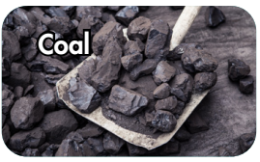
Disadvantages
Advantages
Cheap to build
Expensive to run
Creates pollution

Slide 17
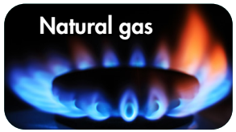
Disadvantages
Advantages
Cheap to build
Expensive to run
Creates some pollution

Slide 18
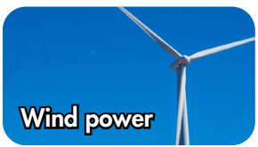
Disadvantages
Advantages
Cheap to run
Renewable
Clean
Expensive to build
Needs windy location

Slide 19
I think three best energy sources are hydro power, wind power, and solar power.

Slide 20
Unit 10: ENERGY SOURCES
Lesson 6: Pronunciation + Speaking
Ms Phương
Zalo: 0966765064
Pronunciation:
- practice pronouncing “and” like /n/
Speaking & Writing:
- talk about the advantages and disadvantages of the energy sources

Slide 21
HOMEWORK
Review all the vocabularies and grammar in this unit.
Practice the weak sound of “and”.
Practice talking about energy sources.
Prepare the next lesson (page 82 SB).

