Slide 2
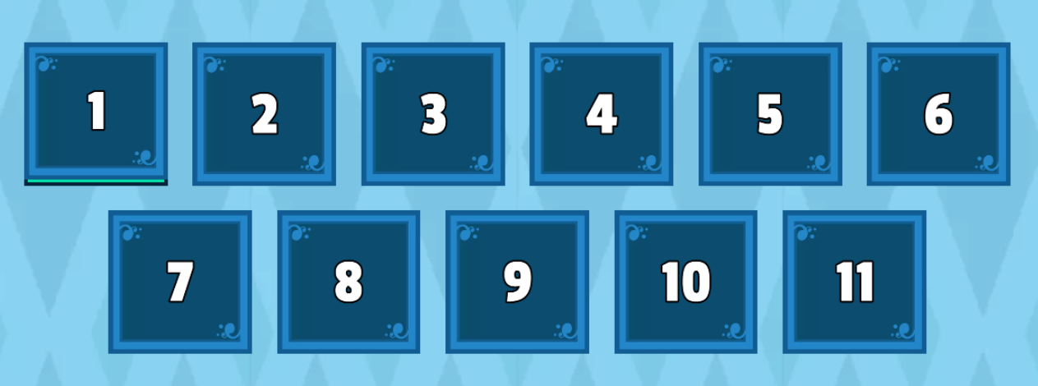
Open the box and say the words.

Slide 3
LESSON 5
Ms Phương
Zalo: 0966765064
GRAMMAR

Slide 5
Read, look and match
We use “but”
to add similar ideas
We use “and”
to add different information

Slide 6
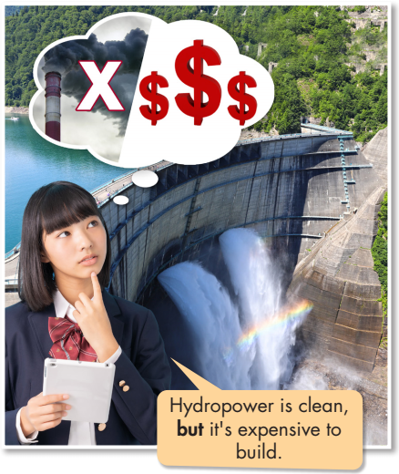
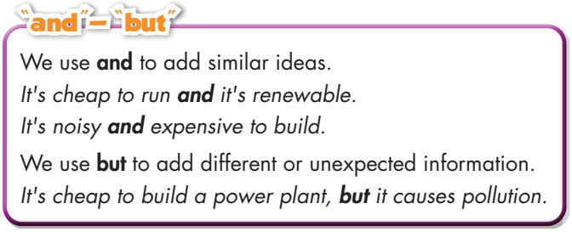

Slide 7
b. Write sentences using the prompts.
1. Coal/cheap/easy/use
Coal is cheap and easy to use.
2. Hydropower/clean/cheap
Hydropower is clean and cheap.
3. Wind power/clean/renewable/noisy
Wind power is clean and renewable, but (it's) noisy.
4. Natural gas/cheap/non-renewable
Natural gas is cheap, but (it's) non-renewable.
5. Motorbikes/popular/cheap/pollution
Motorbikes are popular and cheap, but (they) cause pollution.
6. Microwave ovens/convenient/save money
Microwave ovens are convenient and (they) save money.

Slide 8
, but
and
and
and
, but
and
, but

Slide 9
d. In pairs. Make sentences about different types of transportation. Use the prompt.
Airplanes are fast and convenient, but they cause pollution.
Cars are convenient, but they are expensive.
Bicycles are clean, cheap and good for our health.

Slide 10
Unit 10
ENERGY SOURCES
Lesson 5: Grammar
Ms Phương
Zalo: 0966765064
-

Slide 11
ONLINE GAME

Slide 12
HOMEWORK
Do the exercises on page 17 WB.
Complete the grammar notes in Tiếng Anh 7 i-Learn Smart World Notebook on page 17.
Prepare the next lesson (page 25 SB).

