Slide 2
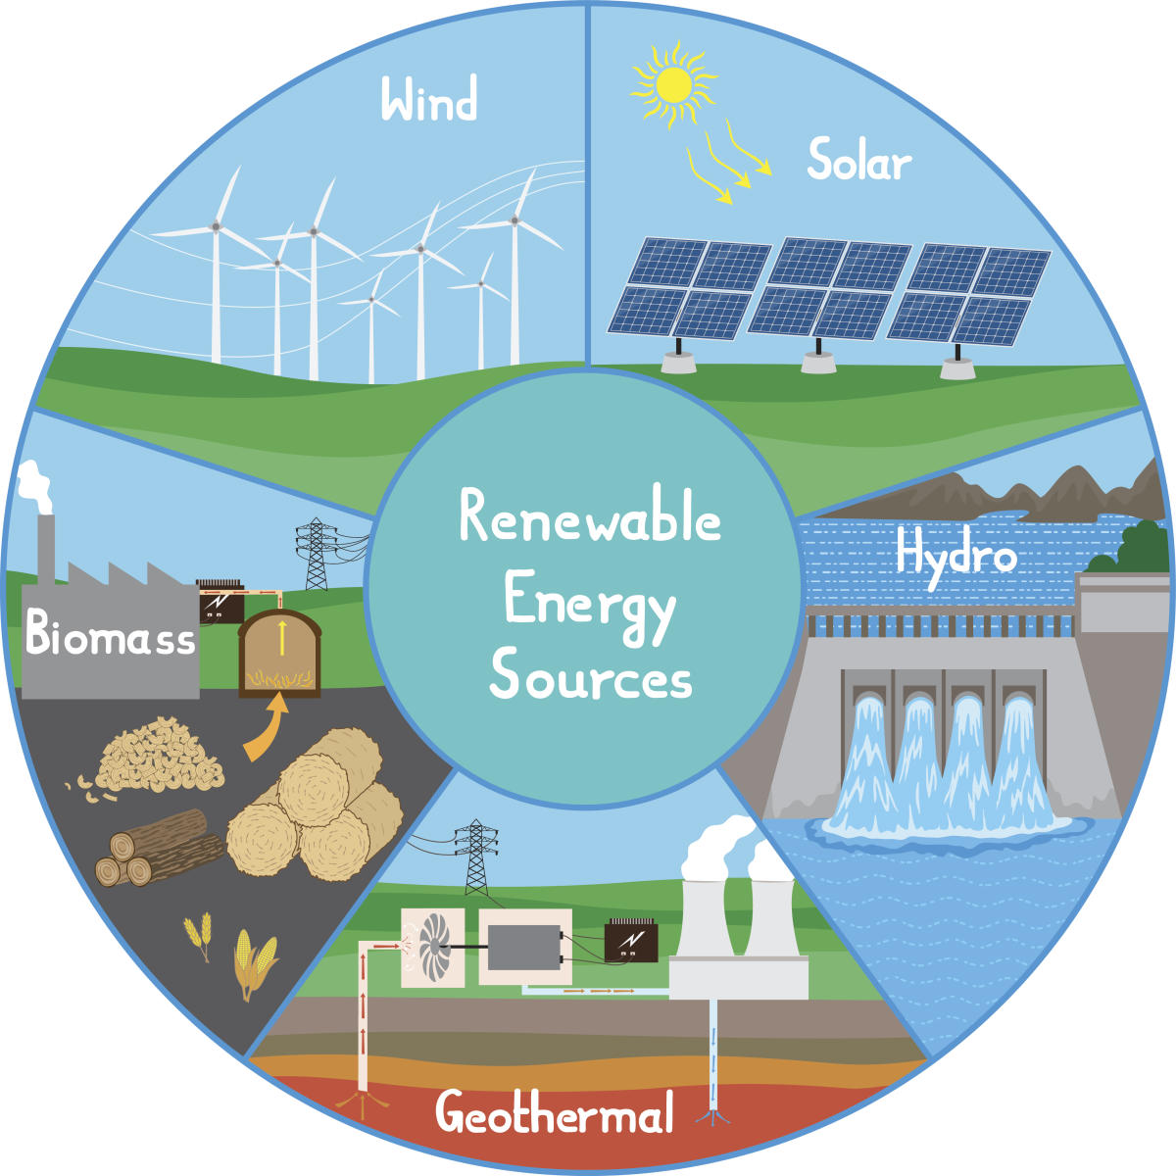
Renewable energy
SHOW

Slide 3
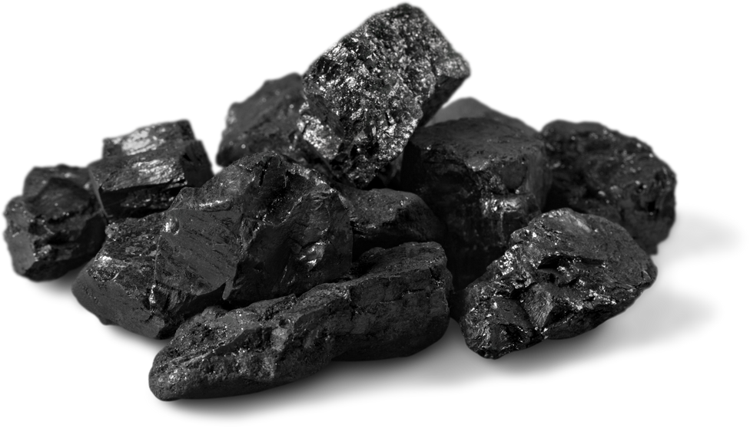
coal
SHOW

Slide 4
oil
SHOW

Slide 5
non-renewable energy
SHOW

Slide 6
wind energy
SHOW

Slide 7
solar energy
SHOW

Slide 8
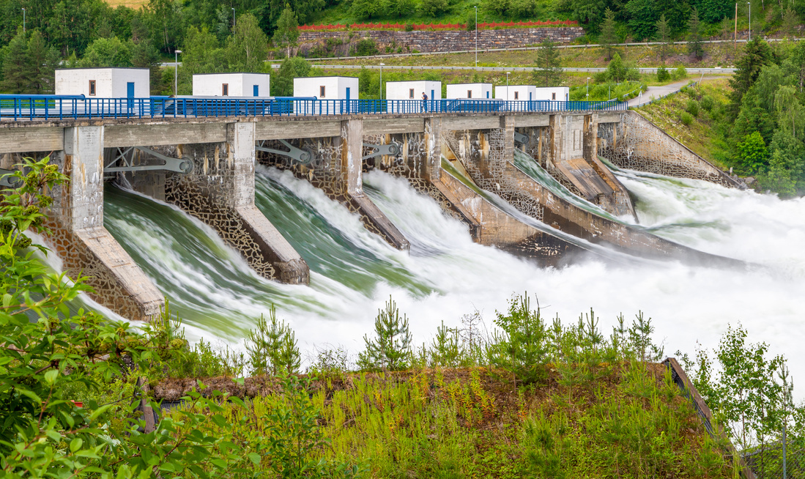
hydropower
SHOW

Slide 9
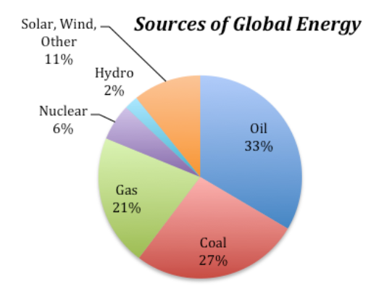
Look at the pie chart about sources of global energy.
1. How many sources of energy are there?
2. Which source of energy do people use most / least?
3. Which is consumed more: fossil fuels (non-renewable energy) or non - fossil fuels (renewable energy)? How many percent?

Slide 10
LESSON 2
Ms Phương
Zalo: 0966765064
GRAMMAR

Slide 11
Students
Boys | 23
Girls | 26
There are more girls than boys in our class.
There are less boys than girls in our class.
Do the same
Furniture
Doors | 2
Windows | 6
There are more windows than doors in our class.
There are less doors than windows in our class.

Slide 12
There are more girls than boys in our class.
There are less boys than girls in our class.
1 . Which part of speech is used after more/less?
Noun
2. What do we use more/less … than for?
To compare 2 things or 2 people

Slide 13
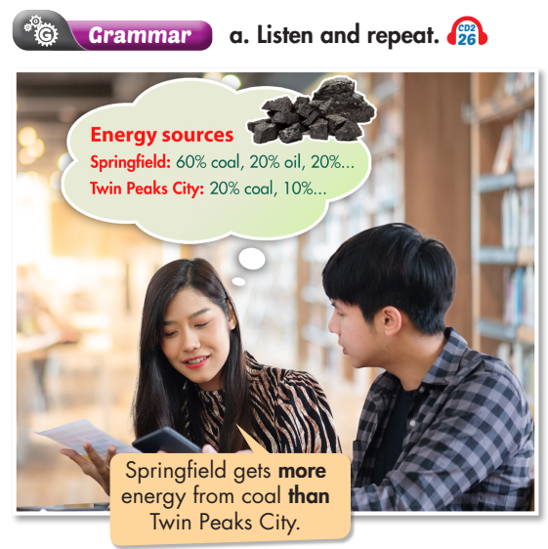
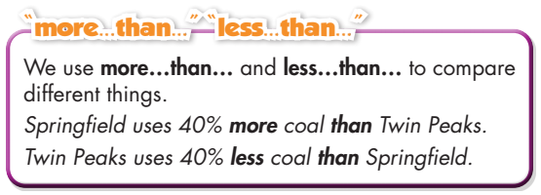

Slide 14
b. Unscramble the sentences.
electricity/than/20%/more/Towns/use/villages. Towns use 20% more electricity than villages.
2. natural/Highdale/burn/gas/Does/than/Wintertown?/more
_____________________________________________________________ 3. than/gets/Springfield/from/energy/40%/less/Twin Peaks./solar/power
_____________________________________________________________ 4. in/use/Springfield/electricity/in/Twin Peaks./People/than/people/more
_____________________________________________________________ 5. of/Maple Falls?/than/from/Greenwood/more/Does/get/coal/its/energy
_____________________________________________________________
→ Does Highdale burn more natural gas than Wintertown?
→ Springfield gets 40% less energy from solar power than Twin Peaks.
→ People in Springfield use more electricity than people in Twin Peaks.
→ Does Greenwood get more of its energy from coal than Maple Falls?

Slide 15
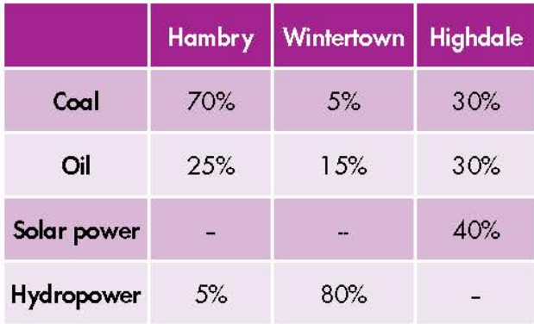
c. Look at the table and write the sentences.

Slide 16
c. Look at the table and write the sentences.
1. Hambry/oil/Highdale 2. Highdale/coal/Hambry 3. Highdale/solar power/Wintertown 4. Hambry/coal/Highdale 5. Wintertown/hydropower/Hambry 6. Wintertown/Hambry/oil/Highdale
Hambry gets less energy from oil than Highdale
Highdale gets less energy from coal than Hambry.
Highdale gets more energy from solar power than Wintertown.
Hambry gets more energy from coal than Highdale.
Wintertown gets more energy from hydropower than Hambry.
Wintertown and Hambry get less energy from oil than Highdale.

Slide 17
Wintertown gets less energy from coal than Hambry.
Highdale gets less energy from hydropower than Wintertown.

Slide 18
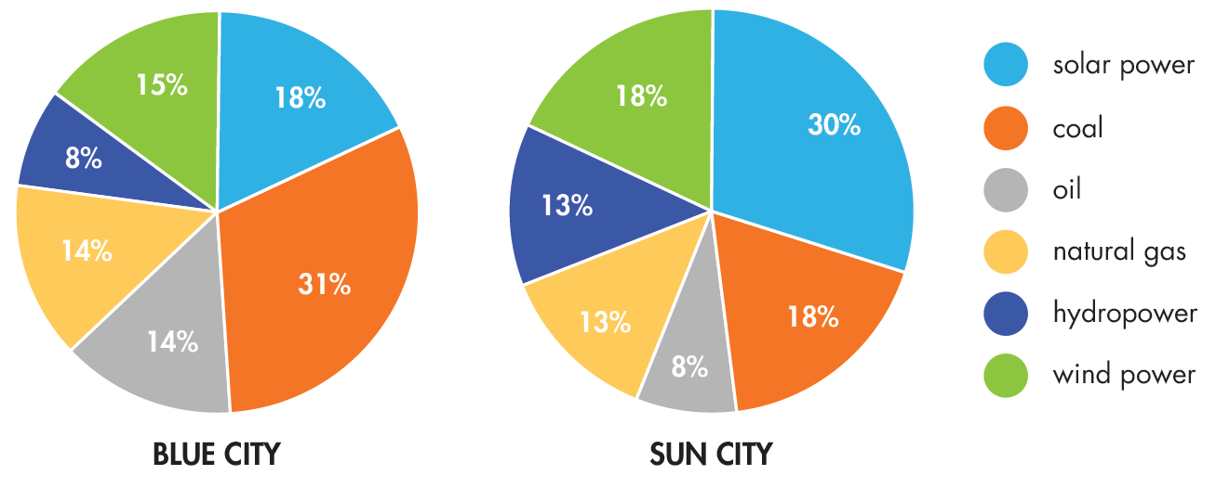

Slide 19
Model sentences
Blue City uses less solar power than Sun City.
Sun City gets less energy from coal than Blue City.
Blue City uses more oil than Sun City.
Sun City gets less energy from natural gas than Blue City.
Sun City uses more wind power than Blue City.

Slide 20
Unit 10
ENERGY SOURCES
Lesson 2: Grammar
Ms Phương
Zalo: 0966765064
-

Slide 21
Homework
Make 2 sentences using Comparison (more…than… and less…than…)
- Do the exercises in WB: Grammar (page 57).
- Complete the grammar notes in Tiếng Anh 7 i-Learn Smart World Notebook (page 61).
- Play consolation games in Tiếng Anh 7 i-Learn Smart World DHA App on www.eduhome.com.vn
- Prepare: Lesson 1.3 – Pronunciation and Speaking (page 78 – SB).

