Slide 1

Unit 1: Free time
Lesson 3.2: Writing + Speaking
Page 11

Slide 3
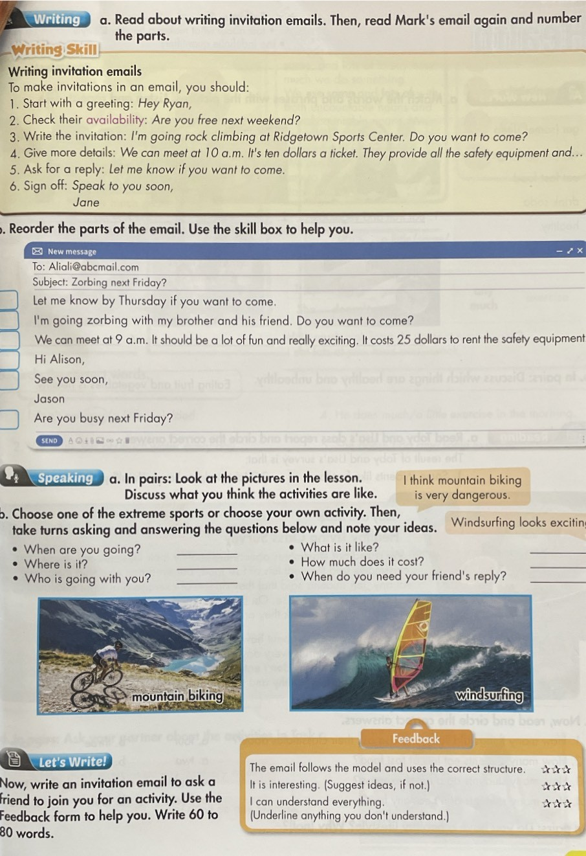

Unit 1 : Free time
LESSSON OUTLINE
Presentation
Practice
Production
Consolidation
Wrap-up

Slide 4

Unit 1
Unit 1 : Free time
By the end of this lesson, students will be able to…
write invitation emails.

Slide 5

Unit 1
Unit 1 : Free time
WARM UP

Slide 7
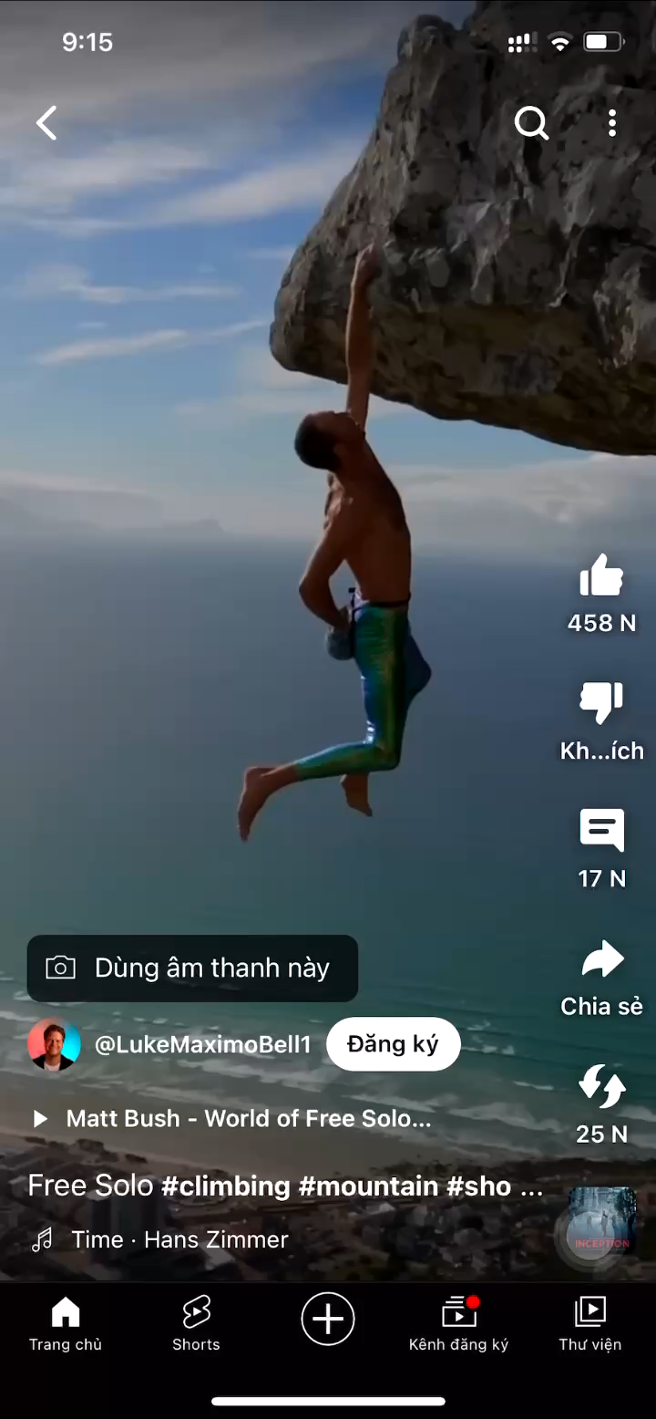
Unit 1 : Free time
a. Name the activities in the following videos.
Rock climbing

Slide 8
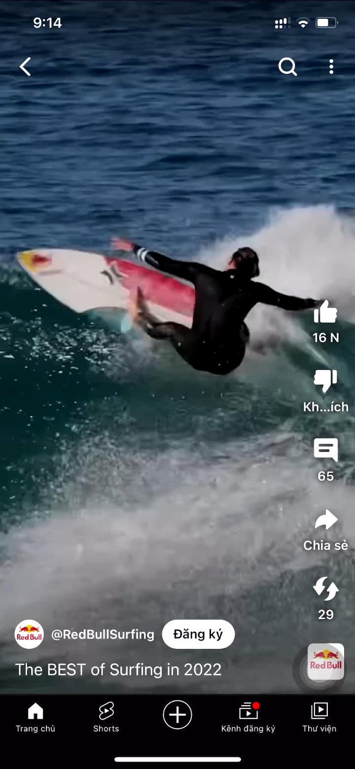
Unit 1 : Free time
a. Name the activities in the following videos.
Surfing

Slide 9
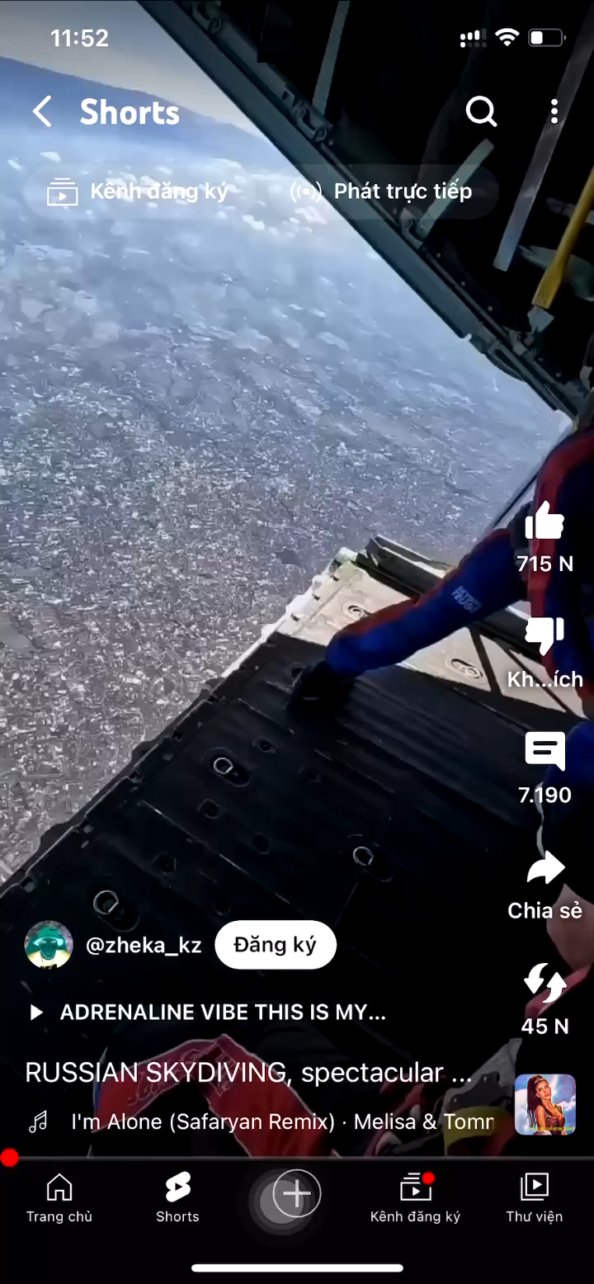
Unit 1 : Free time
a. Name the activities in the following videos.
skydive

Slide 10
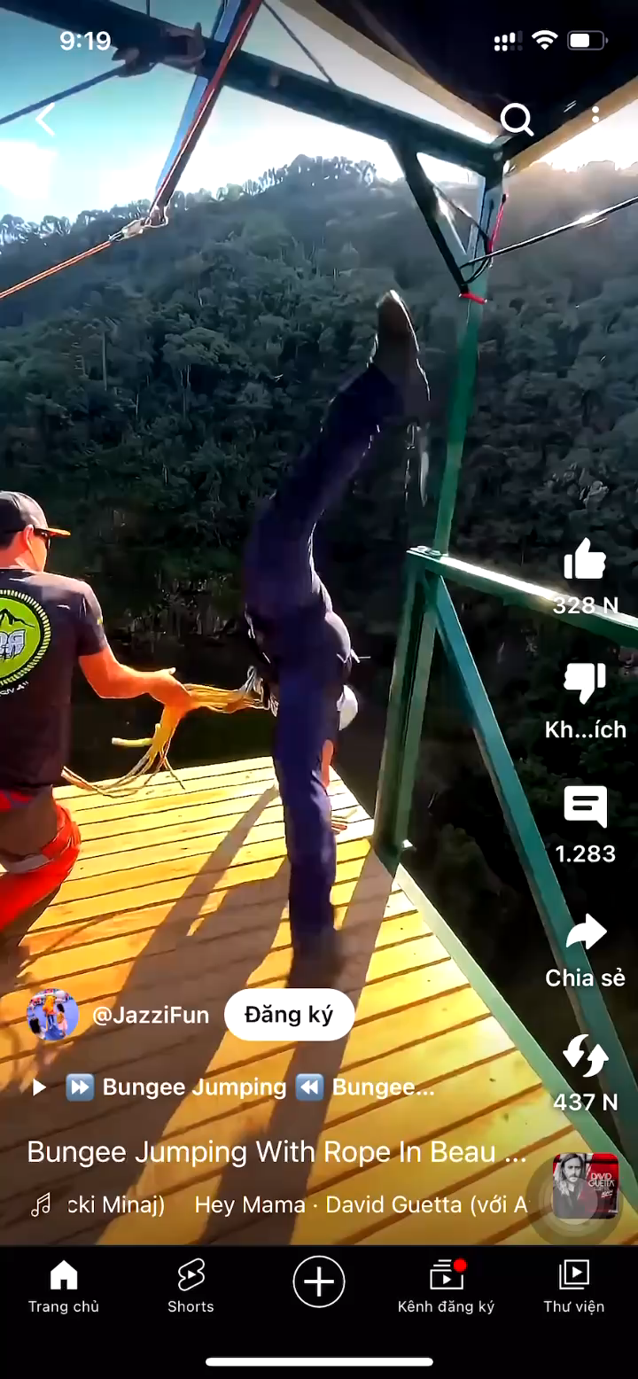
Unit 1 : Free time
a. Name the activities in the following videos.
Bungee

Slide 11
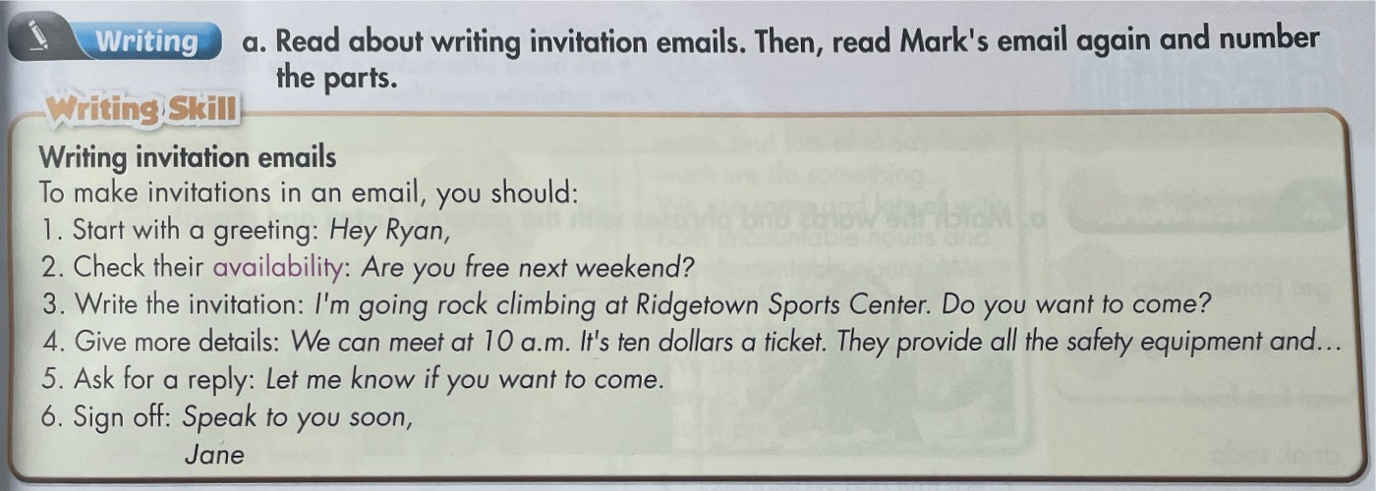
Unit 1 : Free time

Slide 12
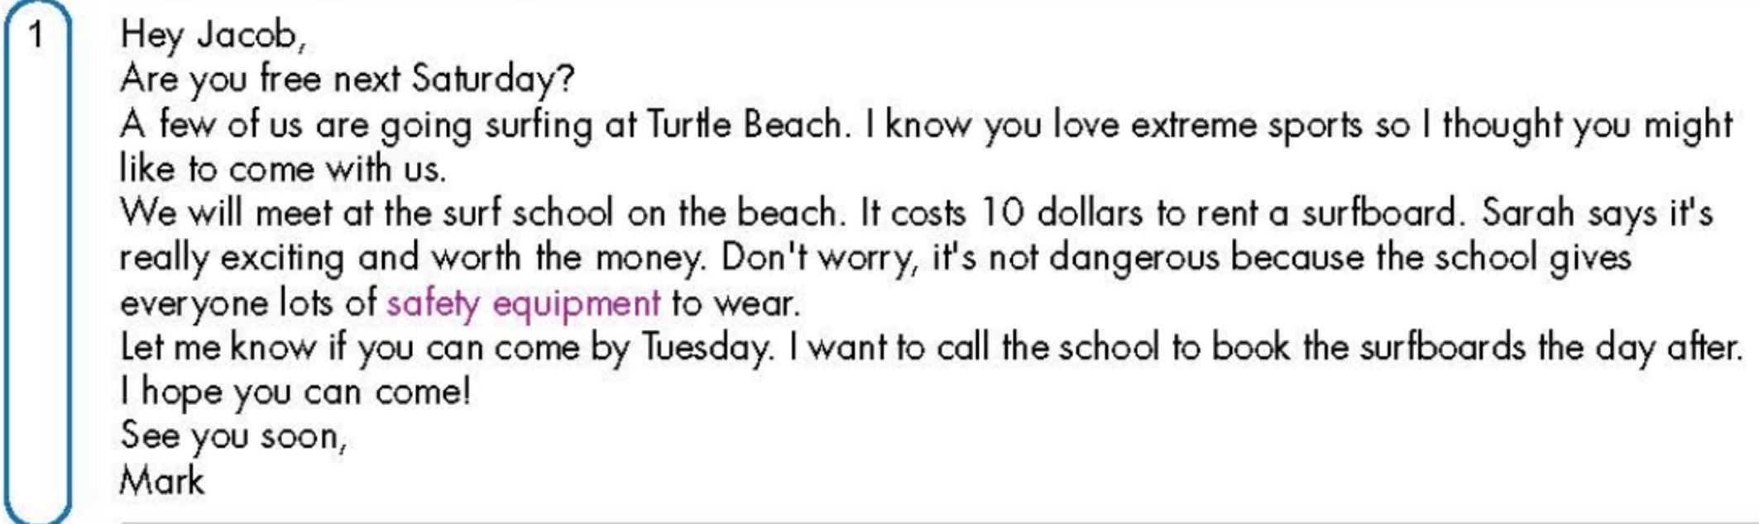
Unit 1 : Free time
2
3
4
5
6

Slide 13
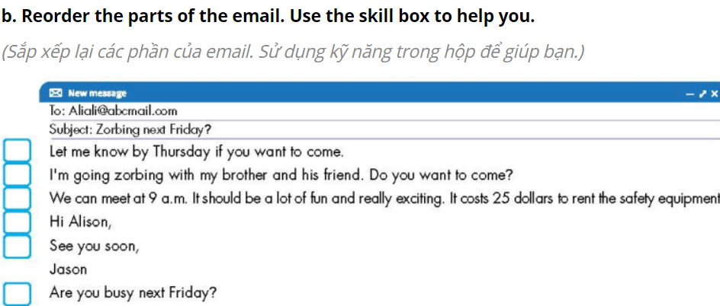
Unit 1 : Free time

Slide 14
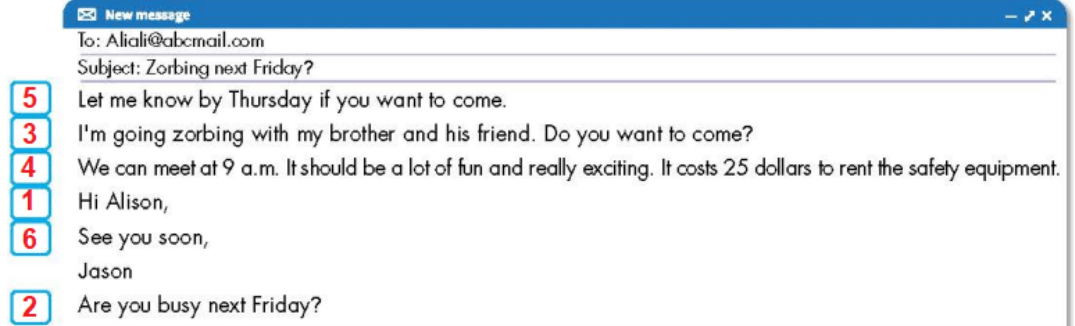
Unit 1 : Free time
=> Ask for a reply
=> Write the invitation
=> Give more details
=> Start with a meeting
=> Sign off
=> Check their availability

Slide 15
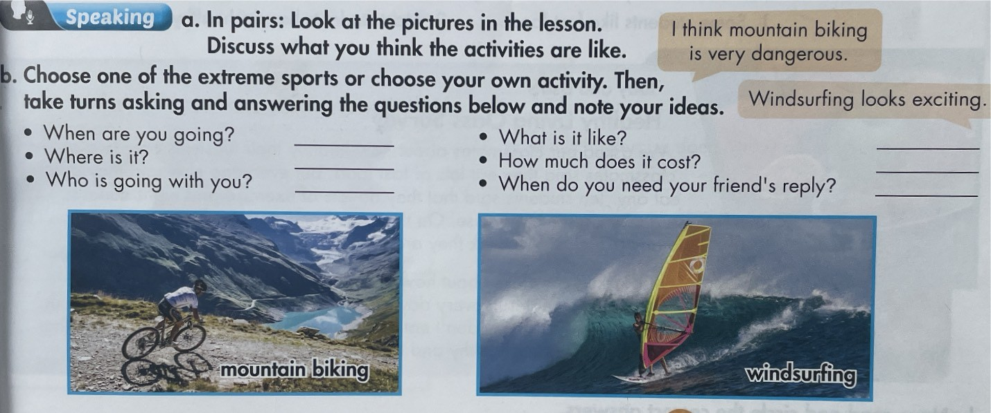
Unit 1 : Free time

Slide 16
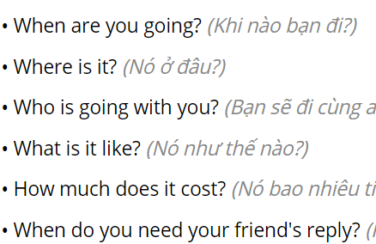
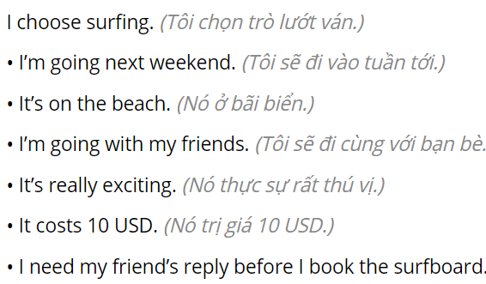
Unit 1 : Free time

Slide 17
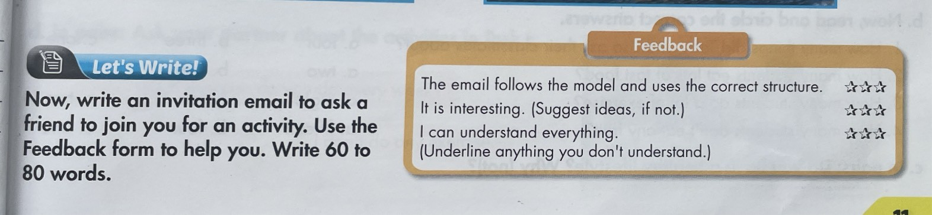
Unit 1 : Free time
WRITING

Slide 18

Unit 1 : Free time
- Exchange your letter with a partner.
- Double check, using the feedback form to see if you can help your friend write better! ​
The letter follows the model and uses the correct structure.
It is interesting. (Suggest ideas, if not.)
I can understand everything.
(Underline anything you don't understand.)

Slide 19
Unit 1 : Free time
Sample answer
Hi Nina,
Are you busy next week?
I'm going skateboarding with my brother. Do you want to come?
We can meet at 7 a.m. It should be a lot of fun and really interesting.
Let me know by Friday if you want to come.
See you soon,
Nhi

Slide 20
Unit 1
Today’s lesson
=> Start with a meeting
=> Check their availability
WRITING
INVITATION EMAILS
=> Write the invitation
=> Give more details
=> Ask for a reply
=> Sign off

Slide 21
Unit 1
Today’s lesson
Writing:
Understand steps to write invitation emails.
Practice writing invitation emails.

Slide 22
Unit 1
Homework
Do the writing exercise in Workbook, page 7.
Prepare Review Unit 1 (pages 84-85, SB).

Slide 23

Lesson 3
Stay positive and have a nice day!

