Slide 1

Unit 1: English in the World
Lesson 1.3: Pronunciation. & Speaking
Pages 6 & 7

Slide 2
Lesson Outline
Warm-up
Pronunciation
Speaking
Consolidation
Wrap-up

Slide 3

By the end of this lesson, students will be able to…
Practice stressing content words in a sentence.
Talk about fun ways/methods to learn English.

Slide 4

WARM-UP

Slide 5
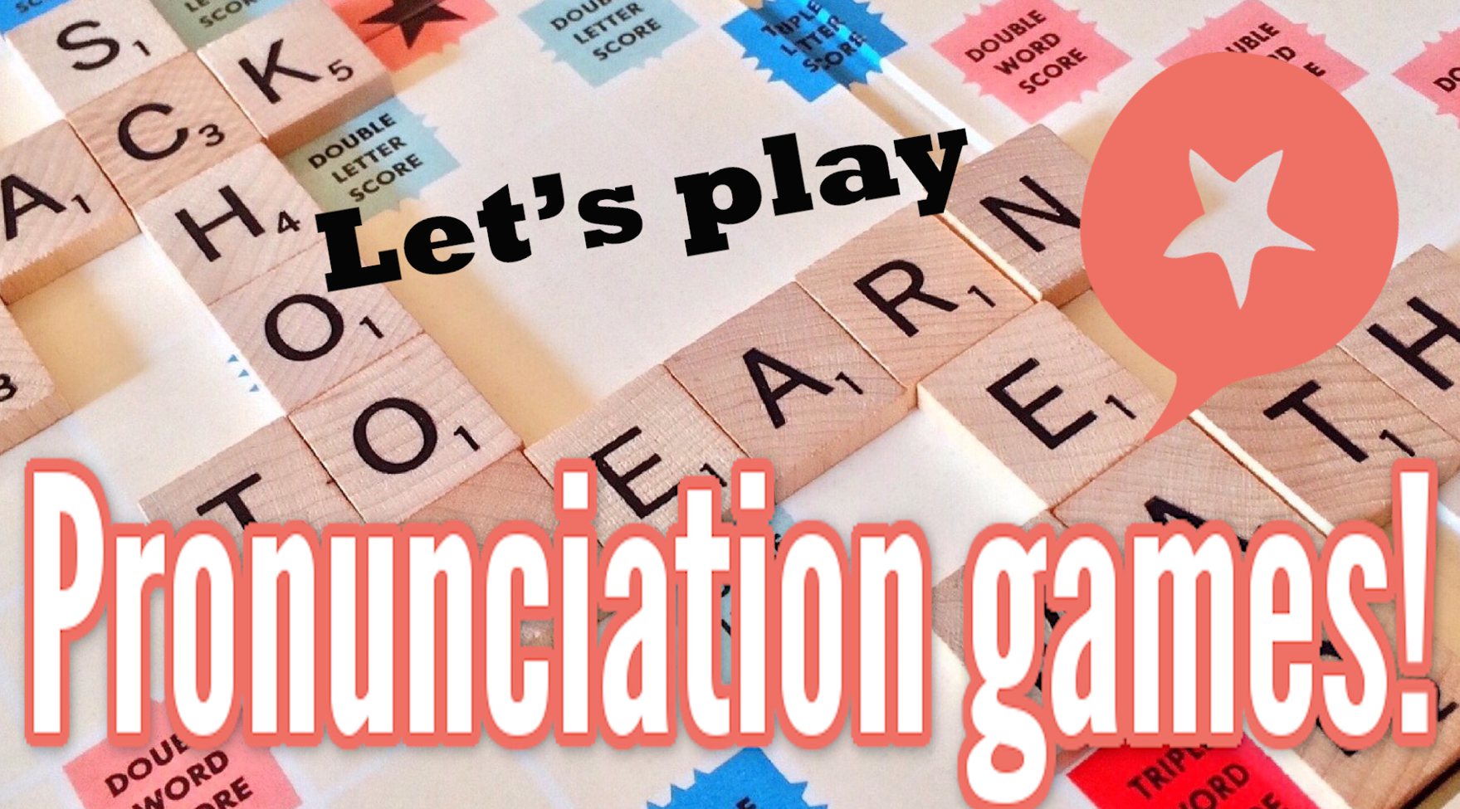
COMPETITION TIME:
Create groups/teams of 5 students.
You will be given some English words with unusual stressed syllables.
You have to underline the stress syllable(s) in these words.
The team(s) with the most correct answers win(s).
Time limit: 5 minutes

Slide 6

Example:
Trapeze
Answer: Trapeze
/trəˈpiːz/

Slide 7
Economical
Literature
Recipe
Jewelry
Dessert
Finance
Antique
Liaison
Oblique
Reservoir

Slide 8
Answers
Economical/ek.əˈnɒm.ɪ.kəl/
Literature /ˈlɪt̬.ɚ.ə.tʃɚ/
Recipe /ˈres.ə.pi/
Jewelry/ˈdʒuː.əl.ri/
Dessert /dɪˈzɝːt/
Finance/ˈfaɪ.næns/
Antique/ænˈtiːk/
Liaison/liˈeɪ.zɑːn/
Oblique /oʊˈbliːk/
Reservoir /ˈrez.ɚ.vwɑːr/

Slide 9

Pronunciation

Slide 10


Task a
Notes:
Content words in a sentence are often stressed.
Content words can be nouns, verbs, adjectives, or adverbs.

Slide 11
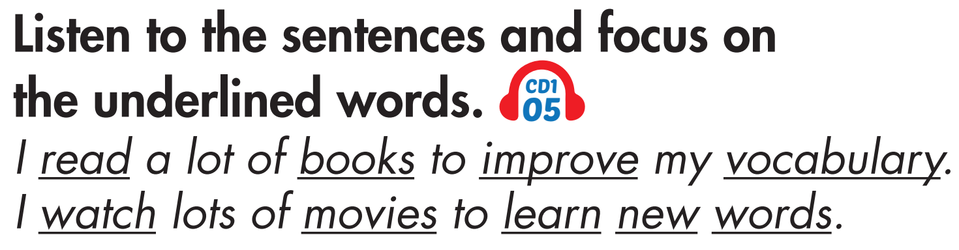
Task b

Slide 12
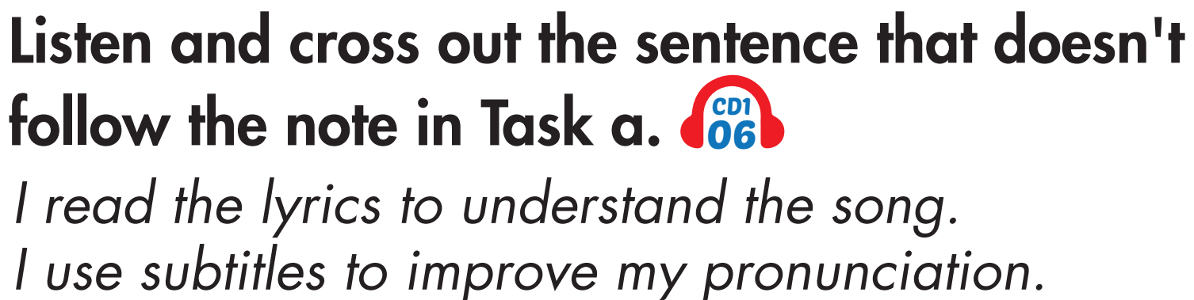
Task c

Slide 13
Task c
Answer

Slide 14

Task d
Read the sentences with the rhythm noted in Task a. to a partner.
I read the lyrics to understand the song.
I use subtitles to improve my pronunciation.

Slide 15

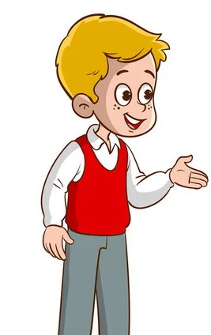
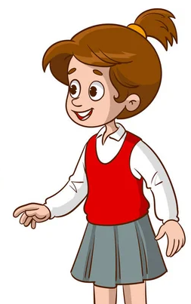
Task a
In pairs: Take turns asking and answering about English study methods. Follow the example on the next slide.

Slide 16
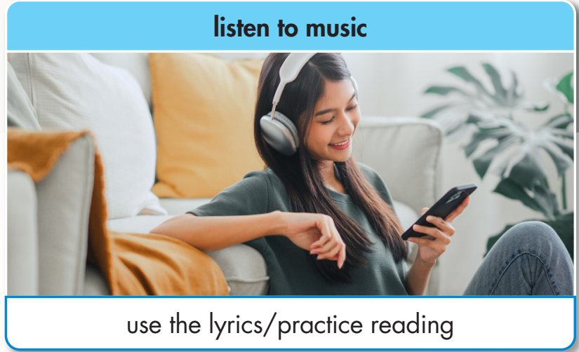
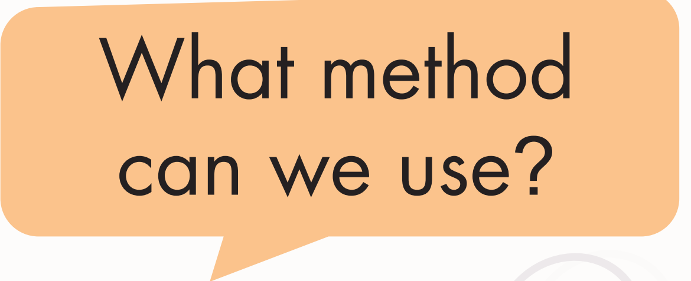
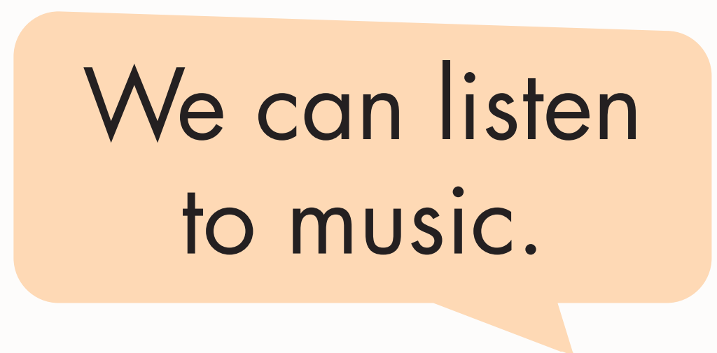
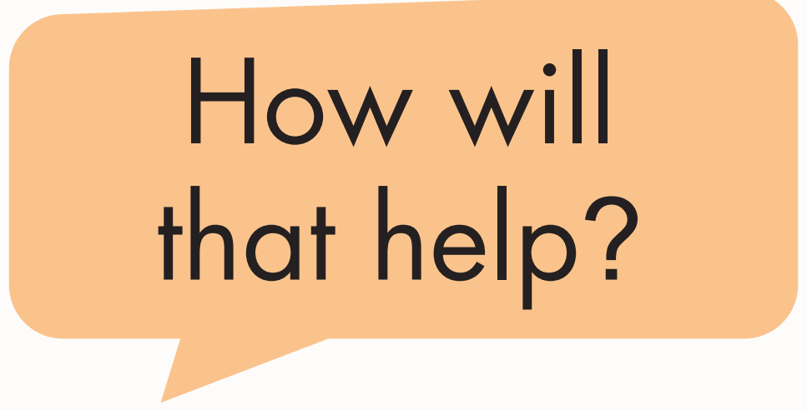
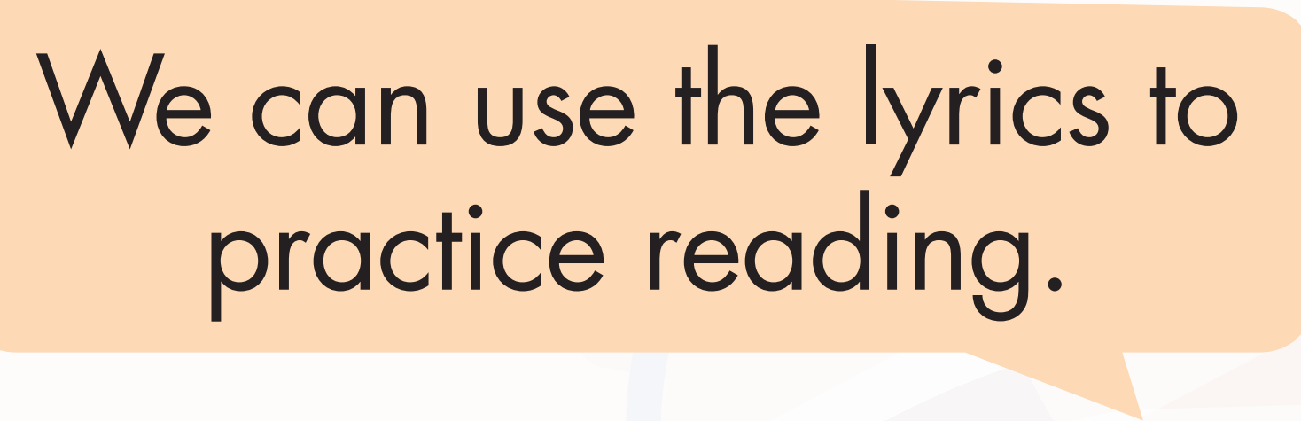

Example

Slide 17


Slide 18
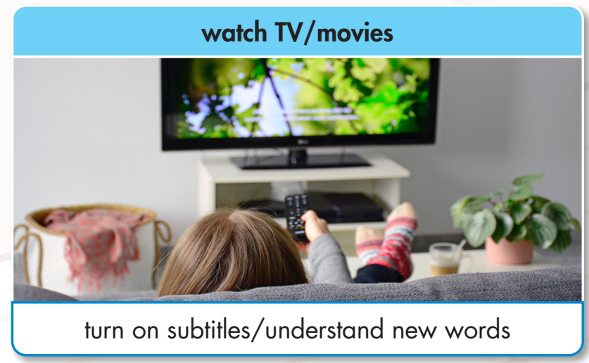

Slide 19


Slide 20
Task a
Now, role-play the conversations in front of the class.

Slide 21
We can read interesting books.
We can note down new words to look them up later.
Suggested answer

Slide 22
We can watch TV or movies.
We can turn on subtitles to understand new words.
Suggested answer

Slide 23
We can keep a notebook.
We can go over our writings to find mistakes.
Suggested answer

Slide 24

Task b
Practice with your own ideas. Look at the example below.
We can practice writing.
Writing about our day can improve our grammar and vocabulary.

Slide 25
Task b
Now role-play your conversations in front of the class.
We can practice writing.
Writing about our day can improve our grammar and vocabulary.

Slide 26
Task b
Suggested answers
We can use online games and quizzes.
They can make learning more fun and interactive.

Slide 27
Task b
Suggested answers
We can read storybooks.
You can summarize each chapter to improve your reading skills.

Slide 28
Task b
Suggested answers
We can study in groups.
We can discuss topics, share ideas, and help each other understand difficult concepts.

Slide 29
Presentation
Speaking

Slide 30

Task a
In pairs: Look at the pictures of fun ways to learn English. Say what the activities are and discuss the purpose of the study methods below and your own ideas.

Slide 31

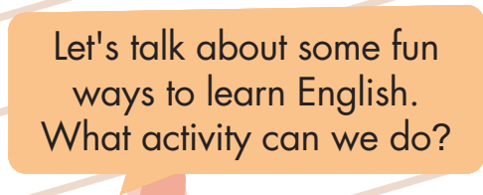
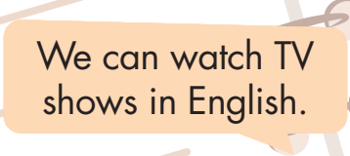
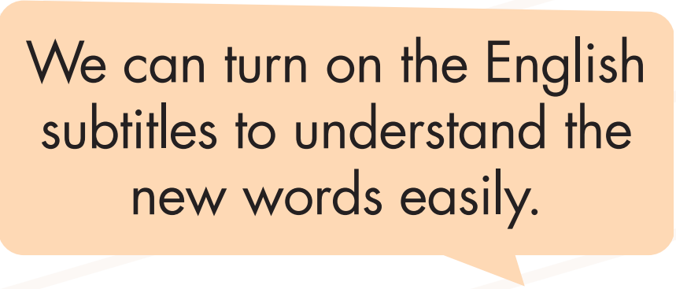
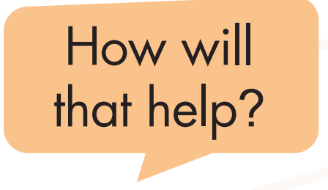
Example

Slide 32


Slide 33


Slide 34
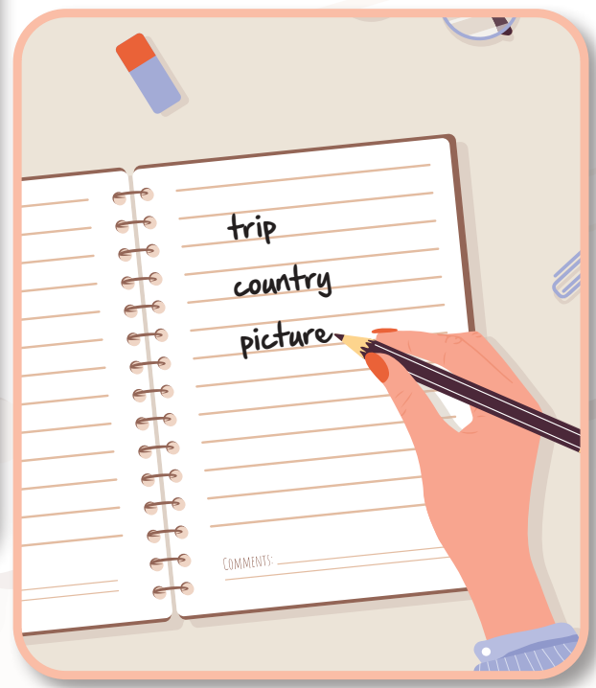

Slide 35


Slide 36
Task a
Suggested answers
Listen to music in English
Read books in English

Slide 37
Task a
Suggested answers
Practice writing in English
Sing along with English songs

Slide 38
Task a
Suggested answers
We can listen to music in English.
We can learn new words from songs and it’s more fun.

Slide 39
Task a
Suggested answers
We can read books in English.
We can expand our vocabulary capacity.

Slide 40
Task a
Suggested answers
We can write daily journals in English.
We can practice our writing skills every day.

Slide 41
Task a
Suggested answers
We can sing along with English songs.
We can learn more new words from lyrics and it’s entertaining too.

Slide 42
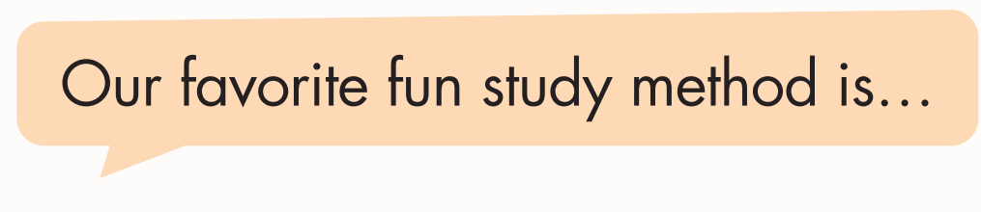
Task b
Now, join another pair and tell them about your favorite fun study method.

Slide 43
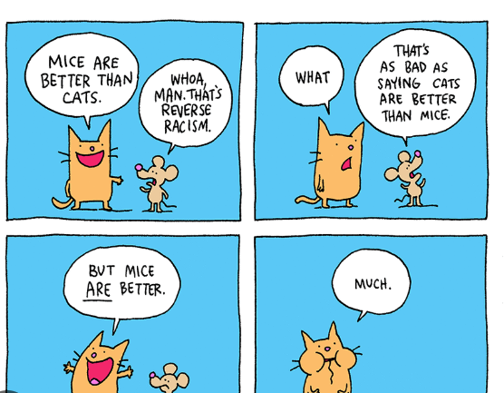
Task b
Suggested answer
Our favorite fun study method is creating comic strips to tell a short story.

Slide 44
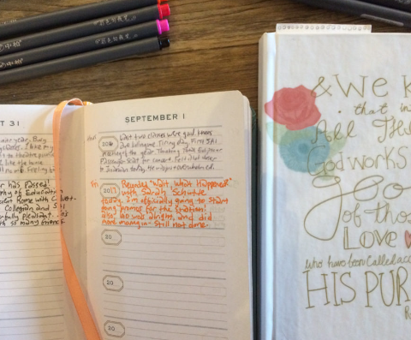
Task b
Suggested answer
Our favorite fun study method is keeping a daily journal to practice writing skills.

Slide 45

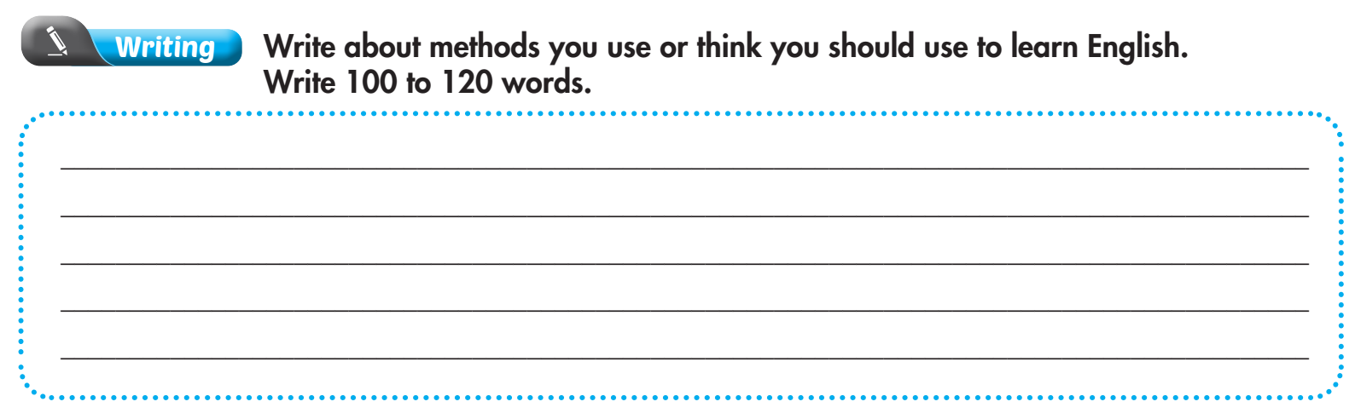
Extra practice - WB - page 3

Slide 46

Suggested answer
My fun study methods
My Story Journal: I keep a cool journal where I write about my day, dreams, and adventures. It's like my personal storybook! This helps me practice writing in English, and I get to be as creative as I want. Sometimes, I share funny stories with my friends, and we all have a good laugh.

Slide 47

Suggested answer
My fun study methods
Word Detective Game: I turn into a word detective! I pick a new word every day and find it everywhere - in books, on TV, or even in conversations. Then, I make a sentence with it. This game makes learning new words super exciting and makes me feel like a real detective on a language mission.

Slide 48

CONSOLIDATION

Slide 49
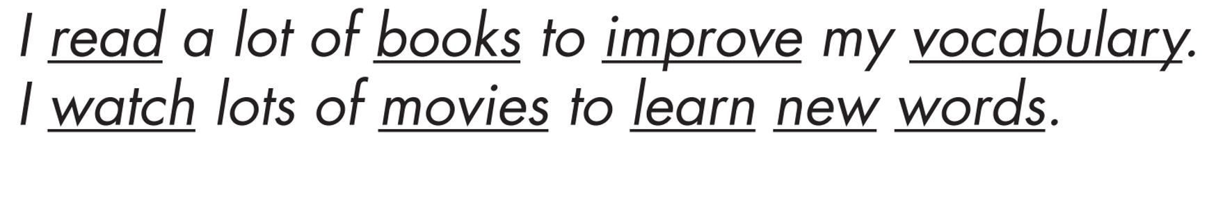
Practice saying these sentences by stressing the underlined words.

Slide 50

WRAP-UP

Slide 51
Today’s lesson
Pronunciation:
Practice stressing content words in a sentence.
Speaking:
Talk about fun ways/methods to learn English.

Slide 52
Homework
Practice saying sentences in the Pronunciation(SB) by stressing content words.
Prepare for the next lesson (Vocabulary & Listening - pages 8 & 9 - SB).
Play the consolidation games on www.eduhome.com.vn

Slide 53

Lesson 3
Stay positive and have a nice day!

