Slide 1

Unit 1: Free Time
Lesson 3.2: Speaking & Writing
Page 13

Slide 2
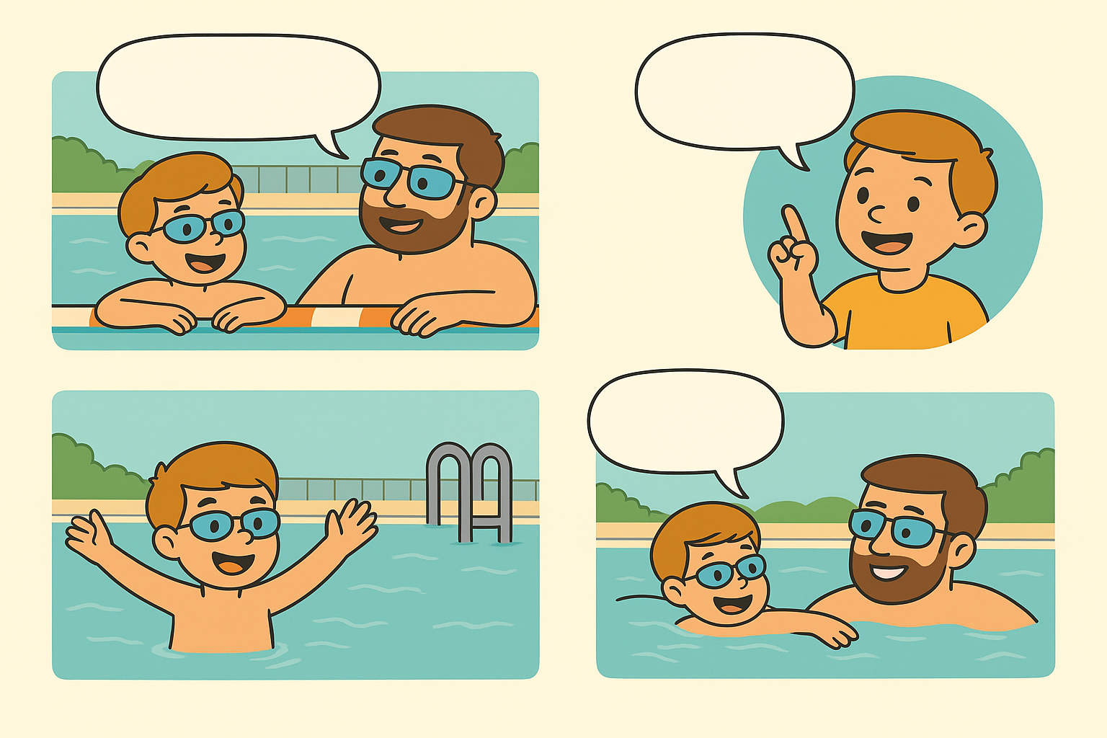
https://www.canva.com/design/DAGyYSMVdrI/JqQubU55XIkVz44zWG1kAA/edit

Slide 3
Number the sentences (1–5)
A. Later, I moved on to longer books with more difficult words . Now, I usually read a novel every week or two.
B. I have a lot of hobbies but my favorite hobby is reading books.
C. I think reading books is really fun and interesting.
D. I started reading books when I was five years old. At first, my parents gave me small storybooks with colorful pictures
E. When I finish one, my mom takes me to the library to get another.
3
1
5
2
4

Slide 4
Writing a descriptive passage
How many parts are there in a basic descriptive passage?
b) What is the function of each part?
I only have one hobby, and that is reading books. I started reading books when I was five years old. At first, my parents gave me small storybooks with colorful pictures. Later, I moved on to longer books with more difficult words. Now, I usually read a novel every week or two, sometimes even faster if the story is exciting. When I finish one, my mom takes me to the library to get another. Reading books is really fun, relaxing, and interesting for me.

Slide 5
Writing a descriptive passage
How many parts are there in a basic descriptive passage?
There are 3 parts.
b) What is the function of each part?
Part1:1 topic sentence: tell the readers what your passage is about.
Part 2: 3-5 Supporting sentences: explain the topic by answering questions what, when, where, who, how, etc. about the topic.
Part 3: 1 concluding sentence: say your main topic again in different words.

Slide 6
I.WRITING:
Write a descriptive passage about 80-100 words about your favorite hobby. The following questions below might help you.
1.What is your favorite hobby?
2.When did you start it?
3.Who do you often do it with?
4.Where do you often do it?
5.When do you usually do it?
6.What do you think about that hobby?
Begin as follows:
I have a lot of hobbies but my favorite hobby is………………………………………

Slide 7
II.SPEAKING: Talk about your hobby
Marks | Name:
 | Lan
Content(6ms) | 6
Pronunciation(1m) | 0.5
Intonation(1m) | 0.5
Fluence(1m) | 0.75
Sefl-Confidence(1m) | 1.0
Total | 8.75

Slide 8
Today’s lesson
Writing
Writing a basic descriptive passage about your favorite hobby.
Speaking
Talking about your favorite hobby.

Slide 9
Homework
Do the writing exercises on page 7 WB.
Do the exercises in Tiếng Anh 8 i-Learn Smart World Notebook on page 11.
Prepare the next lesson (pages 14 & 15 SB)
Play the consolidation games on www.eduhome.com.vn

