Slide 2


Unit
5
NATURAL WONDERS OF VIET NAM
LESSON 5: SKILLS 1
1

Slide 3
LESSON 5: SKILLS 1
LESSON 1: GETTING STARTED
WARM-UP
Warm-up: Clip watching
Reading
PRESENTATION
Task 1: Listen and read the short conversation below, paying attention to the highlighted parts.
Task 2: Work in pairs. Make a short conversation, following the example 1
PRACTICE
Speaking:
Task 3: Read the travel guide entry
Task 4: Now make a list of the things you must bring to the Himalayas. Then add things you mustn’t bring
Task 5: Role-play being a tour guide and a tourist. Tell your partner what to prepare for their trip to the Himalayas
PRODUCTION
CONSOLIDATION
Wrap-up
Homework

Slide 4

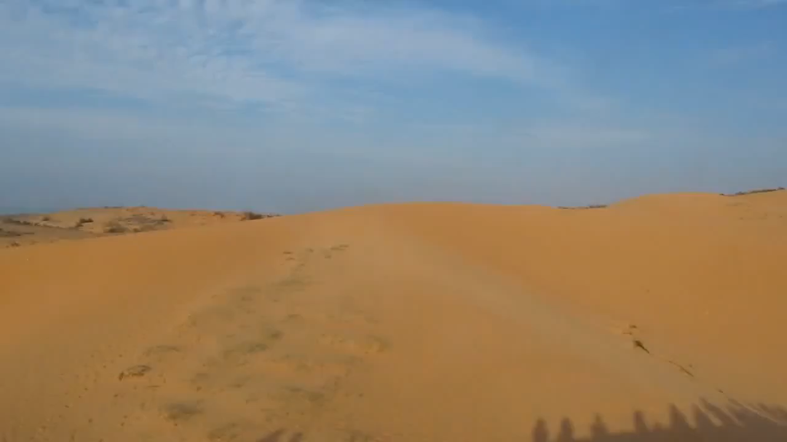
MUI NE
HA LONG BAY

Slide 5

LESSON 5
Reading

Slide 6

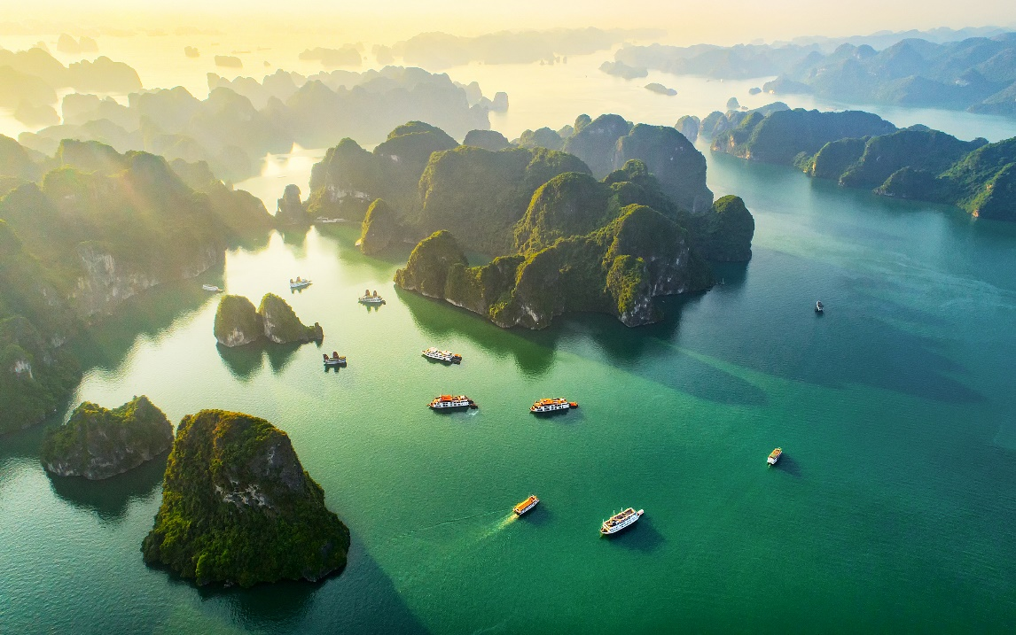
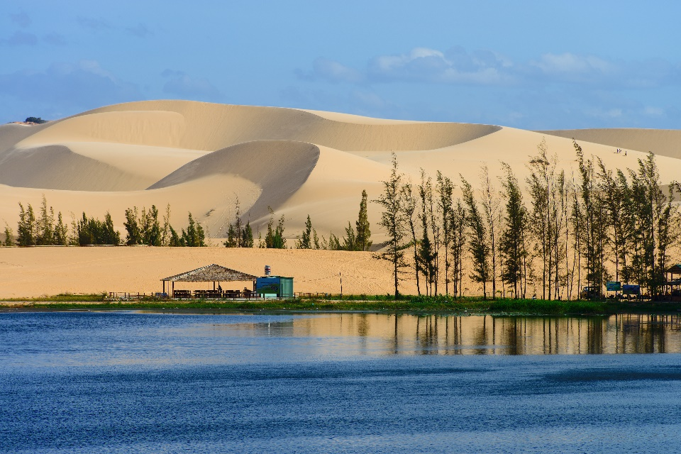
PRESENTATION
Before you read, look at the pictures below. Make predictions about the reading. Then read and check your ideas.
1.
What is the reading about?
2.
What do you know about these places?

Slide 7

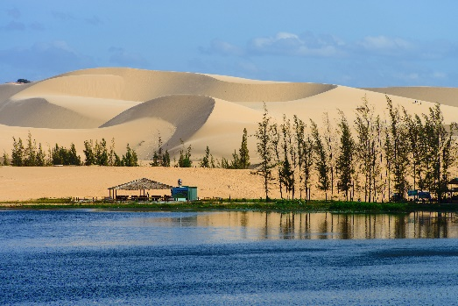
PRESENTATION
* Vocabulary
Ha Long Bay is in Quang Ninh. It has many islands and caves. Tuan Chau, with its beautiful beaches, is a popular tourist attraction in Ha Long Bay. There you can enjoy great seafood. And you can join in exciting activities. Ha Long Bay is Viet Nam’s best natural wonder.
Mui Ne is popular for its amazing landscapes. The sand has different colours: white, yellow, red ... It’s like a desert here. You can ride a bike down the slopes. You can also fly kites, or have a picnic by the beach. The best time to visit the Mui Ne Sand Dunes is early morning or late afternoon. Remember to wear sun cream and bring water.

Slide 8
PRACTICE
Before you read, look at the pictures below. Make predictions about the reading. Then read and check your ideas.
Notes: Tuan Chau: a large island in Ha Long Bay, a popular tourist destination
Mui Ne: a tourist attraction in Binh Thuan Province

Slide 9

PRACTICE
Complete the sentences, using the words from the box.
desert
visit
wonder
islands
remember
1.
Ha Long Bay is famous for its beautiful .
islands
wonder
2.
Ha long Bay is the number one natural in Viet Nam.
desert
3.
A is a large area of land with very little water.
4.
Remember to bring an umbrella, as it often rains there.
to bring an umbrella, as it often rains there.
5.
visit
A lot of people Ly Son Island in the summer.

Slide 10

PRACTICE
Read the text again. Answer the following questions.
1.
Where is Ha Long Bay?
2.
What can you do at Ha Long Bay?
3.
Is there a desert in Mui Ne?
4.
Where can you have a picnic in Mui Ne?
5.
What is the best time to visit the Mui Ne Sand Dunes?

Slide 11
PRACTICE
Read the text again. Answer the following questions.
1.
Where is Ha Long Bay?
It is in Quang Ninh.
Ha Long Bay is in Quang Ninh. It has many islands and caves. Tuan Chau, with its beautiful beaches, is a popular tourist attraction in Ha Long Bay. There you can enjoy great seafood. And you can join in exciting activities. Ha Long Bay is Viet Nam’s best natural wonder.

Slide 12
PRACTICE
Read the text again. Answer the following questions.
2.
What can you do at Ha Long Bay?
We can enjoy (great) seafood and join in exciting activities.
Ha Long Bay is in Quang Ninh. It has many islands and caves. Tuan Chau, with its beautiful beaches, is a popular tourist attraction in Ha Long Bay. There you can enjoy great seafood. And you can join in exciting activities. Ha Long Bay is Viet Nam’s best natural wonder.

Slide 13
PRACTICE
Read the text again. Answer the following questions.
3.
Is there a desert in Mui Ne?
No, there isn’t.
Mui Ne is popular for its amazing landscapes. The sand has different colours: white, yellow, red ... It’s like a desert here. You can ride a bike down the slopes. You can also fly kites, or have a picnic by the beach. The best time to visit the Mui Ne Sand Dunes is early morning or late afternoon. Remember to wear sun cream and bring water.

Slide 14
PRACTICE
Read the text again. Answer the following questions.
4.
Where can you have a picnic in Mui Ne?
By the beach.
Mui Ne is popular for its amazing landscapes. The sand has different colours: white, yellow, red ... It’s like a desert here. You can ride a bike down the slopes. You can also fly kites, or have a picnic by the beach. The best time to visit the Mui Ne Sand Dunes is early morning or late afternoon. Remember to wear sun cream and bring water.

Slide 15
PRACTICE
Read the text again. Answer the following questions.
5.
What is the best time to visit the Mui Ne Sand Dunes?
Early morning or late afternoon.
Mui Ne is popular for its amazing landscapes. The sand has different colours: white, yellow, red ... It’s like a desert here. You can ride a bike down the slopes. You can also fly kites, or have a picnic by the beach. The best time to visit the Mui Ne Sand Dunes is early morning or late afternoon. Remember to wear sun cream and bring water.

Slide 16
PRACTICE
Read the text again. Answer the following questions.
1.
Where is Ha Long Bay?
It is in Quang Ninh.
2.
What can you do at Ha Long Bay?
We can enjoy (great) seafood and join in exciting activities.
3.
Is there a desert in Mui Ne?
No, there isn’t.
4.
Where can you have a picnic in Mui Ne?
By the beach.
5.
What is the best time to visit the Mui Ne Sand Dunes?
Early morning or late afternoon.

Slide 17
Speaking

Slide 18

PRODUCTION
Work in pairs. Make notes about one of the places in the reading. You can add your own ideas.
Ha Long Bay | Mui Ne
interesting islands
a beautiful place
Then tell your partner about the place.
Example:
Ha Long Bay has a lot of interesting islands. It …
Ha Long Bay is in Quang Ninh. It has many islands and caves. Tuan Chau, with its beautiful beaches, is a popular tourist attraction in Ha Long Bay. There you can enjoy great seafood. And you can join in exciting activities. Ha Long Bay is Viet Nam’s best natural wonder.
Mui Ne is popular for its amazing landscapes. The sand has different colours: white, yellow, red ... It’s like a desert here. You can ride a bike down the slopes. You can also fly kites, or have a picnic by the beach. The best time to visit the Mui Ne Sand Dunes is early morning or late afternoon. Remember to wear sun cream and bring water.

Slide 19

PRODUCTION
Some foreign visitors are visiting your city / town / area. You are their tour guide. Tell them some interesting things about the place as well as what they must and mustn’t do there.
Example:
You must follow all the rules.
You mustn’t take photos when you are in the City Museum.

Slide 20

CONSOLIDATION
1
Wrap-up
What have we learnt in this lesson?
Reading: Reading some information about Ha Long Bay and Mui Ne
Speaking: - retelling about Ha Long and Mui Ne
- telling some information about interesting things about the place as well as what they must and mustn’t do there.

Slide 21

CONSOLIDATION
2
Homework
Do exercises in the workbook.
D1/ page 36, D2,3/page 37, D4/page 38

Slide 22







