Slide 1


Warm- up : Networks

Slide 2


Unit
3
HEALTHY LIVING FOR TEENS
LESSON 6: SKILLS 2
1

Slide 3
SPEAKING
1
Work in pairs. Discuss the following question.
How do you make time for study and other activities?

Slide 4
SPEAKING
1
Work in pairs. Discuss the following question.
How do you make time for study and other activities?
- I create a daily, weekly, or monthly schedule with dedicated time for studying, exercising, socializing, and relaxation, giving priority to learning while minimizing distractions like social media.

Slide 5
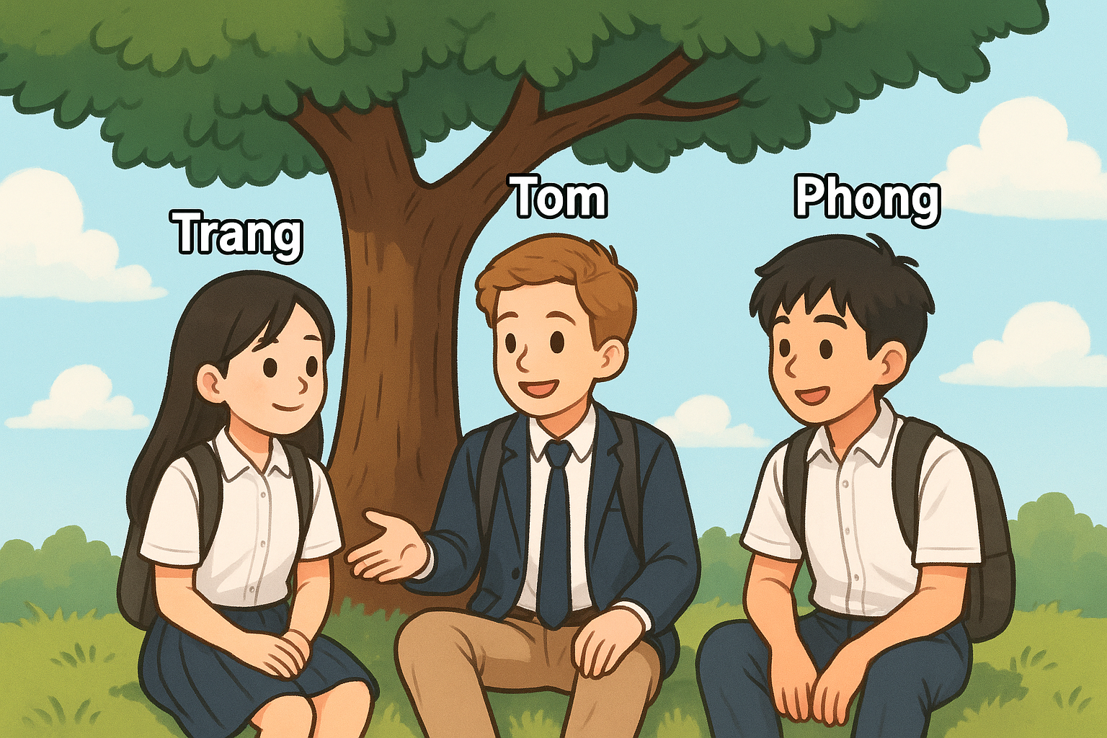

Slide 6
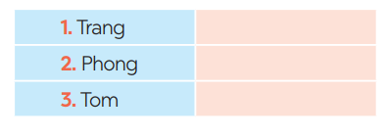
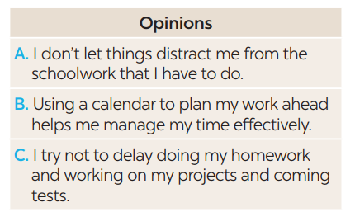
LISTENING
2
You will hear Trang, Phong, and Tom talking about how to manage their time effectively. For each student (1 – 3), choose the opinion (A – C) each of them expresses.
B
A
C
Notes:
Trang: B, Phong: A, Tom: C.

Slide 7
LISTENING
3
Listen again and choose the correct answer A, B, or C.
1. Trang enters what she has to do into a ______ at the beginning of each term.
poster
routine
calendar
2. Trang often uses ______ colours to mark project due dates and exam times on her calendar.
different
the same
similar
Notes:
1. C 2. A 3. A 4. A 5. B

Slide 8
LISTENING
3
Listen again and choose the correct answer A, B, or C.
3. Phong turns off his cell phone and signs out of social media ______ when he starts his work.
accounts
networks
websites
4. Tom tries not to ______ homework until just before the due date.
leave
complete
submit
Notes:
1. C 2. A 3. A 4. A 5. B

Slide 9
LISTENING
3
Listen again and choose the correct answer A, B, or C.
5. Tom ______ his projects and coming tests and adds them to his schedule.
prepares
reviews
revises
Notes:
1. C 2. A 3. A 4. A 5. B

Slide 10
WRITING
4
Match the time management tips in column A with the explanations and / or reasons in column B.
A | B
1. Making a plan or schedule for things you need to do, including appointments, projects, homework and tests | a. You should decide which is the most urgent and important task so that you can concentrate on it first. By doing this, you may not be at a loss to deal with too much work at the same time.
2. Giving priority to the most important task | b. An effective routine can help you accomplish the things you need to do. The more you follow a daily routine, the less you will worry or get stressed.
3. Building an effective daily routine | c. You can plan your work ahead by using a calendar, a diary, or a mobile app. It helps you remember what you need to accomplish and when you should do it.
Notes:
Key: 1. c 2. a 3. b

Slide 11
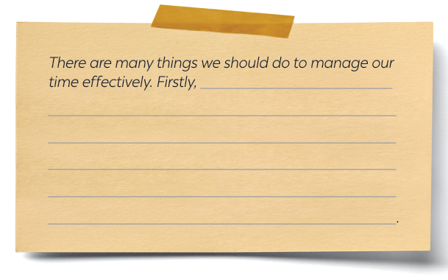
WRITING
5
Write a paragraph (about 100 words) about how to manage your time effectively. Use the tips in 4 or your own ideas.
Notes:
Key: 1. c 2. a 3. b

