Slide 1

Unit 8: Festivals around the World
Lesson 1.3: Pronunciation & Speaking
Page 62

Slide 2

LESSSON OUTLINE
Pronunciation
Practice
Speaking
Consolidation
Wrap-up

Slide 3

By the end of this lesson, students will be able to…
- stress the syllable before “consonant + ian” in nationalities ending in -ian.
- plan a new festival.

Slide 4

WARM-UP

Slide 5

Work in pairs.
Choose the word whose main stress is placed
differently from the others.
1. A. sculpture B. lantern C. support D. passport
2. A. opinion B. experience C. kilometer D. milliliter
3. A. delighted B. negative C. positive D. talented
/ˈskʌlptʃər/
/ˈlæntərn/
/səˈpɔ:rt/
/ˈpæspɔ:rt/
/əˈpɪnjən/
/ɪkˈspɪriəns/
/kɪˈlɑːmɪtər/
/ˈmɪlili:tər/
/dɪˈlaɪtɪd/
/ˈneɡətɪv/
/ˈpɑːzətɪv/
/ˈtæləntɪd/

Slide 6
Work in pairs.
Choose the word whose underlined part is
pronounced differently from that of the other words.
1. A. evidence B. frequency C. spaghetti D. lemonade
2. A. flight B. night C. right D. wish
3. A. local B. homework C. bottle D. grower
/ˈevɪdəns/
/ˈfri:kwənsi/
/spəˈɡeti/
/ˌleməˈneɪd/
/flaɪt/
/naɪt/
/raɪt/
/ wɪʃ/
/ˈloʊkl/
/ˈhoʊmwɜ:rk/
/ˈbɑ:tl/
/ˈɡroʊər/

Slide 7
Work in pairs.
Talk to your partner about Halloween.
HALLOWEEN
1. When’s Halloween?
2. What things do you usually see on Halloween?
3. What do people usually do?
4. Do you like Halloween? Why/ Why not?

Slide 8

PRONUNCIATION

Slide 9
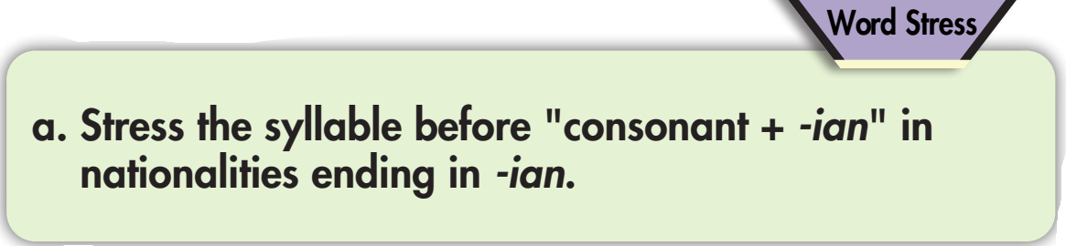
Consonant | -ian | Stress
d | -ian | Canadian
t |  | Egyptian
s |  | Russian

Slide 10
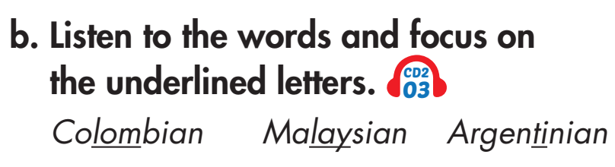


Slide 11
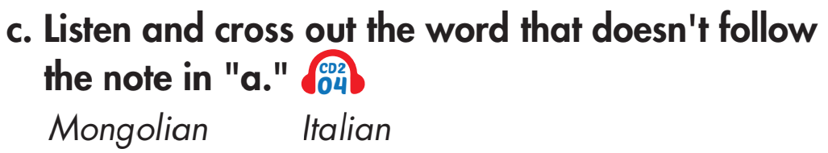
The correct stress is on the second syllable: /mɑːŋˈɡəʊliən/

Slide 12
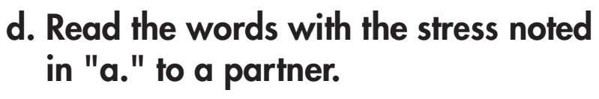
consonant | -ian | Stress
d | -ian | Canadian
t |  | Egyptian
s |  | Russian
l |  | Australian
r |  | Austrian
r |  | Bulgarian

Slide 13

PRACTICE

Slide 14
Katie: Hey Dad, can we go to the Great Reno Balloon Race?
Dad: Where is it?
Katie: It's in Reno, Nevada.
Dad: When is it?
Katie: It'll take place from September 10th to 12th.
Dad: What can you do there?
Katie: There'll be hot-air balloon shows and a pajama party.
Dad: OK. How much are the tickets?
Katie: It's free.
Dad: OK. Let's do that.
Katie: Great!

Slide 15
Katie: Hey Dad, can we go to the Gilroy Garlic Festival?
Dad: Where is it?
Katie: It's in Gilroy, California.
Dad: When is it?
Katie: It'll take place from July 26th to 28th.
Dad: What can you do there?
Katie: There'll be cooking competitions and live music.
Dad: OK. Who will perform?
Katie: King Calaway and Kip Moore.
Dad: OK. Let's do that.
Katie: Great!

Slide 16
Katie: Hey Dad, can we go to the Grape Throwing Festival?
Dad: Where is it?
Katie: It's in Mallorca, Spain.
Dad: When is it?
Katie: It'll take place from September 13th to 30th.
Dad: What can you do there?
Katie: There'll be grape fights and fire dances.
Dad: OK. How much are the tickets?
Katie: It's 25 dollars.
Dad: OK. Let's do that.
Katie: Great!

Slide 17

Katie: Hey Dad, can we go to the ___________________?
Dad: Where is it?
Katie: It's in ______________.
Dad: When is it?
Katie: It'll take place from ___________________.
Dad: What can you do there?
Katie: There'll be ________________________________.
Dad: OK. __________________________?
Katie: _________________.
Dad: OK. Let's do that.
Katie: Great!

Slide 18
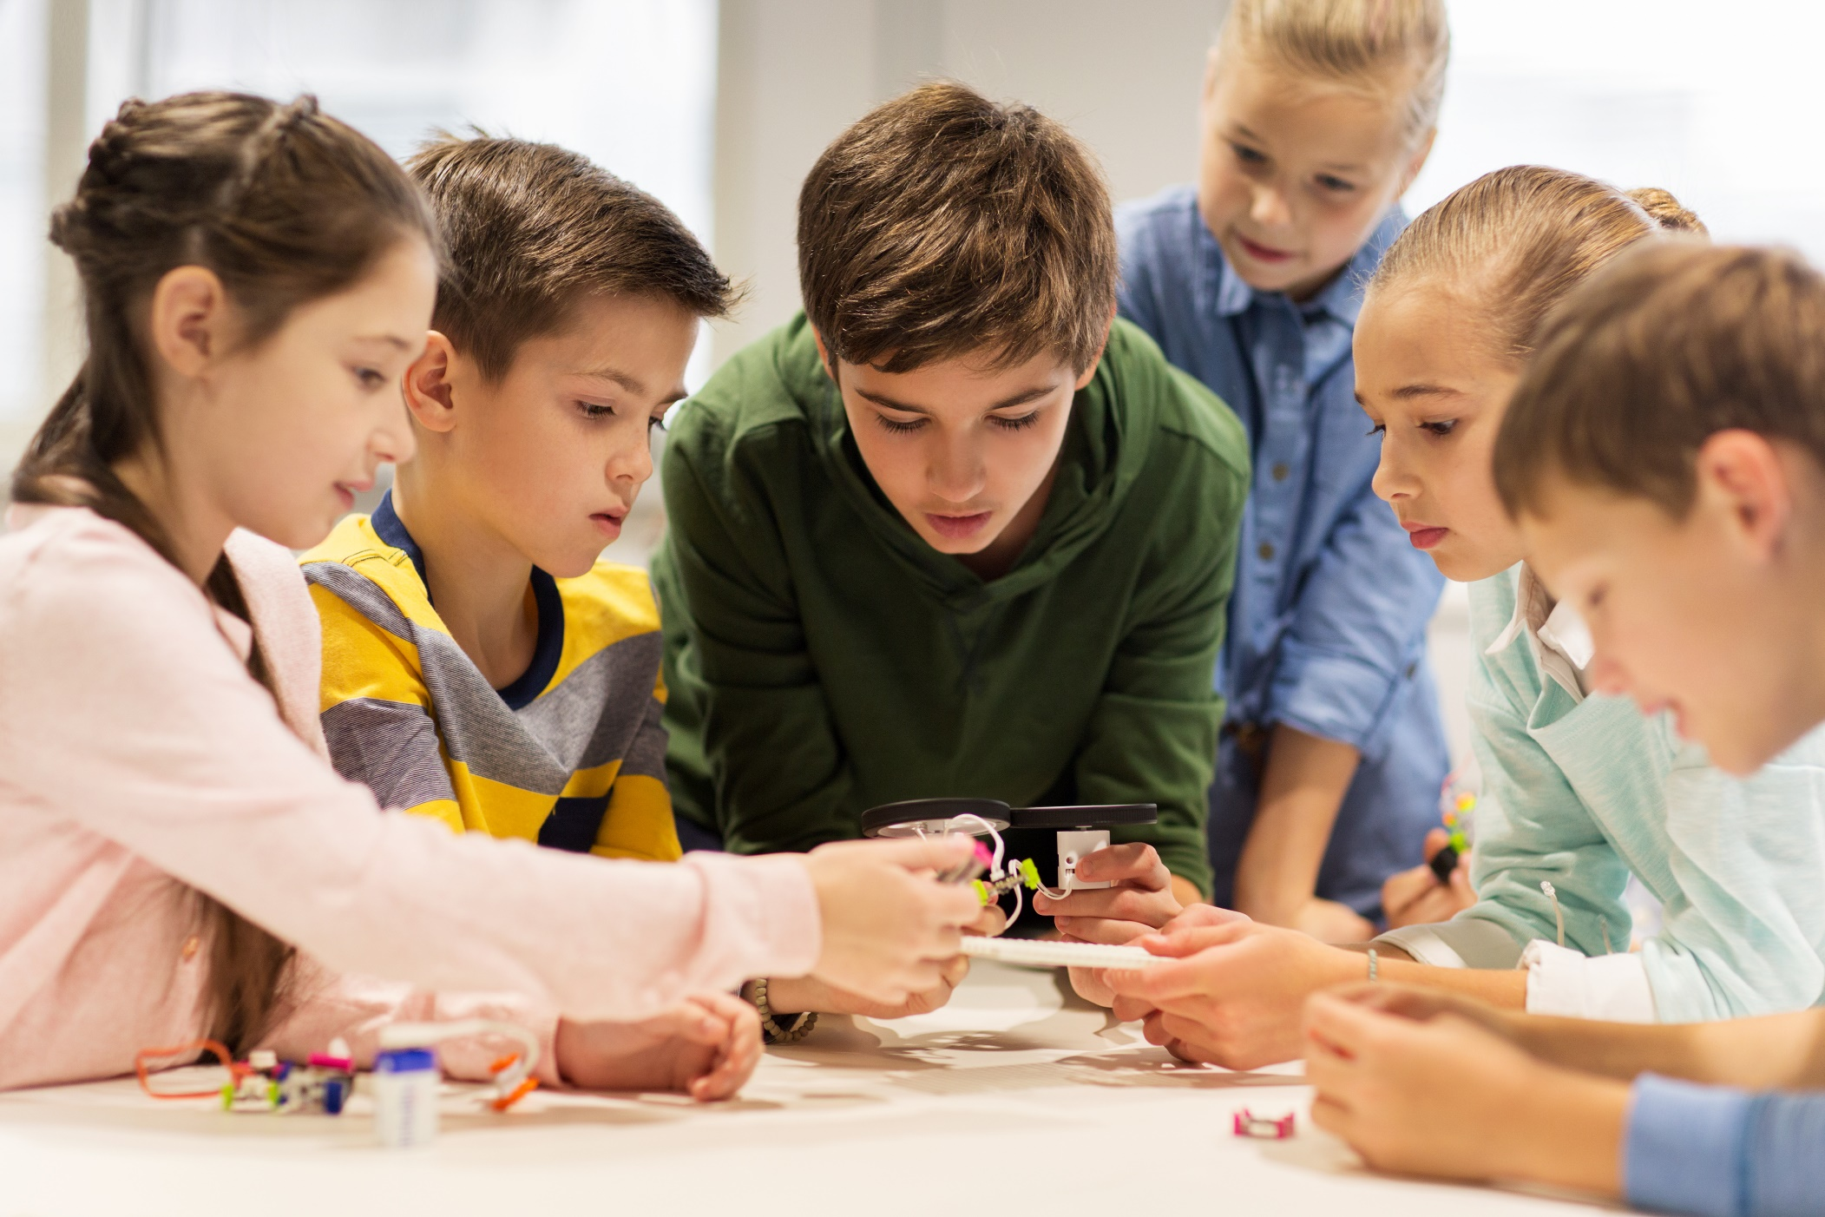
SPEAKING

Slide 19
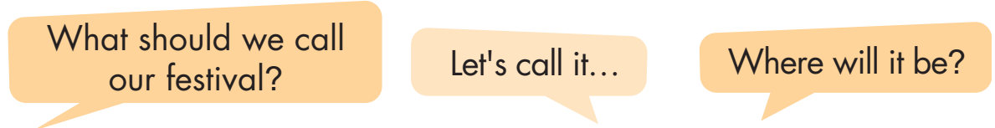
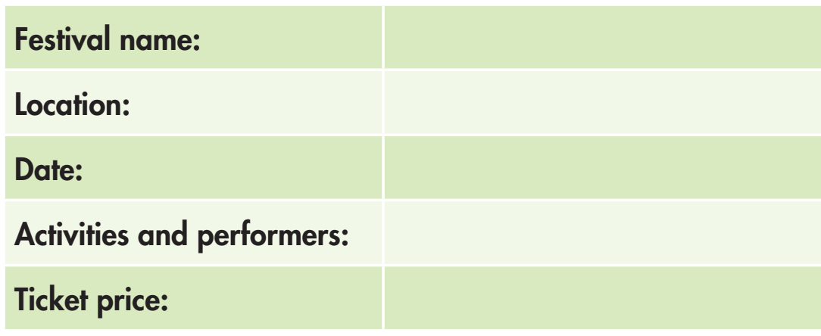
You're planning a new festival for your town.
In pairs: Discuss and fill in the table with the details of your festival.

Slide 20
b. Join two other pairs. Tell them about your festival and discuss to choose the best festival.

Slide 21

CONSOLIDATION

Slide 22
Work in pairs.
Tell your partner about a festival you have been to.

Slide 23

WRAP-UP

Slide 24
Today’s lesson
Stressing on the syllable before “consonant + ian”.
Planning a new festival for your town.

Slide 25
Homework
Learn vocabularies in lesson 1.1.
Review the grammar point in lesson 1.2.
Practice the stress of the words about nationalities ending in “-ian”.
Play the consolidation games in Tiếng Anh 7 i-Learn Smart World DHA App on www.eduhome.com.vn
Prepare the next lesson (page 63 SB).

Slide 26

Lesson 3
Stay positive and have a nice day!

