Slide 1

Period 77.Unit 8: Festivals around the World
Lesson 2.2: Grammar
Page 64

Slide 2



LESSSON OUTLINE
Consolidation
Wrap-up

Slide 3

By the end of this lesson, students will be able to…
use be + different from to say that one thing is not the same as another or other items.
use like + noun to say that two things are similar.
talk about Christmas traditions in some countries.

Slide 4

WARM-UP

Slide 5
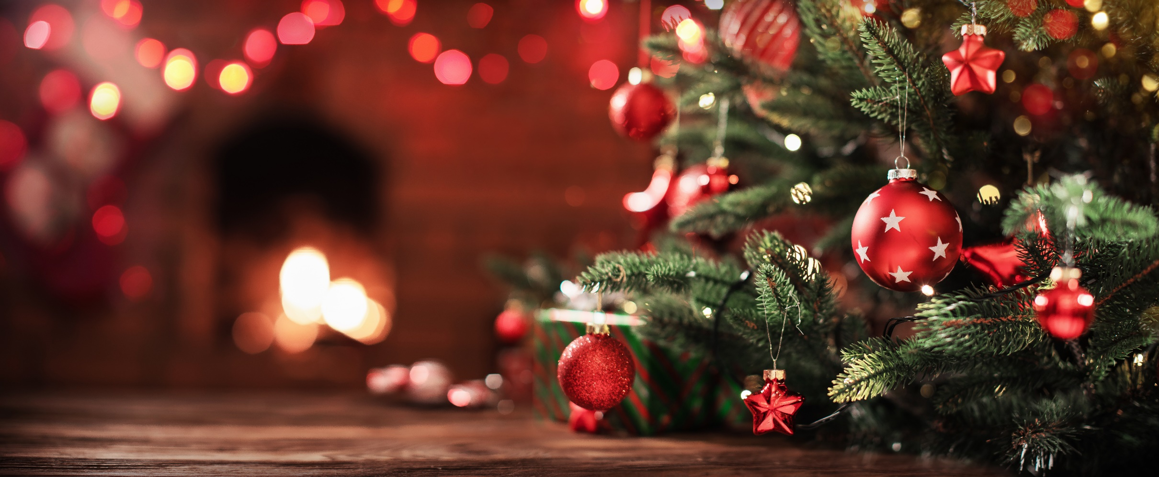
When is Christmas?
It’s on December 25th.

Slide 6
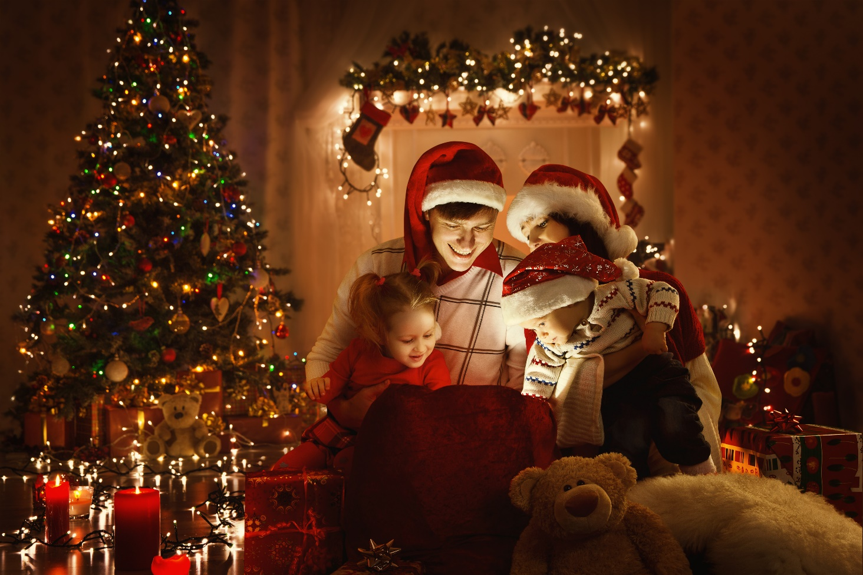
When is Christmas Eve?
It’s on December 24th.

Slide 7
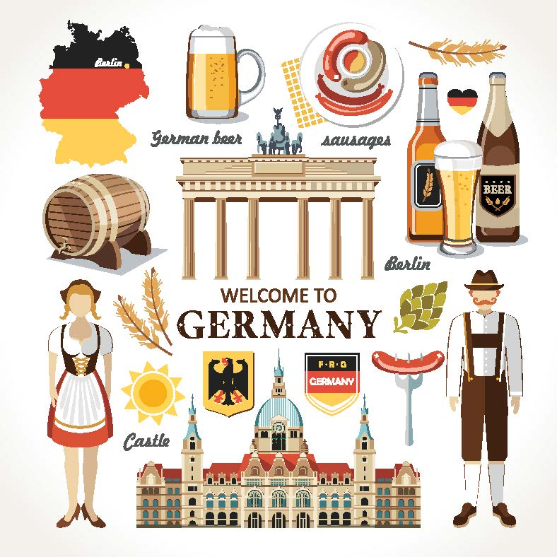
What country is the picture about?
Germany

Slide 8
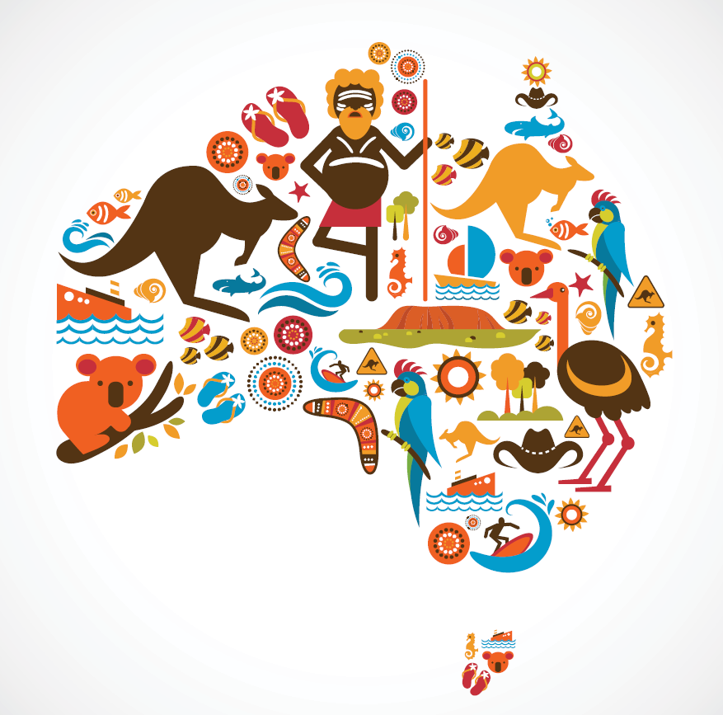
What country is it?
Australia

Slide 9
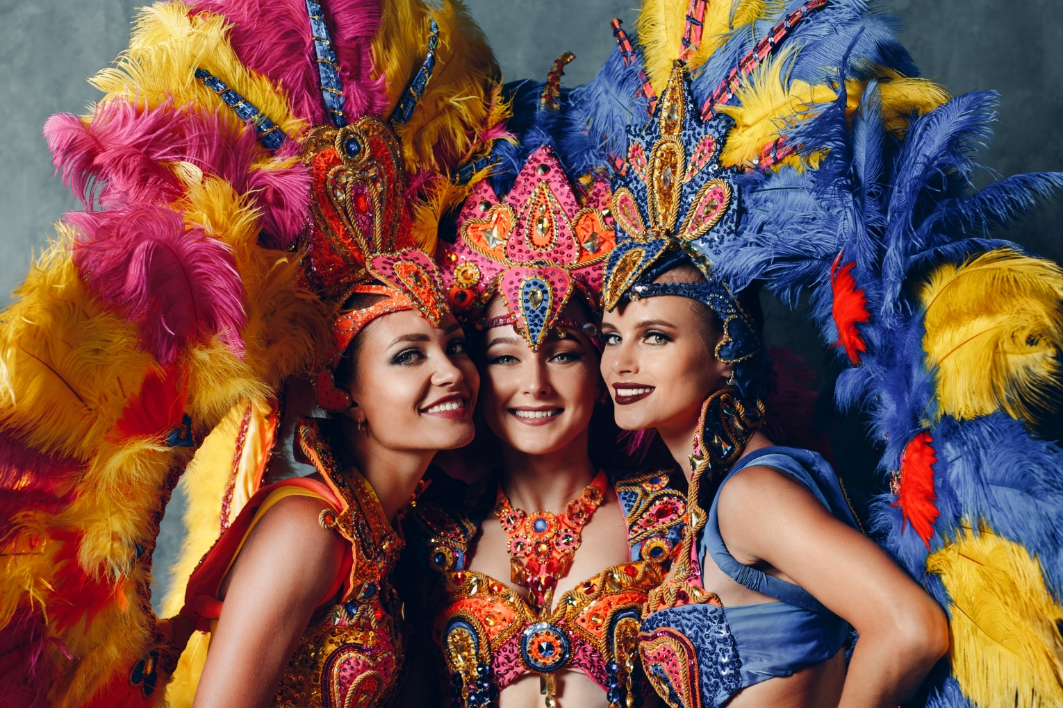
Where is Samba dance from?
Brazil

Slide 10
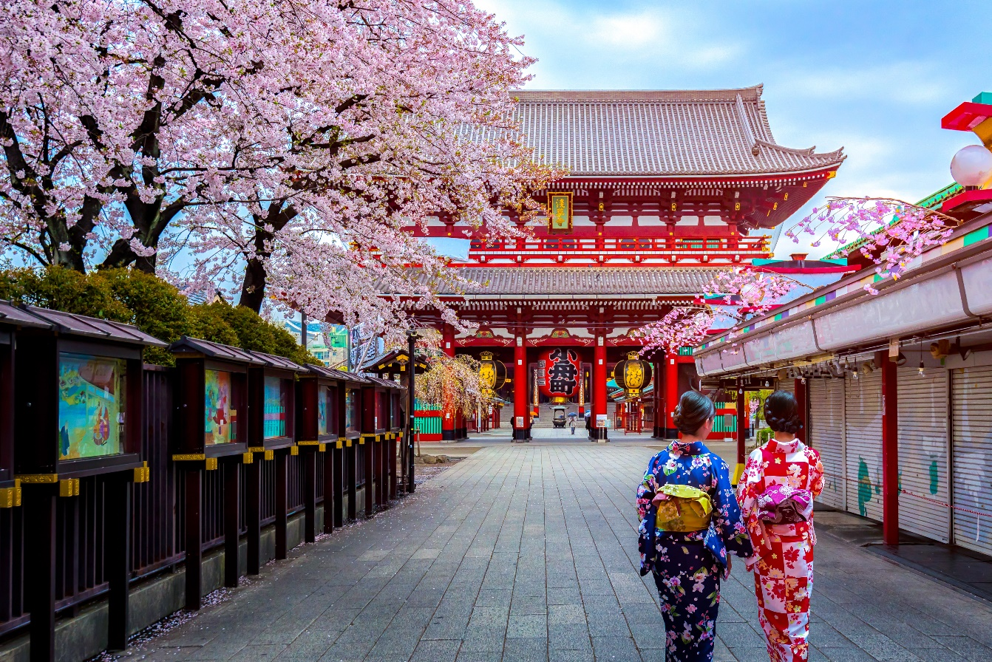
What country is the picture about?
Japan

Slide 11
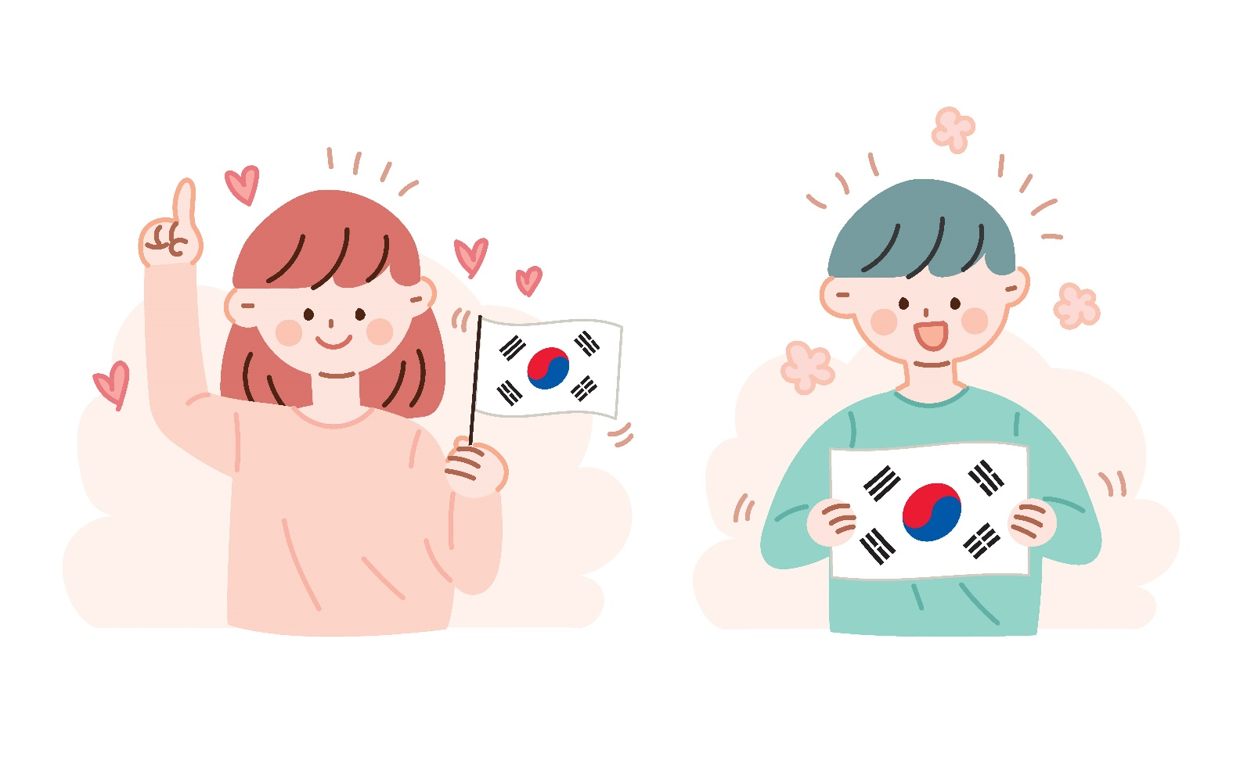
Where are the people from?
South Korea

Slide 12
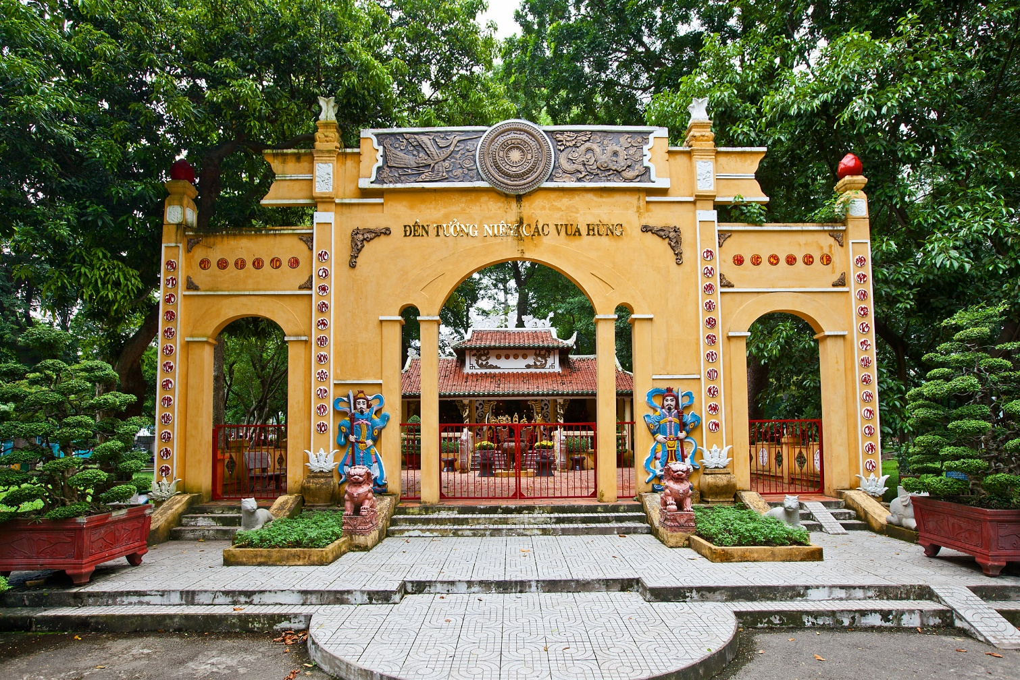
What can you see?
a temple

Slide 13
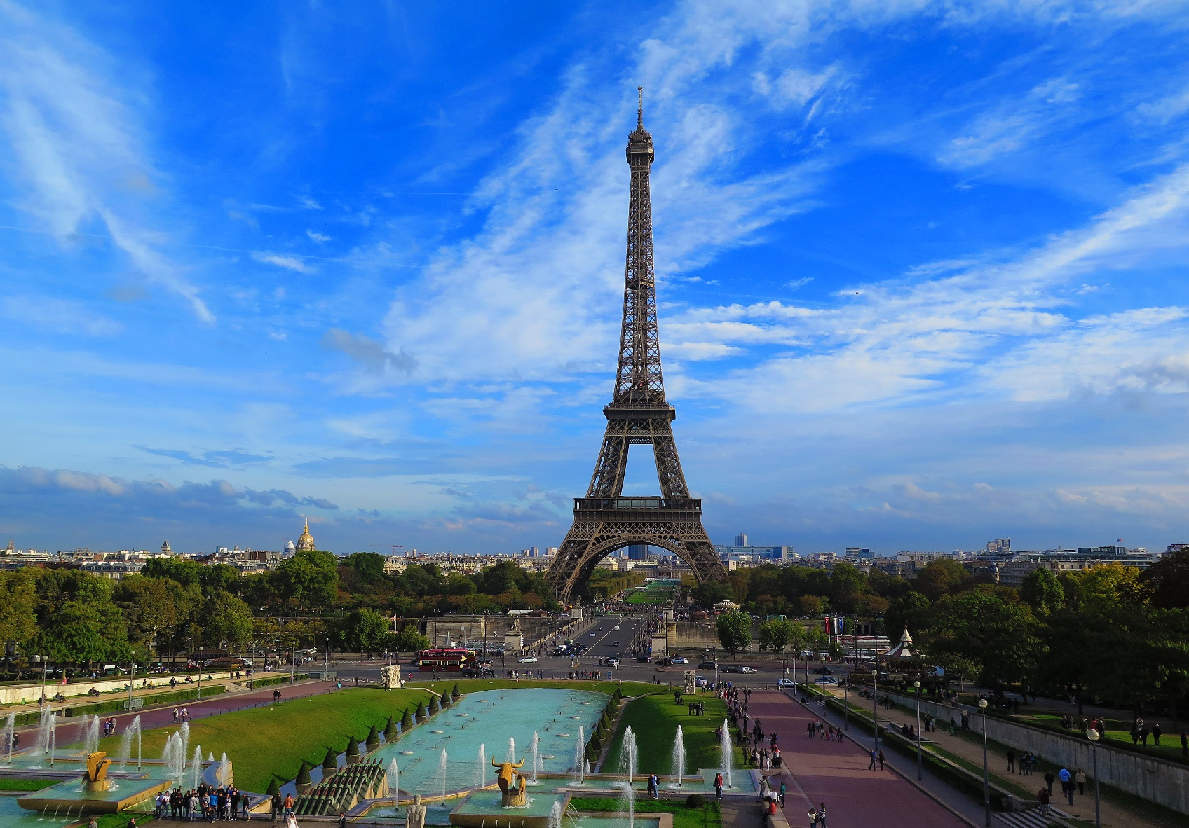
In which country can you see the Eiffel Tower?
France

Slide 14
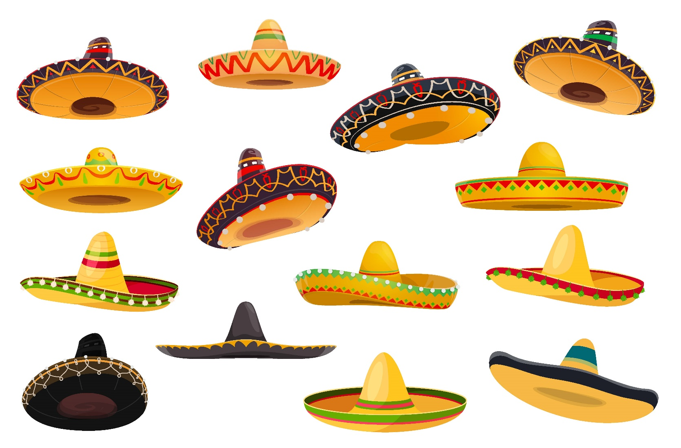
Where are sombreros from?
Mexico

Slide 15
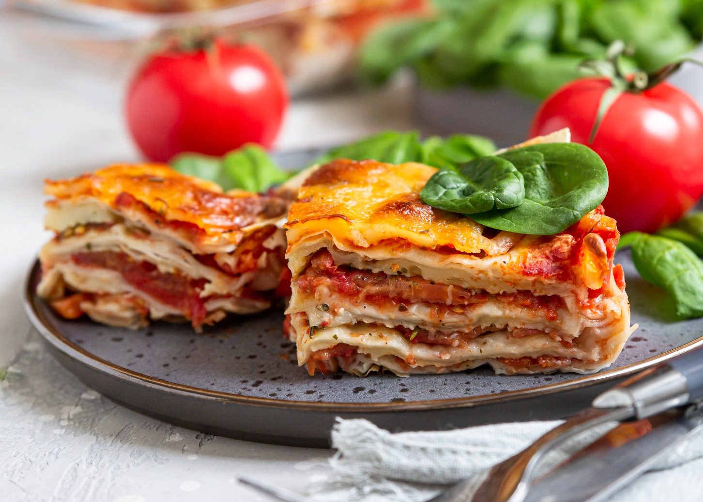
Where is lasagna from?
Italy

Slide 16
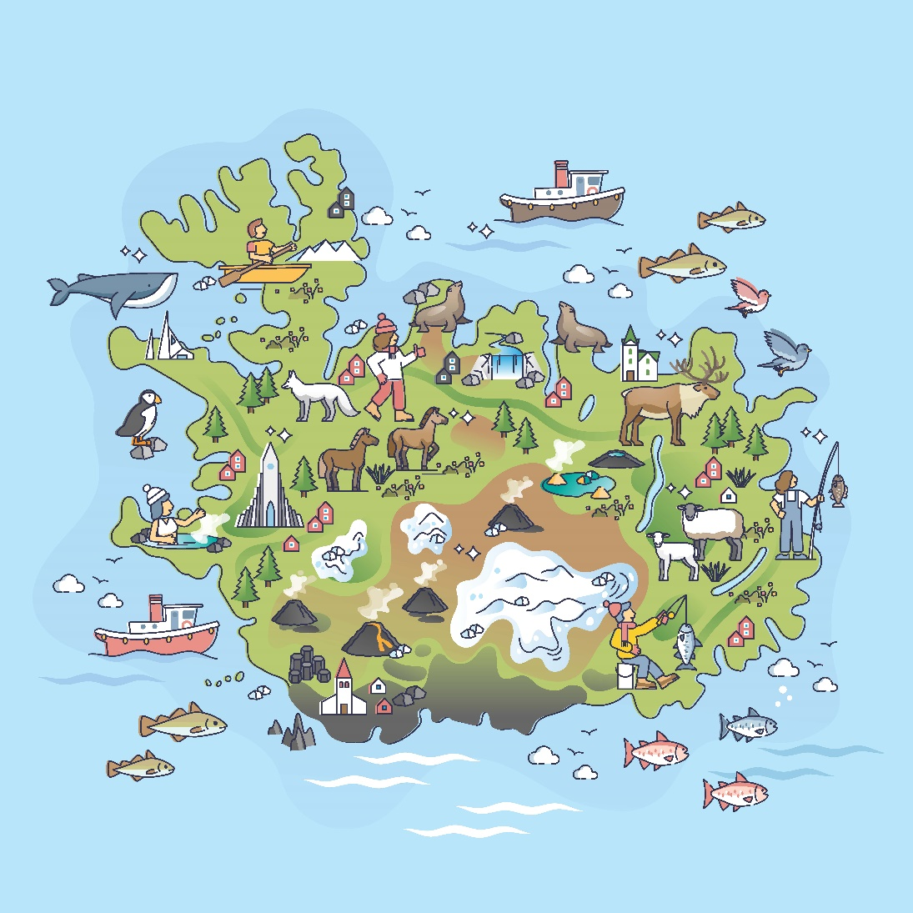
What country is the picture about?
Iceland

Slide 17
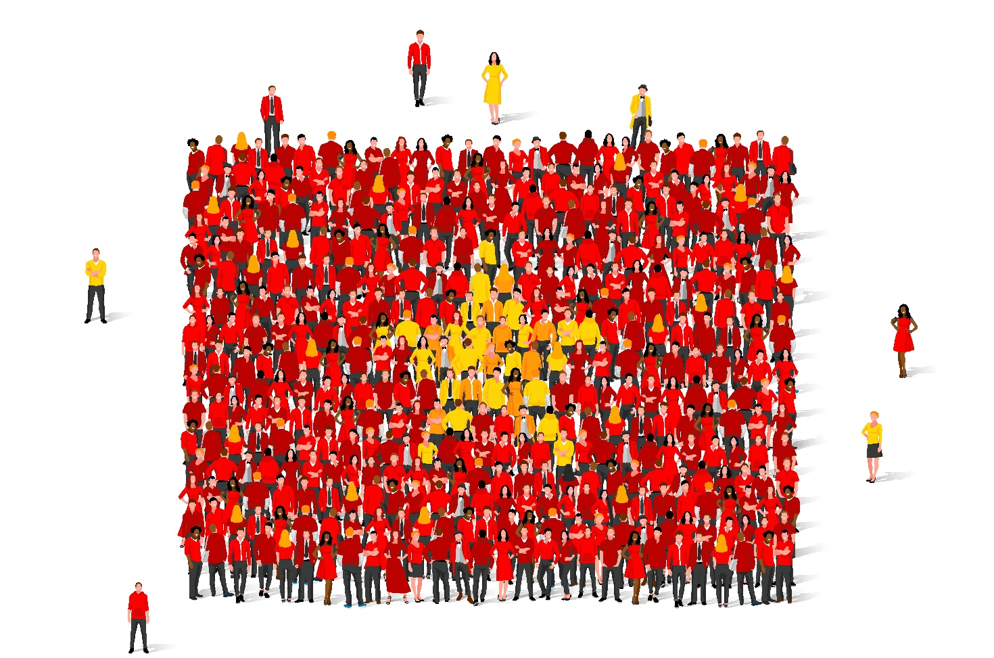
Where are the people from?
Vietnam

Slide 18

What are the people doing?
They are decorating their home.

Slide 19
Country | Nationality
Italy
 | Brazilian
Japan
 | French
The U.S.
 | Icelander
Korea
 | Mexican
Germany
Work in pairs.
Test your partner with vocabulary about countries and nationalities.
Italian
Brazil
Japanese
France
American
Iceland
Korean
Mexico
German

Slide 20



Slide 21
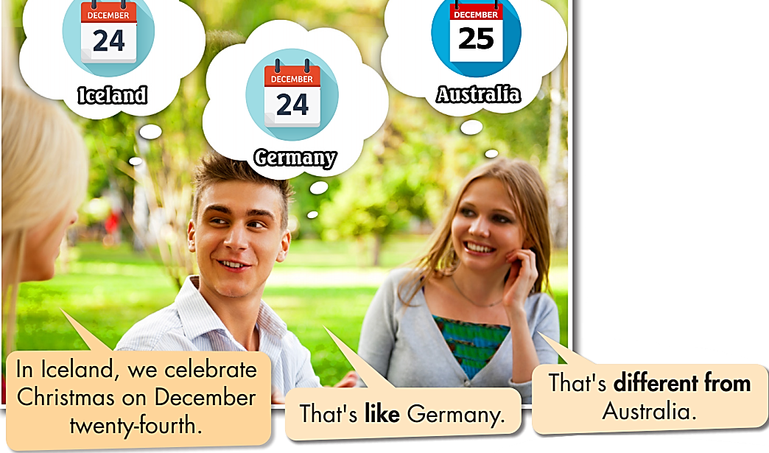



Slide 22
Don’t open your book. Look and read the sentence:
BE DIFFERENT FROM
We use be + different from to say that one thing is not the same as another or other items.
In Italy, they eat seafood at Christmas. That’s different from Japan.

Slide 23
BE DIFFERENT FROM
We use be + different from to say that one thing is not the same as another or other items.
Unscramble the sentences. Tell your partner:
1. dessert/from/different/is/Japan's./Christmas/Germany's
______________________________________________________________
2. Brazil's/costume/Years/is/from/different/Vietnam's./New
______________________________________________________________
3. Halloween/in/from/Halloween/the/in/different/is/Mexico./US
______________________________________________________________
Germany’s Christmas dessert is different from Japan’s.
Brazil’s New Years costume is different from Vietnam’s.
Halloween in the US is different from Halloween in Mexico.

Slide 24
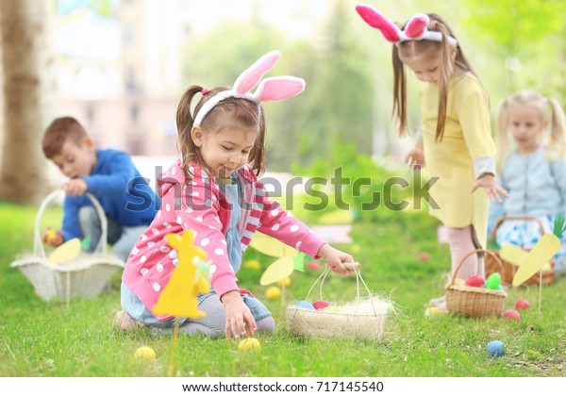
Keep your book closed. Look and read the sentence:
LIKE + NOUN
We use like + noun to say that two things are
similar.
Like American children, French children go egg hunting
on Easter Sunday.

Slide 25
LIKE + NOUN
We use like + noun to say that two things are
similar.
Unscramble the sentences. Tell your partner.
Vietnamese/Koreans/visit/Like/people,/temples.
___________________________________________
Australians,/gifts/Americans/Like/exchange/Christmas./at
___________________________________________
children/Like/French/children,/Easter./chocolate/at/English/get/eggs
___________________________________________
Like Vietnamese people, Koreans visit temples.
Like Australians, Americans exchange gifts at Christmas.
Like French children, English children get chocolate eggs at Easter.

Slide 26
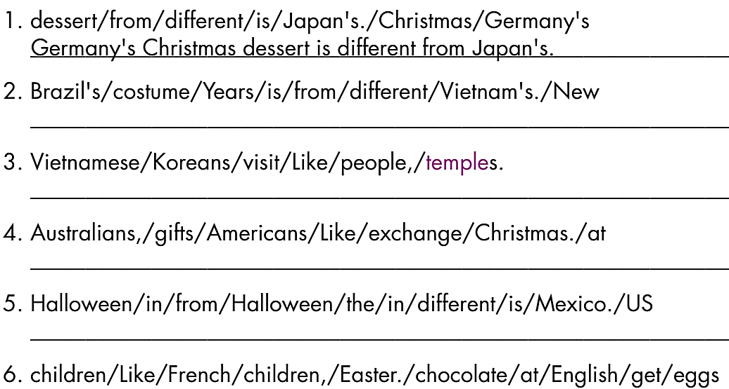
Open the book. Write the complete sentences.

Slide 27
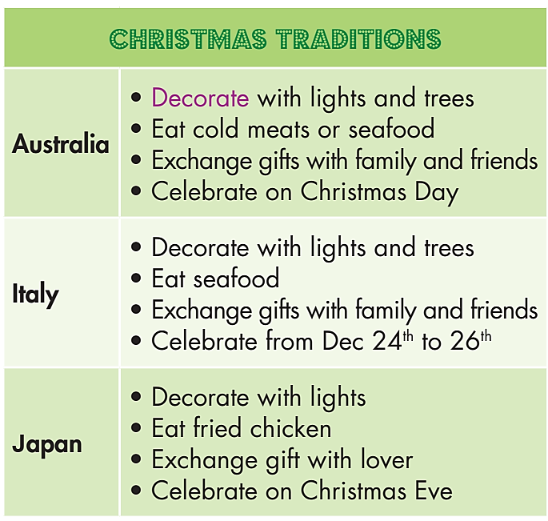
with lights and trees. That’s like
with lights and trees. That’s like
1. Italians decorate __________________________ Australians.
2. Christmas meal in Japan _________________
__________________________________ Italy.
3. Australians exchange ____________________.
That's __________________ Japanese people.
4. Italy celebrates Christmas from ____________.
_______________________________ Australia.
5. Italians exchange _______________________.
______________________________ Australians.
6. Australia celebrates Christmas on __________.
That's ___________________________ Japan.
7. Christmas meal in Italy __________________
______________________________ Australia.

Slide 28
1. Italians decorate ______________________________ Australians.
4. Italy celebrates Christmas from _____________________________ ________________ Australia.
5. Italians exchange ________________________________ Australians.
7. Christmas meal in Italy _____________________________ Australia.
with lights and trees. That’s like
December 24th to 26th. That’s
different from
gifts with family and friends. That's like
is different from Christmas meal in
CHRISTMAS TRADITIONS
Australia | Italy
• Decorate with lights and trees • Eat cold meats or seafood • Exchange gifts with family and friends • Celebrate on Christmas Day | • Decorate with lights and trees • Eat seafood • Exchange gifts with family and friends • Celebrate from Dec 24th to 26th

Slide 29
2. Christmas meal in Japan ______________________________ Italy.
is different from Christmas meal in
CHRISTMAS TRADITIONS
Japan | Italy
• Decorate with lights • Eat fried chicken • Exchange gift with lover • Celebrate on Christmas Eve | • Decorate with lights and trees • Eat seafood • Exchange gifts with family and friends • Celebrate from Dec 24th to 26th

Slide 30
3. Australians exchange ___________________________.
That's __________________ Japanese people.
6. Australia celebrates Christmas on _________________.
That's ___________________________ Japan.
gifts with family and friends
different from
Christmas Day
different from
CHRISTMAS TRADITIONS
Australia | Japan
• Decorate with lights and trees • Eat cold meats or seafood • Exchange gifts with family and friends • Celebrate on Christmas Day | • Decorate with lights • Eat fried chicken • Exchange gift with lover • Celebrate on Christmas Eve

Slide 31
BE DIFFERENT FROM
LIKE + NOUN
d. In pairs: Compare Christmas traditions in your country
with one of the countries in the table in Task c.
CHRISTMAS TRADITIONS
Australia | Italy | Japan
• Decorate with lights and trees • Eat cold meats or seafood • Celebrate on Christmas Day • Exchange gifts with family and friends | • Decorate with lights and trees • Eat seafood • Celebrate from Dec 24th to 26th • Exchange gifts with family and friends | • Decorate with lights • Eat fried chicken • Celebrate on Christmas Eve • Exchange gift with lover

Slide 32
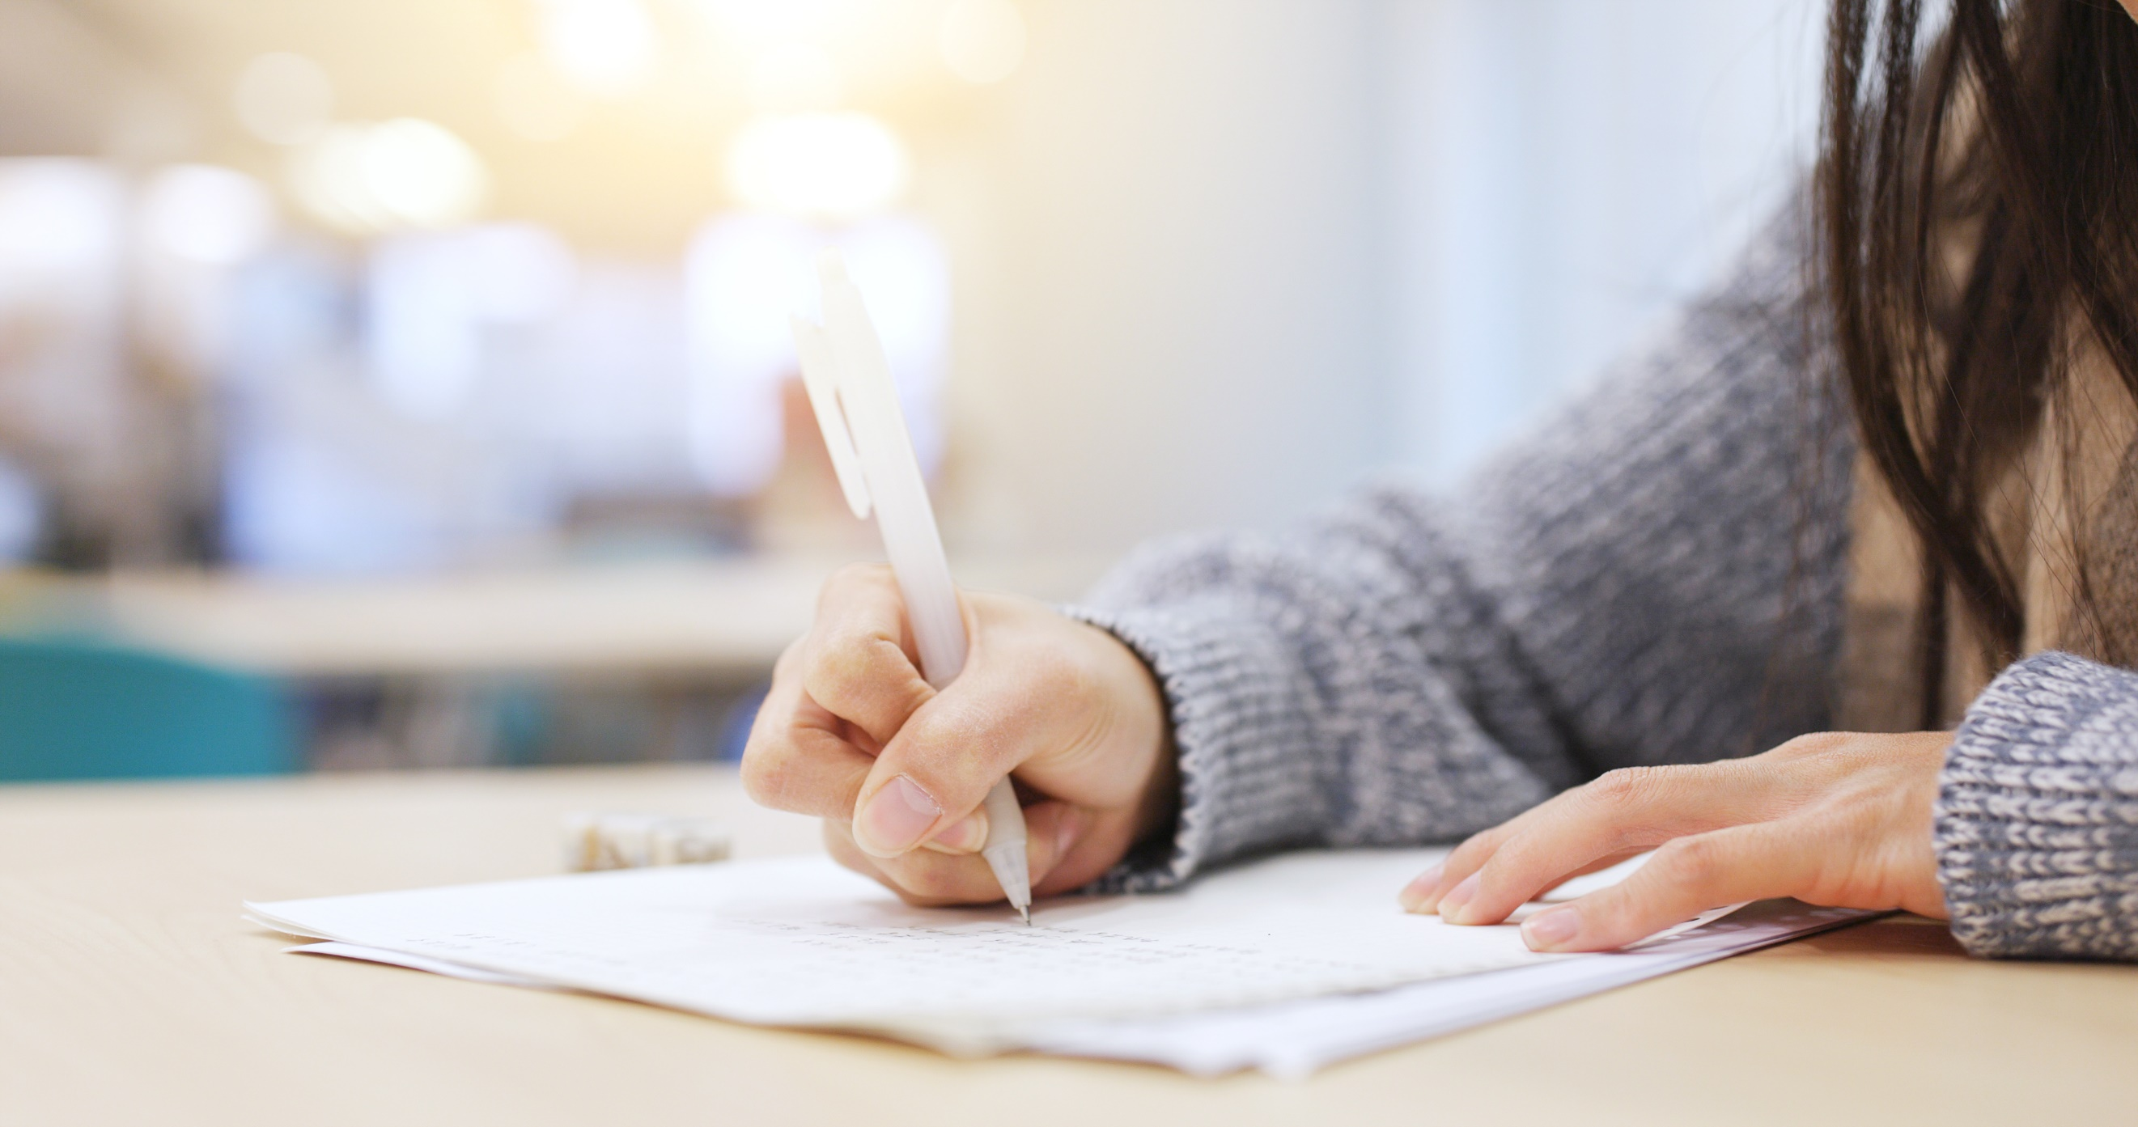


Slide 33
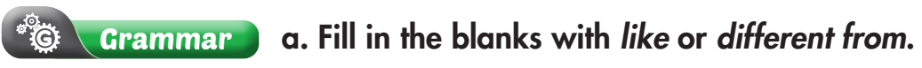
Extra Practice
WB, page 47
different from
1. Thai New Year is ______________ Vietnamese New Year. In Thailand it's in April, but in Vietnam it's in February.
2. People in England celebrate Christmas by decorating a Christmas tree, ______________ people in Germany.
3. Vietnamese food is ______________ Thai food. Thai food is very spicy, but most Vietnamese food is not very spicy.
4. ______________ Vietnamese people, Thai people like to travel back to their hometown for the New Year.
5. Christmas in Italy is ______________ Thailand. In Italy, Christmas is a national holiday, but in Thailand it isn't.
like
different from
Like
different from

Slide 34

Extra Practice
WB, page 47
1. people./Vietnamese/eat/people/lot/Korean/of/noodles/like/a
__________________________________________________________
2. from/different/Korean/American/food/food./is
__________________________________________________________
3. Vietnamese/five/in/holiday/New/Year/lasts/like/days/Thailand./The
__________________________________________________________ 4. from/cake/in/South Korea./rice/Traditional/rice/cake/different/ Vietnamese/is
__________________________________________________________
Vietnamese people eat a lot of noodles like Korean people.
Korean food is different from American food.
The Vietnamese New Year holiday lasts five days like in Thailand.
Traditional Vietnamese rice cake is different from rice cake in South Korea.

Slide 35

CONSOLIDATION

Slide 36
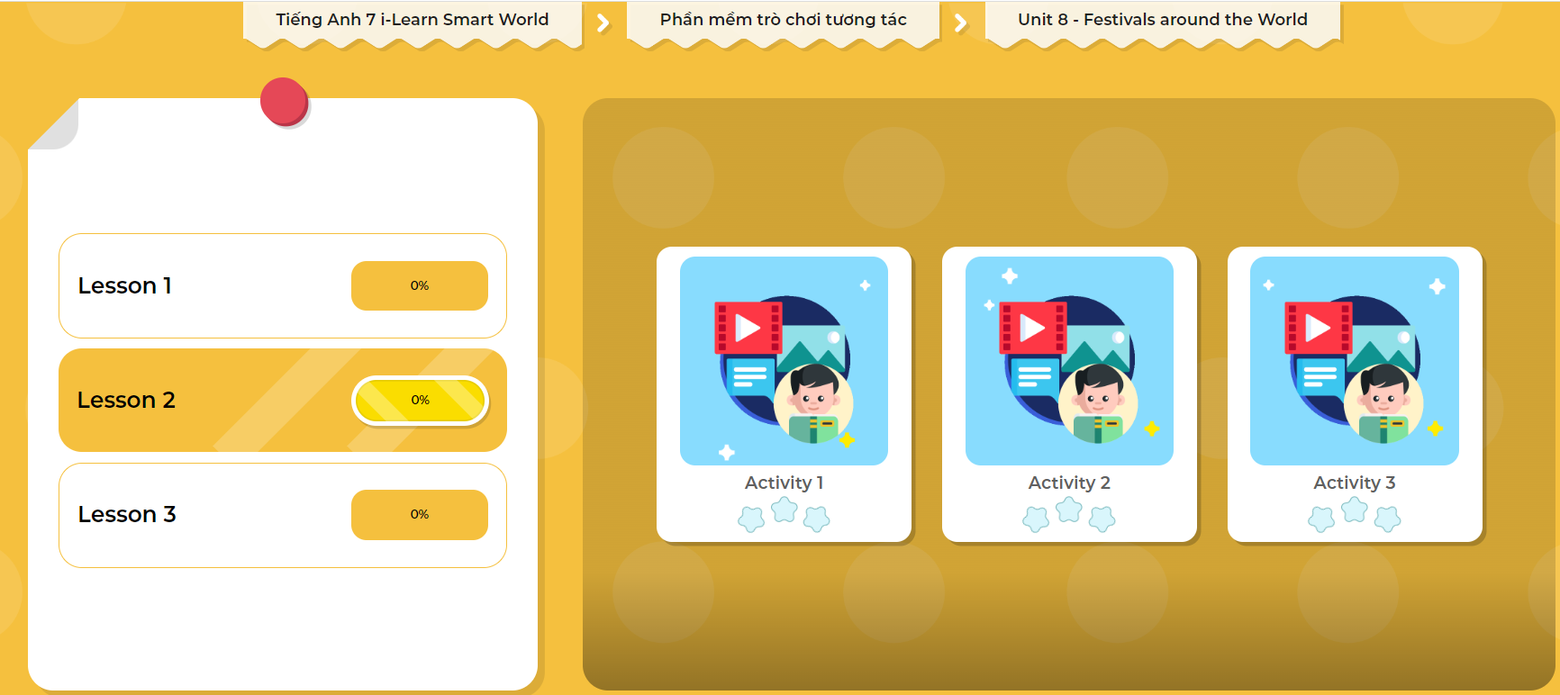
LET’S PLAY!
Click here to play the games!

Slide 37
NEW YEAR TRADITIONS
Work in pairs.
Talk about what Vietnamese people usually do on the Lunar New Year.

Slide 38

WRAP-UP

Slide 39
Today’s lesson
Grammar:
Using be + different from to say that one thing is not the same as another or other items.
Using like + noun to say that two things are similar.
Speaking:
- Talking about Christmas traditions in some countries.

Slide 40
Homework
Review the Grammar points in today’s lesson.
Finish the Writing Exercise in the WB, page 47.
Complete the grammar notes in Tiếng Anh 7 i-Learn Smart World Notebook on page 51.
Prepare the next lesson (page 65 SB).
Play the consolidation games in Tiếng Anh 7 i-Learn Smart World DHA App on www.eduhome.com.vn

Slide 41

Lesson 3
Stay positive and have a nice day!

