Slide 1
REVISION FOR THE 2nd MIDTERM TEST
Lesson REVISION UNIT 5+ UNIT 6
Period 77 Class : 9A4

Slide 2
Write 5 things related to healthy living and 5 things lead to unhealthy living
+Staying healthy | +Staying unhealthy :
+Staying healthy | eating balanced diets , drinking enough water, do morning exercises, don’t use too much screen smart phones, eat lots of vegetables . . . .
+Staying unhealthy : | eating too much junk food, don’t drink enough water, use too much smart phones, Don’t do exercises, smoke lots of cigaratte

Slide 3
I PRONUNCIATION
the /tr/ and /tʃ/ sound.
truth nutrient chooses teacher
II. Review adverbial clauses/ phrases of concession
Although he knows it’s bad for him, he eats a lot of junk food.
Structure: Main clause + although / though + clause.
=> To introduce an idea that contrasts with the main idea.
Structure :Despite / In spite of + N/V-ing, main clause.
Eg: In spite of their harm, many people follow detox diets.
Main clause + despite / in spite of + N/V-ing.
Eg: Many people don't know how to cook a nourishing meal despite knowing the importance of eating healthily.

Slide 4
-Despite / In spite of + N / V-ing, main clause
-Despite / In spite of their harm, many people follow detox
B.Exercises
I.Choose the word whose underlined part differs from the other three in pronunciation in the following questions.
1. A. chemical B. detox C. access D. benefit
2. A. natural B. suggest C. internet D. diet
3. A. organ B. obese C. promote D. bone
Answer keys 1.B 2.A 3.A

Slide 5
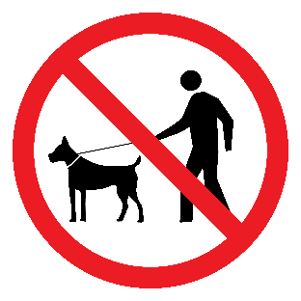
 | 3.What does the sign mean? A. Bring any pets except dogs. B. Bring your dog here. C. No pets allowed D. You mustn't walk your dog on the grass
Answer keys: 1.B 2.D 3.C

Slide 6
V.Write the correct form of the given words.
1.Teenagers using ___________ supplements to lose weight could be putting themselves at risk of serious harm. (DIET)
2.Regular physical activity can be ____________for your health. (BENEFIT)
3.An adult who has a body mass index (BMI) of 30 or more is considered to have_______. (OBESE)
4.Skipping meals can be very __ __ as it impacts your blood sugar and your mood. (HARM)
Answer keys 1. dietary 2. Beneficial
3. Obesity 4. harmful

Slide 7
Write about ways to stay healthy and which ones you do. Write 100 to 120 words.
Questions: 1.How can you maintain 60 minute exercise a day?
2.How can you check your health?
3.How much water do you drink a day?
-There are some ways to stay healthy that everyone has to do daily. Firstly, people should maintain 60 minutes exercise a day.They shouldn’t be lazy after working out every day. They shouldn’t spend too much time on sitting in front of the TV. It's important for more people to understand how exercises help us in good health and stay in shape.Secondly,people should check their health regularly Even they you feel OK now, you should check your health often. Only some people do this now. Technology makes it easier to check for health problems.Thirdly,Every one should drink enough water each day because water makes up about 50% to 70% of your body weight. It’s commonly recommended that you drink eight 8-ounce (237-mL) glasses of water per day.In conclusion, good health is necessary for people, so they have to keep and practice having a healthy life.

Slide 8
HOMEWORK
-LEARN STRUCTURE, VOCABULARY BY HEART
-REWRITE THE SENTENCES

Slide 9
REVISION FOR THE 2nd MIDTERM TEST
Lesson REVISION UNIT 5+ UNIT 6
Period 78 Class : 9A4

Slide 10
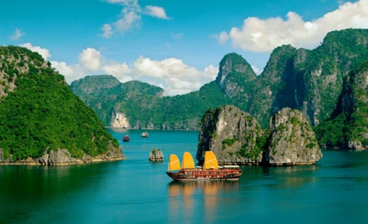
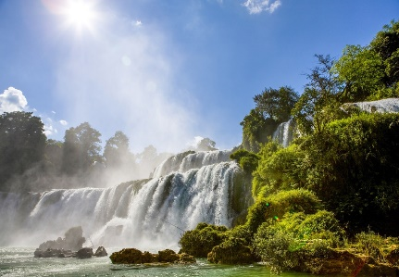
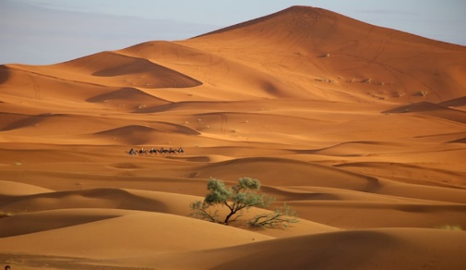

Slide 11
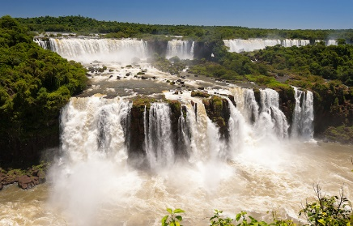
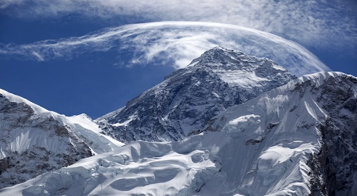
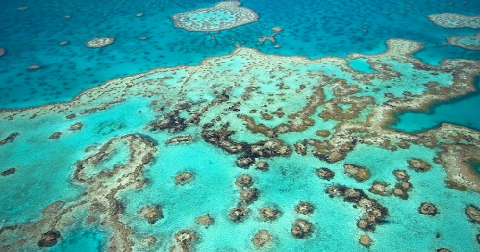
1.Ha Long Bay 2.Bản Giốc water falls 3.Sahara desert 4.Mount Everest
5.The Great Barrier coral in Australia
6.Grand Canyon in the USA

Slide 12
1. Sơn Đoòng Cave is far bigger than both the others.
2. Goa Pindul Cave is more famous for its river than the others.
3. Deer Cave is a bit more difficult to reach than Goa Pindul Cave.
4. Sơn Đoòng Cave isn't as accessible as Deer Cave.
5. Goa Pindul Cave is easier for people to get inside and see this cave than the others.
6. Sơn Đoòng is much more scenic than most other caves
-
+Intensifier + adjective –er/ more + adjective + than
+ (Not) as + adjective + as
+ Irregular comparative adjectives
Good – better Bad –worse Far – father/ further

Slide 13
Structure : VERB + GERUND
Like / don’t mind / hate / enjoy/ love/ prefer / dislike + V-ing
Keep / stop / advoid / consider / / suggest / deny / finish / / spend + V-ing
Review non-defining relative clauses.
Remind the students the following rules
“The relative pronouns/adverbs who, which, when, and where introduce non-defining relative clauses. The clauses are separated from the sentence with commas. We can't use the relative pronoun “that” with non-defining relative clauses.”
Relative adverbs “when” “where” tell us about the time or place. Relative pronouns “who” “which” refer to the people or things.

Slide 14
Complete sentences with Non-defining relative clauses
1.Edmund Hillary and Tenzing Norgay climbed Mount Everest in 1952. They were the first people to ever climb it. (who)
2. Finland is a great place to see the Northern Lights. Many people go there. (where)
3.The Grand Canyon is one of the natural wonders of the world. It is in Arizona, USA. (which)
1.Edmund Hillary and Tenzing Norgay, who were the first people to climb Mount Everest, climbed it in 1952.
2. Finland, where many people go, is a great place to see the Northern Lights.
3. The Grand Canyon, which is in Arizona, USA, is one of the natural wonders of the world.

Slide 15
Write the correct form of the given words.
1. By helping restore damaged ecosystems, you’re preserving the wonders of(1)___________, bringing it back to its former state. (NATURALLY)
2.The Elephant Rock is a (2)____________ outcrop on the Westman Islands archipelago in Iceland. (NATURALLY)
3Their new ways of protecting the ocean habitats are worthy of serious(3)___________. (CONSIDER)
4. This beach has a (4)______________beautiful view, but I wouldn’t recommend staying there too long in November as it’s jellyfish time. You can run into a lot of jellyfish then. (SPECTACULAR)
5. The first Europeans to reach the Grand Canyon were Spanish (5)______________in the 1540s. (EXPLORE)
6.If tourists keep ___________ trees, the animals will leave the park. (damage)
7.Mount Everest is far ________ than most other mountains. (tall)
8.What can we do to stop _________? (hunt)
9.Silver Falls is nice, but Elephant Falls is far ______________. (beauty)
10. The government should consider _______ people for littering. (fine)
11. Bat Cave is beautiful but not as ______________ as Deer Cave. (access)
nature
natural
consideration
spectacularly
explorers
damaging
taller
hunting
more beautiful
fining
accessible

Slide 16
IX.Read the information and write an article about the natural wonder. Write 100 to 120 words.
-Victoria Falls is in southern Africa between Zambia and Zimbabwe -Victoria Falls is also know as “ The Smoke that Thunders” -It is one of the largest waterwalls in the world. More than 500 million liters of waters fall every minutes.
Answer
There are many natural wonders in the world we like to go there.Victoria Falls, which is also known as “The Smoke That Thunders,” is one of the natural wonders of the world. It is also one of the largest waterfalls in the world. The waterfall, which is on the border of Zimbabwe and Zambia, is more than 100 m tall and over 1,700 m wide. It is very big and impressive. A man named David Livingstone, who first saw the waterfall in 1855, named it after the queen of England.

