Slide 1
Period 82.Unit 7: Urban life
Lesson 1.3: Pronunciation. & Speaking
Pages 66 & 67

Slide 2
Lesson Outline
Warm-up
Pronunciation
Speaking
Consolidation
Wrap-up

Slide 3
By the end of this lesson, students will be able to…
Pronounce the /dʒ/ sound.
Talk about problems in a city and solutions to them.

Slide 4
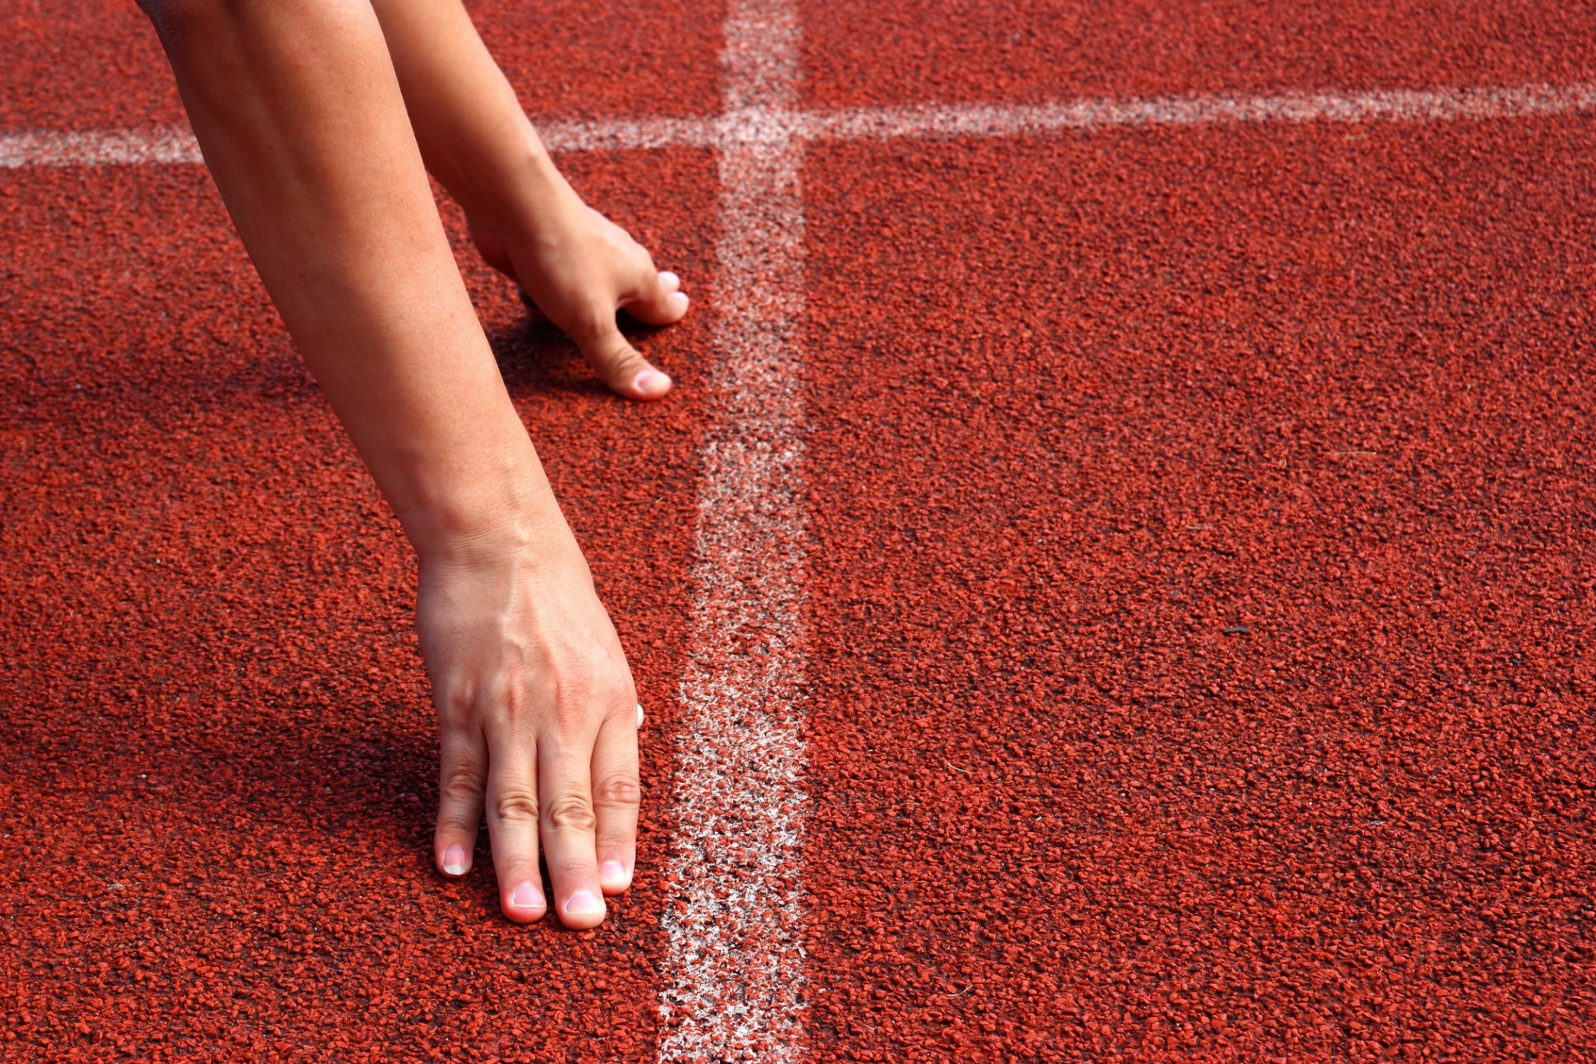
WARM-UP

Slide 5
COMPETITION TIME: WORD GUESSING GAME
Divide the class into groups of 5 students each.
Say the definition of 10 individual words. Each group listens and write down the word on the board/paper.
Teacher can support by giving the first letter of each word.
Which team(s) with the highest number of correct answers win(s).

Slide 6
Example:
Teacher says: a thing/structure that connects two places over a gap, like a river, a valley. People or vehicles cross from one side to the other safely.
Answer: bridge

Slide 7
Teacher says:
1. It's the sixth month of the year, usually when summer begins.
2. A place where people go to exercise and stay fit, often equipped with different equipment like weights.
3. Someone who listens to both sides of a story in a court and decides who is right or wrong.
4. A thick and sweet spread made from fruit, often eaten on bread or toast.

Slide 8
5. To give someone support or confidence to do something.
6. Crossing a busy road without looking is …………………..
7. A person who serves in the military and protects their country.
8. To make something different or to replace one thing with another.
9. The part of a machine that uses fuel or electricity to produce power and make things move, like in cars or trains.
10. very large or big in size, like a giant elephant or a massive building.

Slide 9
Answers:
1. June
2. Gym
3. Judge
4. Jam
5. Encourage
6. Dangerous
7. Soldier
8. Change
9. Engine
10. Huge

Slide 10
Pronunciation

Slide 11
d
+
ʒ
dʒ
=
as in dog is a stop sound
as in vision is a fricative sound
as in encourage /ɪnˈkɜːrɪdʒ/ is an affricate sound
An affricate sound is a sound made by stopping the airstream and releasing it with an audible friction.

Slide 12
b. Listen to the words and focus on the
underlined letters.
Encourage
Traffic jam

Slide 13
Extra practice: Listen and repeat. Focus on the underlined letters.
1. June
2. Gym
3. Judge
4. Dangerous
5. Soldier
6. Change
7. Engine
8. Huge

Slide 14
c. Listen and circle the words you hear.
cherry Jerry
choice Joyce
choke joke

Slide 15
d. Take turns saying the words in Task c. while your partner points to them.
cherry Jerry
choice Joyce
choke joke

Slide 16
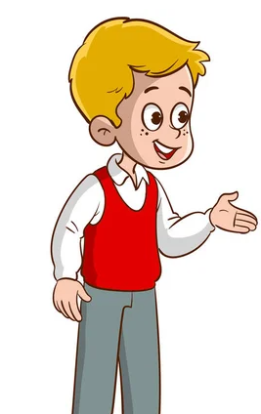
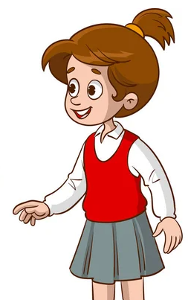
a. In pairs: Practice the conversation. Swap roles and repeat.
Note: remember to pronounce the /dʒ/ sound in words in the conversation.

Slide 17
Bob: I was sitting in a traffic jam when I noticed an interesting sight. Lucy: What happened? Bob: A man was pulling a kayak on the sidewalk. He pulled it all the way to the river and got on it. Lucy: Oh. Bob: And he was wearing a business suit. I thought that was strange. Lucy: What happened after that? Bob: He went away on his kayak. I found out later he was going to work. Lucy: That's very smart! Bob: Yeah. The city should encourage more people to do that.

Slide 18
b. Make two more conversations using the ideas on the right.
Bob: I was ____ when ____. Lucy: What happened? Bob: ____
Lucy: Oh. Bob: ____.
Lucy: What happened after that? Bob: ____ Lucy: That's very ____! Bob: ____. The city should ____.

Slide 19
Conversation 1:
walking to school - I saw an accident
A pedestrian wasn't looking, and a bike didn't stop at the crosswalk.
The pedestrian was looking at her phone when she got hit.
I helped the woman. She got hurt pretty badly.
kind of you
Thanks – ban using phones when walking. It's dangerous.
Bob: I was ____ when ____. Lucy: What happened? Bob: ____
Lucy: Oh. Bob: ____.
Lucy: What happened after that? Bob: ____ Lucy: That's very ____! Bob: ____. The city should ____.

Slide 20
Conversation 2:
reading in the park - something funny happened
A man was having a loud phone call with his wife.
Then an older woman walked to him and said "Shh! You're loud!"
He got uncomfortable and hung up.
funny
Yeah – encourage people to use their phones quietly
Bob: I was ____ when ____. Lucy: What happened? Bob: ____
Lucy: Oh. Bob: ____.
Lucy: What happened after that? Bob: ____ Lucy: That's very ____! Bob: ____. The city should ____.

Slide 21
Presentation
Speaking

Slide 22
a. Choose an event below that you experienced. In pairs: Student A, tell your partner about it. Talk about the context and what happened, then say if it's a problem in your city and give solutions to it. Student B, listen and ask questions.

Slide 24
You’ll never believe what happened to me today.
Oh, really. What happened?
I was walking to the grocery when there was a car accident at the intersection.
Was anyone hurt?
How did you feel?
Luckily! no one injured. But there’s quite a bit damage to both cars.
You’re right. Maybe they should reduce the speed limit in this area.
It’s scary. I think the city should do something about this intersection.

Slide 25
b. What other problems does your city have? How can the city fix them.
The pollution is bad. I think our city should plant more trees and build more parks.

Slide 26
Share your ideas with the class.
Many children beg on the streets. I think …….

Slide 27
CONSOLIDATION

Slide 28
Practice the /dʒ/ sound.
1. Encourage
2. June
3. Gym
4. Judge
5. Dangerous
6. Soldier
7. Change
8. Engine
9. Huge
10. Traffic jam

Slide 29
WRAP-UP

Slide 30
Today’s lesson
Pronunciation:
Practicing the /dʒ/ sound
Speaking:
Talking about city problems and how to fix them.

Slide 31
Homework
Practice saying the /dʒ/ sound.
Do the writing exercise on page 39 - WB
Prepare for the next lesson (Vocabulary & Listening - pages 68 & 69 - SB).
Play the consolidation games on www.eduhome.com.vn

Slide 32
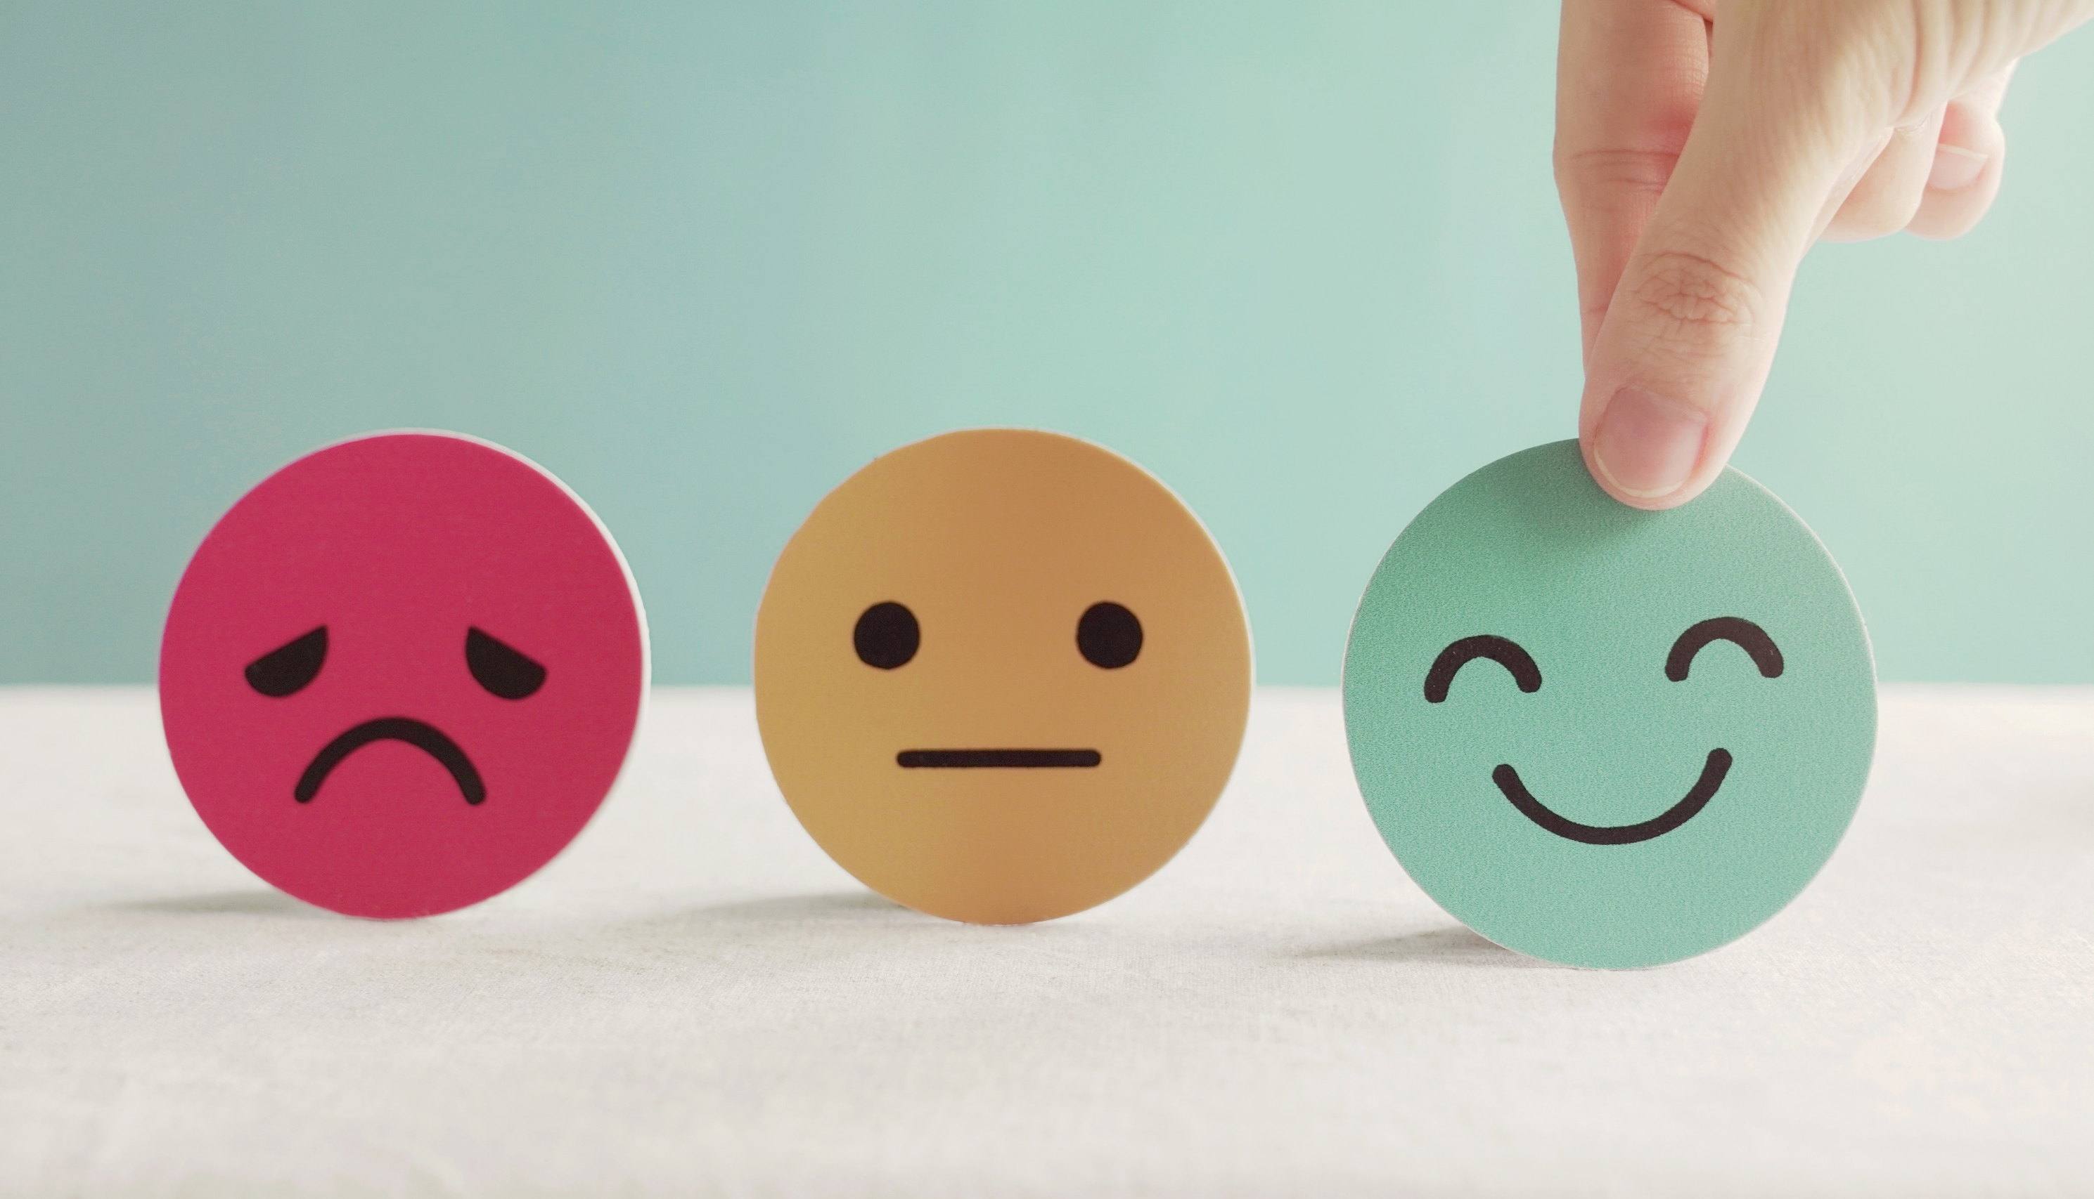
Lesson 3
Stay positive and have a nice day!

