Slide 1
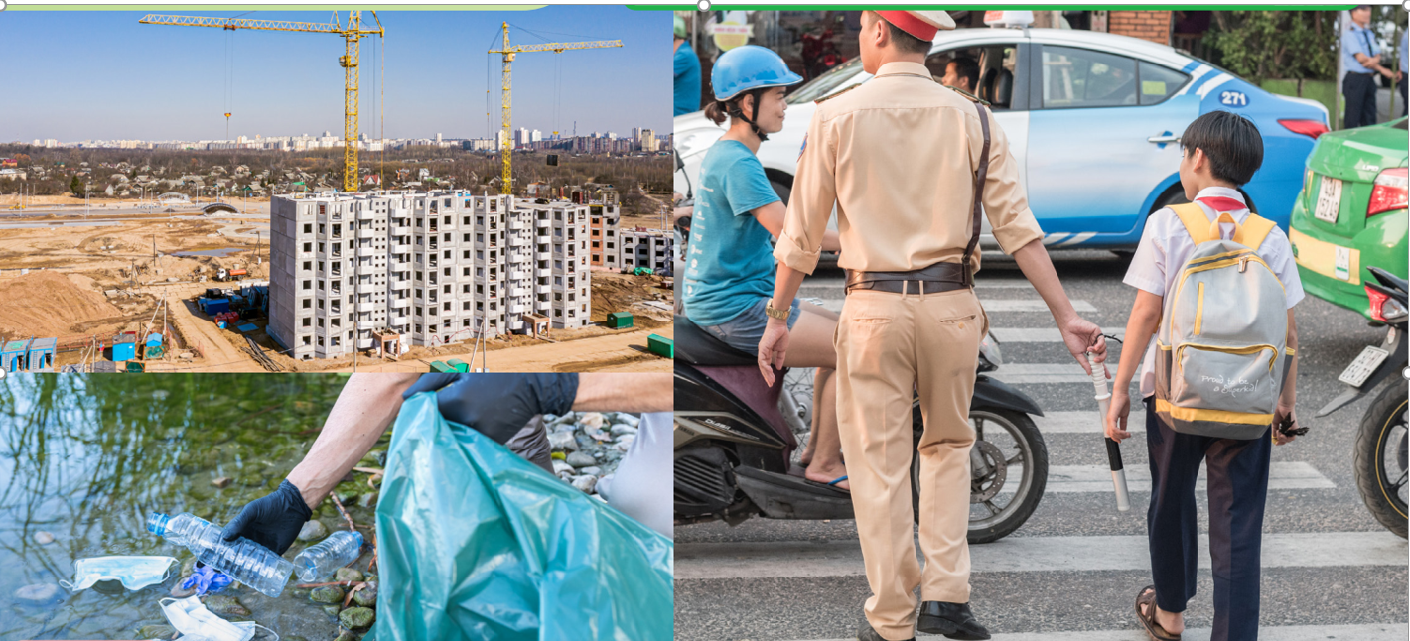
Q1:Where is itslife?
=>A1:It is an urban life
Q2: What is happening?
A2: population in cities is rising.
vehicles driving crosswalk
Q3: Why do people and governments do these things?
A3:They want to have a better urban life

Slide 2

Period 83.Unit 7: Urban life
Lesson 2.1: Vocab & Listening
Pages 68 & 69

Slide 3

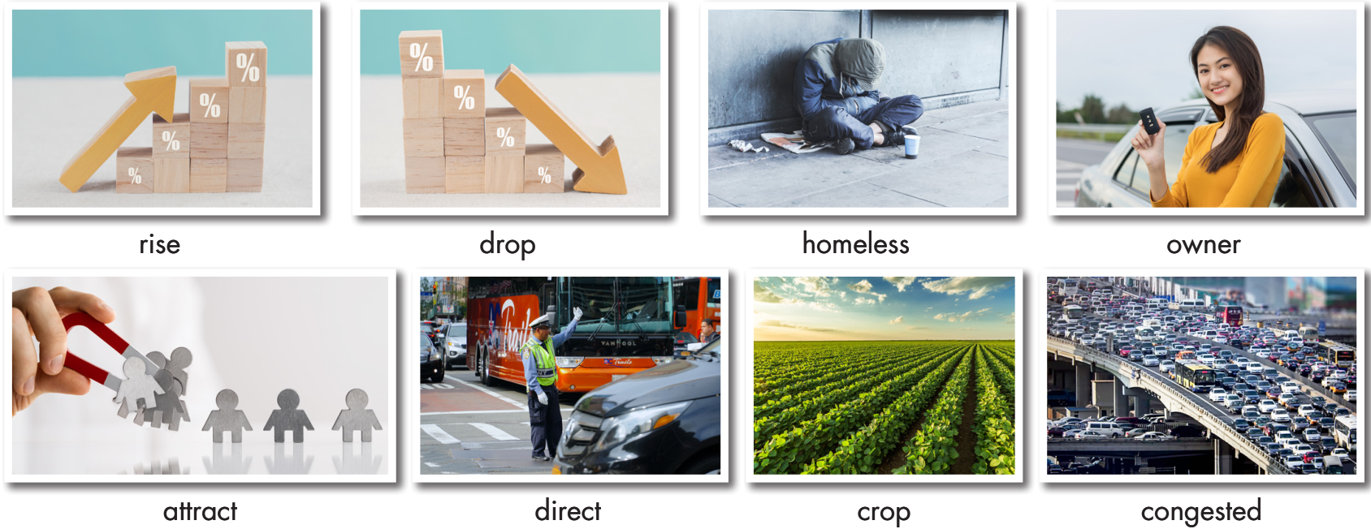
a. Look at the pictures and fill in the blanks.

Slide 4


a. Look at the pictures and fill in the blanks.
Listen and check.
1. ___________: a plant that farmers grow for food
2. ___________: become a lower amount or number
3. ___________: crowded or full of traffic
4. ___________: someone who owns something
5. ___________: having no home and living on the streets
crop
drop
congested
owner
homeless

Slide 5
a. Look at the pictures and fill in the blanks.
Listen and check.
6. _________: make someone come somewhere or take part in something
7. _________: become a higher amount or number
8. _________: control or be in charge of something or somebody
attract
rise
direct

Slide 6
Listen and repeat. Click on each phrase to hear the sound.
crop (n) / krɑːp / vụ mùa
drop (v) / drɑːp / giảm xuống
congested (adj) / kənˈdʒestɪd / tắc nghẽn
owner (n) / ˈoʊnər / người chủ
homeless (adj) / ˈhoʊmləs / vô gia cư
attract (v) / əˈtrækt / thu hút
rise (v) / raɪz / tăng lên
direct (v) / daɪˈrekt / / dɪˈrekt / chỉ huy, điều khiển
Notes:
GV click vào từng cụm nghe âm thanh

Slide 7
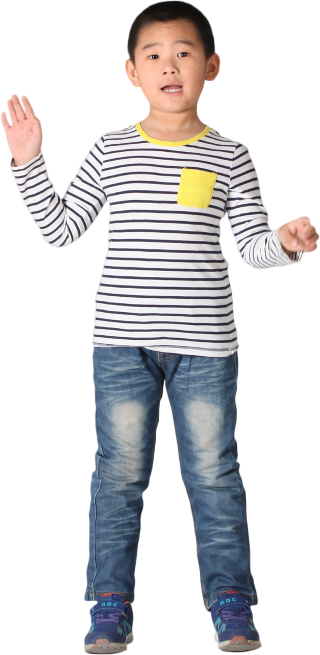

b. In pairs: Use the new words to talk about changes in your area.
There are lots of new store owners.
The population here is rising.

Slide 8
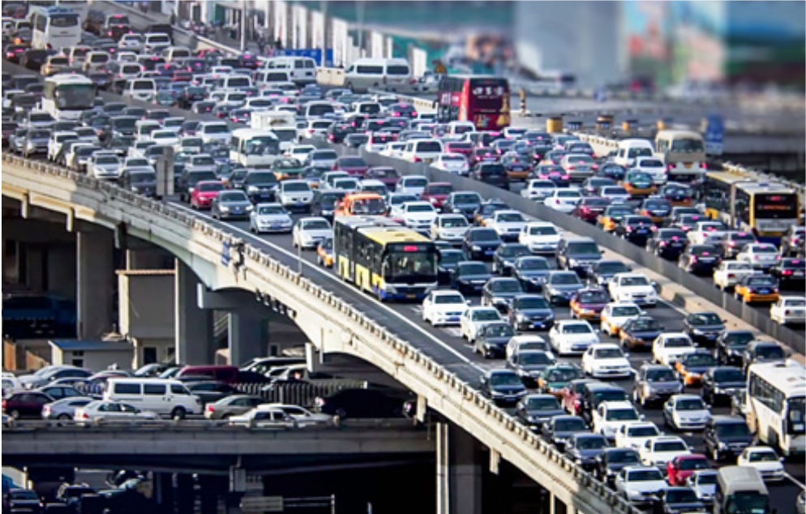
Suggested answer
1. The streets are getting more congested.

Slide 9
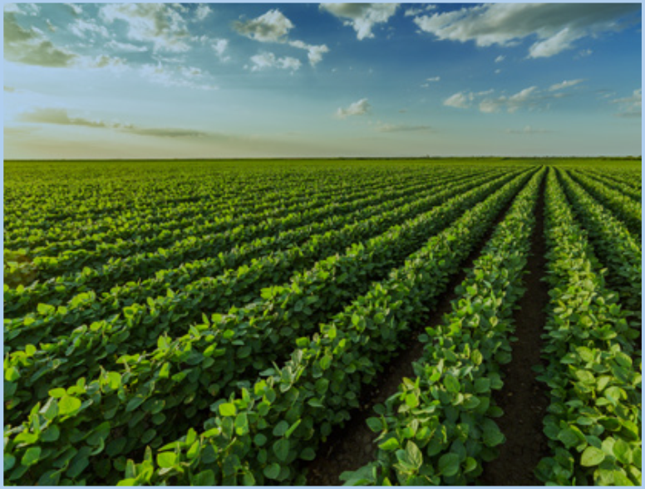
Suggested answer
2. The farmers are trying to grow new crops.

Slide 10

Suggested answer
3. The government is trying to attract people to build more shopping malls and apartments.

Slide 11
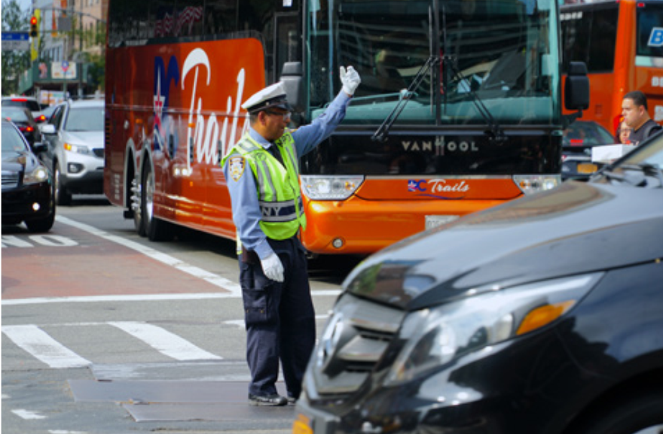
Suggested answer
4. The police officer helps direct vehicles and pedestrians, improving safety on the streets.

Slide 12
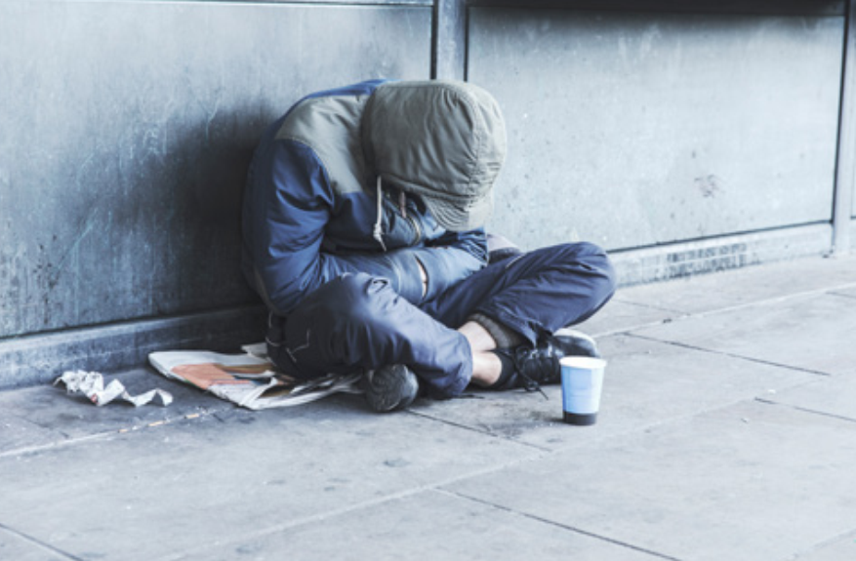
Suggested answer
5. Government should provide affordable housing to reduce the number of homeless people in the city.

Slide 13
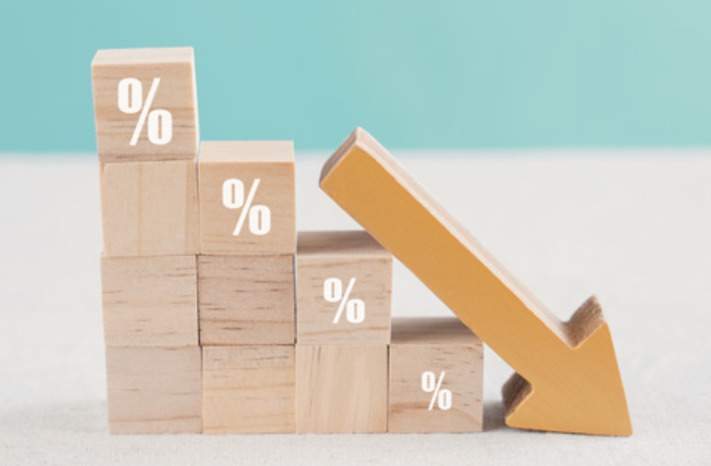
Suggested answer
6. More public transport, traffic congestion will dropp in the city center.

Slide 14


Slide 15
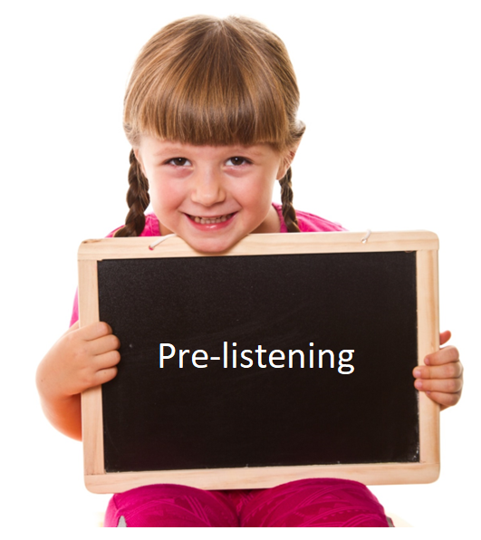
Pre-reading

Slide 16
Pre-listening
A:What problems in cities?
B:They are congestion, littering and population is rising
A:What are consequences of problems?
B:People are late for work, homeless, polution
A:What are good solutions?
B:Building more car stops, houses, giving trash cans

Slide 17
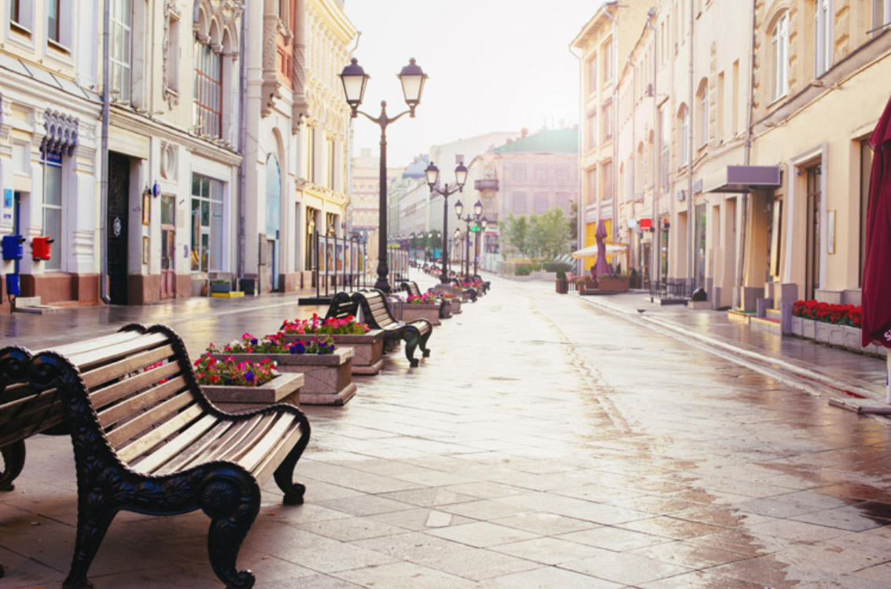
A.What can you see?
B:We can see Shopping mall, closed stores, no shoppers
A:What do you think about this?
B: I think it’s increasing in online shopping

Slide 18

While-listening

Slide 19

Listening 1
a. Listen to Joe and Lily talking about their presentation. What are they mainly talking about?
Solutions to problems
What will happen because of problems
Causes of problems
Consequences of problems

Slide 20
Listening 2
Read the statements and guess what type of words are missing. Are they verbs?/ nouns? / adjectives? etc.?
1. Joe thinks that there won't be enough ____________________.
2. Joe doesn't understand why ____________________________.
3. People are __________________________________ too much.
4. Too many store owners are _____________________________.
5. Lily thinks that the government will need to ________________ to the area.
noun / noun phrase
clause (S + V)
V-ing
V-ing
verb

Slide 21

While-listening
b. now, listen and fill in the blanks.
1. Joe thinks that there won't be enough ____________________.
people to work
Joe: Yeah, it's dropping so quickly that there won't be enough people to work at local businesses.
2. Joe doesn't understand why ____________________________.
(some) school will close
Lily: I agree. I also think it's such a big problem that some schools will close.
Joe: Sorry, can you explain that? I don't understand.
3. People are __________________________________ too much.
littering in the parks
Lily: OK, Joe. Next. People are littering in the parks too much.

Slide 22
While-listening
b. now, listen and fill in the blanks.
4. Too many store owners are _____________________________.
closing their businesses
Joe: Last one. Too many store owners are closing their businesses.
5. Lily thinks that the government will need to __________________________ to the area.
attract more businesses
Lily: I think there's such a decrease in stores that the government will need to attract more businesses to the area.

Slide 23
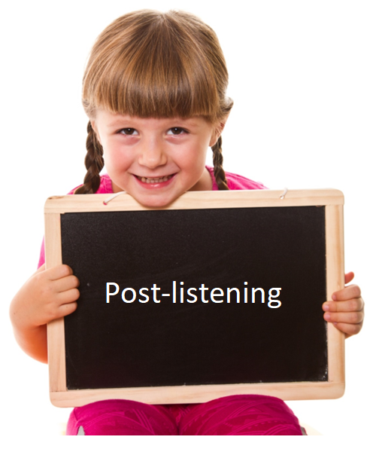
Post-reading

Slide 24

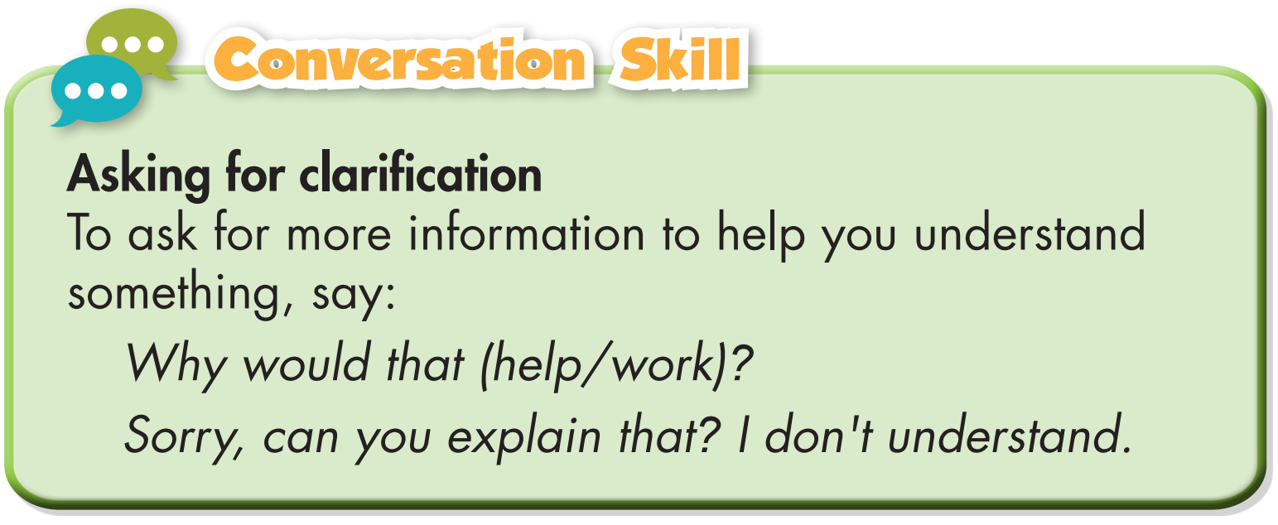
Post-listening
c. Read the Conversation Skill box, then listen and repeat.

Slide 25
Post-listening
d. Listen the conversation again and circle the phrase that you hear.

Slide 26
A: Which problem that Lily and Joe discuss do you think is the biggest? Why?
B:I think the biggest problem may be rising population that there won’t be enough people to work and some schools will close.
A: What should we do
A: We should reduce population and traffic in urban life

Slide 27
HOME WORK :
1.Learn vocabulary by heart and make more sentences
2.Prepare the next lesson : Grammar( page 69-70)
3.Do exercise . Reading c. in workbook. (page 39).

Slide 28

WRAP-UP

Slide 29

Today’s lesson
Vocabularies
1. rise
2. drop
3. homeless
4. owner
5. attract
6. direct
7. crop
8. congested

Slide 30
Today’s lesson
Vocabulary:
- Using new words to describe problems in cities and their future impacts.
Reading:
- Listening for the main idea and specific information.

Slide 31
Homework
Do Vocabulary and Listening in WB page 40
Make sentences using the new words in SB
Prepare for the next lesson (Grammar - pages 69 & 70 - SB)
Play the consolidation games on www.eduhome.com.vn

Slide 32
Script:
Joe: We need to plan our class presentation on the future of our city, Lily.
Lily: OK. The first problem is that the population is dropping.
Joe: Yeah, it's dropping so quickly that there won't be enough people to work at local businesses.
Lily: I agree. I also think it's such a big problem that some schools will close.
Joe: Sorry, can you explain that? I don't understand.

Slide 33
Lily: Well, if there aren't many people living here, fewer
kids will go to schools, and some of them will need to close.
Joe: Oh. Yeah. We should talk about that.
Lily: OK, Joe. Next. People are littering in the parks too much.
Joe: Hmm. Yeah, they're littering so much that the government will have to put more bins in the parks.
Lily: Yeah, that would help. I think they'll also have to organize a clean-up.
Joe: Good idea. Let's talk about that.

Slide 34
Lily: OK.
Joe: Last one. Too many store owners are closing their businesses.
Lily: I think there's such a decrease in stores that the government will need to attract more businesses to the area.
Joe: Yeah. If they don't, people will have to travel a long way to get food and other things. That will make the streets become more congested.
Lily: Exactly!

