Slide 1
Unit 7: Urban life
Lesson 1.2: Grammar
Pages 65 & 66

Slide 2
Lesson Outline
Warm-up
Presentation
Practice
Production
Consolidation
Wrap-up

Slide 3
By the end of this lesson, students will be able to…
- use the past continuous in speaking and writing

Slide 4
WARM-UP

Slide 5
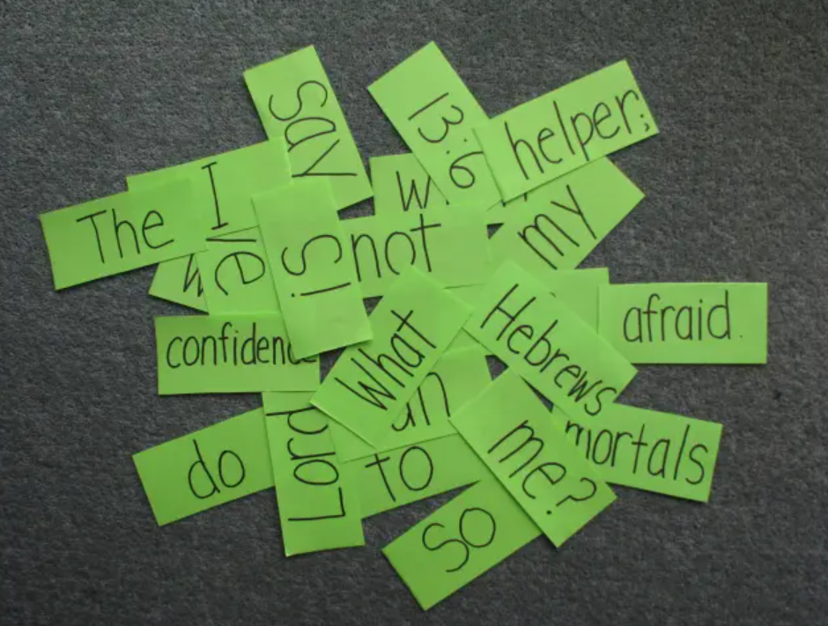
Warm-up
Competition Time
- Work in groups of 5
- Unscramble the words to make sentences.
- Which team has the most correct answers will win.
- Time limit: 5 minutes

Slide 6
Warm-up
Example:
to / was walking / the store / I / when / a / festival. / I / street / saw
Answer:
I was walking to the store when I saw a street festival.

Slide 7
Unscramble the words to make the sentences.
Mary / when / cut herself. / was chopping / she / onions
tripped and fell / while / a bus / was getting off./ My father / he
he / the magician / a new magic trick / was practicing / While / himself. / hurt
at / he / 6 p.m. yesterday./ was snowboarding
surfing / while / the internet / their children / video games./ They were / were playing
performance / We / for / our / all yesterday afternoon./ were practicing

Slide 8
Answers:
Mary was chopping onions when she cut herself.
My father tripped and fell while he was getting off a bus.
While the magician was practicing a new magic trick, he hurt himself.
He was snowboarding at 6 p.m. yesterday.
They were surfing the internet while their children were playing video games.
We were practicing for our performance all yesterday afternoon.

Slide 9
Presentation

Slide 10
Read the sentences again, highlight the past continuous and simple past.
Mary was chopping onions when she cut herself.
My father tripped and fell while he was getting off a bus.
While the magician was practicing a new magic trick, he hurt himself.
He was snowboarding at 6 p.m. yesterday.
They were surfing the internet while their children were playing video games.
We were practicing for our performance all yesterday afternoon.

Slide 11
Read the sentences again, match them to the following statements.
a. An action in progress at a specific time in the past.
____________
b. Two or more actions in progress at the same time in the past.
____________
c. A past action in progress when another action in the Past Simple interrupted it.
____________
d. An action in progress for a period of time in the past.
____________

Slide 12
Answers:
a. An action in progress at a specific time in the past. __________
b. Two or more actions in progress at the same time in the past.
____________
c. A past action in progress when another action in the Past Simple interrupted it. ________________
d. An action in progress for a period of time in the past.
____________
sentence 4
sentence 5
sentences 1, 2, 3
sentence 6

Slide 13
1. One past action was happening and another action in the Past Simple interrupted it.
While + S + Past continuous, S + Past Simple
While the magician was practicing a new magic trick, he hurt himself.
S + Past Simple + while + S + Past continuous
My father tripped and fell while he was getting off a bus.
S + Past continuous when S + Past Simple
Mary was chopping onions when she cut herself.

Slide 14
2. Two or more actions were happening at the same time in the past.
While + S + Past continuous, S + Past continuous
While They were surfing the internet, their children were playing video games.
S + Past continuous while S + Past continuous
They were surfing the internet while their children were playing video games.

Slide 15
3. An action was happening at a specific time in the past.
He was snowboarding at 6 p.m. yesterday.
At 6 p.m. yesterday, He was snowboarding.

Slide 16
4. An action was happening for a period of time in the past.
We were practicing for our performance all yesterday afternoon.
All yesterday afternoon, we were practicing for our performance.

Slide 17
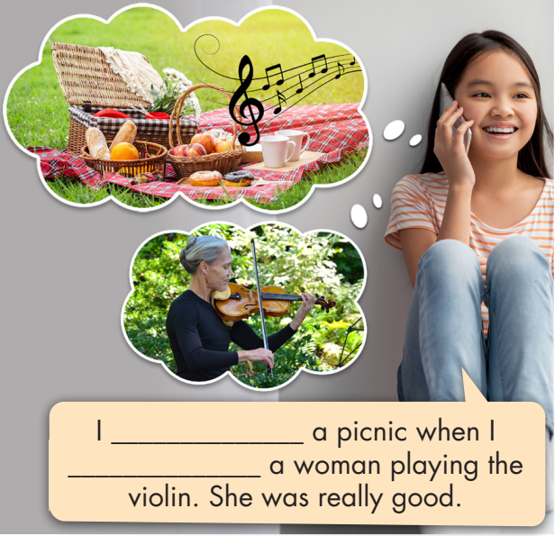
a. Read about the Past Continuous, then fill in the blanks.

Slide 18
b. Listen and check. Listen again and repeat.
I ________________ a picnic when I __________ a woman playing the violin. She was really good.
was having
heard

Slide 19
Affirmative: S + was/were + V-ing
I was riding my bike while he was riding the bus. You were shopping for two hours yesterday. He/She/It was riding the train at 5 p.m. last Friday. We/You/They were playing when we/you/they saw some trash.

Slide 20
Negative: S + wasn’t/weren’t + V-ing
I was not walking to school while you were sleeping. You were not riding the bus all day today. He/She/It was not working at 7 p.m. yesterday. We/You/They were not driving when we/you/they saw the dog.

Slide 21
Yes/No questions: Was/Were + S + V-ing?
Was I cycling while you were walking? Were you eating at 7 p.m. yesterday? Was he/she/it dining at 7 p.m. yesterday? Were we/you/they building when the rain started?

Slide 22
Short answers: Yes, S + was/were.
No, S + wasn’t/weren’t.
Yes, you were. No, you weren't. Yes, I was. No, I wasn't. Yes, he/she/it was. No, he/she/it wasn't. Yes, we/they were. No, we/they weren't.

Slide 23
Wh-questions: Wh-word + was/were + S + V-ing?
What were you doing all day last Saturday? Where were you eating at 6 p.m. last night? Who was he/she/it talking to while I was driving?

Slide 24
Note:
We use when for a past action in progress when an action in the Past Simple interrupted it, and while to talk about two or more actions in progress at the same time in the past.

Slide 25
Presentation
Practice

Slide 26
c. Fill in the blanks with the correct form of the verbs.
1. My mom ___________ for us to come home at 7 p.m. last night. 2. We ___________ (travel) to Vũng Tàu for a holiday when we ___________ (see) an accident. 3. For years, pedestrians ___________ (cross) anywhere they wanted to because there weren't any crosswalks. 4. I ___________ (tell) my mom about the new sports center while my dad ___________ (drive) us to the restaurant. 5. Everyone ___________ (sit) quietly on the bus when a woman ___________ (start) having a very loud phone call.

Slide 27
c. Fill in the blanks with the correct form of the verbs.
1. My mom ___________ for us to come home at 7 p.m. last night. 2. We _____________ (travel) to Vũng Tàu for a holiday when we ___________ (see) an accident. 3. For years, pedestrians ______________ (cross) anywhere they wanted to because there weren't any crosswalks. 4. I ___________ (tell) my mom about the new sports center while my dad ______________ (drive) us to the restaurant. 5. Everyone ___________ (sit) quietly on the bus when a woman _____________ (start) having a very loud phone call.
was waiting
was traveling
saw
were crossing
was telling
was driving
was sitting
started

Slide 28
Extra Practice
WB – P39
Fill in the blanks with the correct form of the verbs.
The government banned cars in the city center because traffic jams ________________ (get) worse.
I _________________ (talk) to my friend while the bus ________________ (arrive).
A pedestrian ________________ (cross) the street when a motorbike ________________ (hit) her.
were getting
was talking
was arriving
was crossing
hit

Slide 29
Extra Practice
WB – P39
Fill in the blanks with the correct form of the verbs.
The city made crosswalks and sidewalks colorful because accidents involving pedestrians ________________ (increase).
People _________________ (struggle) to cross the street all day today. There was so much traffic.
Workers ________________ (fix) the road outside my house at 6 a.m. this morning.
were increasing
were struggling
were fixing

Slide 30
d. Write sentences using the prompts.
1. We/ride/our bikes home/when/a car/stop/in front of us We were riding our bikes home when a car stopped in front of us.
2. Volunteers/pick up/trash/the park/all day yesterday _____________________________________________________ 3. They/work on/new apartment building/while/I/try/sleep _____________________________________________________
Volunteers were picking up trash in the park all day yesterday.
They were working on the new apartment building while I was trying to sleep.

Slide 31
d. Write sentences using the prompts.
4. I/walk/school/with/brother/7 a.m./this morning _____________________________________________________ 5. The mayor/give/speech/when/some noisy people/interrupt /him _____________________________________________________
_____________________________________________________
I was walking to school with my brother at 7 a.m. this morning.
The mayor was giving a speech when some noisy people interrupted him.

Slide 32
Extra Practice
WB – P39
Write sentences using the prompts.
1. we/wait for bus/when/accident/happen We were waiting for the bus when an accident happened.
2. at 7 a.m./morning/workers/fix/road/outside my window _____________________________________________________
3. while/we/walk/school/my friend/complain/about/pollution _____________________________________________________
At 7 a.m. this morning, workers were fixing the road outside my
window.
While we were walking to school, my friend was complaining about the pollution.

Slide 33
Extra Practice
WB – P39
Write sentences using the prompts.
4. pedestrians/wait/more/ten minutes/cross/street/this morning _____________________________________________________
5. we/walk/home/while/my mom/cook/dinner _____________________________________________________
Pedestrians were waiting more than ten minutes to cross the street this morning.
We were walking home while my mom was cooking dinner.

Slide 34
Presentation
Production

Slide 35
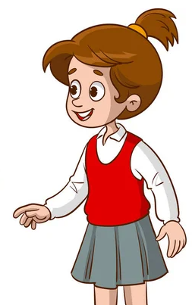
e. In pairs: Use the prompts to make sentences using the Past Continuous.
• ride/bike to school/have an accident • neighbor/sing/so loudly/11 p.m. /last night • large group/noisy people/have/ picnic/we/try/relax in park • I/talk/about soccer/with/ brother/ all night
1. I was riding my bike to school when I had an accident.

Slide 36
Suggested Answers:
2. neighbor/sing/so loudly/11 p.m. /last night _____________________________________________________
3. large group/noisy people/have/ picnic/we/try/relax in park
_____________________________________________________
My neigbor was singing so loudly at 11 p.m. last night.
A large group of noisy people was having a picnic while we were trying to relax in the park.
4. I/talk/about soccer/with/ brother/ all night ____________________________________________________
I was talking about soccer with my brother all night.

Slide 37
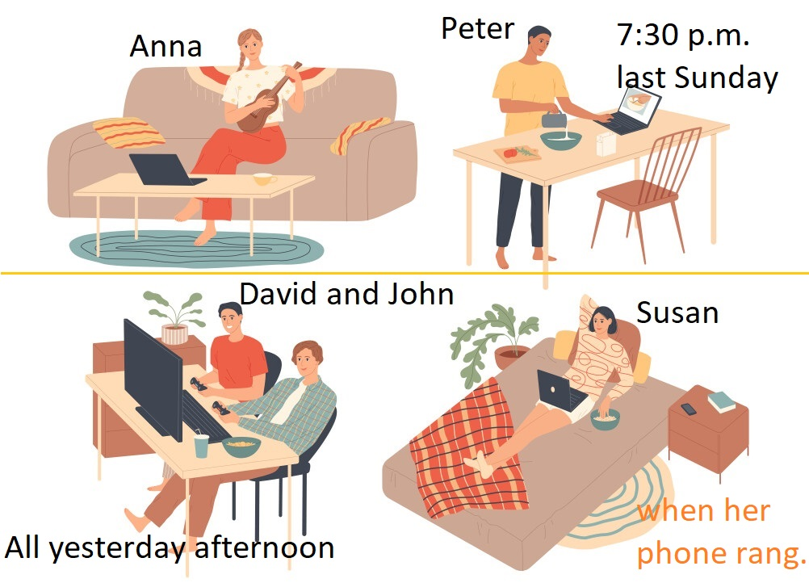
Extra Practice
In groups of 3-4: Look at the pictures and talk about leisure activities with your partners.

Slide 38
Suggested Answers:
At 7:30 p.m. last Sunday, Peter was learning to cook.
At 7:30 p.m. last Sunday, Anna was learning to play Ukulele.
At 7:30 p.m. last Sunday, Peter was learning to cook while Anna was learning to play Ukulele.
David and John were playing video games together all yesterday afternoon.
Susan was watching films on her laptop when her phone rang.

Slide 39
CONSOLIDATION

Slide 40
Read and explain why we can use the past continuous.
At 7:30 p.m. last Sunday, Peter was learning to cook.
At 7:30 p.m. last Sunday, Anna was learning to play Ukulele.
→ Sentences 1 & 2: describe an action happening at a specific time in the past.

Slide 41
Read and explain why we can use the past continuous.
3. At 7:30 p.m. last Sunday, Peter was learning to cook while Anna was learning to play Ukulele.
→ Sentence 3: describes two actions happening at the same time in the past.

Slide 42
Read and explain why we can use the past continuous.
4. David and John were playing video games together all yesterday afternoon.
→ Sentence 4: describes an action happening for a period of time in the past.
5. Susan was watching films on her laptop when her phone rang.
→ Sentence 5: describes one past action happening and another action in the Past Simple interrupted it.

Slide 43
WRAP-UP

Slide 44
Today’s lesson
Grammar: The Past Continuous
We can use the Past Continuous to describe:
one past action happening and another action in the Past Simple interrupted it.
an action happening at a specific time in the past.
an action happening for a period of time in the past.
two or more actions happening at the same time in the past.

Slide 45
Homework
Review how to use the past continuous
Make sentences using the past continuous
Prepare for the next lesson (Pronunciation & Speaking - pages 66 & 67 - SB)
Play the consolidation games on www.eduhome.com.vn

Slide 46
Lesson 3
Stay positive and have a nice day!

