Slide 1
Unit 6: Natural Wonders
Lesson 3.2: Speaking & Writing
Page 63

Slide 2
Lesson Outline
Warm-up
Writing skill
Speaking
Writing
Consolidation
Wrap-up

Slide 3
By the end of this lesson, students will be able to…
Practice using non-defining relative clauses to write informative sentences.
Practice talking about amazing places around the world.
Write an article about Mount Everest.

Slide 4
WARM-UP

Slide 5
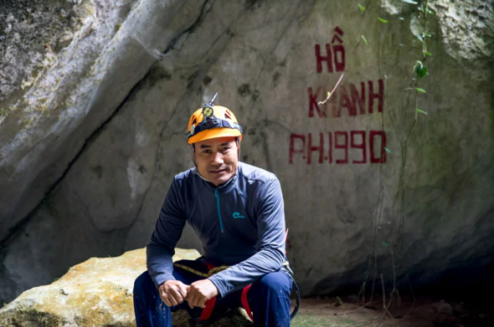
In pairs – Combine these two sentences about this man, then compare with your partner.
Mr. Hồ Khanh is a local man.
He discovered Sơn Đoòng cave in 1991

Slide 6
In pairs – Combine these two sentences about this man, then compare with your partner.
Answer
Mr. Hồ Khanh, who is a local man, discovered Sơn Đoòng cave in 1991.

Slide 7
In pairs – Look at this sentence and answer some questions
Answer
Mr. Hồ Khanh, who is a local man, discovered Sơn Đoòng cave in 1991.

Slide 8
In pairs – Look at this sentence and answer some questions
Mr. Hồ Khanh, who is a local man, discovered Sơn Đoòng cave in 1991.
1. Which is more important information? A local man or discovered Sơn Đoòng cave in 1991.
2. What puts after Mr. Hồ Khanh? What is it called?

Slide 9
Answer
In pairs – Look at this sentence and answer some questions
Mr. Hồ Khanh, who is a local man, discovered Sơn Đoòng cave in 1991.
1. Discovered Sơn Đoòng cave in 1991 is more important, and “a local man” is just additional information. If we omit that, the sentence still makes sense.
2. A comma and “who” put after Mr. Hồ Khanh? It’s called a relative pronoun.

Slide 10
Writing
skill

Slide 11
Task a.
Read about using non-defining relative clauses, then read the article about Sơn Đoòng again. Underline the non-defining relative clauses.
Using non-defining relative clauses to write informative sentences
We can add additional information about a subject using non-defining relative clauses.

Slide 12
Task a.
Read the use of non-defining relative clauses, then read the article about Sơn Đoòng again. Underline the non-defining relative clauses.
The relative pronouns/adverbs who, which, when, and where introduce non-defining relative clauses. The clauses are separated from the sentence with commas. We can't use the relative pronoun “that” with non-defining relative clauses.

Slide 13
Task a.
Read the use of non-defining relative clauses, then read the article about Sơn Đoòng again. Underline the non-defining relative clauses.
Relative adverbs “when” “where” tell us about the time or place. Relative pronouns “who” “which” refer to the people or things.
e.g. Kami Rita Sherpa, who is 52 years old, has climbed Mount Everest more than anyone else.

Slide 14
Task a.
Read the use of non-defining relative clauses, then read the article about Sơn Đoòng again. Underline the non-defining relative clauses.
e.g. Victoria Falls, which is on the border of Zambia and Zimbabwe, is one of the natural wonders of the world.
The cave, where you can find many different types of bats, is popular with tourists.
The summer, when the weather is the warmest, is the best time to visit.

Slide 15
Task b.
Read the article about Sơn Đoòng again. Underline the non-defining relative clauses.
Next on our list is Sơn Đoòng Cave. It's one of the most impressive natural wonders in the world. You can find it in Quảng Bình Province, Vietnam. It is over 9 km long, up to 150 m wide, and up to 200 m deep. An underground river, which runs through the cave, created the cave's shape millions of years ago. Overall, it is 38.5 million m³ (cubic meters) in size.

Slide 16
Task b.
Read the article about Sơn Đoòng again. Underline the non-defining relative clauses.
This makes it the largest known cave passage in the world by volume. Mr. Hồ Khanh, who is a local man, discovered the cave in 1991. He found it again in 2008, and that was when the world first heard about the cave. You can only visit Sơn Đoòng Cave from January to August.

Slide 17
Task b.
Read the article about Sơn Đoòng again. Underline the non-defining relative clauses.
After August, heavy rains, which cause flooding, make it very difficult to get in and out of the cave. There is only one way to visit the cave. There is a special five-day tour, which has cave experts and tour guides. It's a challenging but unique experience, which you should try when you visit this cave. However, the number of visitors each year is limited to protect the cave from damage.

Slide 18
Answer
Task b.
Read the article about Sơn Đoòng again. Underline the non-defining relative clauses.
Next on our list is Sơn Đoòng Cave. It's one of the most impressive natural wonders in the world. You can find it in Quảng Bình Province, Vietnam. It is over 9 km long, up to 150 m wide, and up to 200 m deep. An underground river, which runs through the cave, created the cave's shape millions of years ago. Overall, it is 38.5 million m³ (cubic meters) in size.

Slide 19
Answer
Task b.
Read the article about Sơn Đoòng again. Underline the non-defining relative clauses.
This makes it the largest known cave passage in the world by volume. Mr. Hồ Khanh, who is a local man, discovered the cave in 1991. He found it again in 2008, and that was when the world first heard about the cave. You can only visit Sơn Đoòng Cave from January to August.

Slide 20
Answer
Task b.
Read the article about Sơn Đoòng again. Underline the non-defining relative clauses.
After August, heavy rains, which cause flooding, make it very difficult to get in and out of the cave. There is only one way to visit the cave. There is a special five-day tour, which has cave experts and tour guides. It's a challenging but unique experience, which you should try when you visit this cave. However, the number of visitors each year is limited to protect the cave from damage.

Slide 21
Task c.
Rewrite the sentences using non-defining relative clauses and the given relative pronouns or adverbs.
Example
1. The Mayans were an ancient group of people in Mexico. They built Chichén Itzá. (who) __________________________________________________________________________________________________
The Mayans, who built Chichén Itzá, were an ancient group of people in Mexico.

Slide 22
Task c.
Rewrite the sentences using non-defining relative clauses and the given relative pronouns or adverbs.
2. Victoria Falls is 1.7 km wide. It is also known as "The Smoke That Thunders" in the local language. (which) ________________________________________________________________________________________________

Slide 23
Task c.
Rewrite the sentences using non-defining relative clauses and the given relative pronouns or adverbs.
3. The Great Barrier Reef is over 2,600 km long. 10% of all fish species live there. (where) ________________________________________________________________________________________________

Slide 24
Task c.
Rewrite the sentences using non-defining relative clauses and the given relative pronouns or adverbs.
4. Guanabara Bay is 31 km long and 28 km wide. It is in Rio de Janeiro, Brazil. (which) ____________________________________________________________________________________________________

Slide 25
Task c.
Rewrite the sentences using non-defining relative clauses and the given relative pronouns or adverbs.
5. Between August and April is the best time to see the Northern Lights. The sky is the clearest then. (when) ____________________________________________________________________________________________________

Slide 26
Answer
Task c.
Rewrite the sentences using non-defining relative clauses and the given relative pronouns or adverbs.
2. Victoria Falls is 1.7 km wide. It is also known as "The Smoke That Thunders" in the local language. (which) ________________________________________________________________________________________________
Victoria Falls, which is also known as "The Smoke That Thunders" in the local language, is 1.7 km wide.

Slide 27
Answer
Task c.
Rewrite the sentences using non-defining relative clauses and the given relative pronouns or adverbs.
3. The Great Barrier Reef is over 2,600 km long. 10% of all fish species live there. (where) ________________________________________________________________________________________________
The Great Barrier Reef, where 10% of all fish species live, is over 2,600 km long.

Slide 28
Answer
Task c.
Rewrite the sentences using non-defining relative clauses and the given relative pronouns or adverbs.
4. Guanabara Bay is 31 km long and 28 km wide. It is in Rio de Janeiro, Brazil. (which) ____________________________________________________________________________________________________
Guanabara Bay, which is in Rio de Janeiro, Brazil, is 31 km long and 28 km wide.

Slide 29
Answer
Task c.
Rewrite the sentences using non-defining relative clauses and the given relative pronouns or adverbs.
5. Between August and April is the best time to see the Northern Lights. The sky is the clearest then. (when) ____________________________________________________________________________________________________
Between August and April, when the sky is clearest, is the best time to see the Northern Lights.

Slide 30
Presentation
Speaking

Slide 31
You're doing research for an article about Mount Everest with a friend.
Student A, you have some information about Mount Everest, but you don’t know some other things about it. You will answer Student B's questions about Mount Everest. And then swap the role with student B.

Slide 32
Student A

Slide 33
Student A

Slide 34
Student A

Slide 35
Student B

Slide 36
Student B

Slide 37
Student B

Slide 38
Student B

Slide 39
Student A
Suggested questions and answers
Where is it? It’s on the border of Nepal and Tibet

Slide 40
Student A
Suggested questions and answers
Could you tell me some interesting facts about it?
It grows by around 4 mm a year.
It takes around thirty to forty days to climb it.

Slide 41
Student A
Suggested questions and answers
When is the best time to visit Mount Everest?
The weather is nicest between September–November and April–May.

Slide 42
Student A
Suggested questions and answers
How can we visit Mount Everest?
The hike to Everest Base Camp is 130 km.

Slide 43
Student B
Suggested questions and answers
How high is Mount Everest?
8,848 m above sea level
It is the highest point on Earth above sea level.

Slide 44
Student B
Suggested questions and answers
Could you tell me some interesting facts about it?
Around 3,000 people climbed to the summit.
The first people to climb to the summit were Edmund Hillary and Tenzing Norgay in 1952.

Slide 45
Student B

Slide 46
Student B
Suggested questions and answers
How can we visit Mount Everest?
Fly to Kathmandu, capital city of Nepal, and hike to Everest Base Camp
It takes around 14 days to hike to Everest Base Camp.

Slide 47
Presentation
Writing

Slide 48
Now, write an article about Mount Everest. Use the Writing Skill box, the reading model, and your speaking notes to help you. Write 100 to 120 words.

Slide 49
Suggested answers
Mount Everest, which is also called "Goddess Mother of the World", is a mountain on the border of Nepal and Tibet. The summit, which is 8,848 m high, is the highest point above sea level. It grows by around 4 mm a year. Only around 3,000 people have climbed to this summit.

Slide 50
Suggested answers
It takes around thirty to forty days to climb. Edmund Hillary and Tenzing Norgay, who were the first people to climb Everest, climbed it in 1952. September to November and April to May, when the weather is nicest, are the best times to visit. To get to Everest Base Camp, you can fly to Kathmandu, which is the capital city of Nepal, and hike to Everest Base Camp.

Slide 51
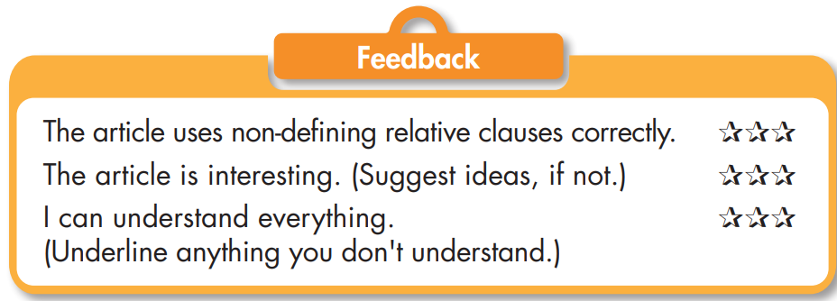
Let’s check your friend’s article and give your own feedback about his/her writing

Slide 52
Extra activities
Presentation

Slide 53
Extra practice - WB - page 37
Rewrite the sentences using non-defining relative clauses and the given relative pronouns or adverbs.
Example
1. Sơn Đoòng Cave is the largest known cave in the world. It's in Vietnam. (which)
Sơn Đoòng Cave, which is in Vietnam, is the largest known cave in the world.
__________________________________________________________________________________________________

Slide 54
Extra practice - WB - page 37
Rewrite the sentences using non-defining relative clauses and the given relative pronouns or adverbs.
2. Edmund Hillary and Tenzing Norgay climbed Mount Everest in 1952. They were the first people to ever climb it. (who) ________________________________________________________________________________________________

Slide 55
Extra practice - WB - page 37
Rewrite the sentences using non-defining relative clauses and the given relative pronouns or adverbs.
3. Summer is the best time to visit. It is warm and dry in the summer. (when) ______________________________________________________________________________________________

Slide 56
Extra practice - WB - page 37
Rewrite the sentences using non-defining relative clauses and the given relative pronouns or adverbs.
4. Finland is a great place to see the Northern Lights. Many people go there. (where) ______________________________________________________________________________________________

Slide 57
Extra practice - WB - page 37
Rewrite the sentences using non-defining relative clauses and the given relative pronouns or adverbs.
5. The Grand Canyon is one of the natural wonders of the world. It is in Arizona, USA. (which) __________________________________________________________________________________________________

Slide 58
Answers
Rewrite the sentences using non-defining relative clauses and the given relative pronouns or adverbs.
2. Edmund Hillary and Tenzing Norgay climbed Mount Everest in 1952. They were the first people to ever climb it. (who) ________________________________________________________________________________________________
Edmund Hillary and Tenzing Norgay, who were the first people to climb Mount Everest, climbed it in 1952.

Slide 59
Answers
Rewrite the sentences using non-defining relative clauses and the given relative pronouns or adverbs.
3. Summer is the best time to visit. It is warm and dry in the summer. (when) ______________________________________________________________________________________________
Summer, when it is warm and dry, is the best time to visit.

Slide 60
Answers
Rewrite the sentences using non-defining relative clauses and the given relative pronouns or adverbs.
4. Finland is a great place to see the Northern Lights. Many people go there. (where) ______________________________________________________________________________________________
Finland, where many people go, is a great place to see the Northern Lights.

Slide 61
Answers
Rewrite the sentences using non-defining relative clauses and the given relative pronouns or adverbs.
5. The Grand Canyon is one of the natural wonders of the world. It is in Arizona, USA. (which) __________________________________________________________________________________________________
The Grand Canyon, which is in Arizona, USA, is one of the natural wonders of the world.

Slide 62
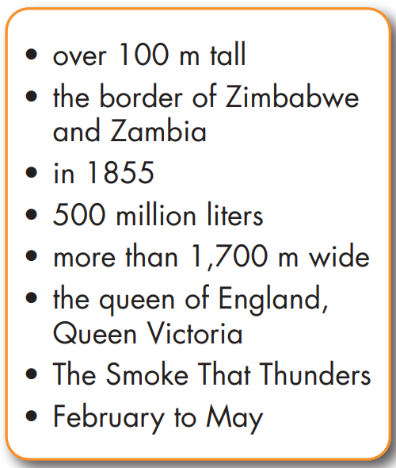
Victoria Falls
( ________________________)
Where:
It's on
__________________________
Size:
• It's ________________________
• It's ________________________

Slide 63
Interesting facts:
• David Livingstone first saw the waterfall __________
• He named it after _______________________
• __________ of water fall every minute

Slide 64
Best time to visit:
__________________________ water is strongest

Slide 65
Answers
Victoria Falls
( ________________________)
The Smoke That Thunders
Where:
It's on
__________________________
the border of Zimbabwe and Zambia
Size:
• It's ________________________
• It's ________________________
over 100 m tall
more than 1,700 m wide

Slide 66
Answers
Interesting facts:
• David Livingstone first saw the waterfall __________
• He named it after _______________________
• __________ of water fall every minute
in 1855
the queen of England, Queen Victoria
500 million liters

Slide 67
Answers
Best time to visit:
February to May
_____________________ water is strongest

Slide 68
Extra practice - WB - page 37
Now, write a paragraph about Victoria Falls. Use the Writing Skill box, the reading model, and your planning notes to help you. Write 100 to 120 words.

Slide 69
Suggested answers
Victoria Falls, which is also known as “The Smoke That Thunders,” is one of the natural wonders of the world. The waterfall, which is on the border of Zimbabwe and Zambia, is more than 100 m tall and over 1,700 m wide. It is very big and impressive.

Slide 70
Suggested answers
A man named David Livingstone, who first saw the waterfall in 1855, named it after the queen of England. On average, 500 million liters of water fall every minute. The best time to visit, when the water is the strongest, is between February and May. It is a really amazing place. I would love to travel there and see it.

Slide 71
CONSOLIDATION

Slide 72
Using non-defining relative clauses to write informative sentences
We can add additional information about a subject using non-defining relative clauses.

Slide 73
The relative pronouns/adverbs who, which, when, and where introduce non-defining relative clauses. The clauses are separated from the sentence with commas. We can't use the relative pronoun “that” with non-defining relative clauses.

Slide 74
Relative adverbs “when” “where” tell us about the time or place. Relative pronouns “who” “which” refer to the people or things.
e.g. Kami Rita Sherpa, who is 52 years old, has climbed Mount Everest more than anyone else.

Slide 75
e.g. Victoria Falls, which is on the border of Zambia and Zimbabwe, is one of the natural wonders of the world.
The cave, where you can find many different types of bats, is popular with tourists.
The summer, when the weather is the warmest, is the best time to visit.

Slide 76
WRAP-UP

Slide 77
Today’s lesson
Writing:
Practice using non-defining relative clauses to write informative sentences.
Write an article about Mount Everest.
Speaking:
Practice talking about amazing places around the world.

Slide 78
Homework
Practice and review writing skill in page 63 (SB)
Do exercise on page 37 – Writing skill and writing an article.
Prepare for the next lesson (Listening, Reading & Voc. - pages 103 & 104 - SB).
Play the consolidation games on www.eduhome.com.vn

Slide 79
Lesson 3
Stay positive and have a nice day!

