Slide 1
Unit 6: Natural Wonders
Lesson 2.2: Grammar
Pages 59 & 60

Slide 2
Lesson Outline
Warm-up
Presentation
Practice
Production
Consolidation
Wrap-up

Slide 3
By the end of this lesson, students will be able to…
Practice and use verb + gerund correctly
Make conversations about how you feel about doing the actions at natural wonders.

Slide 4
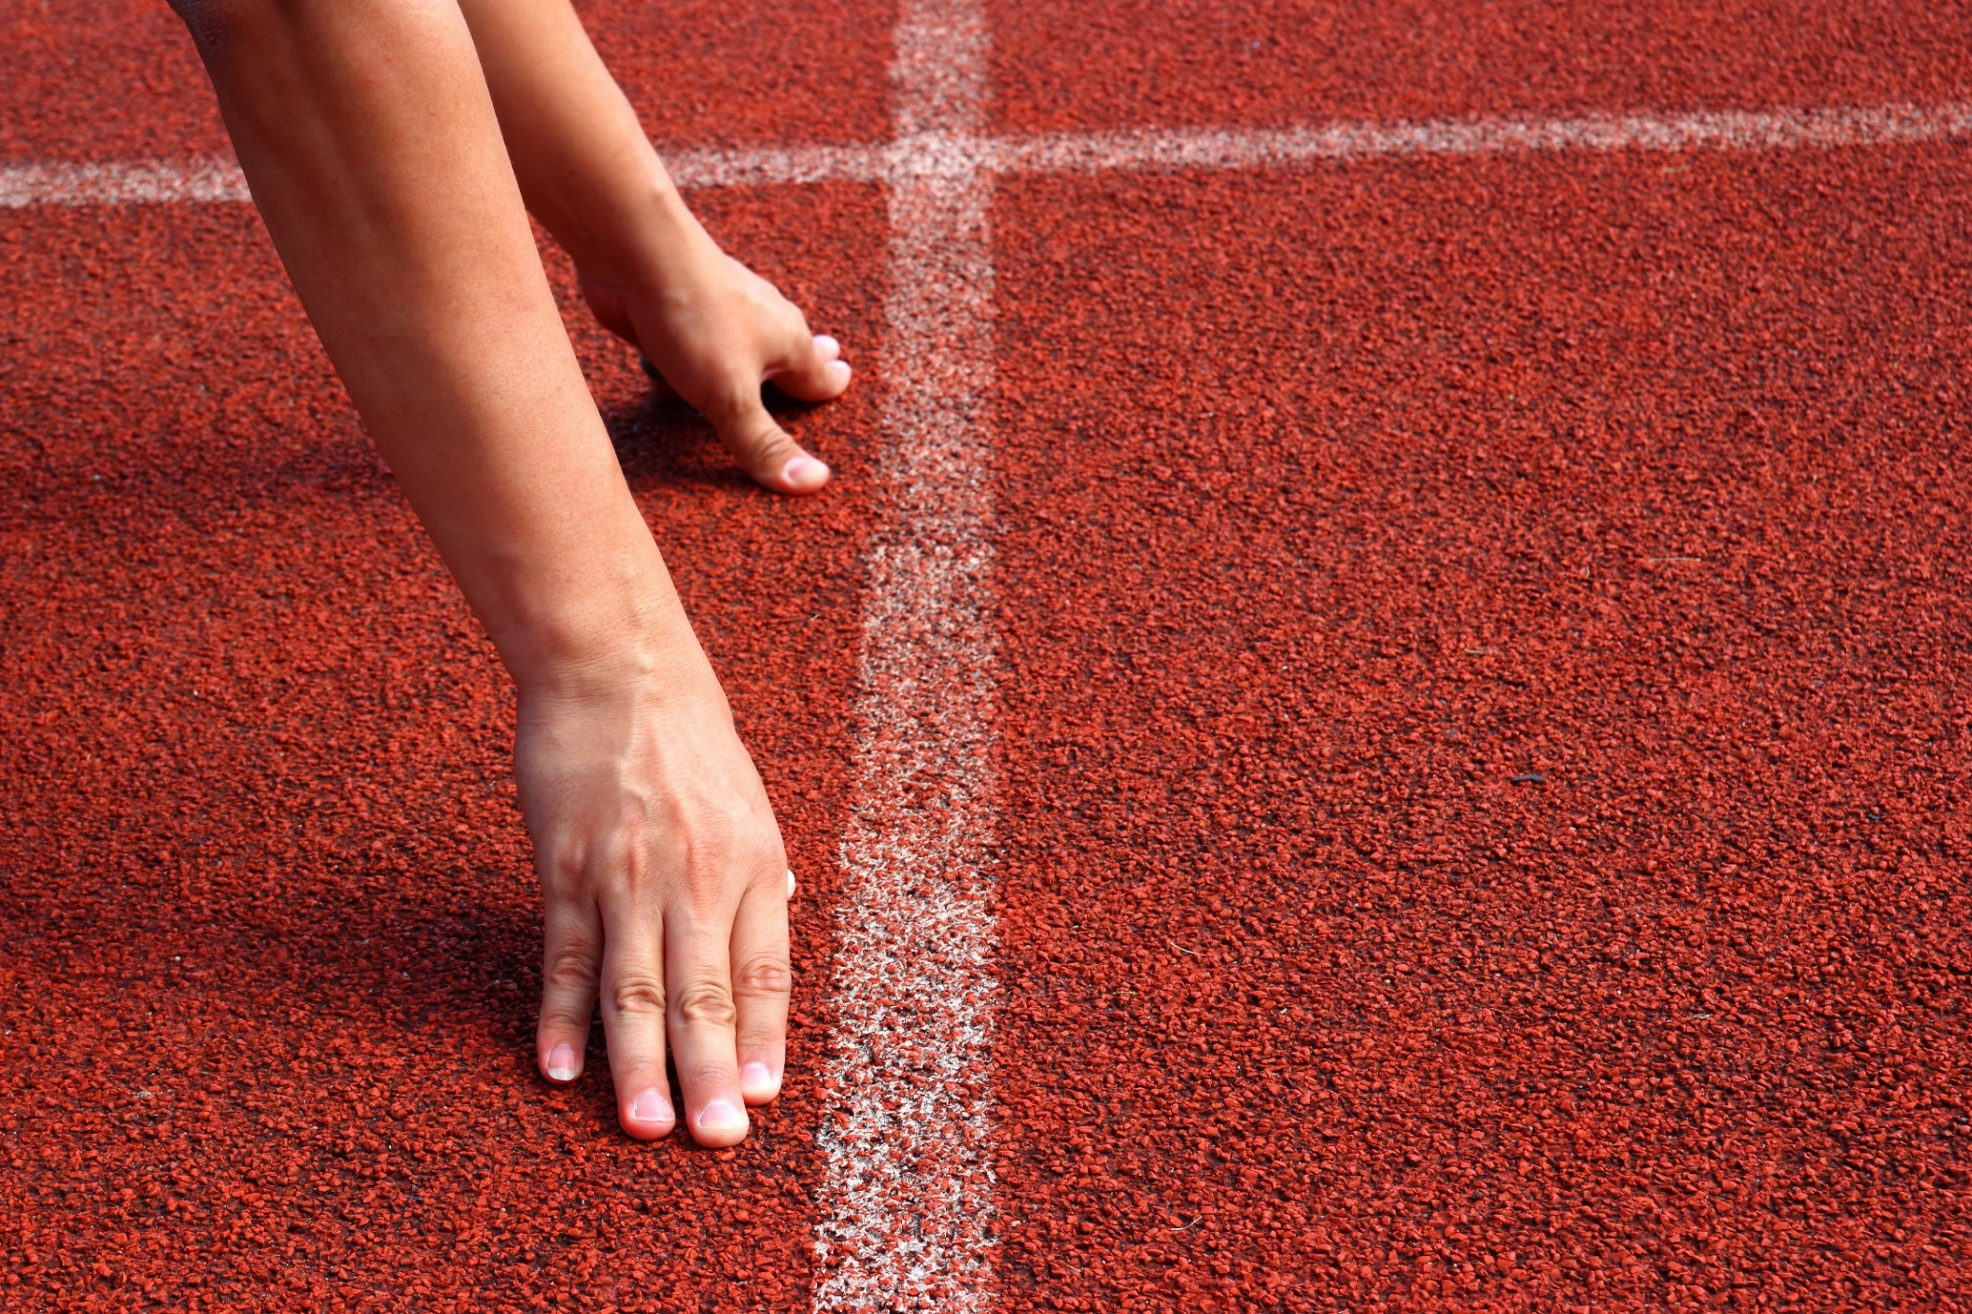
WARM-UP

Slide 5
MEMORY GAME:
Create groups/teams of 3 students.
You will look at some pictures that show things that people do at natural parks just 1 minute and then write down what you like or hate about them.
The team(s) with the most sentences win(s).
Time limit: 5 minutes

Slide 6
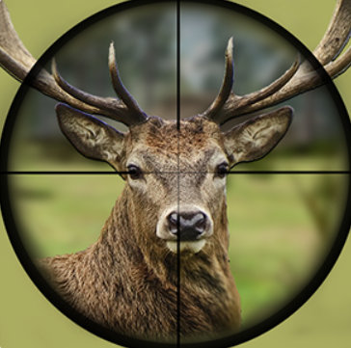
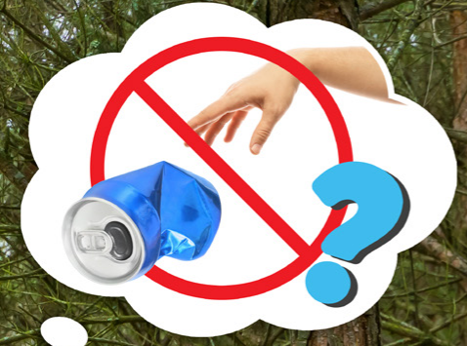
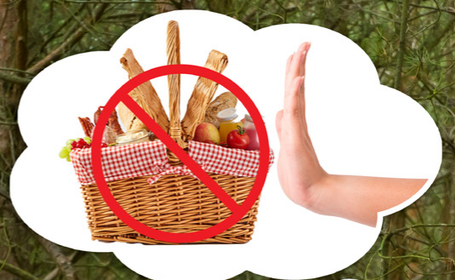
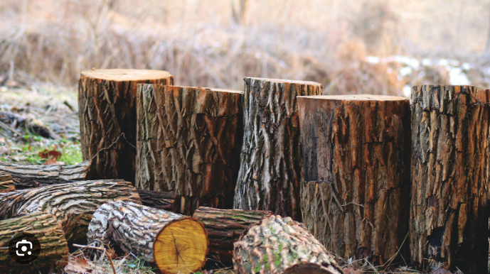
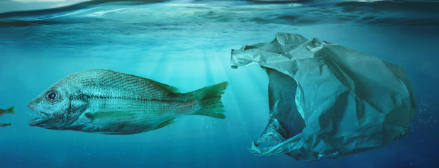
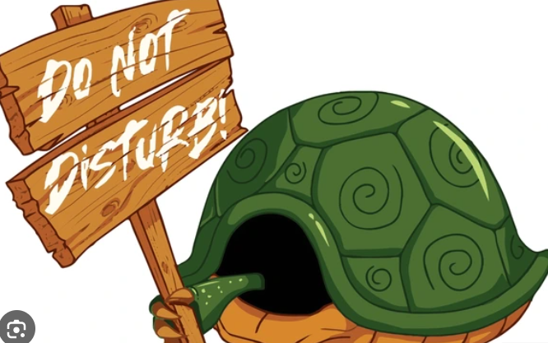
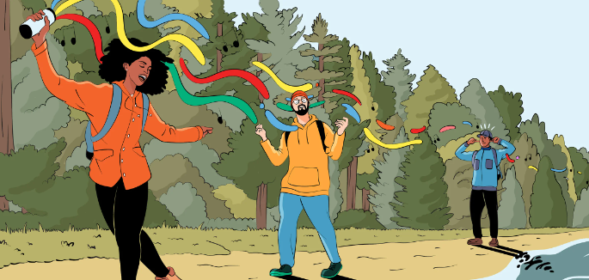
litter
bring food
cut trees
hunt animals
spoil sea water
play loud music
disturb wild animals

Slide 7
Answers
I hate littering in the national park.

Slide 8
Answers
I don’t like bringing food to the national park.

Slide 9
Answers
I hate cutting trees in the national park.

Slide 10
Answers
I hate hunting wild animals in the national park.

Slide 11
Answers
I don’t like using plastic bags and hate spoiling sea animal’s habitat.

Slide 12
Answers
I don’t like playing loud music in the national park.

Slide 13
Answers
I don’t like disturbing animals in the national park.

Slide 14
Presentation

Slide 15
In pairs – Look at these sentences again and answer some question
I hate littering in the national park.
I don’t like playing loud music in the national park.
I don’t like disturbing animals in the national park.
I hate hunting wild animals in the national park.
Presentation
What verbs do you add after “like” and “hate”?
What other verbs except “like” and “hate” do you know?

Slide 16
In pairs – Look at these sentences again and answer some question
Answers
I hate littering in the national park.
I don’t like playing loud music in the national park.
I don’t like disturbing animals in the national park.
I hate hunting wild animals in the national park.
Presentation
After “like” and “hate” we add gerund or V-ing.
They are “mind” “enjoy” “love” “prefer” and so on …

Slide 17
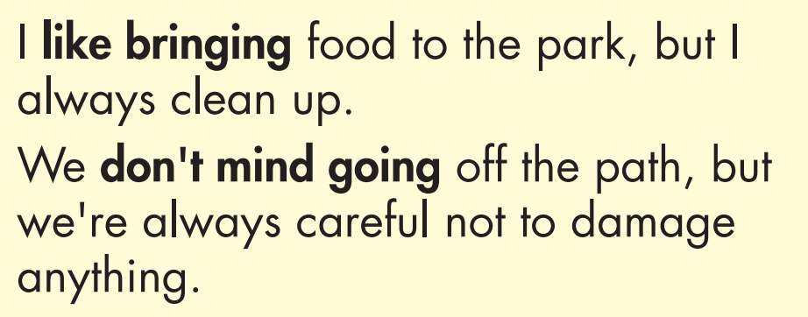
Presentation

Slide 18
Presentation

Slide 19
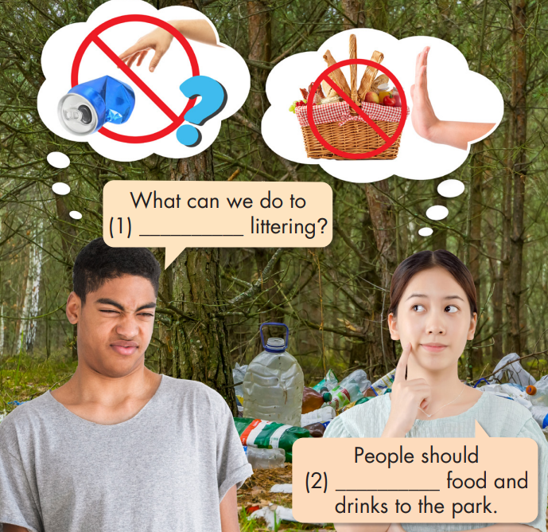
Task a.
Presentation

Slide 20
Task b.
Presentation

Slide 21
Task b.
Answers
stop
Presentation
People should (2) stop bringing food and drinks to the park.

Slide 22
Practice

Slide 23
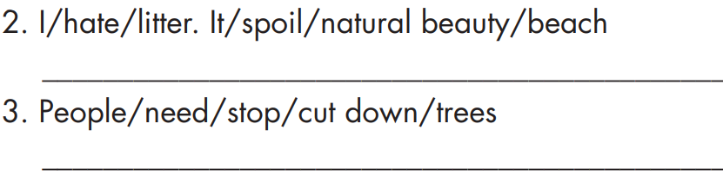
Task c.
Example

Slide 24
Task c.
5. People/should not/keep/use/plastic bags/because/they/
create/lots of trash

Slide 25
Task c.

Slide 26
Task c.
Answers
Example
I hate littering. It spoils the natural beauty of the beach.
People need to stop cutting down trees.

Slide 27
Answers
Task c.
If companies keep polluting the water, it'll/it will harm the fish.
5. People/should not/keep/use/plastic bags/because/they/
create/lots of trash
People shouldn't/should not keep using plastic bags because they create lots of trash.

Slide 28
Answers
Task c.
How can we get people to stop disturbing wildlife?
If people keep littering, the park will become dirty.
People need to avoid breaking rules or they should get fined.

Slide 29
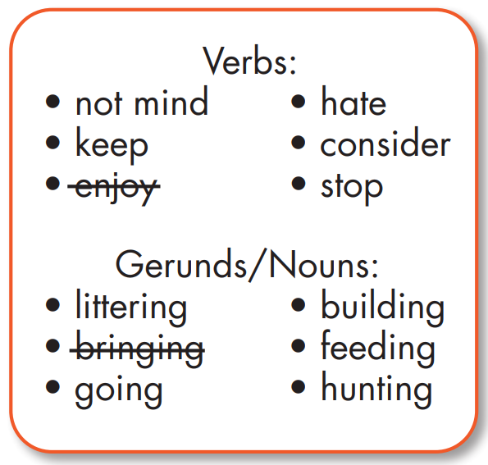
Task d.
Example
1. I ______________ lunch to the beach, but I never litter.
enjoy bringing

Slide 30
Task d.
2. If people ______________ in the river, we won't be able to go fishing there.
3. I ______________ off the path. You can find cool places for photos, but you have to be very careful not to damage anything.

Slide 31
Task d.
4. I ______________ animals. Why would people want to harm them?
5. Do you think we should ______________ the wildlife? Some people think it's cute, but it's actually bad for the animals' health.

Slide 32
Task d.
6. The government should ______________ something around the national park to keep hunters out.

Slide 33
Task d.
Answers
keep littering
2. If people ______________ in the river, we won't be able to go fishing there.
3. I ______________ off the path. You can find cool places for photos, but you have to be very careful not to damage anything.
don’t mind going

Slide 34
Task d.
Answers
4. I ______________ animals. Why would people want to harm them?
5. Do you think we should ______________ the wildlife? Some people think it's cute, but it's actually bad for the animals' health.
hate hunting
stop feeding

Slide 35
Task d.
Answers
6. The government should ______________ something around the national park to keep hunters out.
consider building

Slide 36
Extra practice
Presentation

Slide 37
Extra practice – WB, p. 35
Task a.
People should stop _________ (litter) in national parks.
People like ________ (hunt) animals. I don't understand it.
I hate ________ (visit) the park and seeing all the damage tourists do.
Presentation
Production

Slide 38
Extra practice - WB
Task a.
4. I love ________ (bring) food with me, but I know that other people leave trash behind.
5. We need people to stop _________ (feed) the wild animals.
6. The government should keep ________ (make) new laws to protect the environment.
Presentation
Production

Slide 39
ANSWERS
Task a.
People should stop _________ (litter) in national parks.
People like ________ (hunt) animals. I don't understand it.
I hate ________ (visit) the park and seeing all the damage tourists do.
littering
hunting
visiting
Presentation
Production

Slide 40
ANSWERS
Task a.
bringing
4. I love ________ (bring) food with me, but I know that other people leave trash behind.
5. We need people to stop _________ (feed) the wild animals.
6. The government should keep ________ (make) new laws to protect the environment.
feeding
Presentation
Production
making

Slide 41
Production

Slide 42
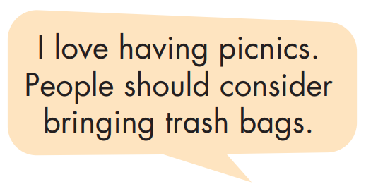
In pairs: Use the prompts to say how you feel about doing the actions below at natural wonders, then give a solution.
Example

Slide 43
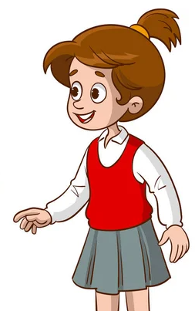
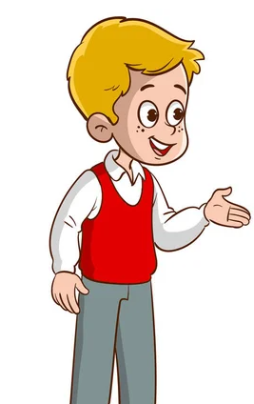
Suggested answers
I hate hunting animals. I think government should consider fining hunters heavily.
Yes, that’s a great idea. If government does it, people will stop hunting.

Slide 44
Suggested answers
I don't mind following park rules. Rangers should consider making more signs.
Yes, that’s right. If rangers do that, people will stop disturbing wild animals.

Slide 45
CONSOLIDATION

Slide 46
Presentation

Slide 47
Presentation

Slide 48
WRAP-UP

Slide 49
Today’s lesson
Grammar:
Practice and use verbs + gerund
Speaking:
Make conversations about how you feel about doing things at natural wonders

Slide 50
Homework
Review using verbs + gerund and practice how you feel about doing things at national parks.
Do exercise on pages 35 (WB) – Grammar.
Prepare for the next lesson (Pronunciation & Speaking - pages 60 & 61 - SB).
Play the consolidation games on www.eduhome.com.vn

Slide 51
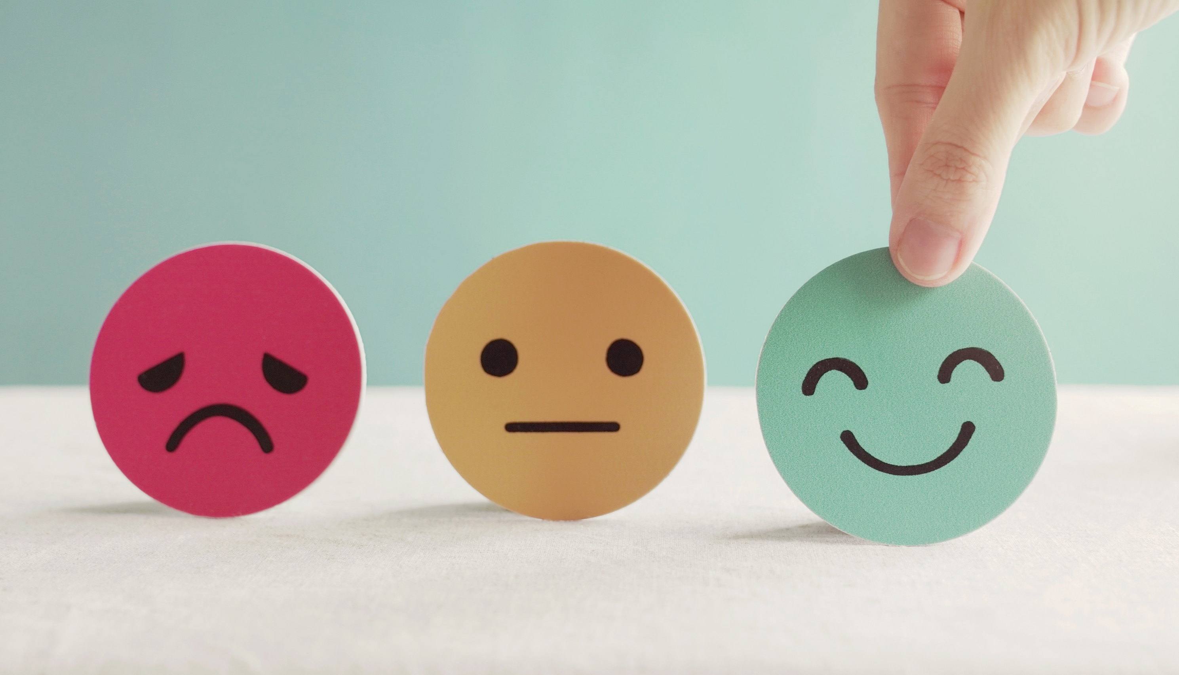
Lesson 3
Stay positive and have a nice day!

