Slide 1

Unit 6: Natural Wonders
Lesson 2.1: Vocab & Listening
Pages 58 & 59

Slide 2
Lesson Outline
Warm-up
Vocabulary
Listening
Consolidation
Wrap-up

Slide 3
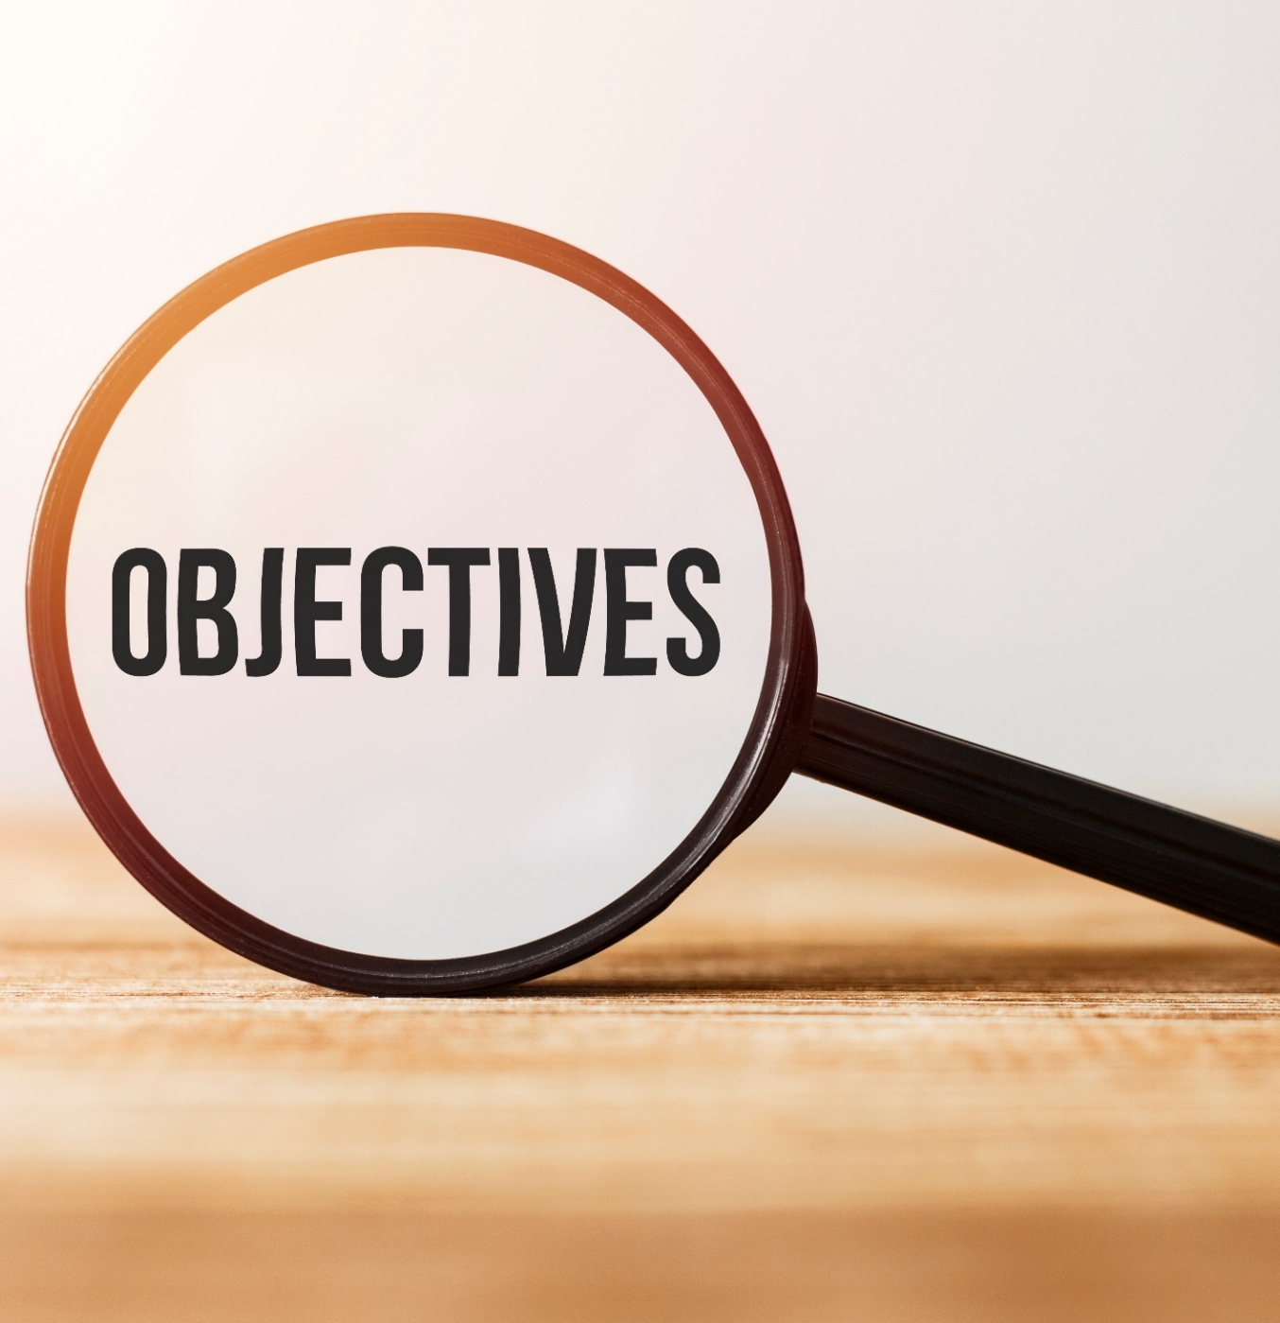
By the end of this lesson, students will be able to…
- learn and use vocabulary related to natural wonders
- practice listening for specific information
To practice functional English – politely disagreeing

Slide 4

WARM-UP

Slide 5

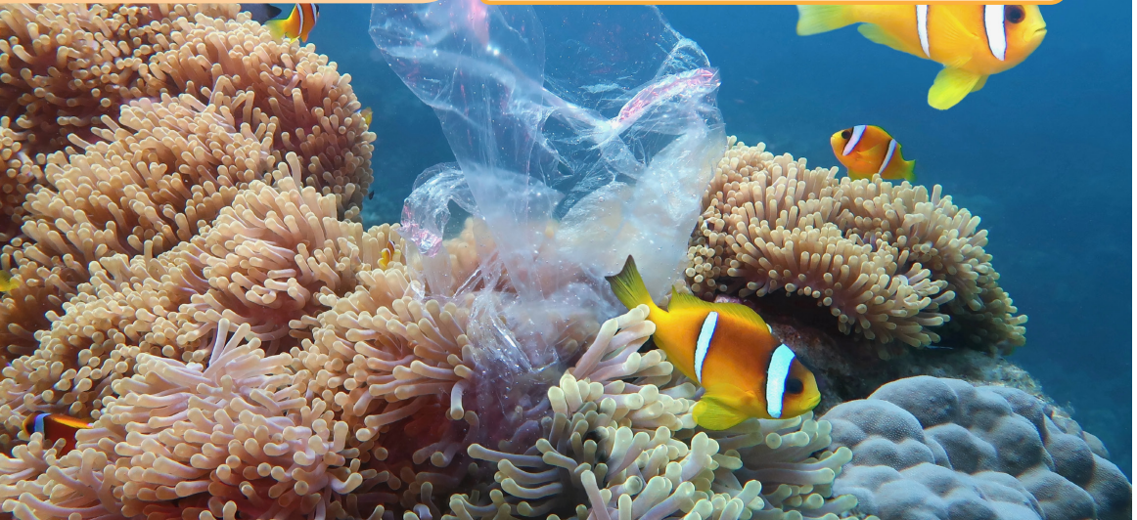
Work in pairs. Look at the pictures:
What can you see?
What causes problems like this?

Slide 6
Suggested answers:
The picture shows some fish swimming in the sea and there is a plastic bag stuck in coral.
Because people leave their trash on the beach and the trash goes in the sea and gets stuck in coral or sea animals. It spoils water environment and is bad for sea animals.

Slide 7

PRE-LISTENING

Slide 8



Slide 9
Task a. Match the words with the definitions.
fine (v)
litter (v)
consider (v)
government (n)
ranger (n)
hunt (v)
disturb (v)
spoil (v)
______________ – leave trash in the wrong place, e.g. on the floor, in water, etc.
______________ – catch or kill wild animals
______________ – change something good into something bad
______________ – think about something carefully before you make a decision

Slide 10
Task a. Match the words with the definitions.
fine (v)
litter (v)
consider (v)
government (n)
ranger (n)
hunt (v)
disturb (v)
spoil (v)
5. ______________ – make somebody pay money because they did something wrong
6. ______________ – move something or change its position
7. ______________ – a person who takes care of a park, a forest, or an area in the country
8. ______________ – the group of people who make the rules and decide what happens in a country

Slide 11
Answers
Task a. Match the words with the definitions.
fine (v)
litter (v)
consider (v)
government (n)
ranger (n)
hunt (v)
disturb (v)
spoil (v)
litter
_________ – leave trash in the wrong place, e.g. on the floor, in water, etc.
___________ – catch or kill wild animals
___________ – change something good into something bad
___________ – think about something carefully before you make a decision
hunt
spoil
consider

Slide 12
Answers
Task a. Match the words with the definitions.
fine (v)
litter (v)
consider (v)
government (n)
ranger (n)
hunt (v)
disturb (v)
spoil (v)
5. ______ – make somebody pay money because they did something wrong
6. _________ – move something or change its position
7. __________ – a person who takes care of a park, a forest, or an area in the country
8. ______________ – the group of people who make the rules and decide what happens in a country
fine
disturb
ranger
government

Slide 13
Task b. Choose the words in task a and fill in the blanks.
People sometimes ______ animals in national parks because they can sell them for a lot of money.
When we met the ________, he told us not to start any fires in the forest he looks after.
If you do something bad, the police might _______ you, and you'll have to pay some money.
hunt
fine (v)
litter (v)
consider (v)
government (n)
ranger (n)
hunt (v)
disturb (v)
spoil (v)
Pre-reading

Slide 14
Task b. Choose the words in task a and fill in the blanks.
4. If companies build too many hotels, they will __________ the beach, and people won't visit it anymore.
5. The __________ wants to make a new law to reduce the country's air pollution.
6. You should never __________. You should always put your trash in a trash can.
fine (v)
litter (v)
consider (v)
government (n)
ranger (n)
hunt (v)
disturb (v)
spoil (v)
Pre-reading

Slide 15
Task b. Choose the words in task a and fill in the blanks.
7. I decided not to go to university, but I did __________ going for a long time.
8. Don't __________ any plants or animals when you visit a natural wonder. You shouldn't touch or move the plants or animals.
fine (v)
litter (v)
consider (v)
government (n)
ranger (n)
hunt (v)
disturb (v)
spoil (v)
Pre-reading

Slide 16

Task b. Choose the words in task a and fill in the blanks.
Listen and answer
People sometimes ______ animals in national parks because they can sell them for a lot of money.
When we met the ________, he told us not to start any fires in the forest he looks after.
If you do something bad, the police might _______ you, and you'll have to pay some money.
hunt
fine (v)
litter (v)
consider (v)
government (n)
ranger (n)
hunt (v)
disturb (v)
spoil (v)
ranger
Pre-reading
fine

Slide 17
Listen and answer
Task b. Choose the words in task a and fill in the blanks.
4. If companies build too many hotels, they will ________ the beach, and people won't visit it anymore.
5. The __________ wants to make a new law to reduce the country's air pollution.
6. You should never __________. You should always put your trash in a trash can.
fine (v)
litter (v)
consider (v)
government (n)
ranger (n)
hunt (v)
disturb (v)
spoil (v)
spoil
government
Pre-reading
litter

Slide 18
Listen and answer
Task b. Choose the words in task a and fill in the blanks.
7. I decided not to go to university, but I did __________ going for a long time.
8. Don't __________ any plants or animals when you visit a natural wonder. You shouldn't touch or move the plants or animals.
fine (v)
litter (v)
consider (v)
government (n)
ranger (n)
hunt (v)
disturb (v)
spoil (v)
consider
disturb
Pre-reading

Slide 19
Listen and repeat. Click on each phrase to hear the sound.
fine (v) /faɪn/ bắt phạt (ai), phạt vạ (ai)
litter (v) /ˈlɪtər/ vứt rác rưởi bừa bãi
consider (v) /kənˈsɪdər/ xem xét kỹ, cân nhắc kỹ
disturb (v) /dɪˈstɜːrb/làm xáo trộn, quầy rầy
hunt (v) /hʌnt/ săn bắt
ranger (n) /ˈreɪndʒər / người bảo vệ rừng
spoil (v) /spɔɪl/ làm hư hỏng
government (n) /ˈɡʌvərnmənt/ chính quyền, sự cai trị
Notes:
GV click vào từng cụm nghe âm thanh

Slide 20
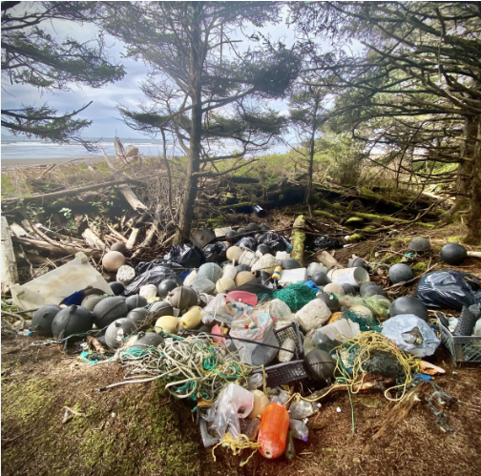
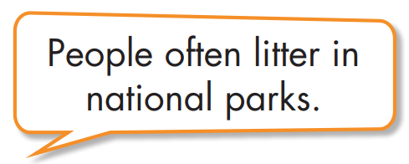
Task c.
EXAMPLE
Pre-reading

Slide 21
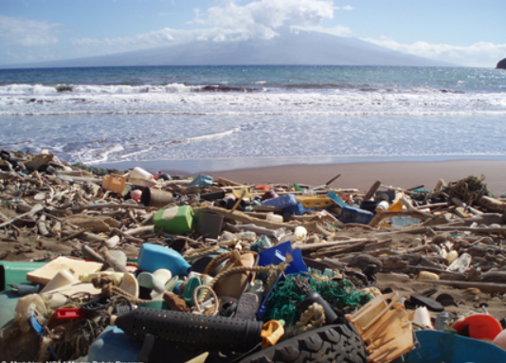
Task c.
Suggested answers
People spoil the beach when they leave their trash.
Pre-reading

Slide 22
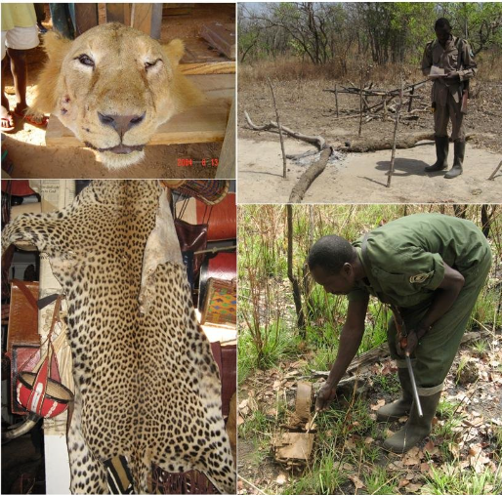
Task c.
Suggested answers
Some people hunt wild animals in national parks.
Pre-reading

Slide 23
Task c.
Suggested answers
The rangers can't stop all the problems because the park is so big.
Pre-reading

Slide 24
While-listening

Slide 25

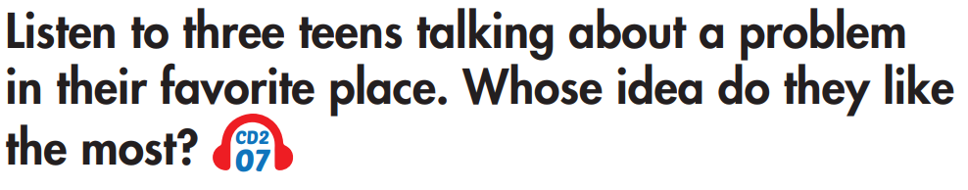
Task a.

Slide 26
Task a.
ANSWER

Slide 27

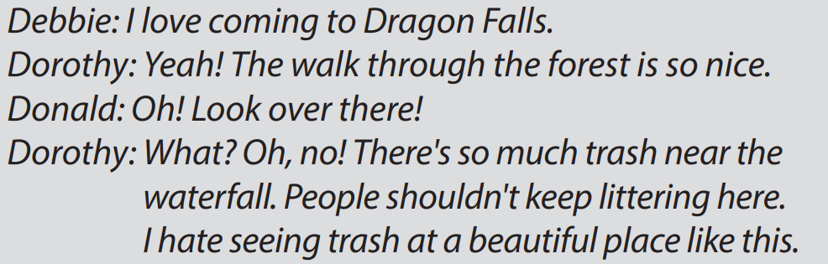
Task b.
Answers and clues
Pre-reading

Slide 28
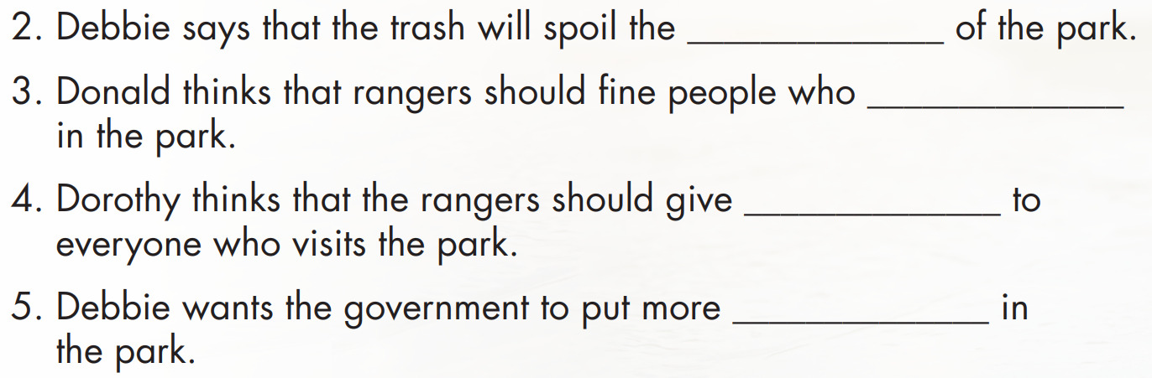
Task b.
Pre-reading

Slide 29
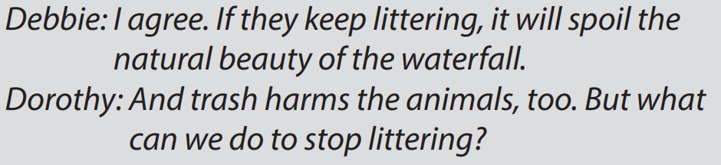
Task b.
natural beauty
Answers and clues
Pre-reading

Slide 30
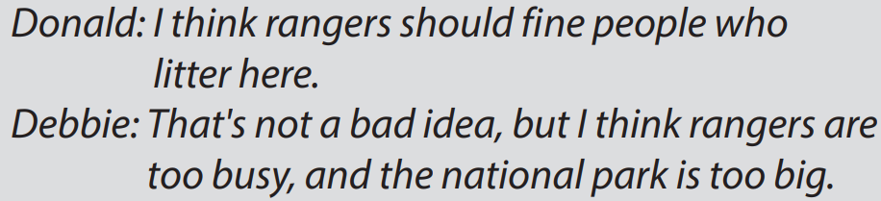
Task b.
litter
Answers and clues

Slide 31
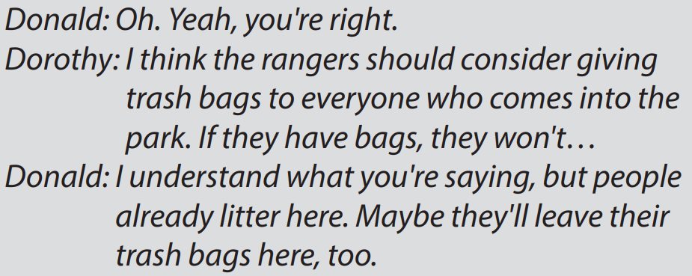
Task b.
trash bags
Answers and clues

Slide 32
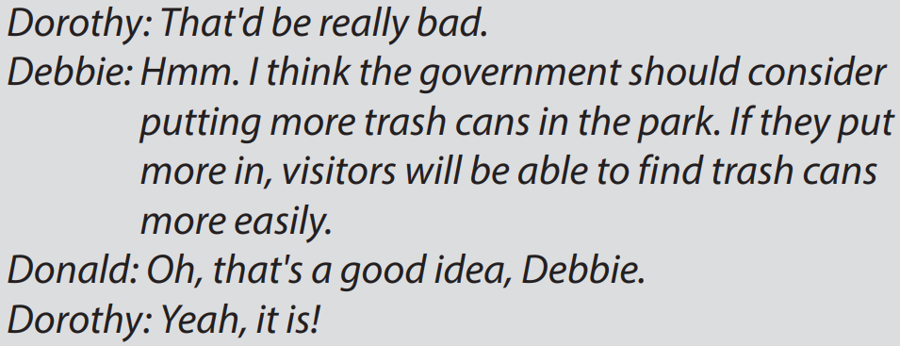
Task b.
trash cans
Answers and clues

Slide 33
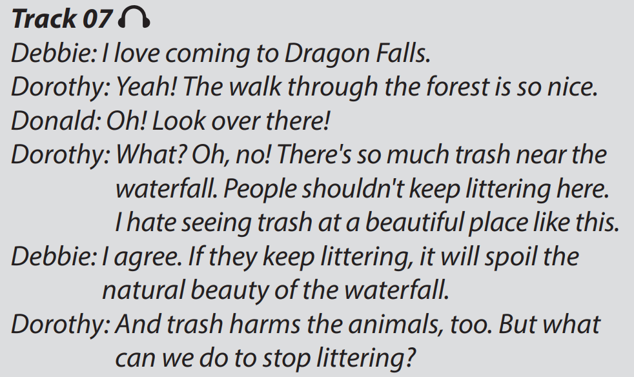
Task c.
In groups of three – Practice the conversation

Slide 34
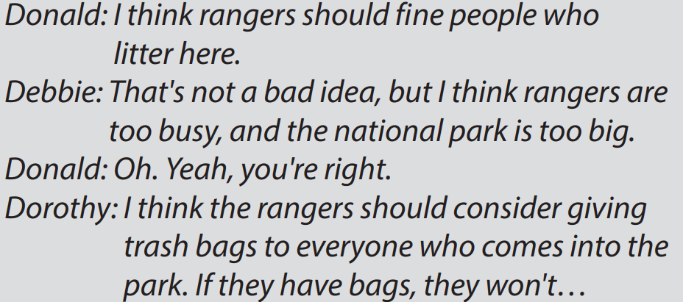
Task c.
In groups of three – Practice the conversation

Slide 35
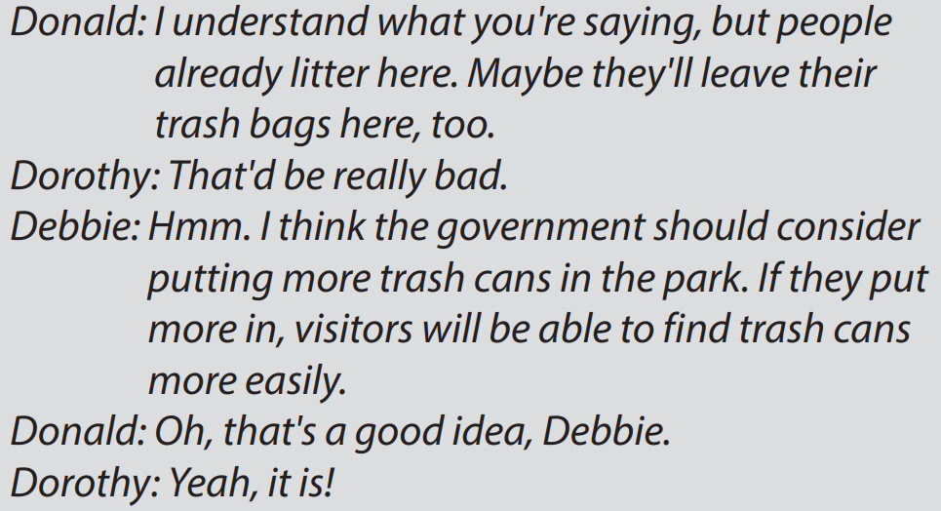
Task c.
In groups of three – Practice the conversation

Slide 36
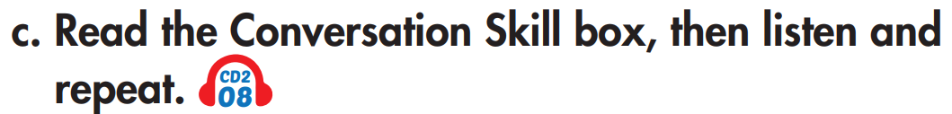
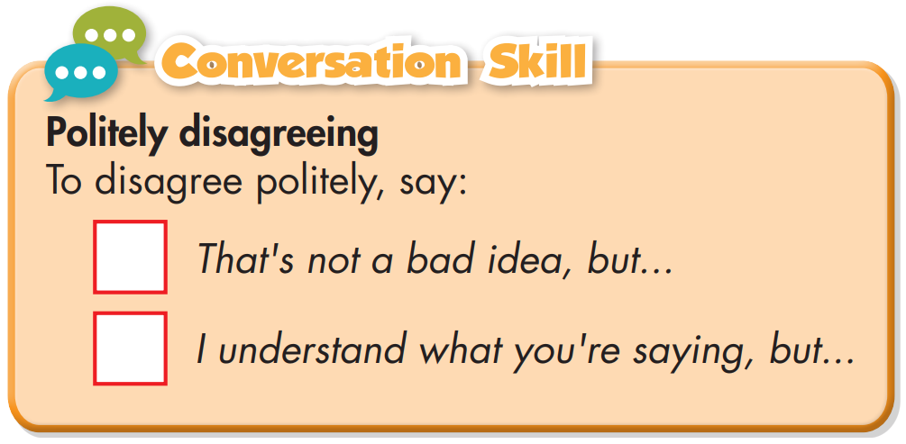
Pre-reading

Slide 37
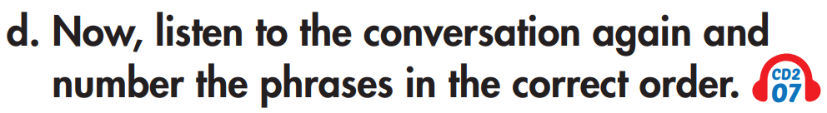
Pre-reading
1
2

Slide 38
Post-listening

Slide 39

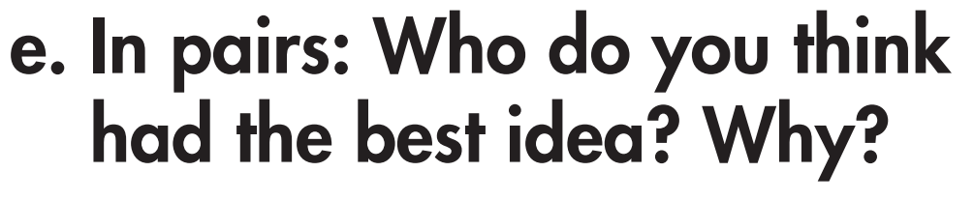
Suggested answer
I think Debbie’s idea is the best because if there are trash cans available, people won’t litter anymore
And I think Donald’s idea is better because if rangers fine people who litter, they will stop doing it, for sure.

Slide 40


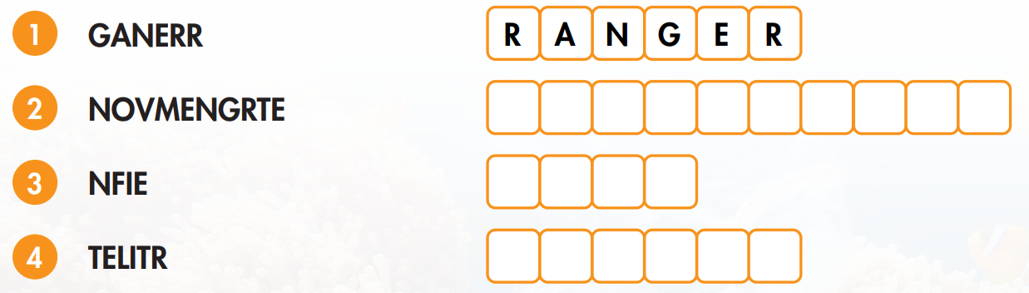
EXTRA PRACTICE – WB, P34
Task a.

Slide 41
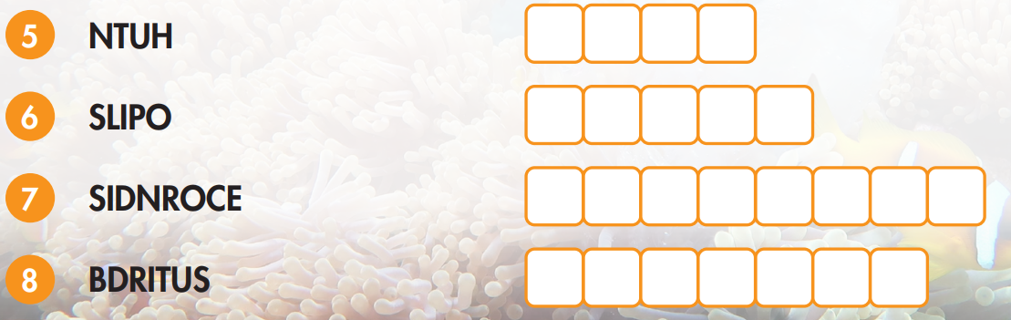
EXTRA PRACTICE - WB
Task a.

Slide 42
ANSWER
Task a.
G O V E R N M E N T
F I N E
L I T T E R

Slide 43
ANSWER
Task a.
H U N T
S P O I L
C O N S I D E R
D I S T U R B

Slide 44
EXTRA PRACTICE - WB
Many people around the world still _______________ animals to get food for their families.
I really hope the _______________ makes some new laws to protect our natural wonders.
When I visit a national park, I try not to _____________ any of the animals. I just leave them alone.
Did you _______________ bringing a trash bag? You should think about that next time.

Slide 45
EXTRA PRACTICE - WB
5. The _______________ showed us around the national park he protects.
6. Don't _______________! Pick up your trash and put it in a garbage can.
7. When you litter, the police can _______________ you. Sometimes you have to pay a lot of money.
8. Don't leave trash in the park after you have a picnic. It will _______________ the park for everyone else.

Slide 46
ANSWER
Many people around the world still ______ animals to get food for their families.
I really hope the ____________ makes some new laws to protect our natural wonders.
When I visit a national park, I try not to ________ any of the animals. I just leave them alone.
Did you _________ bringing a trash bag? You should think about that next time.
hunt
government
disturb
consider

Slide 47
ANSWER
5. The _______ showed us around the national park he protects.
6. Don't _______! Pick up your trash and put it in a garbage can.
7. When you litter, the police can _____ you. Sometimes you have to pay a lot of money.
8. Don't leave trash in the park after you have a picnic. It will _______ the park for everyone else.
ranger
litter
fine
spoil

Slide 48

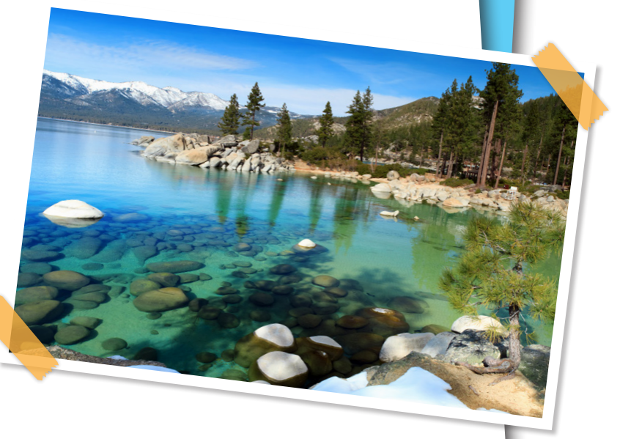

Slide 49
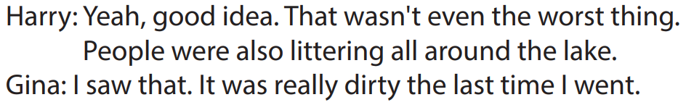
ANSWER
Listening script

Slide 50
Harry and Gina's favorite place is Richmond _________.
People were making a lot of noise by playing ______________________________.
Harry thinks if people keep littering, _______________________________ there anymore.

Slide 51
4. People were jumping off _________________________ into the water.
5. The rangers __________________________ so people would stop climbing on the rocks.

Slide 52
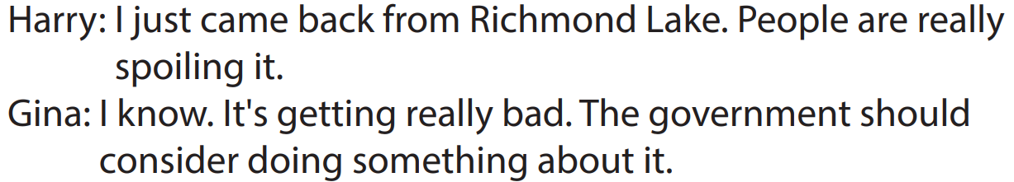
ANSWER
Harry and Gina's favorite place is Richmond ________.
Lake
Listening script

Slide 53
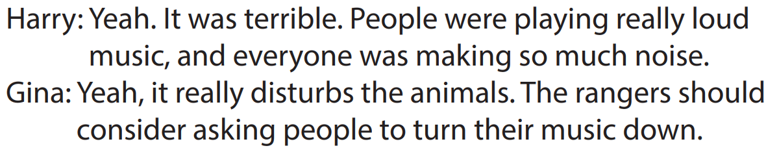
ANSWER
2. People were making a lot of noise by playing __________________.
(really) loud music
Listening script

Slide 54
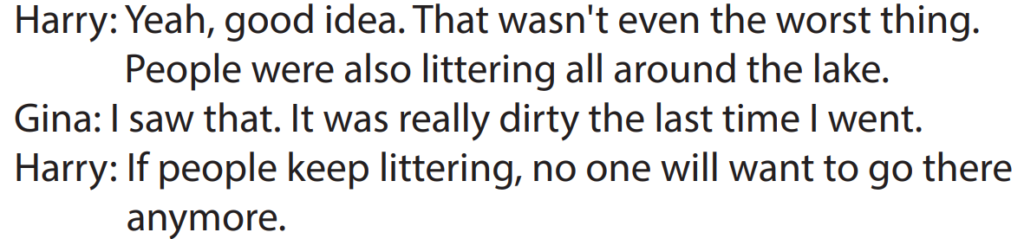
ANSWER
3. Harry thinks if people keep littering, ____________________ there anymore.
no one will want to go
Listening script

Slide 55
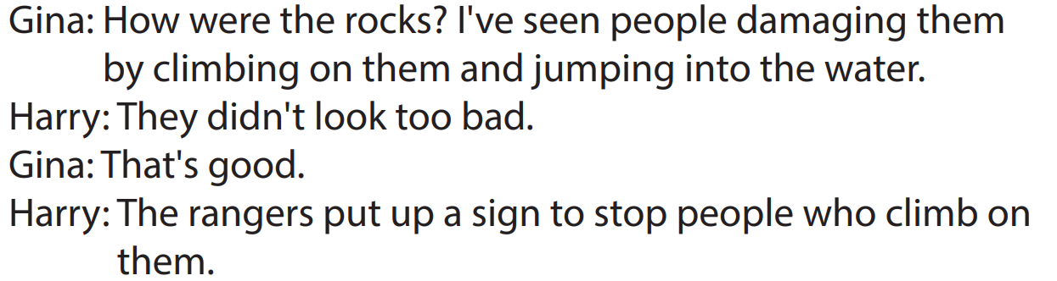
ANSWER
4. People were jumping off _________ into the water.
the rocks
Listening script

Slide 56
ANSWER
5. The rangers _____________ so people would stop climbing on the rocks.
put up a sign
Listening script

Slide 57
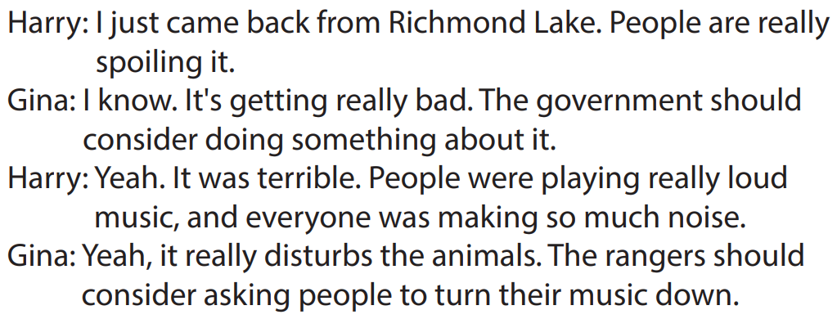
Task c.
In pairs – Practice the conversation

Slide 58
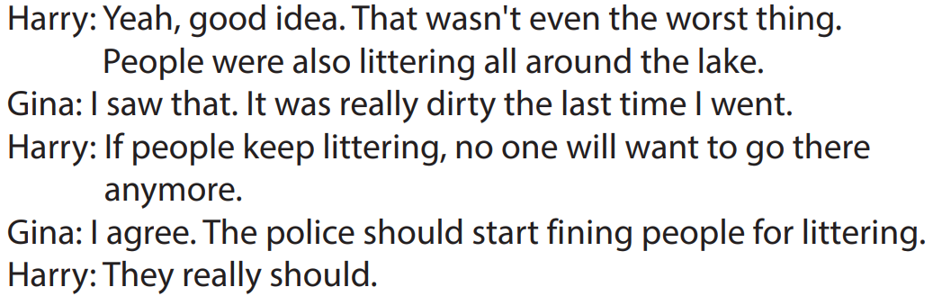
Task c.
In pairs – Practice the conversation

Slide 59
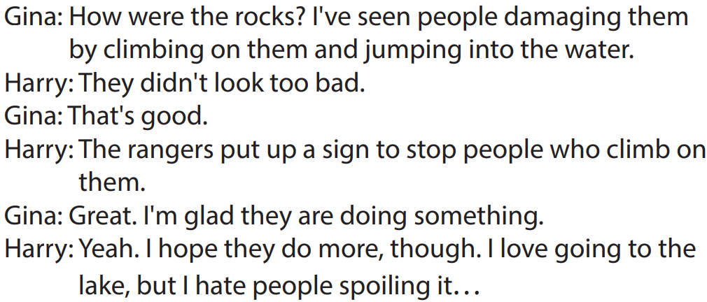
Task c.
In pairs – Practice the conversation

Slide 60

CONSOLIDATION

Slide 61
Listen and repeat. Click on each phrase to hear the sound.
fine (v) /faɪn/ bắt phạt (ai), phạt vạ (ai)
litter (v) /ˈlɪtər/ vứt rác rưởi bừa bãi
consider (v) /kənˈsɪdər/ xem xét kỹ, cân nhắc kỹ
disturb (v) /dɪˈstɜːrb/làm xáo trộn, quầy rầy
hunt (v) /hʌnt/ săn bắt
ranger (n) /ˈreɪndʒər / người bảo vệ rừng
spoil (v) /spɔɪl/ làm hư hỏng
government (n) /ˈɡʌvərnmənt/ chính quyền, sự cai trị
Notes:
GV click vào từng cụm nghe âm thanh

Slide 62
Pre-reading
1
2

Slide 63

WRAP-UP

Slide 64

Today’s lesson
Vocabularies
fine (v)
litter (v)
consider (v)
government (n)
ranger (n)
hunt (v)
disturb (v)
spoil (v)

Slide 65
Today’s lesson
Vocabulary:
- Using vocab. related to Natural Wonders and
Listening:
Understanding conversations about problems that nature has and ways to protect it.
Practice how to disagree politely
Practicing listening for specific information.

Slide 66
Homework
Review vocabulary about natural wonders and ways to disagree politely
Do exercise on pages 34 & 35 – Vocab. & Listening
Prepare for the next lesson (Grammar - pages 59 & 60 - SB)
Play the consolidation games on www.eduhome.com.vn

Slide 67

Lesson 3
Stay positive and have a nice day!

