Slide 1

Unit 6: Natural Wonders
Lesson 1.1: Vocab & Reading
Pages 54 & 55

Slide 2
Lesson Outline
Warm-up
Vocabulary
Reading
Consolidation
Wrap-up

Slide 3

By the end of this lesson, students will be able to…
- learn and use vocabulary related to natural wonders
- practice reading specific information

Slide 4

WARM-UP

Slide 5

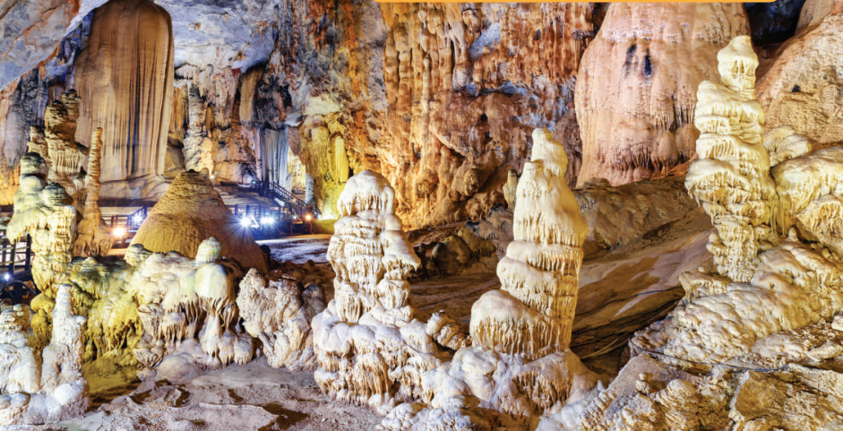
Work in pairs. Look at the pictures:
What kind of place does the picture show?
Why do you think some people like to visit places like that?

Slide 6
Suggested answers:
The picture shows the inside of a natural cave.
Because they want to explore and connect with nature, or they want to escape from their busy lives and enjoy the beauty of nature.

Slide 7

Pre-reading

Slide 8



Slide 9
Task a. Match the words with the definitions.
rainforest
summit
outcrop
mount
scenic
accessible
spectacular
formation
______________ – a large rock that stands above the ground or water
______________ – the top of something
______________ – that people can easily reach, enter, use, or see
______________ – the shape that nature has made something into, e.g. rocks, clouds

Slide 10
Task a. Match the words with the definitions.
rainforest
summit
outcrop
mount
scenic
accessible
spectacular
formation
5. ______________ – a mountain (We only use this in place names, e.g. Mount Fansipan.)
6. ______________ – an area with lots of plants and trees that has a lot of rain
7. ______________ – very exciting to look at
8. ______________ – having beautiful natural things to see

Slide 11
Suggested Answer
Task a. Match the words with the definitions.
rainforest
summit
outcrop
mount
scenic
accessible
spectacular
formation
______________ – a large rock that stands above the ground or water
______________ – the top of something
______________ – that people can easily reach, enter, use, or see
______________ – the shape that nature has made something into, e.g. rocks, clouds
outcrop
summit
accessible
formation

Slide 12
Task a. Match the words with the definitions.
Suggested Answer
5. ______________ – a mountain (We only use this in place names, e.g. Mount Fansipan.)
6. ______________ – an area with lots of plants and trees that has a lot of rain
7. ______________ – very exciting to look at
8. ______________ – having beautiful natural things to see
rainforest
summit
outcrop
mount
scenic
accessible
spectacular
formation
mount
rainforest
spectacular
scenic

Slide 13
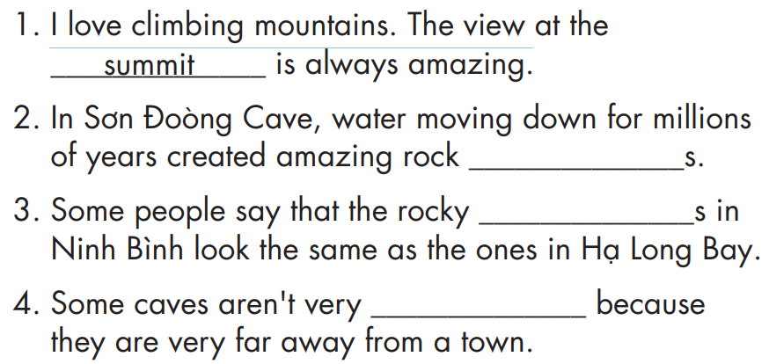
Task b. Choose the words in task a and fill in the blanks.
rainforest
summit
outcrop
mount
scenic
accessible
spectacular
formation
Pre-reading

Slide 14
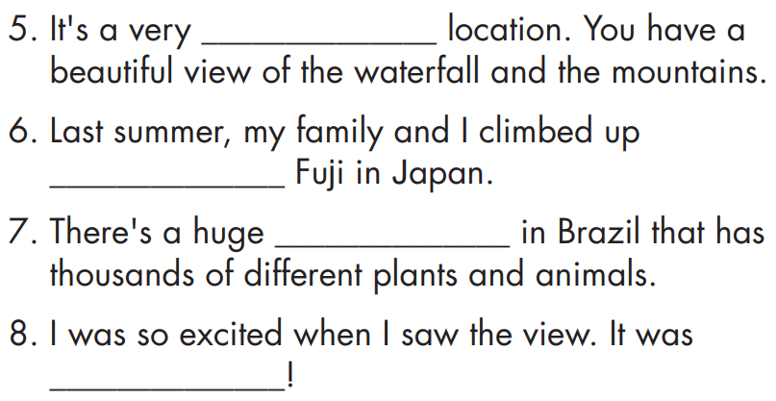
Task b. Choose the words in task a and fill in the blanks.
rainforest
summit
outcrop
mount
scenic
accessible
spectacular
formation
Pre-reading

Slide 15

Task b. Listen and check the answers.
Answers
rainforest
summit
outcrop
mount
scenic
accessible
spectacular
formation
formation
outcrop
accessible

Slide 16
Task b. Listen and check the answers.
Answers
rainforest
summit
outcrop
mount
scenic
accessible
spectacular
formation
scenic
mount
rainforest
spectacular

Slide 17
Listen and repeat. Click on each phrase to hear the sound.
summit (n) /ˈsʌmɪt/ đỉnh hoặc điểm cao nhất (núi)
formation (n) /fɔːrˈmeɪʃn/ sự hình thành
outcrop (n) /ˈaʊtkrɑːp/ sự trồi lên (của một lớp đất)
accessible (adj) /əkˈsesəbl/có thể tới, có thể gần được
scenic (adj) /ˈsiːnɪk / đẹp gây ấn tượng
mount (n) / maʊnt / ngọn núi
rainforest (n) / ˈreɪnfɔːrɪst / rừng mưa nhiệt đới
spectacular (adj) /spekˈtækjələr/ đẹp ngoạn mục
Notes:
GV click vào từng cụm nghe âm thanh

Slide 18



Task c. In pairs: Use the new words to talk about amazing natural places you visited or would like to visit.
And our family reached the summit of the mountain in Sapa, and the view was amazing.

Slide 19
Task c. In pairs: Use the new words to talk about amazing natural places you visited or would like to visit.
Suggested answer
Where would you like to go next summer?
I’d like to go to the rainforest to get close to nature. How about you?

Slide 20
While-reading

Slide 21

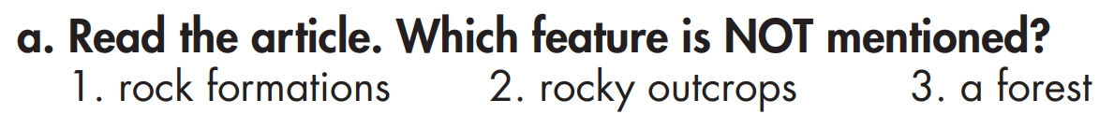
Task a.
Three amazing Caves in Southeast Asia
Many tourists know Southeast Asia for its beaches and national parks, but they often miss another kind of natural wonder hidden there. In this article, we'll explore three amazing caves in Southeast Asia!

Slide 22
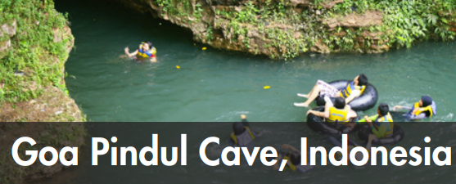
Task a.
Goa Pindul Cave is famous for its river. Visitors can float along it and enjoy the fantastic rock formations. Goa Pindul Cave is far more accessible than many other caves. Visitors can reach it without having to hike or climb.

Slide 23
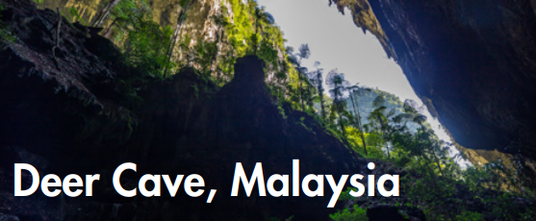
Task a.
Deer Cave is much bigger than Goa Pindul Cave. It's over four kilometers long. Visitors can see wildlife here, including deer. It's a bit more difficult to reach than Goa Pindul Cave. There's a long walk, so visitors should bring strong shoes and raincoats.

Slide 24
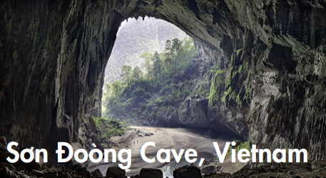
Task a.
Sơn Đoòng Cave is far bigger than both the others. Because of this, it's much more scenic than most other caves. It has things like a forest, underground rivers, and a rock formation called "The Great Wall of Vietnam". It's in a rainforest, so it isn't as accessible as Deer Cave, and it's much more expensive to visit.

Slide 25
Task a.
Do you know any other caves or more information about these ones? Write a comment and let us know!

Slide 26
Answer and clues:
Task a.
Goa Pindul Cave is famous for its river. Visitors can float along it and enjoy the fantastic rock formations. Goa Pindul Cave is far more accessible than many other caves. Visitors can reach it without having to hike or climb.

Slide 27
Answer and clues:
Task a.
Sơn Đoòng Cave is far bigger than both the others. Because of this, it's much more scenic than most other caves. It has things like a forest, underground rivers, and a rock formation called "The Great Wall of Vietnam". It's in a rainforest, so it isn't as accessible as Deer Cave, and it's much more expensive to visit.

Slide 28
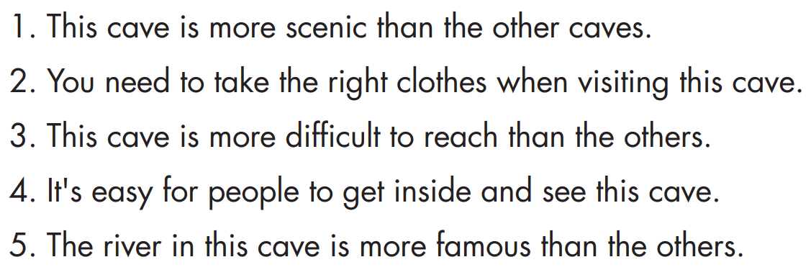
Task b. Read the descriptions and underline key words

Slide 29
Suggested answer
Task b. Read the descriptions and underline key words

Slide 30
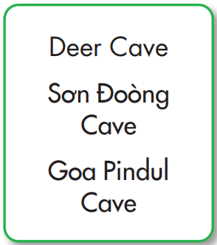
Task c. Read and match the descriptions to the correct cave

Slide 31
Example
Task c. Read and match the descriptions to the correct cave
Sơn Đoòng Cave is far bigger than both the others. Because of this, it's much more scenic than most other caves. It has things like a forest, underground rivers, and a rock formation called "The Great Wall of Vietnam".

Slide 32
Answer and clues:
Task c. Read and match the descriptions to the correct cave
Deer Cave is much bigger than Goa Pindul Cave. It's over four kilometers long. Visitors can see wildlife here, including deer. It's a bit more difficult to reach than Goa Pindul Cave. There's a long walk, so visitors should bring strong shoes and raincoats.

Slide 33
Answer and clues:
Task c. Read and match the descriptions to the correct cave
Sơn Đoòng Cave is far bigger than both the others. Because of this, it's much more scenic than most other caves. It has things like a forest, underground rivers, and a rock formation called "The Great Wall of Vietnam". It's in a rainforest, so it isn't as accessible as Deer Cave, and it's much more expensive to visit.

Slide 34
Answer and clues:
Task c. Read and match the descriptions to the correct cave
Goa Pindul Cave is famous for its river. Visitors can float along it and enjoy the fantastic rock formations. Goa Pindul Cave is far more accessible than many other caves. Visitors can reach it without having to hike or climb.

Slide 35
Answer and clues:
Task c. Read and match the descriptions to the correct cave
Goa Pindul Cave is famous for its river. Visitors can float along it and enjoy the fantastic rock formations. Goa Pindul Cave is far more accessible than many other caves. Visitors can reach it without having to hike or climb.

Slide 36
Task d. Listen and read
Three amazing Caves in Southeast Asia
Many tourists know Southeast Asia for its beaches and national parks, but they often miss another kind of natural wonder hidden there. In this article, we'll explore three amazing caves in Southeast Asia!

Slide 37
Task d. Listen and read
Goa Pindul Cave is famous for its river. Visitors can float along it and enjoy the fantastic rock formations. Goa Pindul Cave is far more accessible than many other caves. Visitors can reach it without having to hike or climb.

Slide 38
Task d. Listen and read
Deer Cave is much bigger than Goa Pindul Cave. It's over four kilometers long. Visitors can see wildlife here, including deer. It's a bit more difficult to reach than Goa Pindul Cave. There's a long walk, so visitors should bring strong shoes and raincoats.

Slide 39
Task d. Listen and read
Sơn Đoòng Cave is far bigger than both the others. Because of this, it's much more scenic than most other caves. It has things like a forest, underground rivers, and a rock formation called "The Great Wall of Vietnam". It's in a rainforest, so it isn't as accessible as Deer Cave, and it's much more expensive to visit.

Slide 40
Task d. Listen and read
Do you know any other caves or more information about these ones? Write a comment and let us know!

Slide 41
Post-reading

Slide 42

In pairs: Talk together and share your ideas.
Which cave would you most like to visit the most?
I’d like to go to ………. because ………

Slide 43
In pairs: Talk together and share your ideas
Who would you take with you?
I’d like to go to there with my ………. because ………

Slide 44
In pairs: Talk together and share your ideas
Suggested answer
Which cave would you most like to visit the most?
I’d like to go to Son Doong cave in Vietnam because I want to explore one of the most spectacular caves in the world.

Slide 45
In pairs: Talk together and share your ideas
Suggested answer
Who would you take with you?
I’d like to go there with my best friend because we both love nature and exploring new places and new things.

Slide 46

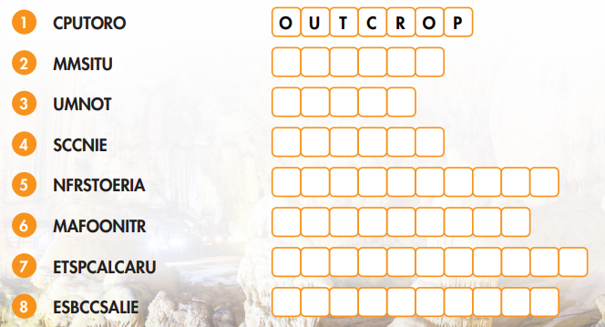
Extra practice – WB, P 32

Slide 47
ANSWER
S U M M I T
M O U N T
S C E N I C
R A I N F O R E S T
F O R M A T I O N
S P E C T A C U L A R
A C C E S S I B L E

Slide 48
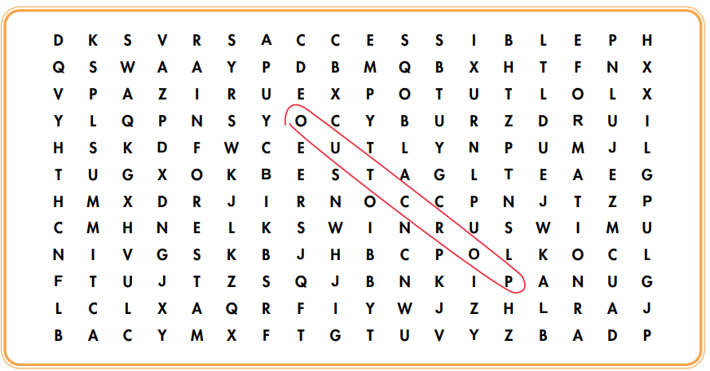
EXTRA PRACTICE - WB

Slide 49
ANSWER

Slide 50
Extra practice - WB
Three of the Best Places to Relax in Vietnam
The Best Beaches around the World
Exciting Vietnam

Slide 51
Extra practice - WB
Many tourists come to Vietnam for an exciting holiday, but not many know about these amazing places. In this article, we will explore three great places to relax. An Bàng Beach is a great beach near Hội An. Visitors can swim in the nice warm sea or make sandcastles on the beautiful beach. It's very accessible since it's just a short drive from Hội An. You can even take a bicycle from the old town.

Slide 52
Extra practice - WB
Côn Đảo Island is a small island off the south coast of Vietnam. It's not as accessible as An Bàng Beach. You can fly there from the airport in Ho Chi Minh City. I think it's much quieter and more relaxing than An Bàng. Last is Lý Sơn Island. This small island is off the east coast of Vietnam. It's very quiet and very clean. It's much more relaxing than An Bàng Beach, but it's not as accessible as Côn Đảo Island. You can only get there by boat. What do you think? Which place would you most like to visit? Let us know in the comments below. You can also let us know if there are any places we missed.

Slide 53
Extra practice - WB
ANSWER
Three of the Best Places to Relax in Vietnam
The Best Beaches around the World
Exciting Vietnam
Many tourists come to Vietnam for an exciting holiday, but not many know about these amazing places. In this article, we will explore three great places to relax.

Slide 54
Extra practice - WB
Visitors to An Bàng Beach can make ________________ on the beach.
You can _____________ from Hội An's old town to An Bàng Beach.
Côn Đảo Island isn't as accessible as ______________.
Lý Sơn Island isn't as accessible as ________________.
5. You can only take ___________ to Lý Sơn Island.

Slide 55
ANSWER AND CLUES
sandcastles
Visitors to An Bàng Beach can make ________________ on the beach.
You can _____________ from Hội An's old town to An Bàng Beach.
take a bicycle
An Bàng Beach is a great beach near Hội An. Visitors can swim in the nice warm sea or make sandcastles on the beautiful beach. It's very accessible since it's just a short drive from Hội An. You can even take a bicycle from the old town.

Slide 56
ANSWER AND CLUES
Côn Đảo Island isn't as accessible as ______________.
Lý Sơn Island isn't as accessible as ________________.
An Bàng beach
Côn Đảo island
Côn Đảo Island is a small island off the south coast of Vietnam. It's not as accessible as An Bàng Beach. You can fly there from the airport in Ho Chi Minh City. I think it's much quieter and more relaxing than An Bàng. Last is Lý Sơn Island. This small island is off the east coast of Vietnam. It's very quiet and very clean. It's much more relaxing than An Bàng Beach, but it's not as accessible as Côn Đảo Island.

Slide 57
ANSWER AND CLUES
a boat
5. You can only take ___________ to Lý Sơn Island.
You can only get there by boat. What do you think? Which place would you most like to visit? Let us know in the comments below. You can also let us know if there are any places we missed.

Slide 58

CONSOLIDATION

Slide 59
In pairs: Talk together and share what places you have studied today.
I remember about Son Doong cave, it …………
I remember that …………..

Slide 60
In pairs: Talk together and share what places you have studied today.
I remember about Son Doong cave, has things like a forest, underground rivers, and a rock formation called "The Great Wall of Vietnam"
Suggested answer
I remember that we should bring strong shoes and raincoats in Deer cave because there is a long walk to that cave.

Slide 61

WRAP-UP

Slide 62

Today’s lesson
Vocabularies
1. outcrop
2. mount
3. accessible
4. rainforest
5. scenic
6. spectacular
7. summit
8. formation

Slide 63
Today’s lesson
Vocabulary:
- Using vocab. related to Natural Wonders.
Reading:
- Understanding an article about some famous places around the world and in Vietnam.
- Practicing reading for specific information.

Slide 64
Homework
Review vocabulary about natural wonders
Do exercise on pages 32 & 33 – Vocab. & Reading
Prepare for the next lesson (Grammar - pages 55 & 56 - SB)
Play the consolidation games on www.eduhome.com.vn

Slide 65

Lesson 3
Stay positive and have a nice day!

