Slide 1
Unit 7: Movies
Lesson: Review
Pages 98 & 99

Slide 2
Objectives
By the end of this lesson, students will be able to…
Vocabulary: Review vocabularies related to movies.
Structure: Review prepositions: on/at/in and Past Simple with “be”.
Pronunciation: Identify words with different stress.
Reading: Practice reading for specific information.
Listening: Practice listening for details.

Slide 3
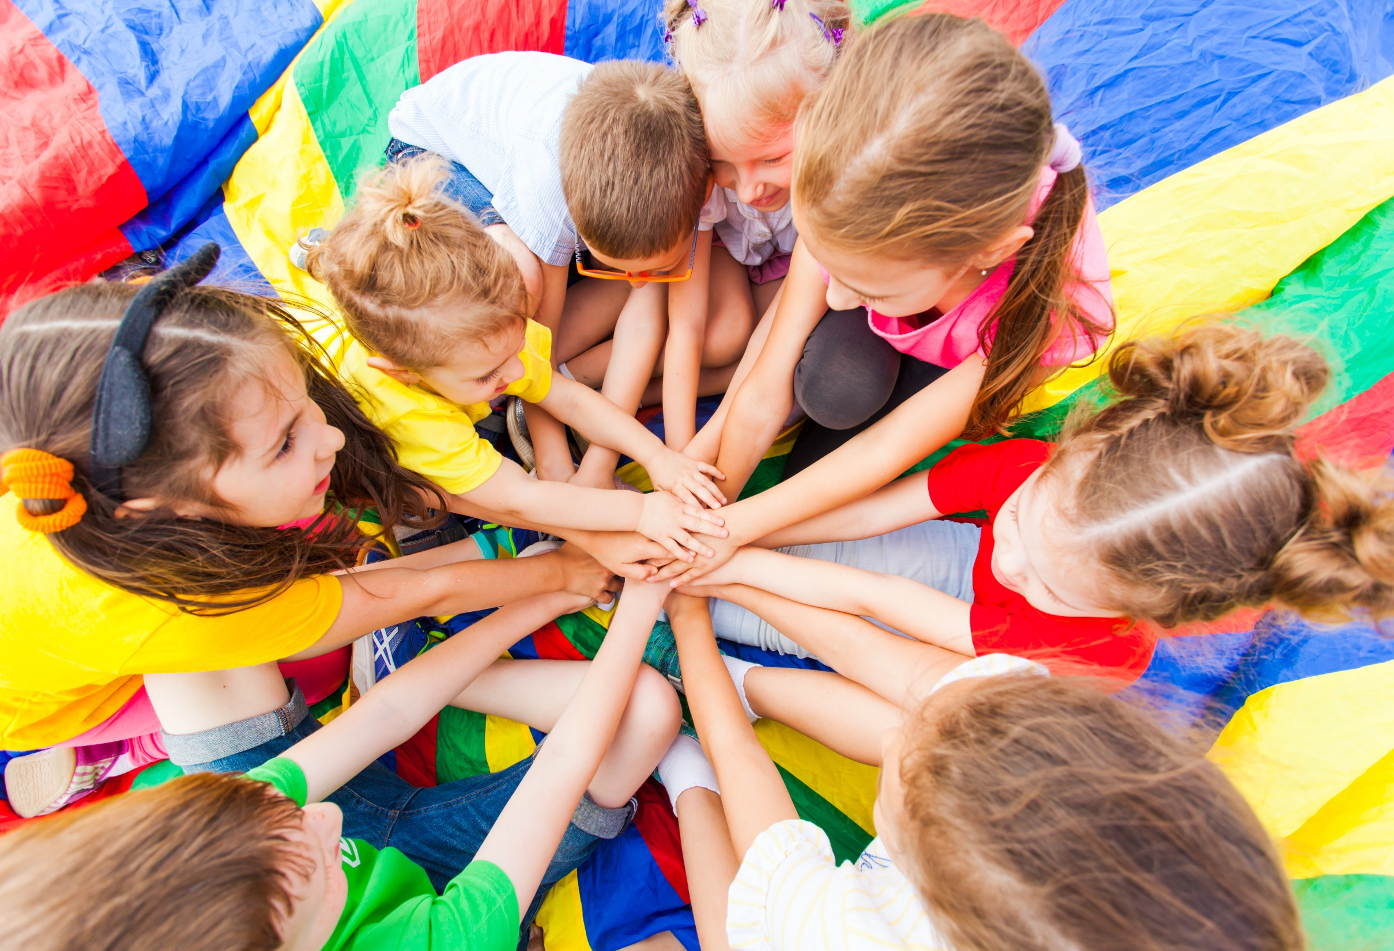
WARM-UP

Slide 4
Past simple (Quá khứ đơn)
Tobe
S + was/were + O
V
(động từ thường)
V_{ed}
V₂
S +

Slide 5
V_{1 (hiện tại)}
V_{2 (quá khứ)}
Watch (xem)
Attack (tấn công)
Play (chơi)
Save (cứu)
Fight (chiến đấu)
Win (chiến thắng)
Come (đến)
Become (trở thành)
Go (đi)
→ Watched
→ Attacked
→ Played
→ Saved
→ Fought
→ Won
→ Came
→Became
→ Went

Slide 6
While-Writing
a. With a partner, use the notes to make sentences about the famous American, George Washington.

Slide 7
a. With a partner, use the notes to make sentences about the famous American, George Washington.
George Washington/ first president/ USA
George Washington was the first president of the USA.
born/ 1732,/ general/ 1775
He was born in 1732 and became a general in 1775.
fought/ many battles/ against/ British
He fought many battles against the British.
His army/ won/ Battle of Yorktown/ 1781./ last battle/ war
His army won the Battle of Yorktown in 1781. It was the last
battle of the war.
He/ president/ United States of America/ 1789.
He became president of the United States of America in 1789.

Slide 8
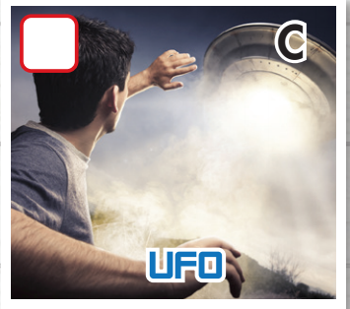
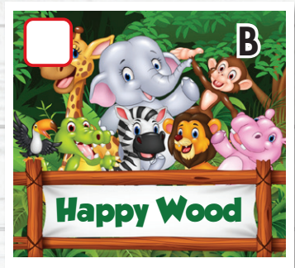
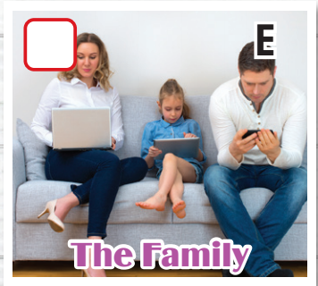
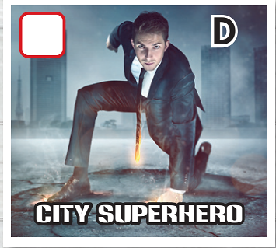
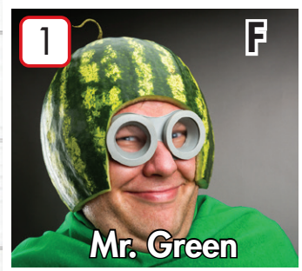
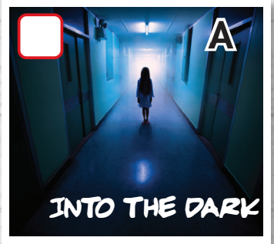
What kind of movie? List down kind of movie you can remember in the order
Notes:
6 clicks- 6 kinds of movie

Slide 9
Go around your class. Ask and find out kinds of movie that your friend likes
What kind of movie do you like?
I like…..
Kind of movie | Name
Comedy
Science fiction
Horror
Action
Animated
Drama

Slide 10
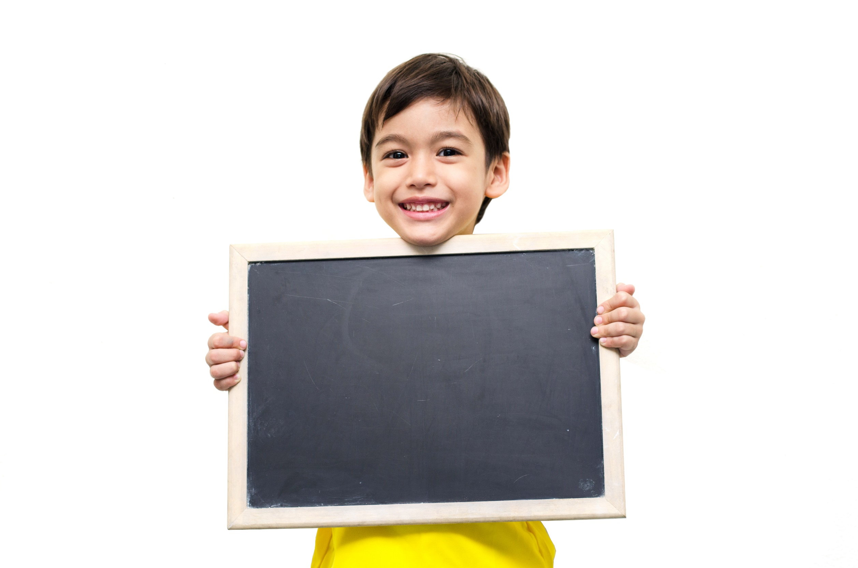
Listening

Slide 11
Pre-Listening

Slide 12
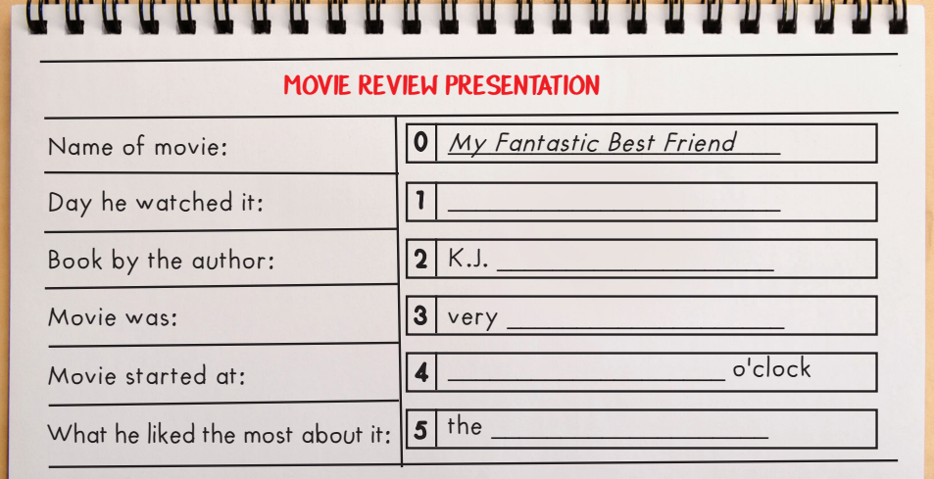
Pre-Listening
Guess what you need to fill in?
Day of week?
A name? Spelling of name.
An adjective?
Time?
Noun?

Slide 13
B: Hi, everyone. I'm Harry, and my presentation is about a movie I like. The movie is called My Fantastic Best Friend.

Slide 14
Thursday
I watched it on Thursday with my sister.

Slide 15
Birch
The movie is a comedy based on a book by the American
author K.J. Birch, that's B-I-R-C-H.

Slide 16
funny
I really liked the movie because it was very funny.

Slide 17
Seven/7
The movie started at seven o'clock and was pretty short, only ninety minutes long.

Slide 18
music
The thing I liked the most about My Fantastic Best Friend was the music. It was fantastic!

Slide 19
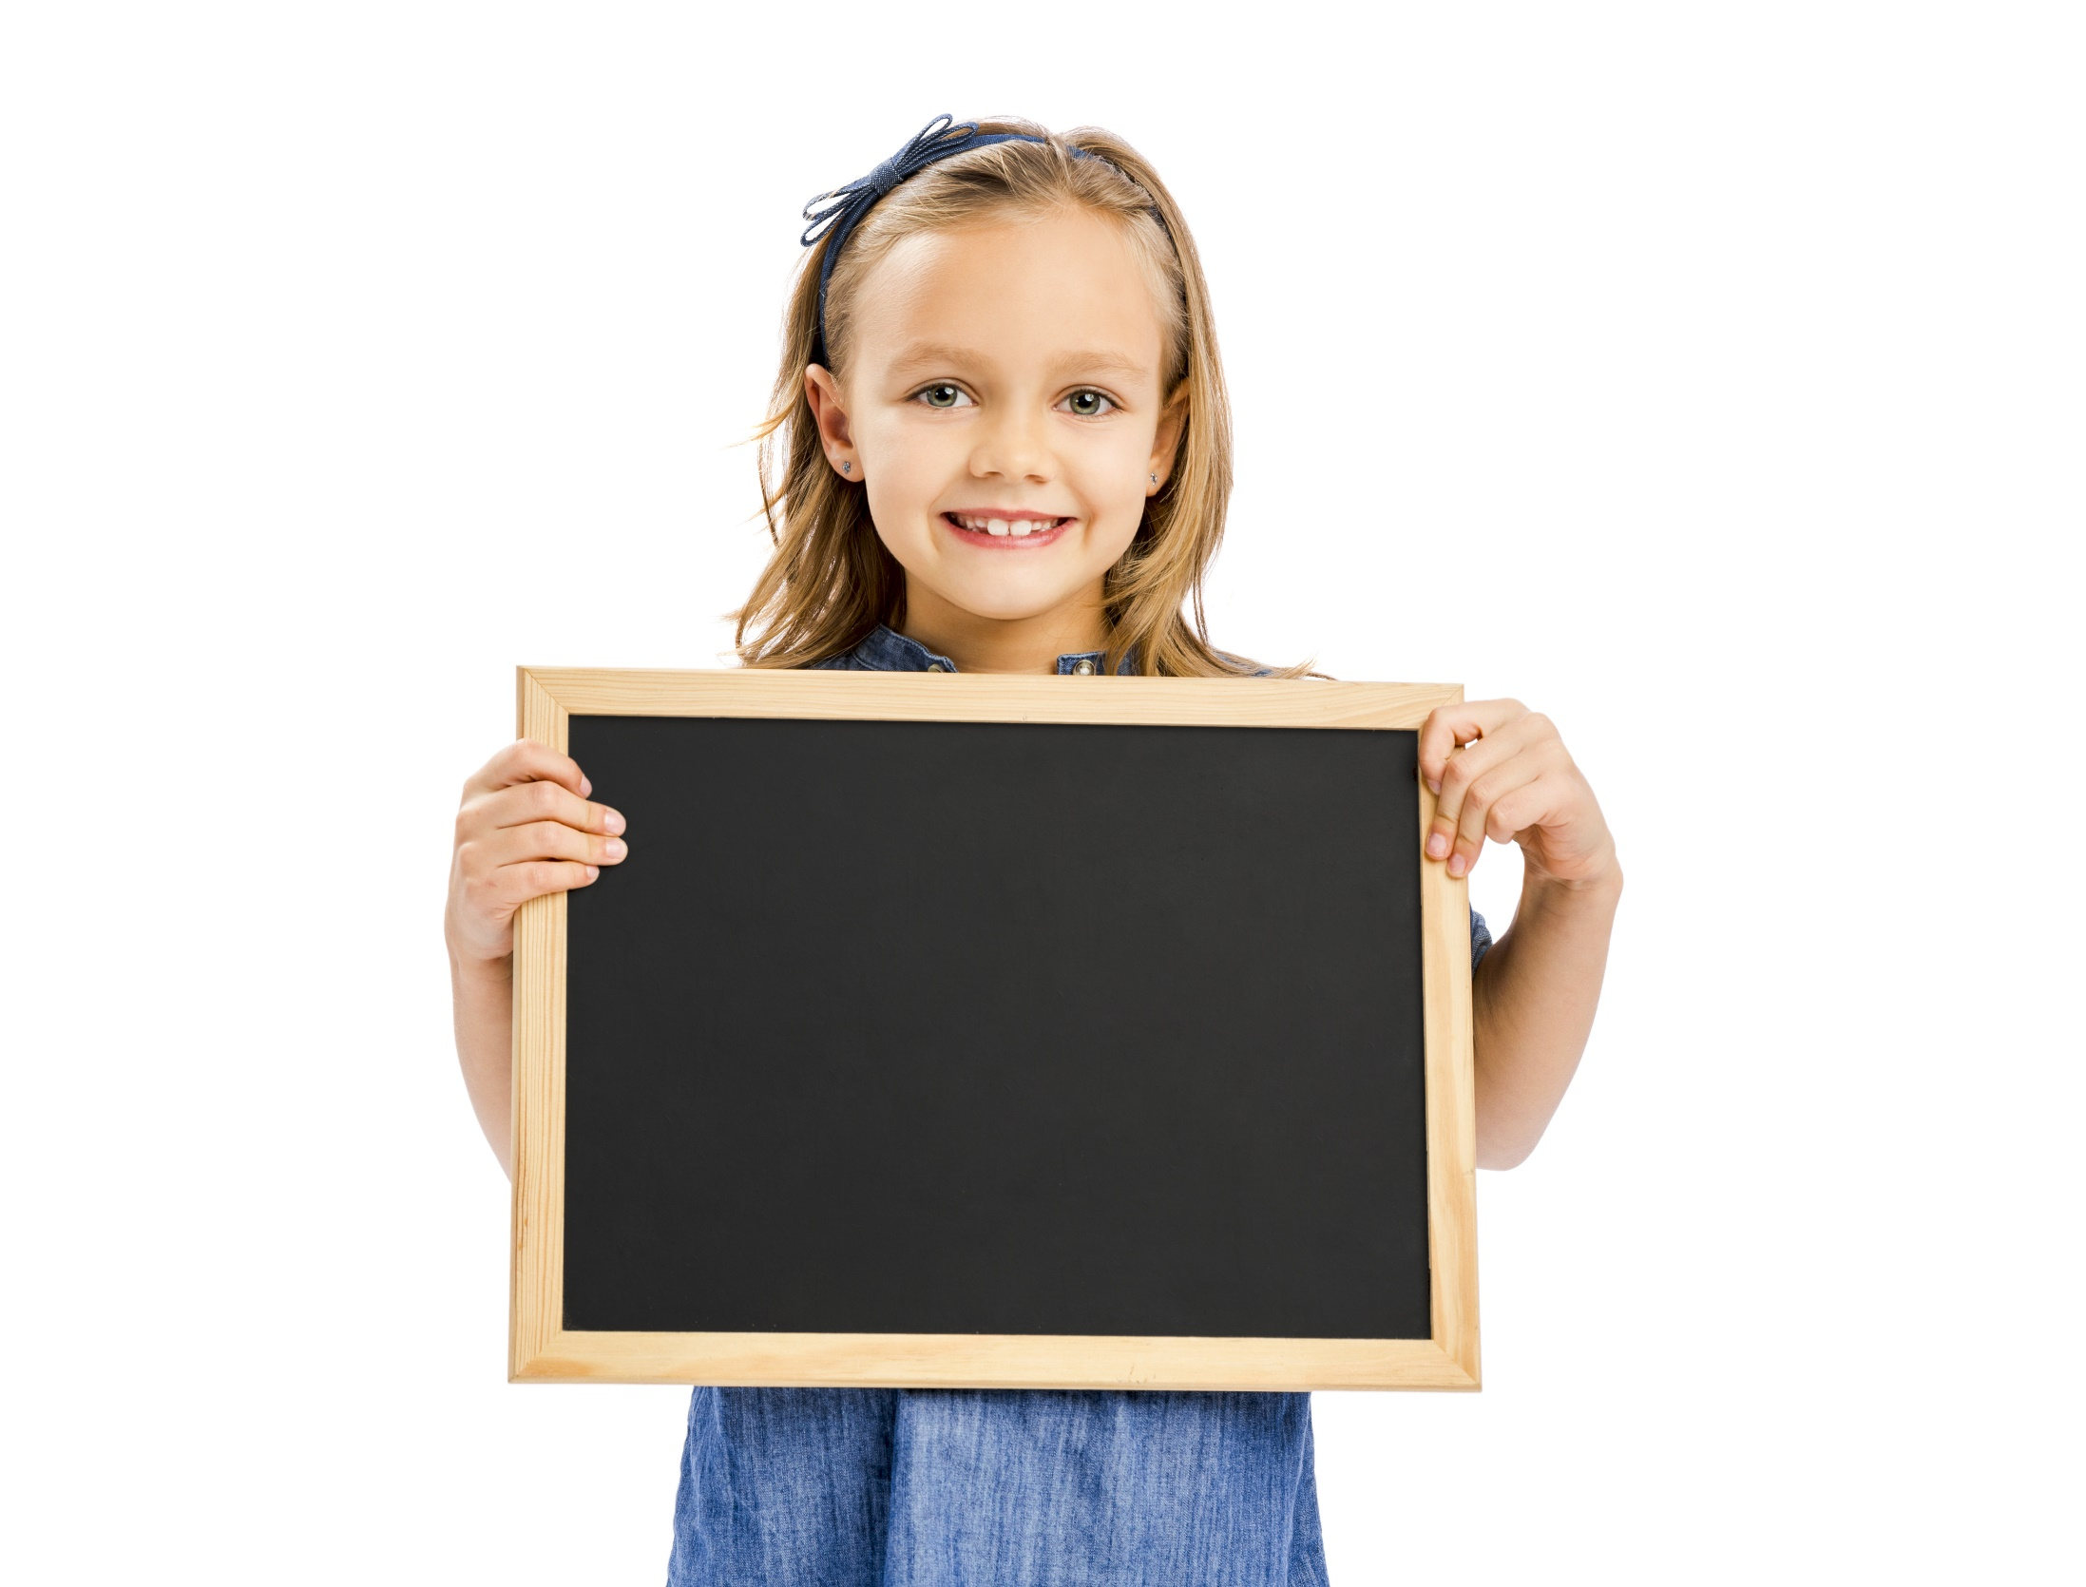
Reading

Slide 21
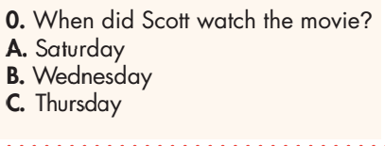
Pre-Reading
Underline key words.

Slide 22
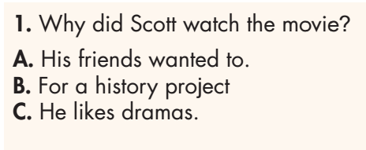
Pre-Reading
Underline key words.

Slide 23
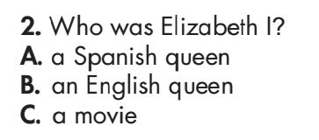
Pre-Reading
Underline key words.

Slide 24
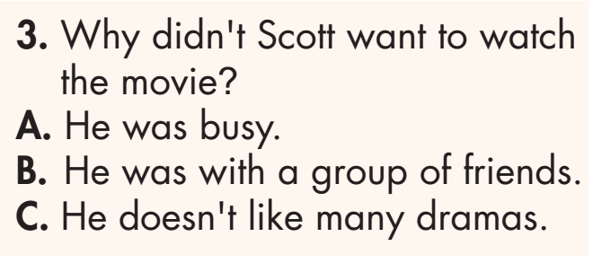
Pre-Reading
Underline key words.

Slide 25
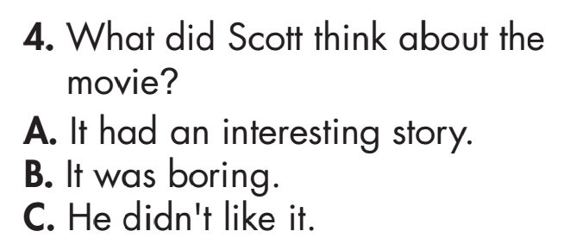
Pre-Reading
Underline key words.

Slide 26
While-Reading

Slide 27
While-Reading

Slide 28
While-Reading

Slide 29
While-Reading

Slide 30
Extra Practice
WB page 68

Slide 31
Extra Practice
WB page 68

Slide 32
Extra Practice
WB page 68

Slide 33
Extra Practice
WB page 68

Slide 34
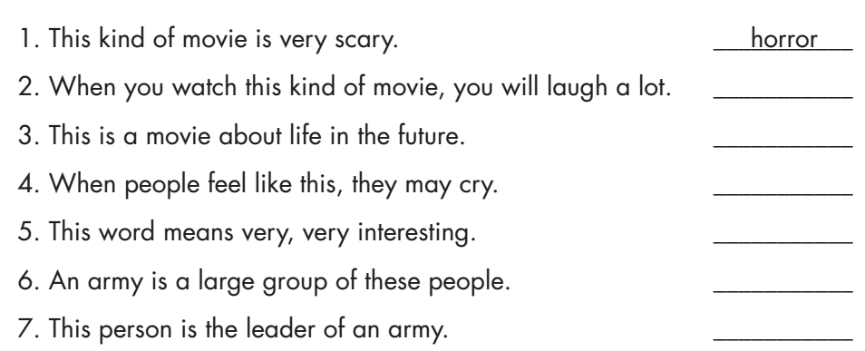
comedy
science fiction
sad
exciting
soldiers
general

Slide 35
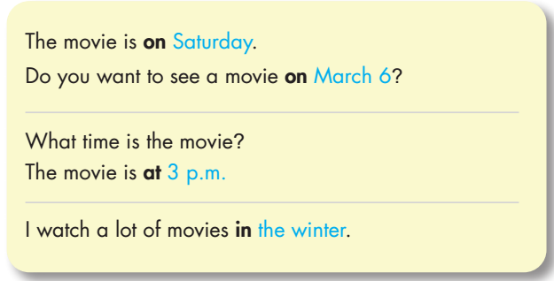

Slide 36
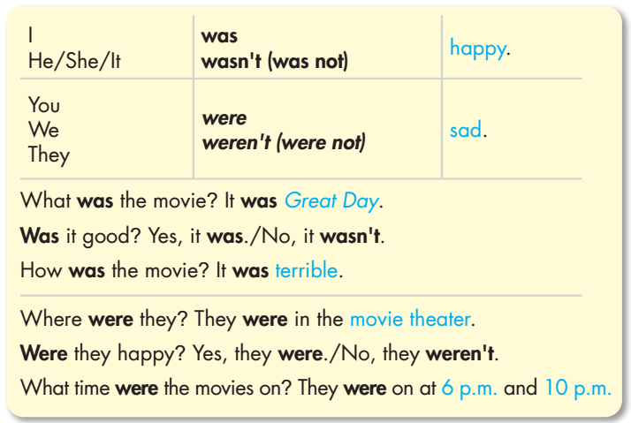

Slide 37
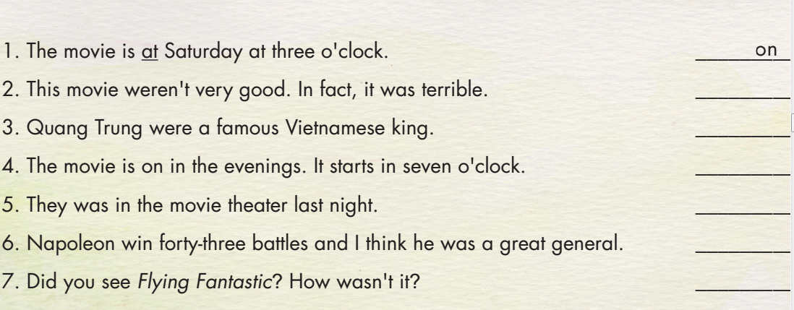
Underline the mistake in each sentence. Write the correct word on the line.
wasn’t
was
at
were
won
was

Slide 38
Where is the stress in each of these words?
against boring action fantasy exciting become adventure
horror comic between soldier movie author title animation
wonderful mystery amazing musical terrible animated
1st syllable | Second syllable | Third syllable

Slide 39
Where is the stress in each of these words?
against boring action fantasy exciting become adventure
horror comic between soldier movie author title animation
wonderful mystery amazing musical terrible animated
FIRST SYLLABLE
Boring Action
Fantasy Horror
Comic Soldier
Movie Author
Title Terrible
Wonderful Mystery
Musical Animated

Slide 40
Where is the stress in each of these words?
against boring action fantasy exciting become adventure
horror comic between soldier movie author title animation
wonderful mystery amazing musical terrible animated
SECOND SYLLABLE
Against
Exciting
Become
Adventure
Between
Amazing

Slide 41
Where is the stress in each of these words?
against boring action fantasy exciting become adventure
horror comic between soldier movie author title animation
wonderful mystery amazing musical terrible animated
THIRD SYLLABLE
animation

Slide 42
Stress on the first syllable. The rest are on the second syllable.
Stress on the third syllable. The rest are on the first syllable.
Stress on the second syllable. The rest are on the first syllable.

Slide 43
Stress on the second syllable. The rest are on the first syllable.
Stress on the second syllable. The rest are on the first syllable.

Slide 44
CONSOLIDATION

Slide 45
Answer the following questions in pairs.
- What kinds of movies do you like? Use some adjectives to describe those kinds of movie.
- What kind of movie do you dislike? Use an adjective to describe that kind of movie.
- What are you doing on Saturday?
- List down a historical movie you watched. How was the movie? Who was it about?

Slide 46
WRAP-UP

Slide 47
Lesson 3
Today’s lesson
Vocabulary: Review vocabularies related to movies.
Structure: Review prepositions: on/at/in and Past Simple with “be”.
Pronunciation: Identify words with different stress.
Reading: Practice reading for specific information.
Listening: Practice listening for details.

Slide 48
Homework
Review all the vocabularies, pronunciation and grammar points in the unit.
Prepare the next lesson (page 61 - SB).
Play the consolidation games in Tiếng Anh 6 i-Learn Smart World DHA App on www.eduhome.com.vn.

Slide 49
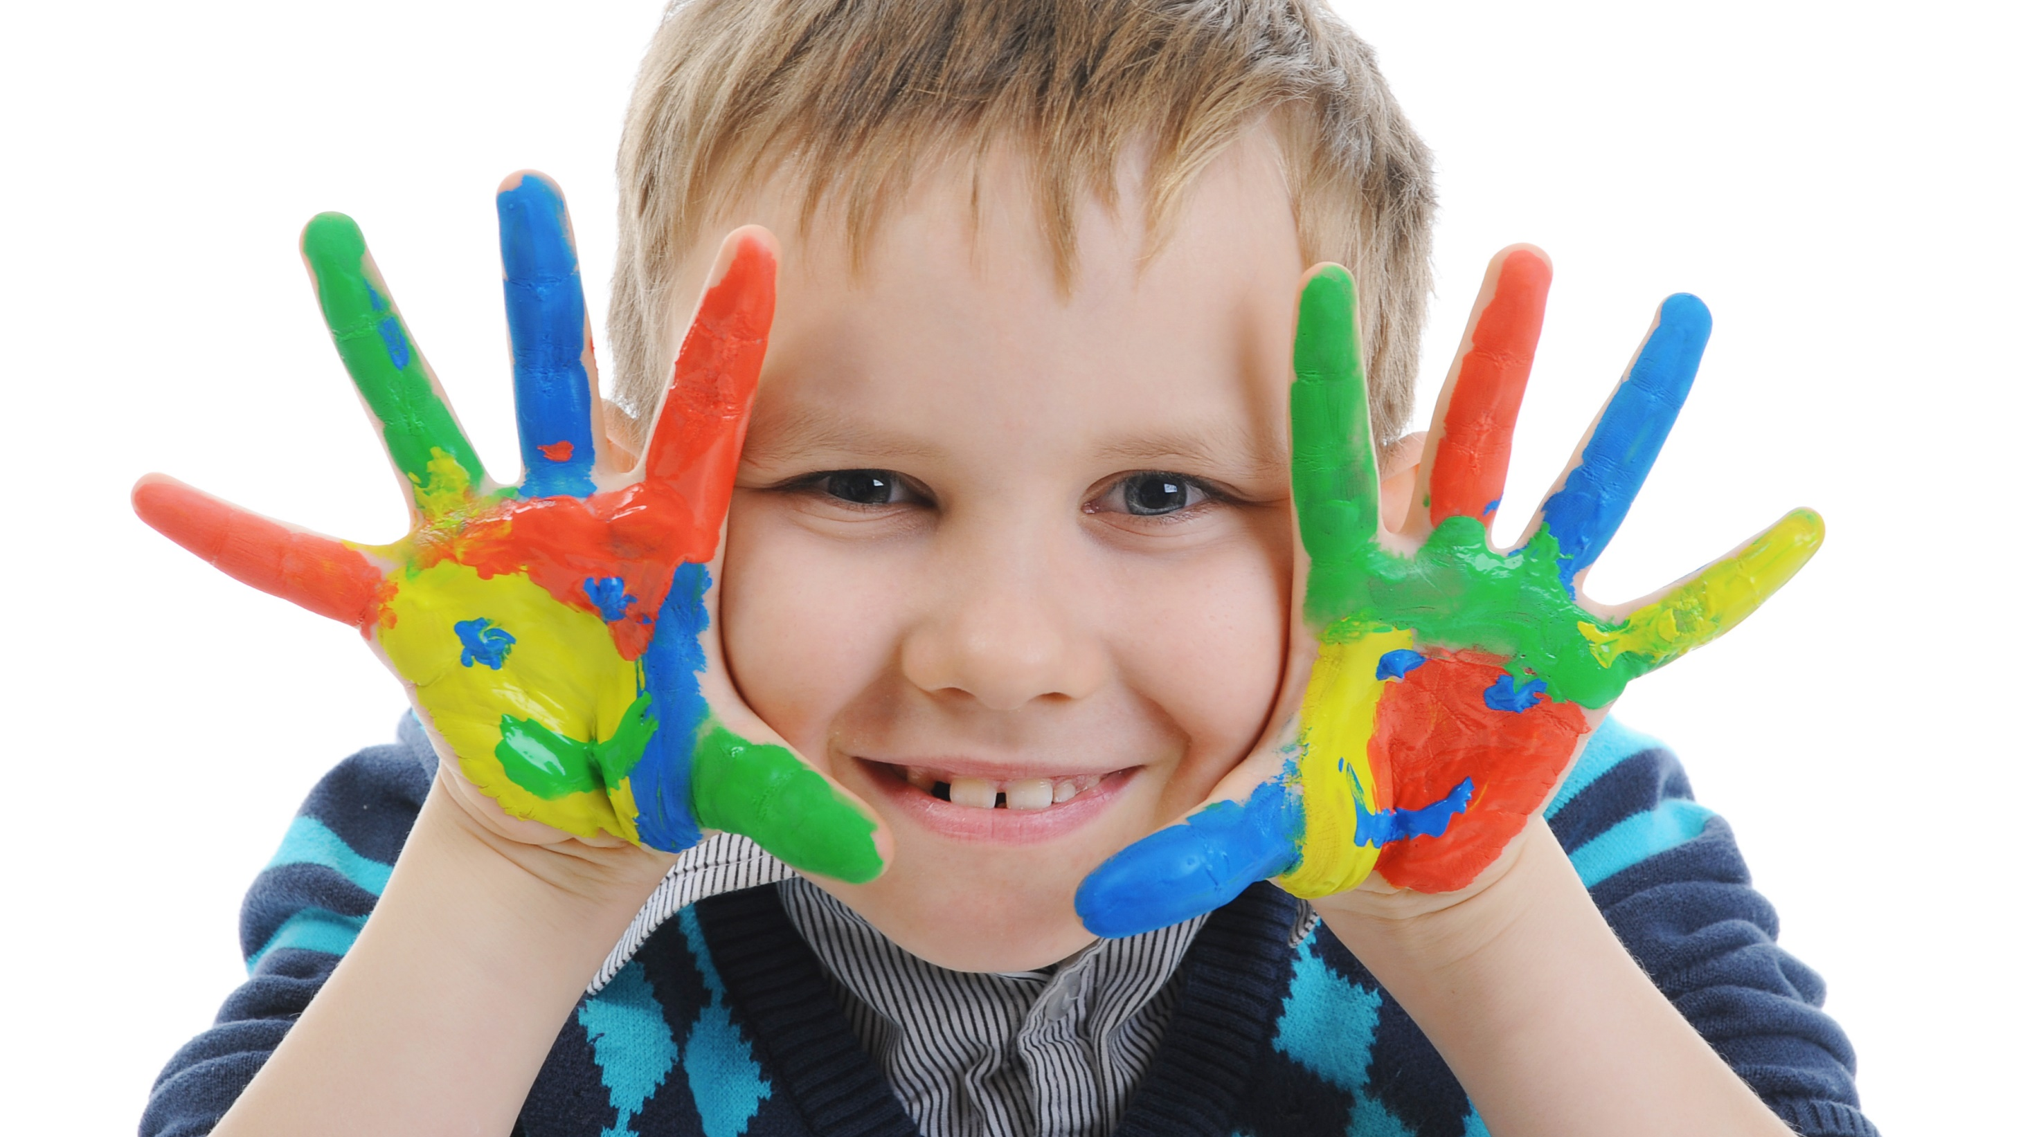
Enjoy your day!

