Slide 1

Unit 7: Movies
Lesson 2.3: Pronunciation & Speaking
Page 59

Slide 2
Lesson Outline
Warm-up
Pronunciation
Practice
Speaking
Consolidation
Wrap-up

Slide 3

Objectives
By the end of this lesson, students will be able to…
stress the first syllable for most two-syllable adjectives.
express opinions and exchange information about movies.

Slide 4

WARM-UP

Slide 5



Slide 6
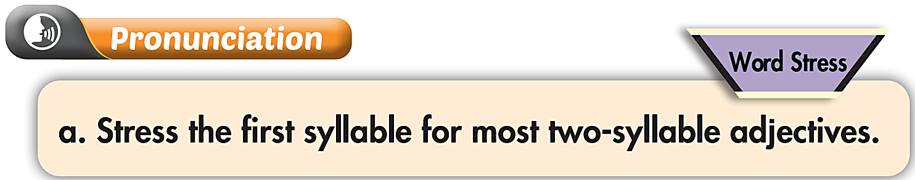
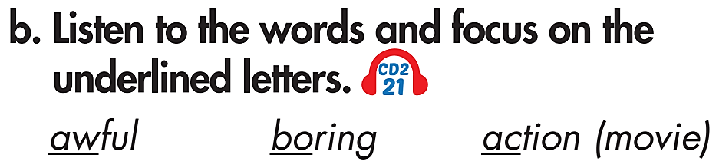

Listen again and repeat

Slide 7
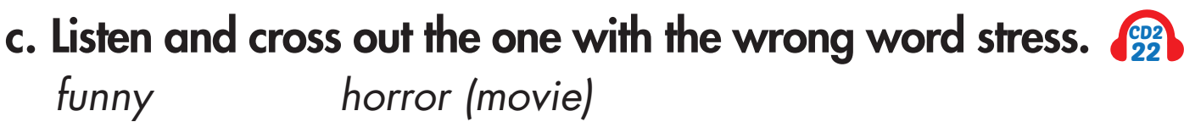
funny – Wrong. Stress is on
the second syllable
Listen again and repeat

Slide 8

Speaking

Slide 9
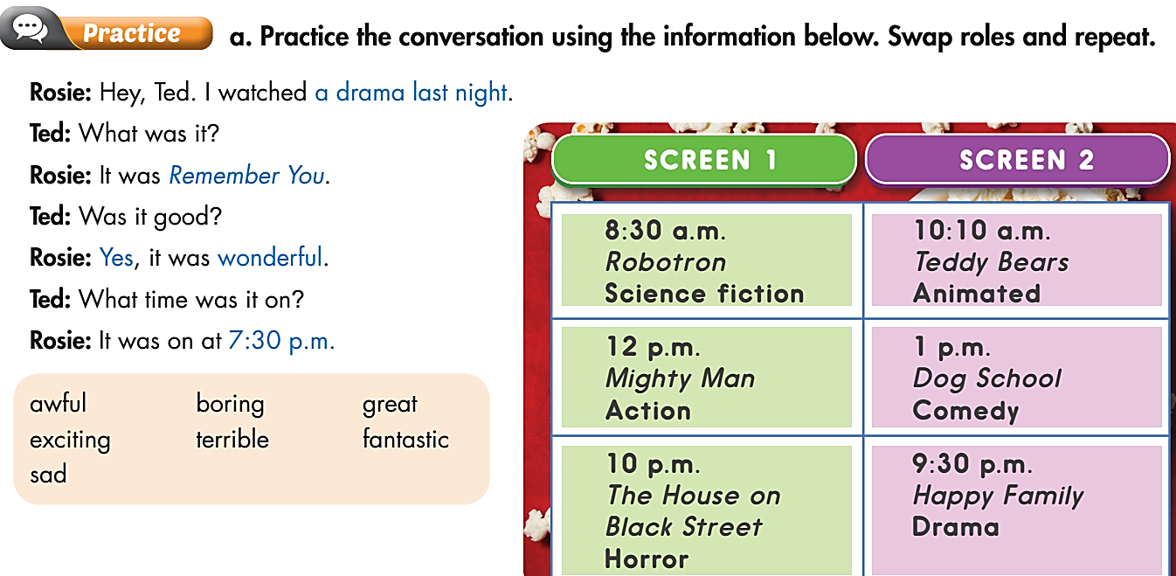
Pre-Speaking

Slide 10
Pre-Speaking
Rosie: Hey, Ted. I watched an action movie yesterday.
Ted: What was it?
Rosie: It was Mighty Man.
Ted: Was it good?
Rosie: No, it was terrible.
Ted: What time was it on?
Rosie: It was on at 12:00 p.m.

Slide 11
Pre-Speaking
Rosie: Hey, Ted. I watched an animated movie yesterday.
Ted: What was it?
Rosie: It was Teddy Bears.
Ted: Was it good?
Rosie: Yes, it was great.
Ted: What time was it on?
Rosie: It was on at 10:10 a.m.

Slide 12
Pre-Speaking
Rosie: Hey, Ted. I watched a science fiction movie yesterday.
Ted: What was it?
Rosie: It was Robotron.
Ted: Was it good?
Rosie: Yes, it was fantastic.
Ted: What time was it on?
Rosie: It was on at 8:30 a.m.

Slide 13

Pre-Speaking
A: Hey, Ted. I watched .
B: What was it?
A: It was .
B: Was it good?
A: , it was .
B: What time was it on?
A: It was on at .

Slide 14
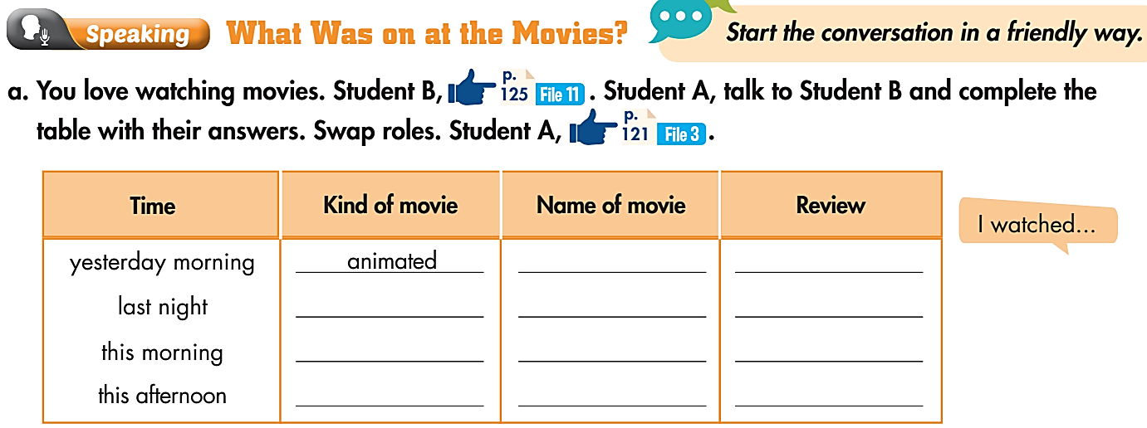
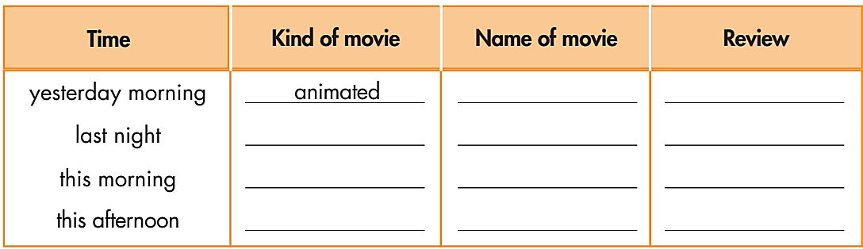
While-Speaking
Hey,….. I watched an animated movie yesterday.
Play Time
boring
What was it?
It was Play Time.
Was it good?
No, it was boring.
What time was it on?
It was on at 10 a.m.

Slide 15

While-Speaking
You love watching movies. . Student B, talk to Student A and complete the table with their answers.
Hey,….. I watched a comedy yesterday.
comedy
Dr. Disaster
funny
What was it?
It was Dr. Disaster.
Was it good?
Yes, it was funny.
What time was it on?
It was on at 9 a.m.

Slide 16
While-Speaking
Hey, _____. I watched _____.
What was it?
It was _____.
Was it good?
Yes, it was _____.
What time was it on?
It was on at _____.

Slide 17
Post-Speaking
Each student asks 5 friends in the class about the movie they last saw and fill in the following table.
You: Hey, what was the last movie you watched?
People’s name | Name of movie | Kind of movie | Time | Review
Winnie | Slumdog Millionaire | drama | 3 days ago | fantastic
Winnie: It was Slumdog Millionaire.
You: What kind of movie was it?
Winnie: It was a drama.
You: When did you watch it?
Winnie: 3 days ago.
You: Was it good?
Winnie: Yes, it was fantastic.

Slide 18

Unit 7
CONSOLIDATION

Slide 19
Write about the last movie you saw. Please include the name, type of film, the time and place you watched it, who were with you, and your film review. Please write at least 40 words.
e.g.
The last movie I saw was Skyfall. It was an action movie. I watched it on TV at home last night with my sister at about 8 p.m. The actors in the film were great. The music was also good. There were a lot of exciting action scenes in the film. It was fantastic.

Slide 20
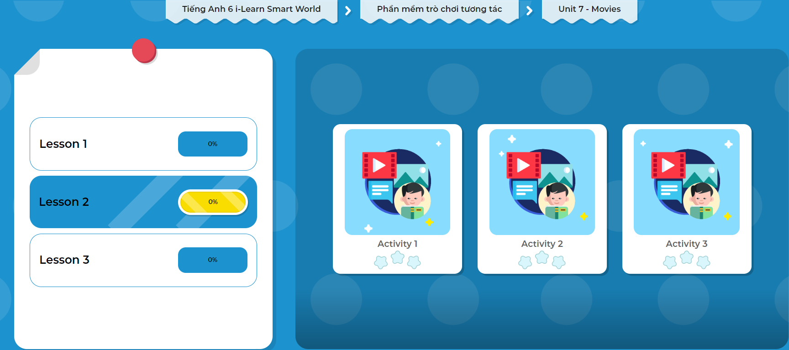
Click on the picture below to play the games!

Slide 21

WRAP-UP

Slide 22
Today’s lesson
Pronunciation:
stress the first syllable for most two-syllable adjectives
Speaking:
express opinions and exchange information about movies

Slide 23
Homework
Learn by hearts vocabularies, practice the grammar, and make sentences using them.
Do the exercises on page 41 WB.
Prepare the next lesson (page 60 - SB).
Play the consolidation games in Tiếng Anh 6 i-Learn Smart World DHA App on www.eduhome.com.vn.

Slide 24

Have a nice day!

