Slide 1

Unit 7: Movies
Lesson 2.2: Grammar
Page 58

Slide 2
Lesson Outline
Warm-up
Grammar
Consolidation
Wrap-up

Slide 3

Objectives
By the end of this lesson, students will be able to:
Use the Past Simple (with TO BE) to talk about completed events, states, or actions.

Slide 4

WARM-UP

Slide 5
Work in pairs
Underline the sentences that describe activities in the past.
I was late for class yesterday.
I will tell you a very interesting story.
They were not at home when I came there.
He was very excited about the movie last night.
Mary is preparing the meal for the whole family.

Slide 6

PRESENTATION
Use the Past Simple to talk about completed events, states, or actions.

Slide 7
Look at three sentences and circle the correct word to complete the rule for Past Simple Tense with TO BE:
I was born on 21st April 2010.
Jack was late for his meeting last week.
They were not at the office yesterday.
I He/ She / It | was wasn’t (was not) | happy.
You We They | were weren’t (were not) | sad.

Slide 8

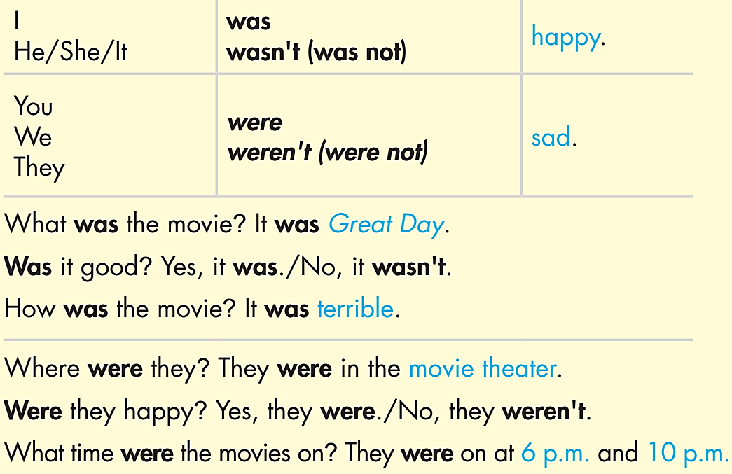
Remember:

Slide 9

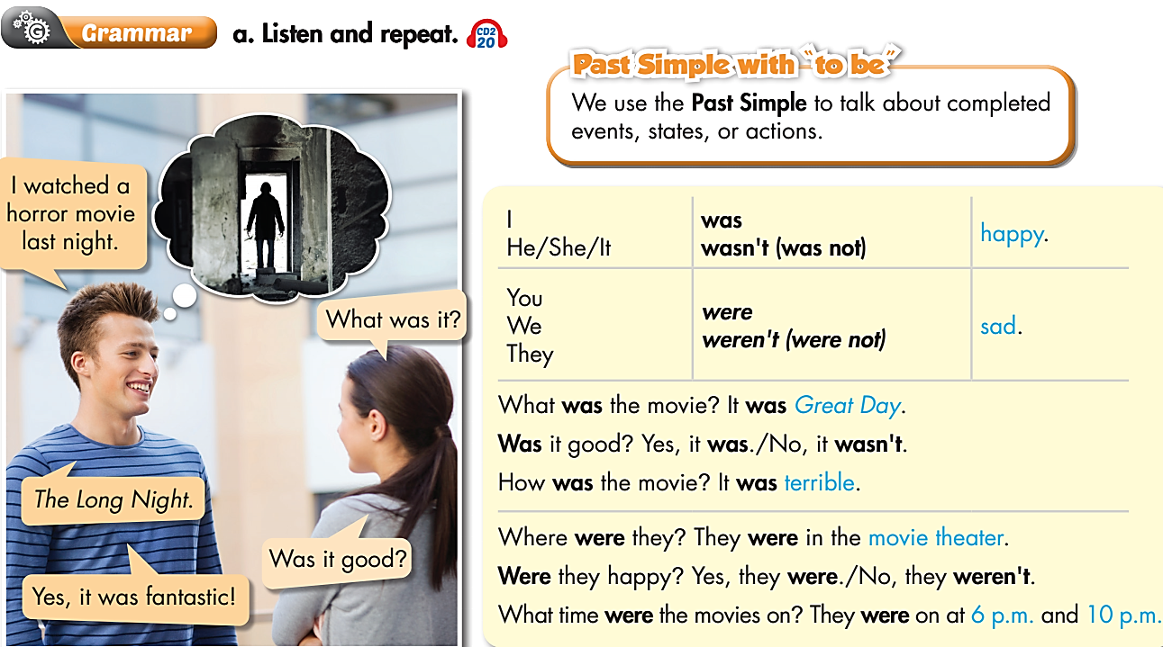

Slide 10

PRACTICE

Slide 11
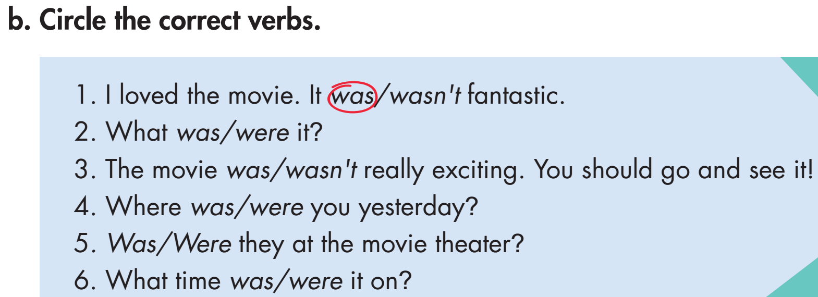

Slide 12
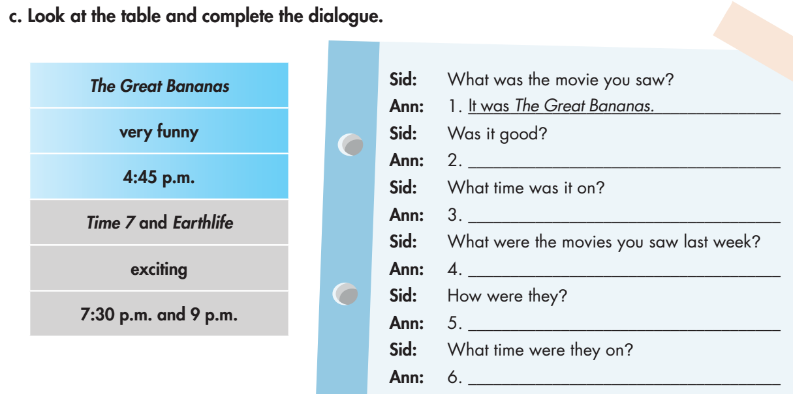
Yes, it was very funny.
It was on at 4:45 p.m.
They were Time 7 and Earth life.
They were exciting.
They were on at 7:30 p.m. and 9 p.m.

Slide 13
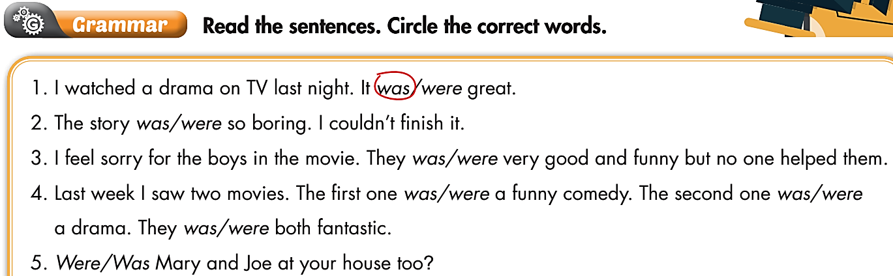
Extra Practice
WB p. 38

Slide 14
PRODUCTION

Slide 15

Work in pairs
Ask and answer about your last trip with your family:
When was your last trip with your family?
Who was the first person to have the idea of the trip?
How was the weather on the trip?
How was the destination?
What were the feelings of family members during the trip?
E.g.
A: Hey, do you want to go out with me this weekend?
B: Sure.
A: When are you free?
B: I’m free on Sunday.
A: Yes, me too. What time shall we meet?
B: At 10 a.m. Shall we meet at the Bella coffee shop?
A: That sounds great.
When was your last trip with your family?
My last trip with my family was last month.

Slide 16
Report about your friend’s most special day in a year.
Hi, my name is……. My friend’s name is……. He/ She had a trip with his/ her family……… His/ Her………… was the first person to have the idea of the trip. The weather on the trip was………. The destination was…… He/ She was…….. Other family members were ……… during the trip.

Slide 17

CONSOLIDATION

Slide 18
Write about the last time you went out. Remember to describe the time, place, the weather, your feelings, and people you went out with. (Please write at least 40 words).
E.g.
The last time I went out was last Sunday. I went to the movies with my classmates. It was the first time we went to the cinema, so we were very excited. We were afraid of the rain, but luckily, it was sunny.

Slide 19
The police station is to the left of the movie theater and the post office is to the right of the movie theater. (BETWEEN)
→ The movie theater_____________________________________________________________.
Keep our community clean by picking up trash. (TO)
→ Pick_____________________________________________________________.
My house is behind the post office. (FRONT)
→ The post office_____________________________________________________________.

Slide 20
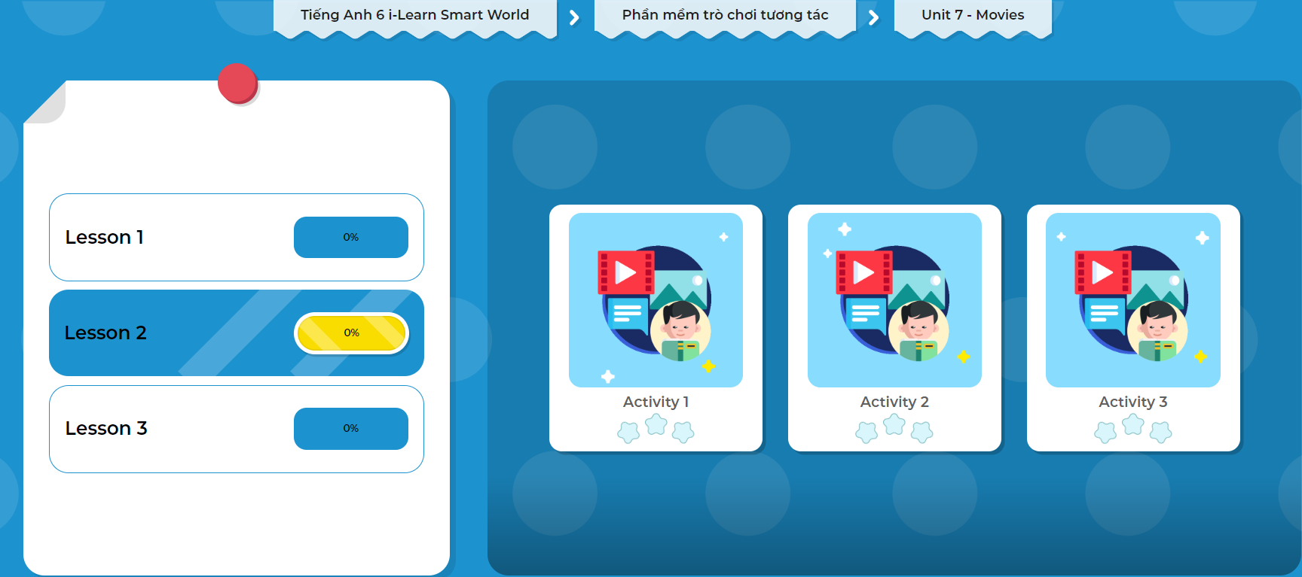
Click on the picture below to play the games!

Slide 21

WRAP-UP

Slide 22
Today’s lesson
Grammar
Use the Past Simple (with TO BE) to talk about completed events, states, or actions.

Slide 23
Homework
Practice the grammar point, make sentences using it
Do the exercises on page 41 WB.
Complete the grammar notes in Tiếng Anh 6 i-Learn Smart World Notebook on page 43.
Prepare the next lesson (page 59 - SB).
Play the consolidation games in Tiếng Anh 6 i-Learn Smart World DHA App on www.eduhome.com.vn

Slide 24
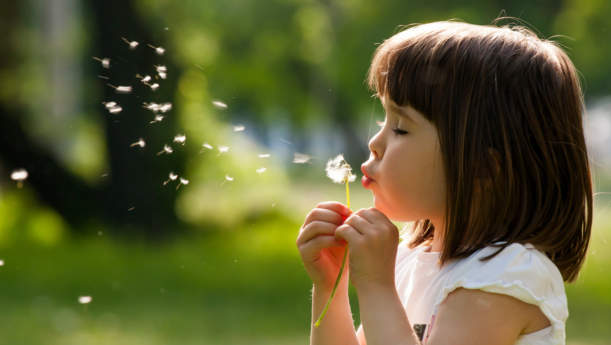
Enjoy your day!

