Slide 1

Unit 7: Movies
Lesson 1.3: Pronunciation & Speaking
Page 56

Slide 2
Lesson Outline
Warm-up
Pronunciation
Practice
Speaking
Consolidation
Wrap-up

Slide 3

Objectives
By the end of this lesson, students will be able to…
make and respond to suggestions about movies
pronounce /ət/ for "…at…" (but not at the start)

Slide 4

WARM-UP

Slide 5
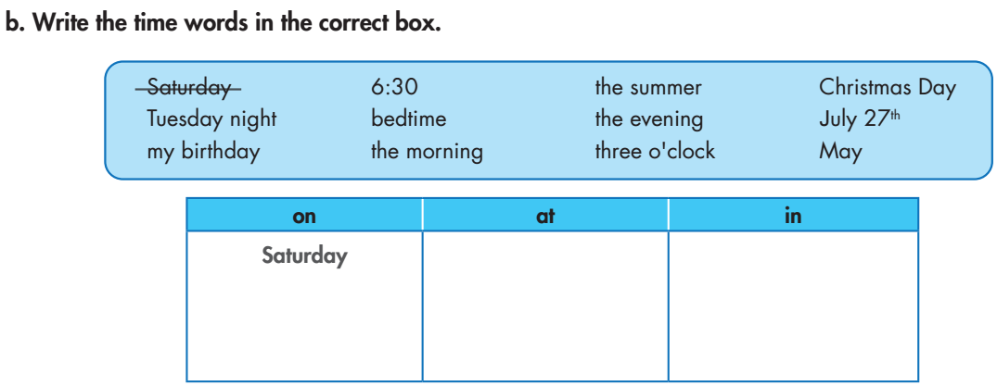
6:30
the summer
Christmas Day
the evening
Tuesday night
bedtime
the morning
my birthday
three o'clock
May
July 27th

Slide 6

SM4 IN, ON, AT (time) - Gameshow quiz

Slide 7
Find someone who …..
In 5 minutes, walk around the class to find people who love each type of movies to fill in the table. Who finishes it first will say Bingo and become the winner.
Type of movie | The person who loves it
comedy
science fiction
horror
action
drama
animated
What’s your favorite type of movie?
It’s drama.

Slide 8



Slide 9
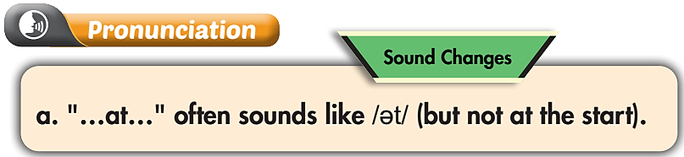

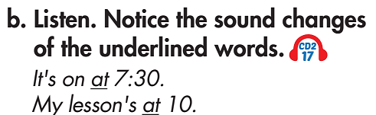
Listen again and repeat

Slide 10
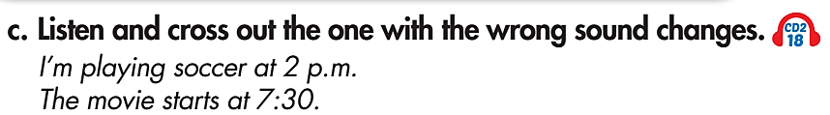
Wrong.
Doesn't use the weak form.
Listen again and repeat

Slide 11
Practice pronouncing “at” in the following sentences:
At 3 o’clock this morning, I woke up.
I usually wake up at 7:00 a.m.
I’m going to meet Jack at the cinema.
I often visit my parents at Christmas.
At night, most shops are closed.
Lucy looked at the picture carefully.
I couldn’t find the answer at that time.
Tim is very famous at school.
At the end of the road, a young girl is playing guitar.

Slide 12

Speaking

Slide 13
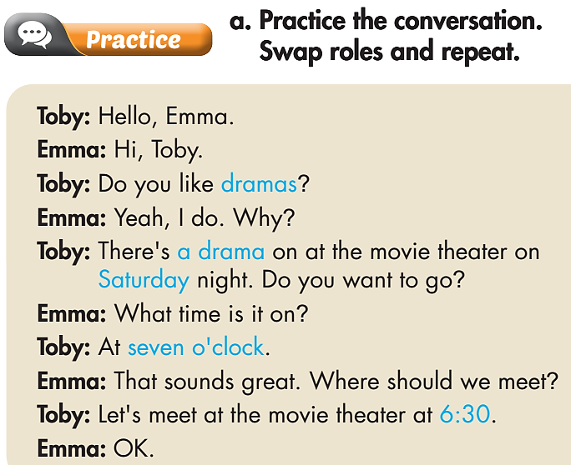
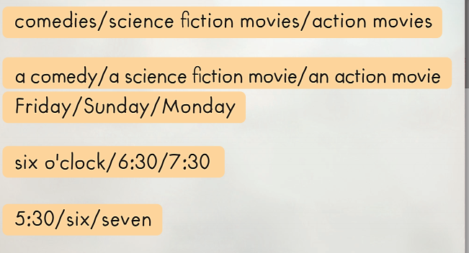
Pre-Speaking

Slide 14
Pre-Speaking
Toby: Hello, Emma.
Emma: Hi, Toby.
Toby: Do you like comedies?
Emma: Yeah, I do. Why?
Toby: There's a comedy on at the movie theater on Friday night. Do you want to go?
Emma: What time is it on?
Toby: At six o'clock.
Emma: That sounds great. Where should we meet?
Toby: Let's meet at the movie theater at 5:30.
Emma: OK

Slide 15
Pre-Speaking
Toby: Hello, Emma.
Emma: Hi, Toby.
Toby: Do you like science fiction movies?
Emma: Yeah, I do. Why?
Toby: There's a science fiction movie on at the movie theater on Sunday night. Do you want to go?
Emma: What time is it on?
Toby: At 6:30.
Emma: That sounds great. Where should we meet?
Toby: Let's meet at the movie theater at six.
Emma: OK

Slide 16
Pre-Speaking
Toby: Hello, Emma.
Emma: Hi, Toby.
Toby: Do you like action movies?
Emma: Yeah, I do. Why?
Toby: There's an action movie on at the movie theater on Monday night. Do you want to go?
Emma: What time is it on?
Toby: At 7:30.
Emma: That sounds great. Where should we meet?
Toby: Let's meet at the movie theater at seven.
Emma: OK

Slide 17

Pre-Speaking
A: Hello, ________.
B: Hi, Toby.
A: Do you like ________?
B: Yeah, I do. Why?
A: There's ________ on at the movie theater on ________ night. Do you want to go?
B: What time is it on?
A: At ________.
B: That sounds great. Where should we meet?
A: Let's meet at the movie theater at ________.
B: OK

Slide 18
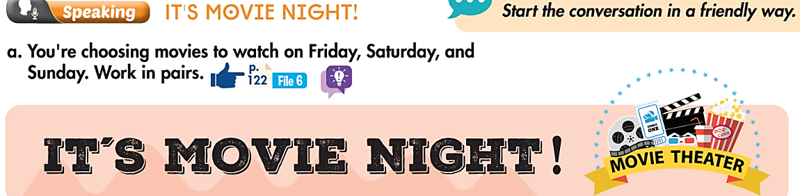
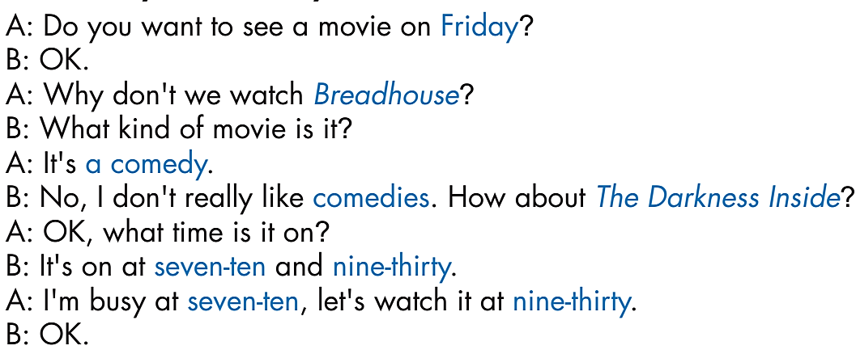
While-Speaking

Slide 19
While-Speaking
We’re going to watch The Darkness Inside. What movie do you want to watch?
We are going to watch Breadhouse because we love comedies.

Slide 20
Post-Speaking
Find movie goers
After choosing movies in pairs, each student walks around the class and asks friends who will watch each movie and fill in the following table.
Movie | Day & Time | Movie goers
Play time | 12:00 - Friday | Alex
The boys
Bull fight
High school dance-off
Space wars
Breadhouse
That moment at midnight
The darkness inside
Robot world
You: Hey, what movie do you want to watch?
Alex: I’m going to watch Play time.
You : What time do you want to watch it?
Alex: I’m going to watch it at 12:00 on Friday.

Slide 21

Unit 7
CONSOLIDATION

Slide 22
Write about your discussion to go to the movies this weekend.
Report what movie you want to see, what movie your friend wants to see and why. What is your decision? Tell all the time the movie is on. Find reasons why you decide on one time to see it.
E.g.
I am going to the movies with my friend this weekend. I want to see Space wars, a science fiction film. My friend wants to see Breadhouse, a comedy because he loves funny films. We decide to see Breadhouse. It is on at 1:40 and 6:15 on Sunday. Because 6:15 is a bit late, so we plan to watch it at 1:40.

Slide 23
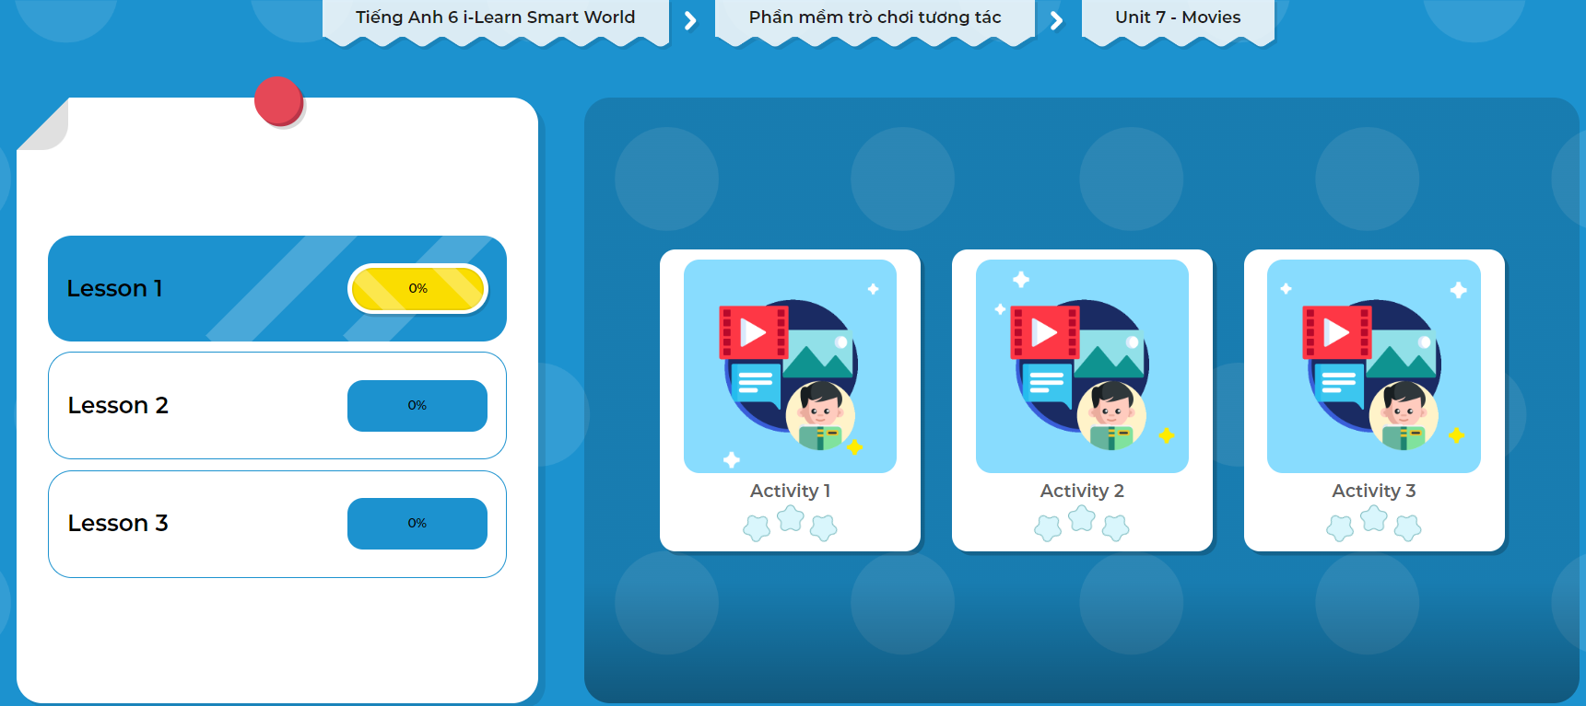
Click on the picture below to play the games!

Slide 24

WRAP-UP

Slide 25
Today’s lesson
Pronunciation:
pronounce /ət/ for "…at…" (but not at the start)
Speaking:
- make and respond to suggestions about movies

Slide 26
Homework
Learn by hearts vocabularies and make sentences using them.
Do the exercises on page 39 WB.
Prepare the next lesson (page 57 - SB).
Play the consolidation games in Tiếng Anh 6 i-Learn Smart World DHA App on www.eduhome.com.vn.

Slide 27
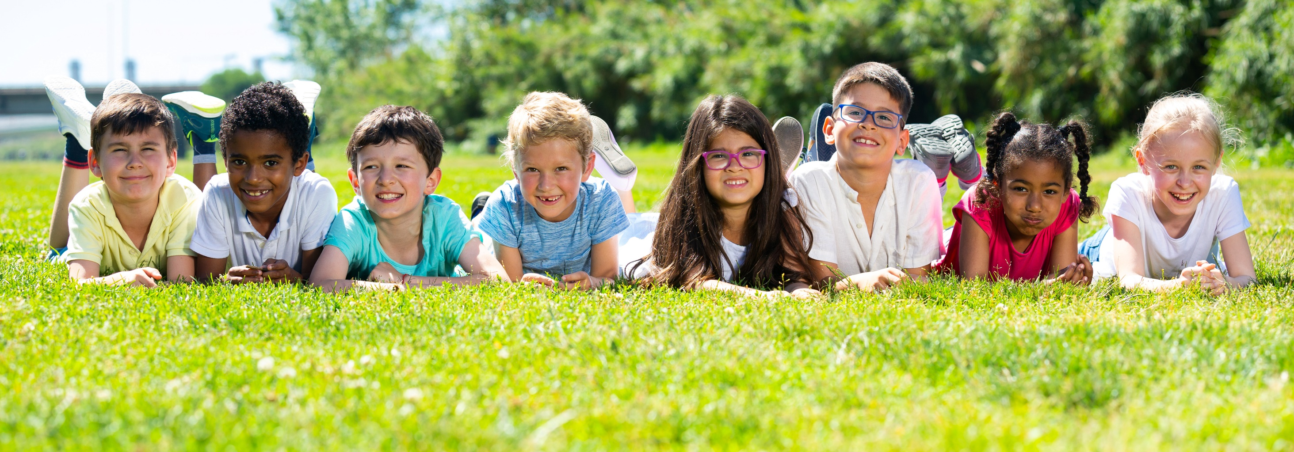
Have a nice day!

