Slide 1
Unit 7: Movies
Period 65 - Lesson 1.2: Grammar
Page 55

Slide 2
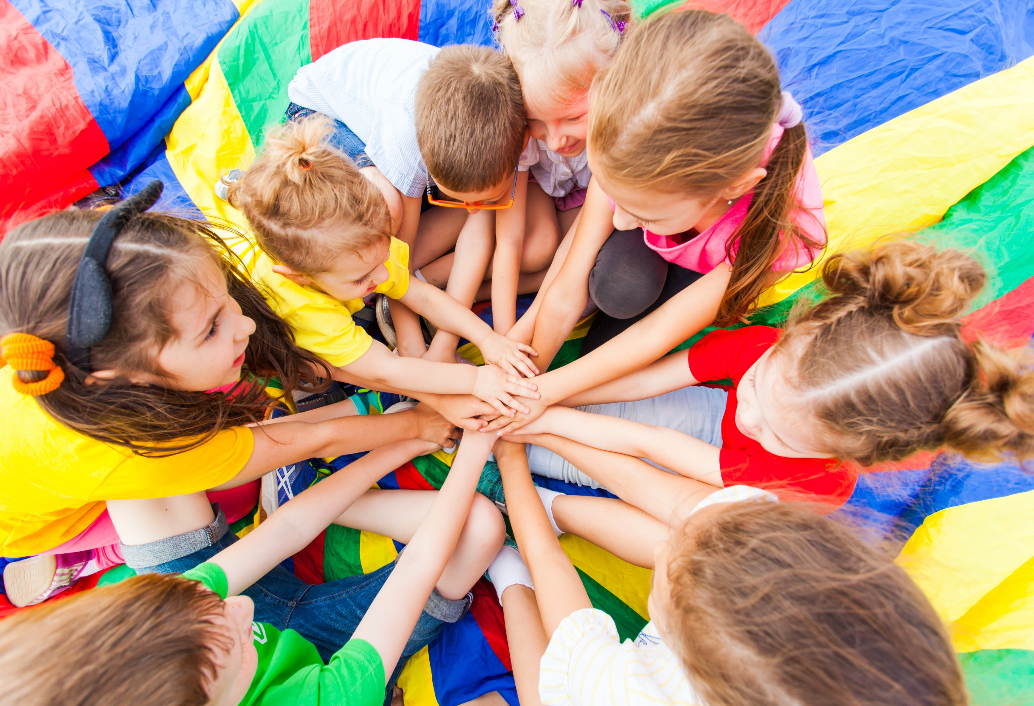
WARM-UP

Slide 3
Reorder the sentences:
1. birthday / is / 12th February. / My / on
→
2. movie / The / 6:30. / at / is
3. am / I / busy / the afternoon. / in
→
4. at / on / is / a / There / horror / 5 p.m. / Monday / film
→
My birthday is on 12th February.
The movie is at 6:30.
I am busy in the afternoon.
There is a horror film on Monday at 5 p.m.

Slide 4
PRESENTATION
Use prepositions of time to say when things happen

Slide 5
My birthday is on 12th February.
The movie is at 6:30.
I am busy in the afternoon.
There is a horror film on Monday at 5 p.m.
in, on, at
Prepositions of time
Giới từ chỉ thời gian,

Slide 6
Look at three sentences and complete the rule for prepositions of time:
My birthday is on 12th February.
The movie is at 6:30.
I am busy in the afternoon.
There is a horror film on Monday at 5 p.m.
Use ______ with days and dates.
Use _______ with specific times.
Use _______ with periods of time.
on
Có Thứ , ngày tháng
at
Thời điểm cụ thể
in
Khoảng thời gian

Slide 8
Remember:

Slide 9
PRACTICE

Slide 10
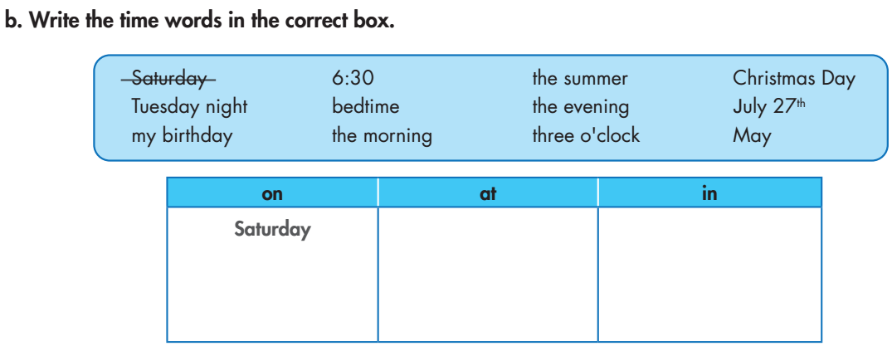
6:30
the summer
Christmas Day
the evening
Tuesday night
bedtime
the morning
my birthday
three o'clock
May
July 27th

Slide 11
in the evening
at 2 p.m.
on Sunday at 10 a.m.
in the summer
at 10:30 in the morning

Slide 12
PRODUCTION

Slide 14
SM4 IN, ON, AT (time) - Gameshow quiz

Slide 15
WRAP-UP

Slide 16
Today’s lesson
Grammar
Use prepositions of time to say when things happen.
Use on with days and dates.
Use at with specific times.
Use in with periods of time.

Slide 17
Homework
Do the exercises on pages 39 WB.
Do the exercises in Tiếng Anh 6 i-Learn Smart World Notebook on page 41.
Prepare the next lesson (page 56 - SB).
Play the consolidation games in Tiếng Anh 6 i-Learn Smart World DHA App on www.eduhome.com.vn.

Slide 18
CONSOLIDATION

Slide 19
Write at least 3 activities you do every weekday, and some special activities you do on the weekend. Remember to include the time. Please write at least 40 words.
e.g.
I usually wake up at 6 o’clock to have breakfast. Then I go to school at 6:40 a.m. I go back home at 5:00 p.m to have a bath and watch TV. After dinner, I do my homework at 7:30 p.m. Then I go to bed at 9:00 p.m. On the weekend, I often get up late at 8:00 a.m. At 10:00 a.m., my family visits my grandparents and stays there until the afternoon. In the evening, I watch TV with my family until 9:00 p.m.

Slide 20
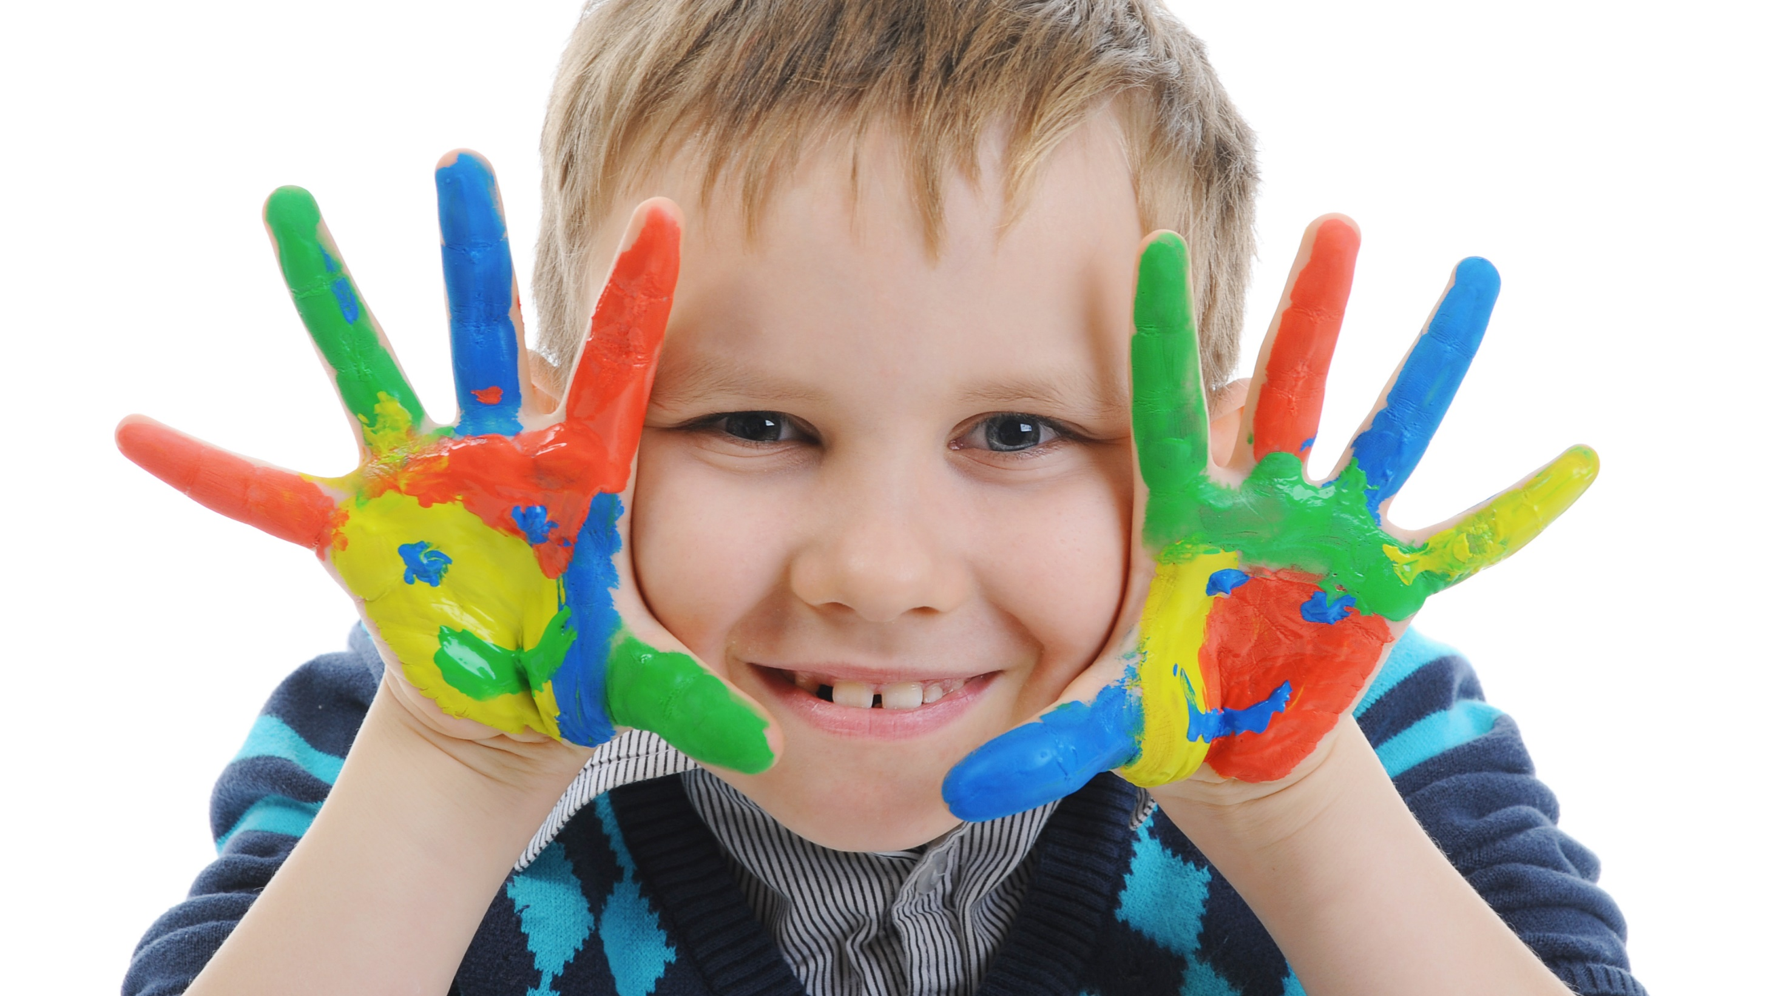
Enjoy your day!

