Slide 1
Unit 7: Movies
Lesson 1.1: Vocabulary & Listening
Page 54

Slide 2
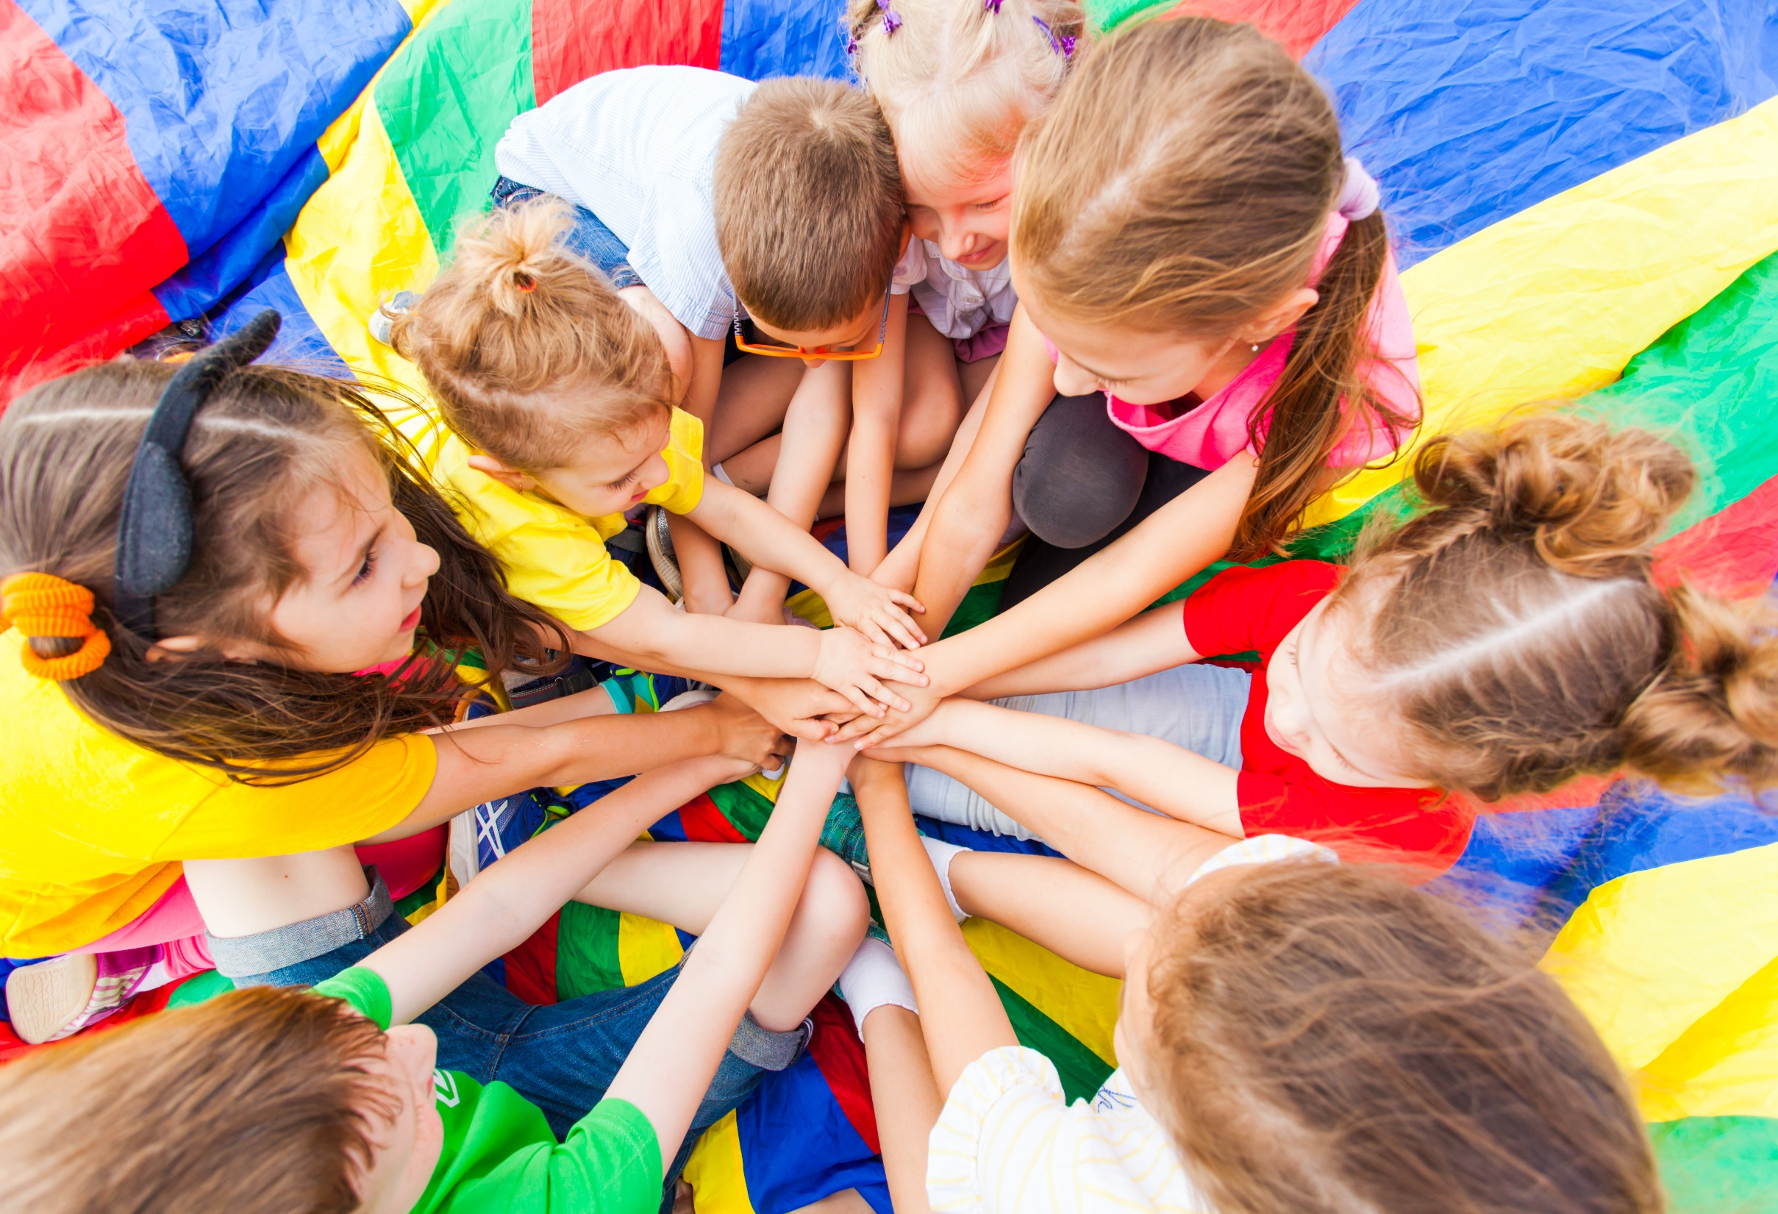
WARM-UP

Slide 3
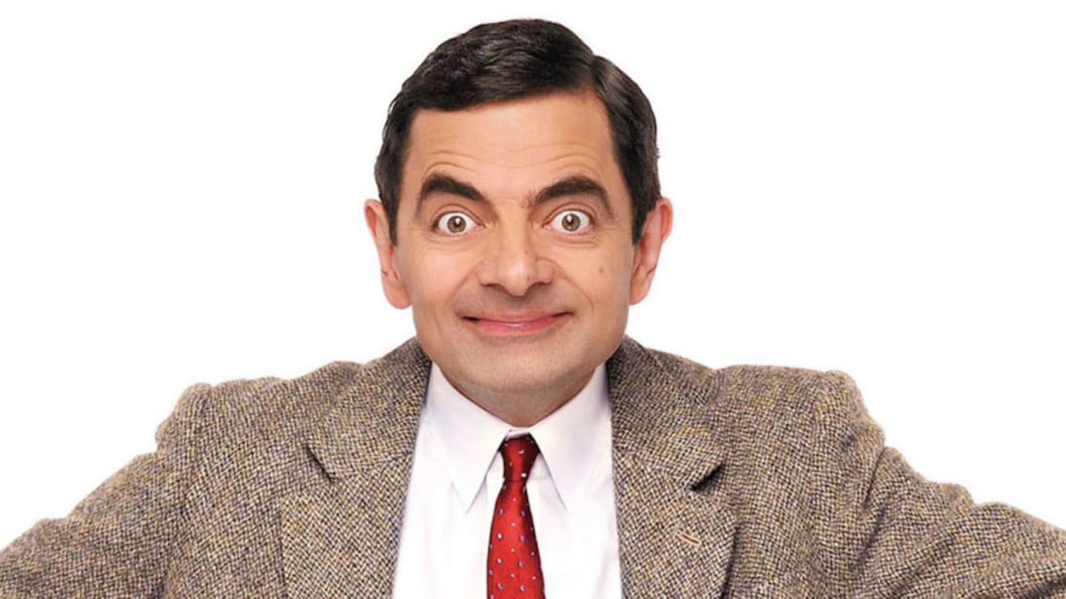
LESSON 6: SKILLS 2
Watch the video and write down the type of the film.

Slide 5
New words
comedy
science fiction
horror
action
drama
animated

Slide 6
Work in pairs. Number the pictures.
3
6
2
4
5

Slide 7
Listen and repeat. Click each phrase to hear the sound.
comedy (n) /ˈkɒmədi/ phim hài
science fiction (n) /ˌsaɪəns ˈfɪkʃn/ phim khoa học viễn tưởng
horror (n) /ˈhɔːrər/ phim kinh dị
action (n) /ˈækʃn/ phim hành động
drama (n) /ˈdrɑːmə/ phim chính kịch
animated (adj) /ˈænɪmeɪtɪd/ hoạt hình

Slide 8
Practice saying the words. Focus on the word stress.
comedy (n) /ˈkɒmədi/ phim hài
science fiction (n) /ˌsaɪəns ˈfɪkʃn/ phim khoa học viễn tưởng
horror (n) /ˈhɔːrər/ phim kinh dị
action (n) /ˈækʃn/ phim hành động
drama (n) /ˈdrɑːmə/ phim chính kịch
animated (adj) /ˈænɪmeɪtɪd/ hoạt hình

Slide 9
Please complete the words about different types of movies:
ho_ _ _r
c_m_ _y
_ct_ _n
an_ _ _ted
d_ _m_
s_ _enc_ f_ _tion
horror
comedy
action
animated
drama
science fiction

Slide 10
Match the movies to their descriptions.
horror
comedy
action
animated
drama
science fiction
It has of a series of moving drawings of people, animals, and objects.
It is about future, space travel or life on other planets.
It has a series of events in someone’s life.
It makes you feel very afraid.
It has many exciting scenes like car chases or fighting.
It makes you laugh.
D
F
E
A
C
B

Slide 12
Extra Practice
WB page 38
animated
comedy
horror
action
science fiction

Slide 13
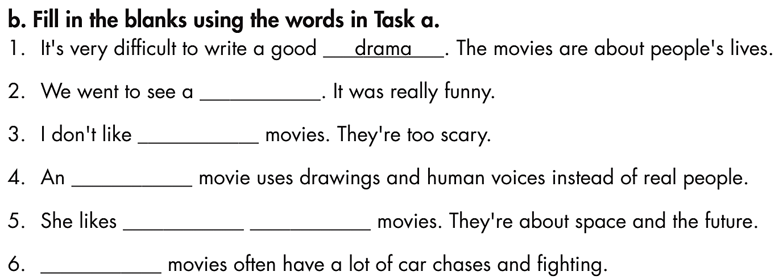
Extra Practice
WB page 38
comedy
horror
animated
science fiction
Action

Slide 14
Listening

Slide 15
Pre-Listening
Read the instruction quickly. Underline the key words. What are we going to do?
Listen and write the correct answer.

Slide 16
While-Listening
Now listen and write the correct answer.  FIRST TIME
☞ YOUR ANSWER?
animated movie
☞ WHY?

Slide 17
While-Listening
Now listen again and check.  SECOND TIME
While you are listening, focus on the film Lily wants to see and her friends’ ideas:
Lily: It's an animated movie.
Peter: I love animated movies.
Debra: Me too. What time's it on?
☞ YOUR ANSWER?
☞ THE ANSWER IS …
animated movie

Slide 18
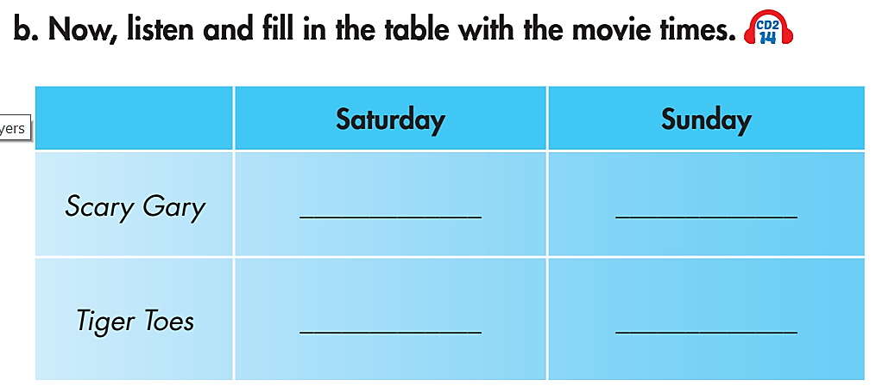
Pre-Listening
Read the instruction and questions quickly. Underline the key words. What are we going to do?

Slide 19
While-Listening
Now listen and fill in the blanks.  FIRST TIME
☞ WHAT ARE YOUR ANSWERS?

Slide 20
While-Listening
Now listen and fill in the blanks.  SECOND TIME
☞ WHY ARE THESE ANSWERS?
4:30
2:30, 7:30
5:00

Slide 21
While - listening
Now listen again and check.  THIRD TIME
Lily: Why don't we watch Scary Gary?
Debra: What kind of movie is it?
Lily: It's a horror movie.
Peter: Cool! What time is it?
Lily: It's only on this Saturday, at four-thirty.

Slide 22
Now listen again and check.  THIRD TIME
Lily: How about Tiger Toes?
Peter: What kind of movie is it?
Lily: It's an animated movie.
Peter: I love animated movies.
Debra: Me too. What time's it on?
Lily: It's on at two-thirty and seven-thirty on Saturday. Is seven-thirty OK?
Debra: Yeah.
Peter: No, I can't make it. How about on Sunday?
Lily: There's just one showing on Sunday afternoon, at five.

Slide 23
Audio Scripts
Practice the discussion in a group of three.
Lily: Hey! Do you want to see a movie this weekend?
Peter: Sure.
Lily: Why don't we watch Scary Gary?
Debra: What kind of movie is it?
Lily: It's a horror movie.
Peter: Cool! What time is it?
Lily: It's only on this Saturday, at four-thirty.
Debra: Oh, I'm busy then.
Lily: How about Tiger Toes?
Peter: What kind of movie is it?
Lily: It's an animated movie.
Peter: I love animated movies.
Debra: Me too. What time's it on?
Lily: It's on at two-thirty and seven-thirty on Saturday. Is seven-thirty OK?
Debra: Yeah.
Peter: No, I can't make it. How about on Sunday?
Lily: There's just one showing on Sunday afternoon, at five. Is everyone free?
Debra: Yeah!
Peter: Let's go!

Slide 24
Work in pairs
Post-Listening
What kind of movie would you like to watch?
I’d like to watch a comedy because it’s very funny.

Slide 25
Post-Listening

Slide 26
Work in pairs
Post-Listening
Hey! Do you want to see a movie this weekend?
Ask your friend to go to the movies this weekend. Remember to discuss these things:
The kind of film you want to see
The day and time you can watch it together
You can use the information from the Listening section.
Sure.
Why don’t we watch…….
What kind of movie is it?
It’s …………….
Cool. What time is it on?
It’s on ……………. at ………..
Oh…..

Slide 27
Extra Practice
WB page 38

Slide 28
CONSOLIDATION

Slide 29
Write at least 4 sentences to describe your plan to watch the movie with your friend at the weekend. You can use the information from the Listening Section.
Include the type of movie, why you want to watch that movie, the day and time you can watch together.
E.g.
We plan to watch Scary Gary. It’s a horror movie. We love watching scary scenes in the movie. We are going to watch it on Saturday at 4:30 p.m.

Slide 30
WRAP-UP

Slide 31
Today’s lesson
Vocabularies
comedy
science fiction
horror
action
drama
animated
Listening:
Listening for main ideas and specific information.
Speaking:
Start a friendly conversation
Make and respond to suggestions about movies
Use prepositions of time

Slide 32
Homework
Do the exercises on page 38 WB.
Do the exercises in Tiếng Anh 6 i-Learn Smart World Notebook on page 40.
Prepare the next lesson (page 55 - SB).
Play the consolidation games in Tiếng Anh 6 i-Learn Smart World DHA App on www.eduhome.com.vn.

Slide 33
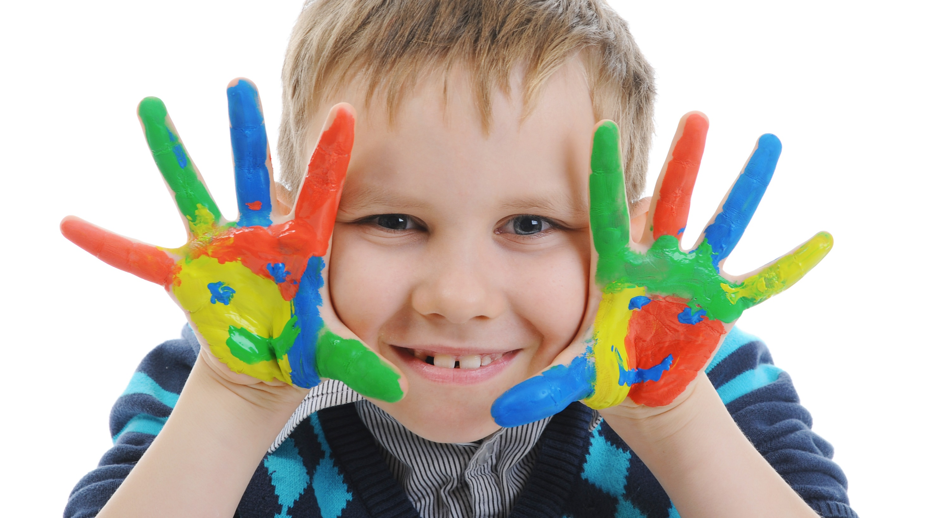
Enjoy your day!

