Slide 1

Unit 6. Community Services
Lesson: Review
Pages 96 & 97

Slide 2
Lesson Outline
Warm-up
Listening
Reading
Vocabulary
Grammar
Pronunciation
Consolidation
Wrap-up

Slide 3
Objectives
By the end of this lesson, students will be able to…
- review words related to environmental charity.
- review grammar: A/ an/ the; prepositions of place
- review pronunciation: /st/, /l/
- improve the listening, reading, speaking, and writing skills.

Slide 4

WARM-UP

Slide 5

Work in pairs
Write down as many vocabularies in Unit 6 as possible in 1 minute (books closed).

Slide 6
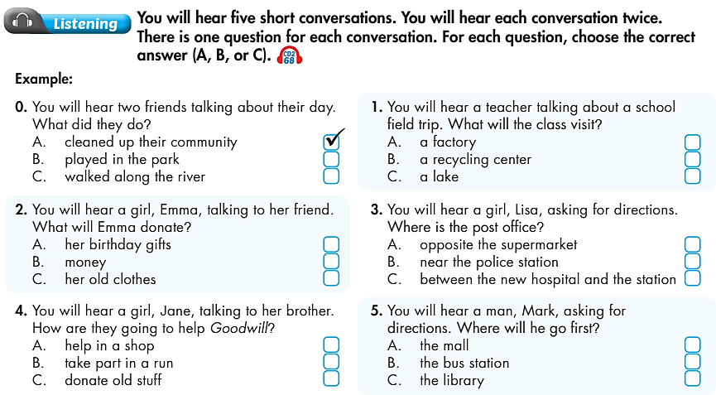

✓
✓
✓
✓
✓
✓

Slide 7
Audio Scripts
0. B: Are you tired?
G: Yes. There was so much trash in the park.
B: And along the river, too. There were cans and bottles everywhere.
G: But I'm glad that we cleaned up our community.
B: Me too.
1. W: Good morning, class. For our field trip on Saturday, you'll see how we can recycle plastic, glass, and paper. You'll also find out what happens to the trash that we can't recycle. The bus leaves at 8:30, so don't be late.

Slide 8
Audio Scripts
2. Jane: You have so many dresses, Emma.
Emma: I know. Most of them were birthday gifts.
Jane: Are you throwing these jeans and T-shirts away?
Emma: I don't know. I don't wear them anymore but they're still good.
Jane: Why don't you donate them?
Emma: That's a good idea!
3. Lisa: Excuse me, where's the post office?
Bob: There's a small one on King's Street, or a big one on New Street.
Lisa: The post office on King's Street. Is it near the police station?
Bob: No, it's opposite the supermarket.

Slide 9
Audio Scripts
4. Jane: Do you need these books, Ken?
Ken: No, I already read them.
Jane: What about your old toys?
Ken: No, I don't need them. Why are you collecting old stuﬀ?
Jane: I'm going to donate them to Goodwill.
Ken: I see. Let me help you.
5. Mark: Excuse me, where is the mall?
Tina: It's on Green Street, next to the bus station.
Mark: Thanks. How about the library?
Tina: That's near here. It's next to the park.
Mark: OK. I'll go there first. Thank you.

Slide 10
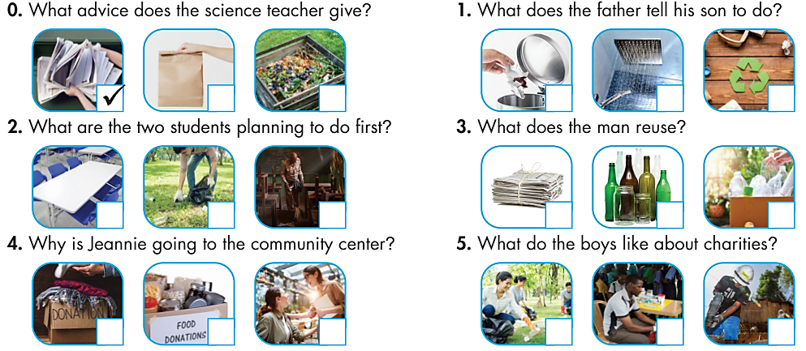
Extra Practice
WB, page 67
You will hear five short conversations. You will hear each conversation twice. There is one question for each conversation. For questions 1-5, put a tick (✓) in the box.
✓
✓
✓
✓
✓
✓

Slide 11
Audio Scripts
0. Abby: Teacher, what can I do to help save the environment?
Teacher: That’s a great question, Abby. You should start by recycling old newspapers and boxes.
Abby: Oh yeah. I will collect the ones we have around the house.
Teacher: Great!
1. Father: Son, you should remember to always put the trash in the trash can.
Son: Sure, Dad.
Father: And make sure that you don’t put plastic in there.
Son: I know. I never do that. Don’t worry.

Slide 12
Audio Scripts
2. Lily: Jacob, I want to help with the school Christmas party this weekend.
Jacob: Can I help?
Lily: Sure. What should we do, though?
Jacob: Let’s help clean the classrooms before the parents get to the school.
Lily: That’s a good idea. What else?
Jacob: After the classrooms I think we can help with the tables in the cafeteria.
Lily: Alright.

Slide 13
Audio Scripts
3. M: When I am at home, I do my best to help the environment. I reuse glass bottles and jars. I also take showers instead of baths. That way I can save some water, too.
4. Eric: Where are you going, aunt Jeannie?
Jeannie: I’m going to the community center.
Eric: What do you need to do there?
Jeannie: I’m donating clothes for poor children.
Eric: Oh, OK. I have some you can take, too.

Slide 14
Audio Scripts
5. B1: I think that charities are great.
B2: Why?
B1: Because they help people and animals.
B2: How do they help?
B1: Some help to build houses for free, so poor people have somewhere to live.
B2: Oh yeah. And some help animals that are hurt.
B1: Yes, you’re right.

Slide 15
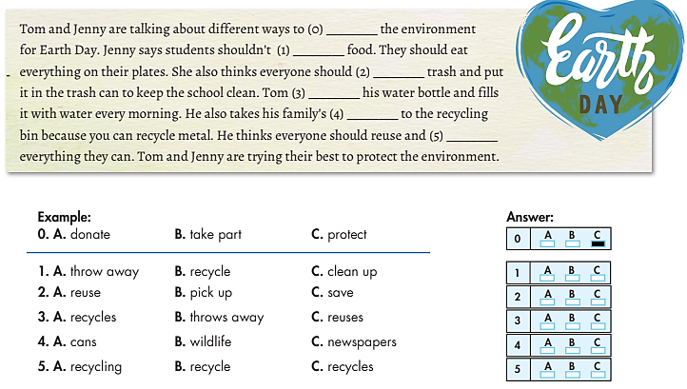

Slide 16
Tom and Jenny are talking about different ways to (0) ________ the environment for Earth Day. Jenny says students shouldn't (1) _____________ food. They should eat everything on their plates. She also thinks everyone should (2) ________ trash and put it in the trash can to keep the school clean. Tom (3) ________ his water bottle and fills it with water every morning. He also takes his family's (4) ________ to the recycling bin because you can recycle metal. He thinks everyone should reuse and (5) ________everything they can. Tom and Jenny are trying their best to protect the environment.
C. protect
A. throw away
B. pick up
C. reuses
A. cans
B. recycle

Slide 17
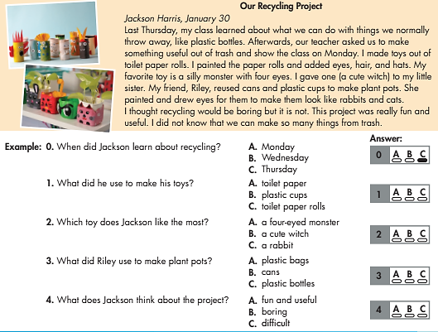
Extra Practice
WB, page 67
Read the article about a school recycling project.
Choose the correct answer (A, B, or C)

Slide 18
Our Recycling Project
Jackson Harris, January 30
Last Thursday, my class learned about what we can do with things we normally throw away, like plastic bottles. Afterwards, our teacher asked us to make something useful out of trash and show the class on Monday. I made toys out of toilet paper rolls. I painted the paper rolls and added eyes, hair, and hats. My favorite toy is a silly monster with four eyes. I gave one (a cute witch) to my little sister. My friend, Riley, reused cans and plastic cups to make plant pots. She painted and drew eyes for them to make them look like rabbits and cats. I thought recycling would be boring but it is not. This project was really fun and useful. I did not know that we can make so many things from trash.

Slide 19
0. When did Jackson learn about recycling?
A. Monday B. Wednesday C. Thursday
1. What did he use to make his toys?
A. toilet paper B. plastic cups C. toilet paper rolls
2. Which toy does Jackson like the most?
A. a four-eyed monster B. a cute witch C. a rabbit
3. What did Riley use to make plant pots?
A. plastic bags B. cans C. plastic bottles
4. What does Jackson think about the project?
A. fun and useful B. boring C. difficult

Slide 20
1. hospital a. give money, food, clothes, etc. to someone or something.
2. trash b. Some drinks such as cola come in these metal containers.
3. charity c. a place where doctors and nurses work.
4. donate d. make sure that somebody or something is safe.
5. library e. a place where you buy stamps and send letters.
6. can f. an organization for helping people or animals.
7. protect g. You throw this away.
8. post offce h. People can come here to read books for free.

Slide 21
1. Is there a/the post office near here?
Yes, a/the post offce is on Magnolia Street. It's next to the park.
2. What do/does WWF do?
3. What can I do to help save the environment?
Recycle/Recycles plastic bottles.

Slide 22
4. You can/doesn't donate money.
5. The/A library is on Pine Street. There's only one library on that street.
6. Don't/Can't use plastic bags.
7. The police station is opposite/between the bus station and the post offce.
8. Where do/are they work?

Slide 23

Circle the word which has the underlined part pronounced differently from the others.
1. A. customer B. sticker C. student D. question
2. A. stay B. listen C. study D. start
3. A. stop B. castle C. station D. stamp
4. A. recycle B. reusable C. article D. usually
5. A. single B. plastic C. simple D. bottle
6. A. social B. people C. talk D. useful

Slide 24
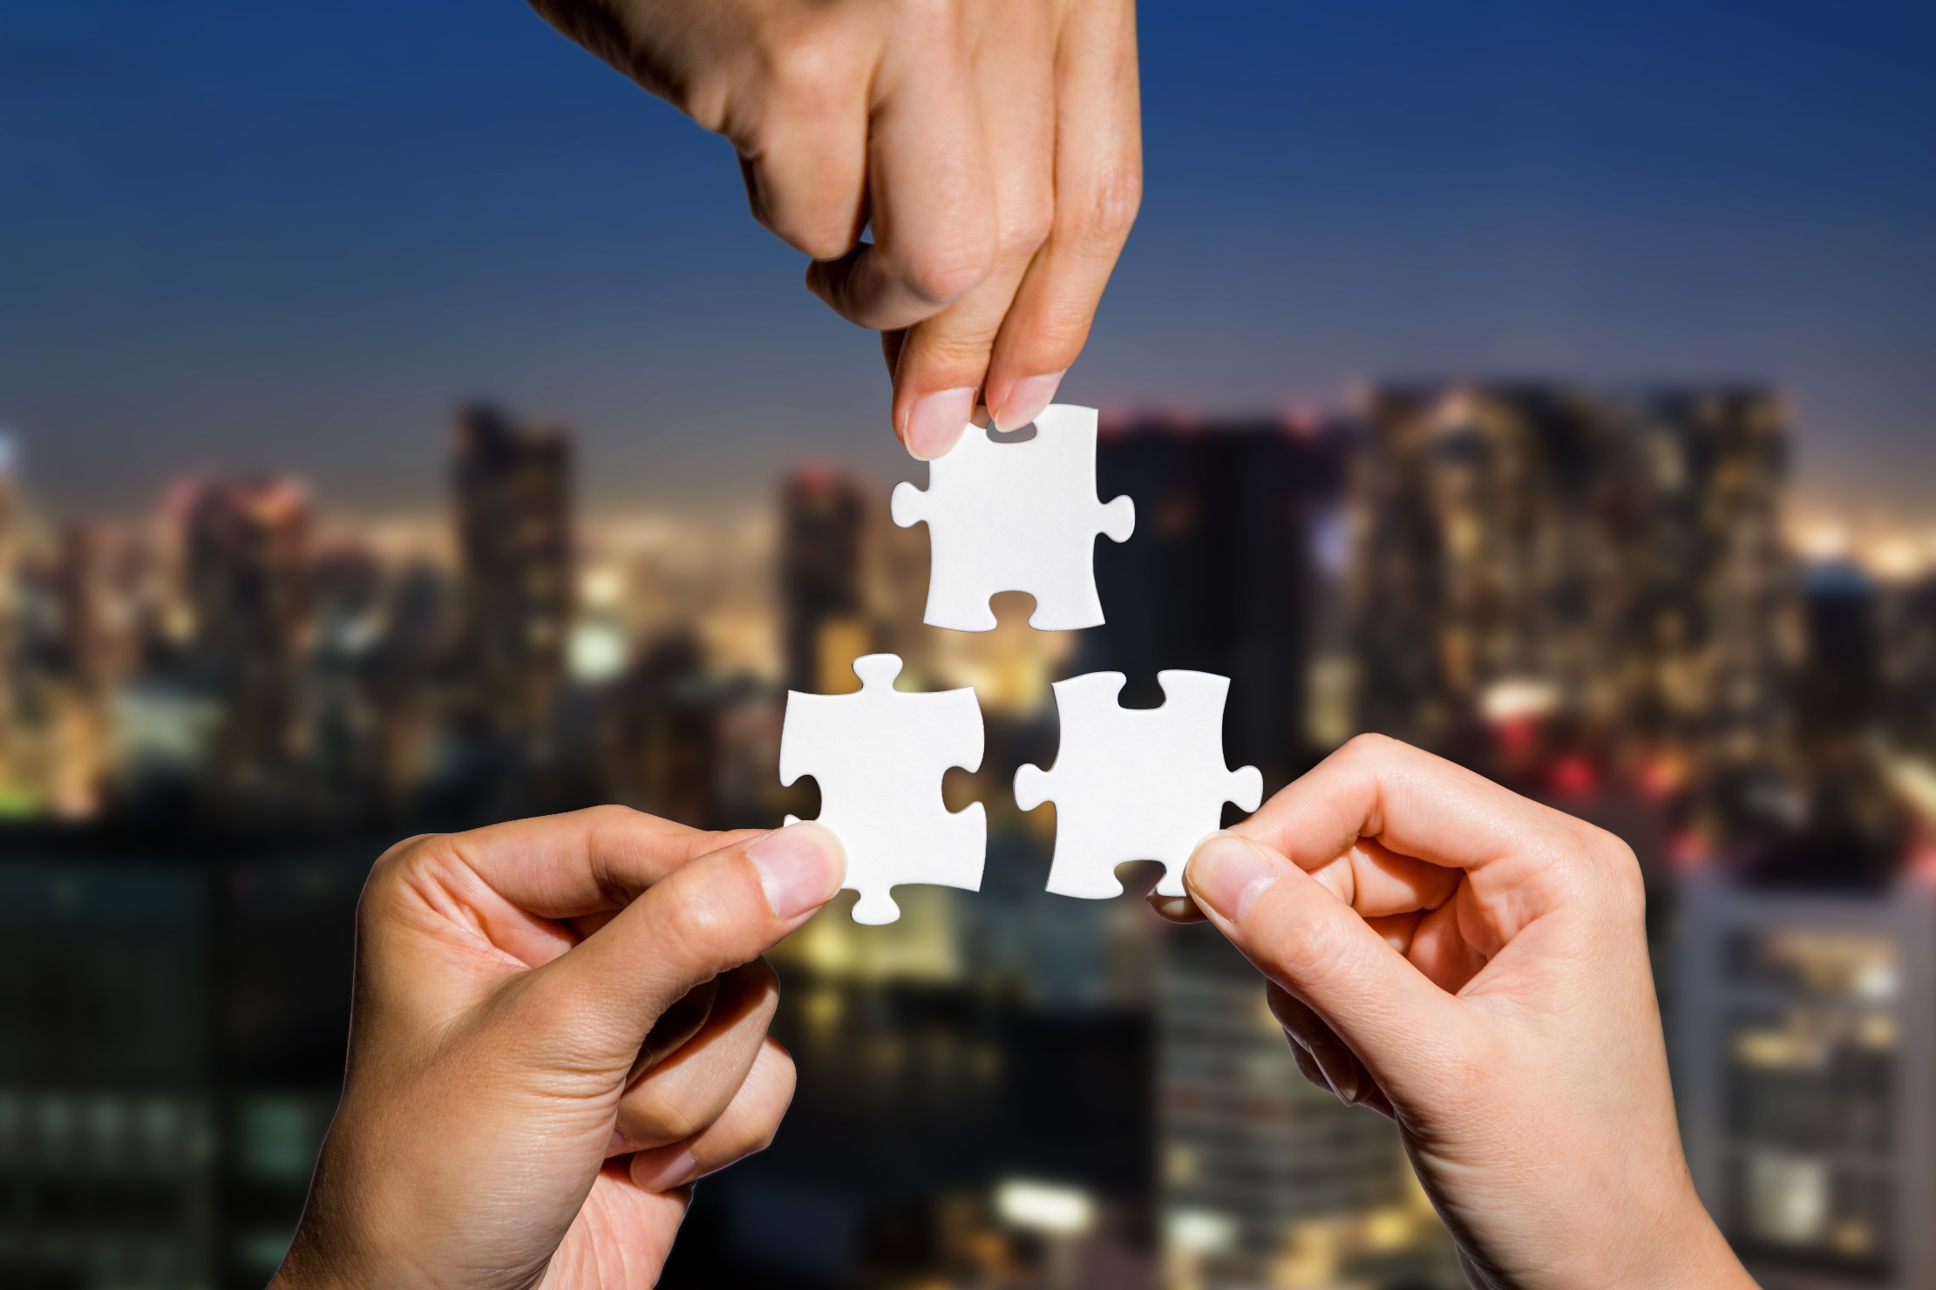
CONSOLIDATION

Slide 25

Work in pairs
Ask and answer about the way to protect the environment.

Slide 26

WRAP-UP

Slide 27
Today’s lesson
* Grammar of Unit 6: A/ an/ the; prepositions of place
* Vocabulary of Unit 6: Vocabulary about public places, environmental charity.

Slide 28
Homework
Review all vocabularies and grammar points in Unit 6.
Prepare the next lesson (page 54 - SB).
Play the consolidation games in Tiếng Anh 6 i-Learn Smart World DHA App on www.eduhome.com.vn.

Slide 29

Lesson 3
Stay positive and have a nice day!

