Slide 1

Unit 6: Community Services
Lesson 3.2: Reading, Speaking & Writing
Page 53

Slide 2
Lesson Outline
Warm-up
Pre-Writing: Reading
Pre-Writing: Speaking
Writing
Consolidation
Wrap-up

Slide 3
Objectives
By the end of this lesson, students will be able to…
- read about a charity in Vietnam.
- talk about how to save the Earth.
- write a paragraph about an organization.

Slide 4

WARM-UP

Slide 5

ANSWER KEYS
post office
police station
train station
recycle
throw away
pick up

Slide 6

Presentation

Slide 7

Reading

Slide 8
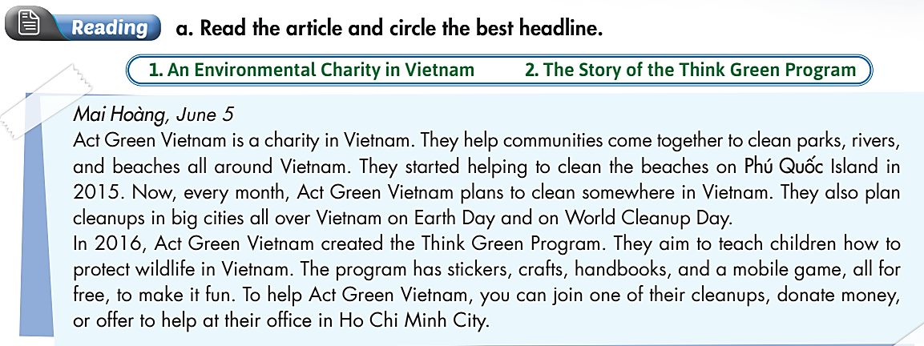
Pre - writing
What is this?
- An article.
What are you going to do?
- Read the article and circle the best headline.

Slide 9
Pre - reading
Underline the key words and guess what the best headline is.
a. Read the article and circle the best headline.
1. An Environmental Charity in Vietnam.
2. The Story of the Think Green Program.

Slide 10
Pre - writing
Skim the article and underline the key words.
Mai Hoàng, June 5
Act Green Vietnam is a charity in Vietnam. They help communities come together to clean parks, rivers, and beaches all around Vietnam. They started helping to clean the beaches on Phú Quốc Island in 2015. Now, every month, Act Green Vietnam plans to clean somewhere in Vietnam. They also plan cleanups in big cities all over Vietnam on Earth Day and on World Cleanup Day.

Slide 11
Pre - writing
Skim the article and underline the key words.
In 2016, Act Green Vietnam created the Think Green Program. They aim to teach children how to protect wildlife in Vietnam. The program has stickers, crafts, handbooks, and a mobile game, all for free, to make it fun. To help Act Green Vietnam, you can join one of their cleanups, donate money, or offer to help at their office in Ho Chi Minh City.

Slide 12
Pre - reading
1. An Environmental Charity in Vietnam.
2. The Story of the Think Green Program.

Slide 13
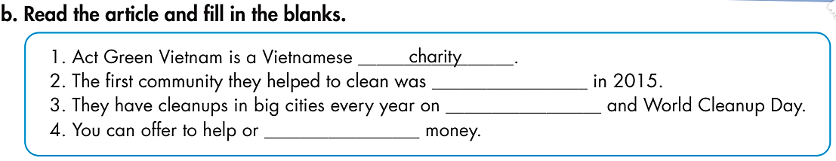
Pre - writing
What are you going to do?
- Read the article and fill in the blanks.

Slide 14
Pre - writing
Skim the article again and fill in the blanks.
Mai Hoàng, June 5
Act Green Vietnam is a charity in Vietnam. They help communities come together to clean parks, rivers, and beaches all around Vietnam. They started helping to clean the beaches on Phú Quốc Island in 2015. Now, every month, Act Green Vietnam plans to clean somewhere in Vietnam. They also plan cleanups in big cities all over Vietnam on Earth Day and on World Cleanup Day.

Slide 15
Pre - writing
Skim the article again and fill in the blanks.
In 2016, Act Green Vietnam created the Think Green Program. They aim to teach children how to protect wildlife in Vietnam. The program has stickers, crafts, handbooks, and a mobile game, all for free, to make it fun. To help Act Green Vietnam, you can join one of their cleanups, donate money, or offer to help at their office in Ho Chi Minh City.

Slide 16
Pre - writing
ANSWER KEYS
1. Act Green Vietnam is a Vietnamese ____________ .
2. The frst community they helped to clean was ____________ in 2015.
3. They have cleanups in big cities every year on ____________ and World Cleanup Day.
4. You can offer to help or ____________ money.
charity
Phú Quốc Island
Earth Day
donate

Slide 17

Practice

Slide 18

Speaking

Slide 19

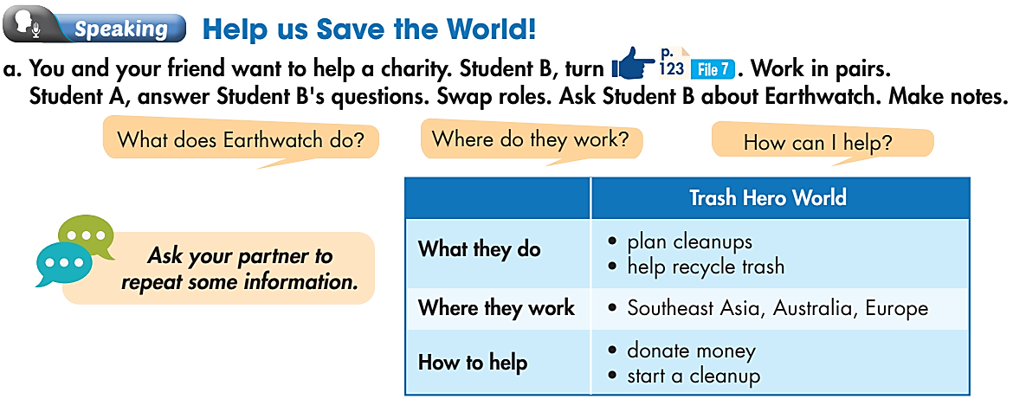
Pre-Speaking
Work in pairs.
Help us Save the World!
What do you want to do?
→ Help a charity.
What are you going to do?
→ Student A answers Student B’s questions and swap roles.

Slide 20

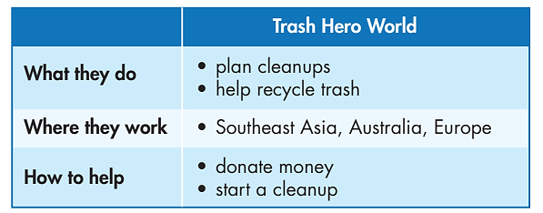
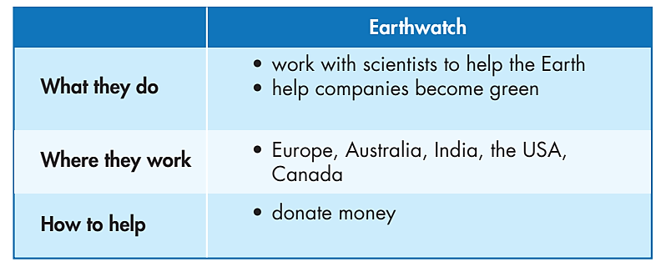
Work in pairs.
While-Speaking
Student A
Student B

Slide 21
Work in pairs.
While-Speaking
Student A asks – Student B answers

Slide 22
STUDENT A
STUDENT B
Hello. What does Trash Hero World do?
They plan cleanups and help recycle trash.
Where do they work?
In the Southeast Asia, Australia, and Europe.
How do I help them?
You can donate money.
Great. Thank you very much.
You’re welcome.

Slide 23
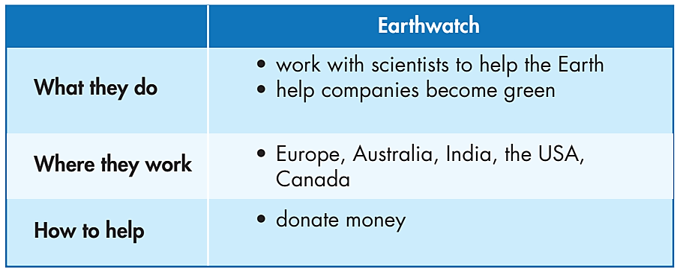
Work in pairs.
While-Speaking
Student B asks – Student A answers

Slide 24
STUDENT A
STUDENT B
What do you want to know?
What does Earthwatch do?
They work with scientists to help the Earth and help companies become green.
Where do they work?
In Europe, Australia, India, the USA, and Canada.
How do I help them?
You can donate money.
Great. Thanks a lot.

Slide 25

Work in pairs.
While- writing
Decide which charity you want to help

Slide 26

Production

Slide 27

Writing

Slide 28
Post - writing
Work in pairs.
Choose the notes to write a paragraph about the World Wide Fund for Nature (WWF).
What they do:
• protect wildlife and the environment
• make sure everyone has enough food.
• reduce food waste
Where they work:
in more than 100 countries
When they started:
1961, in Switzerland
How to help:
• take part in events
• donate money

Slide 29
Post - writing
Model paragraph
The World Wide Fund for Nature (WWF) is a very large charity. They work to protect wildlife and the environment, make sure everyone has enough food. They also help to reduce food waste. They work in more than 100 countries. They started their work
in 1961, in Switzerland. To help the WWF, you can take part in one of their events or donate money.

Slide 30

CONSOLIDATION

Slide 31
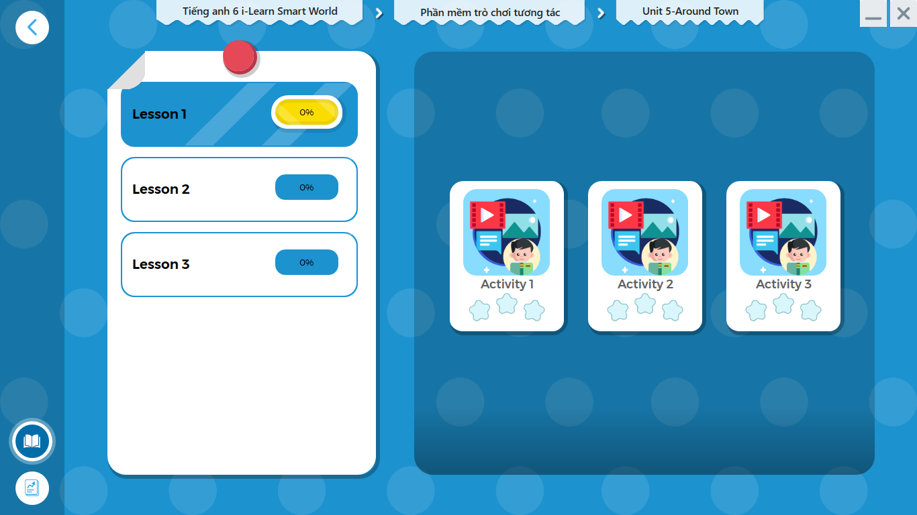
LET’S PLAY!
Click here to play the games.

Slide 32

Extra Practice
WB, page 31
Work in pairs.
Write a paragraph about the International Fund for Animal Welfare (IFAW) using the information below. Write 50 to 60 words.
What they do:
• work to save animals
• teach communities how to look after and protect wildlife all around the world
Where they work:
• in more than 40 countries
When they started:
• in 1969, Canada
How to help:
• donate money

Slide 33

WRAP-UP

Slide 34
Today’s lesson
Reading: read about a charity in Vietnam.
Speaking: talk about how to save the Earth.
Writing: write a paragraph about an organization.

Slide 35
Homework
Practice asking and answering the ways to protect the environment.
Do the exercises in Tiếng Anh 6 i-Learn Smart World Notebook on page 39.
Prepare the next lesson (page 96 & 97 - SB).
Play the consolidation games in Tiếng Anh 6 i-Learn Smart World DHA App on www.eduhome.com.vn.

Slide 36

Enjoy your day!

