Slide 1

Unit 6: Community Services
Lesson 3.1: Vocabulary & Listening
Page 52

Slide 2
Lesson Outline
Warm-up
Vocabulary
Listening
Consolidation
Wrap-up

Slide 3
Objectives
By the end of this lesson, students will be able to…
- Practice and learn vocabularies: charity, donate, free, protect, wildlife.
- Practice listening for specific information.

Slide 4

WARM-UP

Slide 5

Work in pairs.
Chatting
1. Name some public services near your house. Are they good?
2. What do you do with your family to save the environment?
3. What do you do with your friends to protect the earth?
4. What do you think about recycling things?

Slide 6

New words
……..
…….
…….
……..

Slide 7

Listen and repeat. Click each phrase to hear the sound.
charity (n) /ˈtʃærəti/ tổ chức từ thiện
protect (v) /prəˈtekt/ bảo vệ
free (adj) /friː/ miễn phí
wildlife (n) /ˈwaɪldlaɪf/ đời sống hoang dã
donate (v) /ˈdəʊneɪt/ quyên góp
Notes:
GV click vào từng cụm nghe âm thanh

Slide 8
Look at the IPA (International Phonetic Alphabet) and
the meaning of each word to read out the word
/ˈtʃærəti/ tổ chức từ thiện
/prəˈtekt/ bảo vệ
/friː/ miễn phí
/ˈwaɪldlaɪf/ đời sống hoang dã
/ˈdoʊneɪt/ quyên góp
Notes:
GV click vào từng cụm nghe âm thanh

Slide 9

Presentation

Slide 10
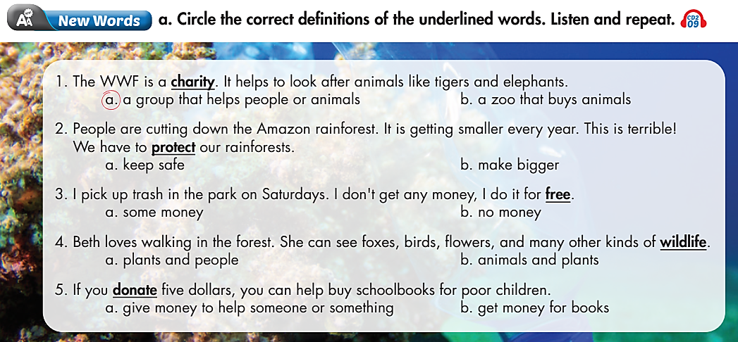
How many sentences are there? – Five
What are you going to do? – Circle the correct definitions of the underlined words

Slide 11

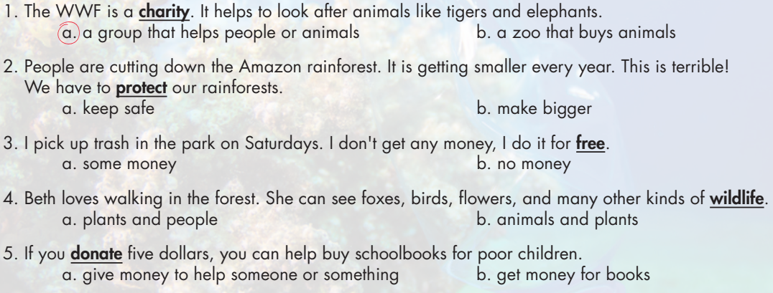
Work in pairs. Fill in the blanks.

Slide 12

Practice

Slide 13


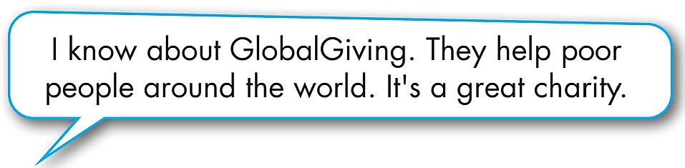
Work in pairs.
Discuss and answer the questions.
1. Do you know any charities?
2. Who or what do they help?

Slide 14
Extra Practice
WB page 26
Fill in the blanks using the words you have learnt.
wildlife
1. I like ___________ TV programs. I can learn about tigers, lions, and lots of other animals.
2. Every year, we collect all of our old clothes and books, then we ___________ them to a charity.
3. I got these jeans for ___________. I didn’t have to pay any money for them.
4. I give money to help ___________ rare animals from hunters.
5. I gave money to a ___________ last year. They use the money to help poor children around the world.
donate
free
protect
charity

Slide 15

Production

Slide 16

b. In pairs: And and answer what you do to help community.

Slide 17
STUDENT A
STUDENT B
Hi B. Do you do anything to help the community?
Yes, of course.
So, what do you do?
I collect my old books and clothes. Then I donate them to the charity.
That’s great!
Thanks.

Slide 18

Listening

Slide 19
Pre-Listening
Read the instruction quickly. Underline the key words. Does the charity work in one country, or many countries?
a. Listen to two people talking about a charity. Does the charity work in one country, or many countries?
1. One country
2. Many countries

Slide 20
While-Listening
Now listen and choose the correct answer.  FIRST TIME
a. Listen to two people talking about a charity. Does the charity work in one country, or many countries?
☞ YOUR ANSWER?
2. Many countries
☞ WHY?

Slide 21
While-Listening
Now listen again and check.  SECOND TIME
While you are listening, focus on what Professor Jones says.
Professor Jones: In 2018, over a million people in many countries took part in a huge beach cleanup.
☞ YOUR ANSWER?
One country
Many countries.
☞ THE ANSWER IS …

Slide 22
While-listening
b. Now, listen and fill in the blanks. FIRST TIME
1. Trash Free Seas started in ______________ in the USA.
2. They wanted to protect ocean _____________.
3. In 2018, they picked up more than ______________ million
kilograms of trash.
4. People can visit the website if they want to ____________.
☞ WHAT ARE YOUR ANSWERS?

Slide 23
While-listening
b. Now, listen and fill in the blanks. SECOND TIME
Trash Free Seas started in ______________ in the USA.
2. They wanted to protect ocean _____________.
3. In 2018, they picked up more than ______________ million
kilograms of trash.
4. People can visit the website if they want to ____________.
1986
wildlife
ten
donate
☞ WHAT ARE YOUR ANSWERS?

Slide 24
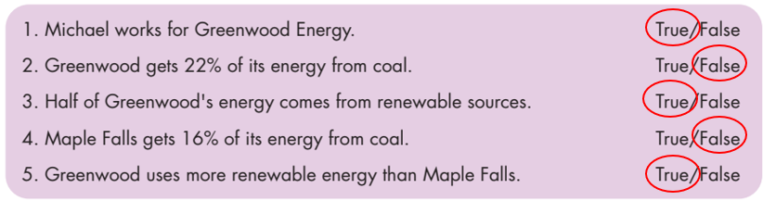
While - listening
While-Listening
Now listen again and check.  THIRD TIME
Professor Jones: Well, the charity started in 1986 in the USA.
1. Trash Free Seas started in 1986 in the USA.
Professor Jones: 1986. Anyway, they help protect ocean wildlife by cleaning up beaches.
2. They wanted to protect ocean wildlife.

Slide 25
While - listening
While - listening
Now listen again and check.  THIRD TIME
Professor Jones: In 2018, over a million people in many countries took part in a huge beach cleanup.
3. In 2018, they picked up more than ten million kilograms of trash.
Professor Jones: If anyone wants to donate, please visit the Trash Free Seas website. Just five dollars will be a big help! The website is www…
4. People can visit the website if they want to donate.

Slide 26
Audio Scripts
Practice the conversation with a partner.
Lisa: Thanks for joining us, Professor. Can you tell us about Trash Free Seas?
Professor Jones: Well, the charity started in 1986 in the USA.
Lisa: When? Sorry, could you repeat that?
Professor Jones: 1986. Anyway, they help protect ocean wildlife by cleaning up beaches.
Lisa: I see.
Professor Jones: In 2018, over a million people in many countries took part in a huge beach cleanup.
Lisa: Great!
Professor Jones: They picked up over ten million kilograms of trash.

Slide 27
Audio Scripts
Practice the conversation with a partner.
Lisa: How much? Sorry, could you say that again?
Professor Jones: Ten million kilos.
Lisa: Wow! That's amazing. How can our listeners help?
Professor Jones: If anyone wants to donate, please visit the Trash Free Seas website. Just five dollars will be a big help! The website is www…

Slide 28
Post-Listening
Listen and write "True" or "False."
1. There are 18 different kinds of penguins in the world.
2. The Global Penguin Society makes money by protecting penguins.
3. GPS works with school teachers and famous movie stars.
4. Fewer than six thousand students visited penguins.
5. Donations for GPS help pay people to work for them.
True
False
False
False
True

Slide 29
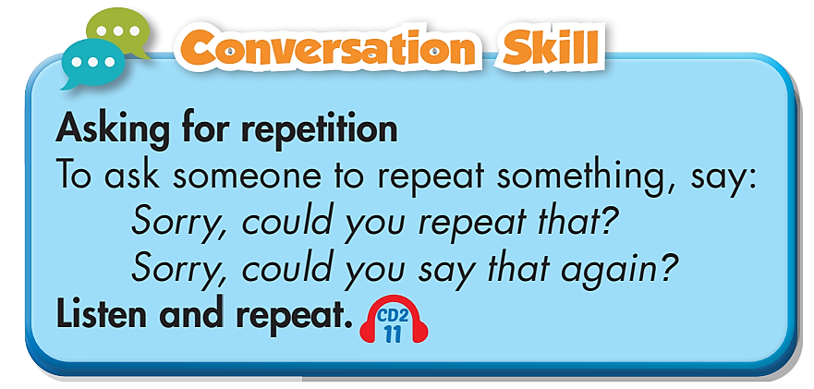
Post-Listening

Slide 30

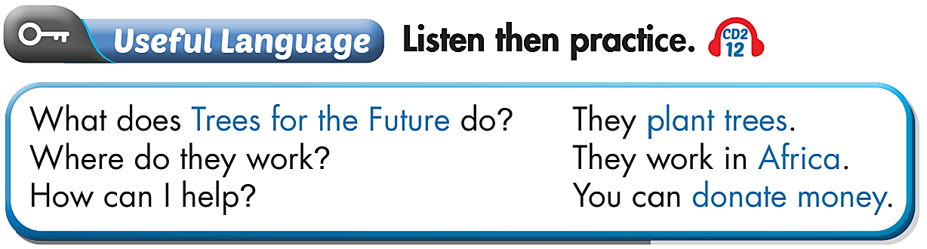
Work in pairs.

Slide 31

CONSOLIDATION

Slide 32
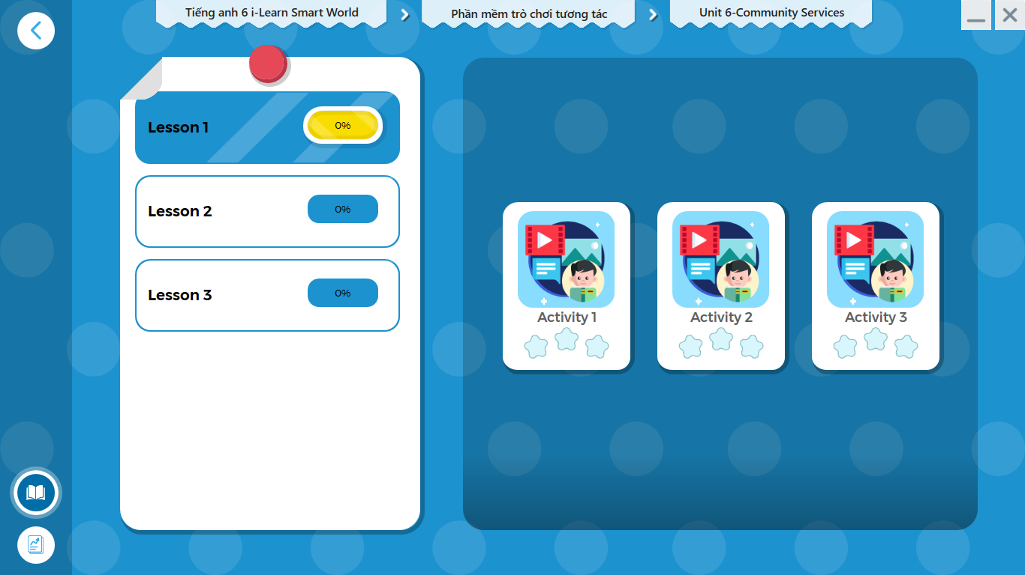
LET’S PLAY!
Click here to play the games.

Slide 33
Write about what you do to help the community.
When and how.
Write about 60-80 words.

Slide 34

WRAP-UP

Slide 35
Today’s lesson
Vocabularies:bʌs st/
charity (n)
donate (v)
free (adj)
protect (v)
wildlife (n)
Listening: for specific information.
Conversation Skill: Asking for repetition

Slide 36
Homework
Learn by hearts vocabularies and make sentences using them.
Do the exercises on page 36 WB.
Do the exercises in Tiếng Anh 6 i-Learn Smart World Notebook on page 38.
Prepare the next lesson (page 53 - SB).
Play the consolidation games in Tiếng Anh 6 i-Learn Smart World DHA App on www.eduhome.com.vn.

Slide 37

Enjoy your day!

