Slide 1
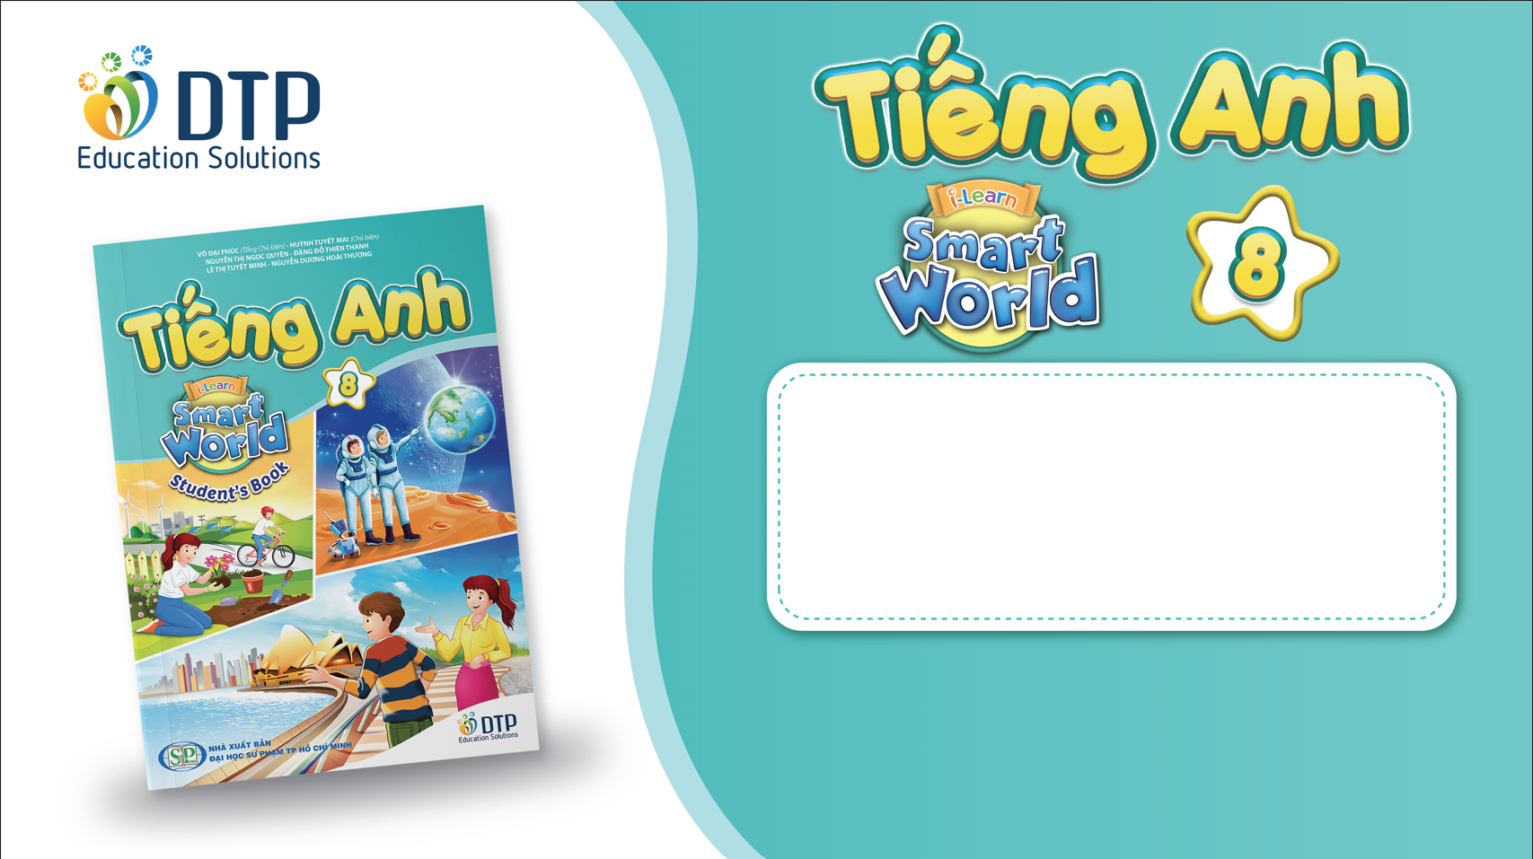
Unit 6: Life on other planets
Lesson 3.1 – Reading & Writing
Pages 62 & 63

Slide 2
Lesson Outline
Warm-up
Reading
Writing
Consolidation
Wrap-up

Slide 3
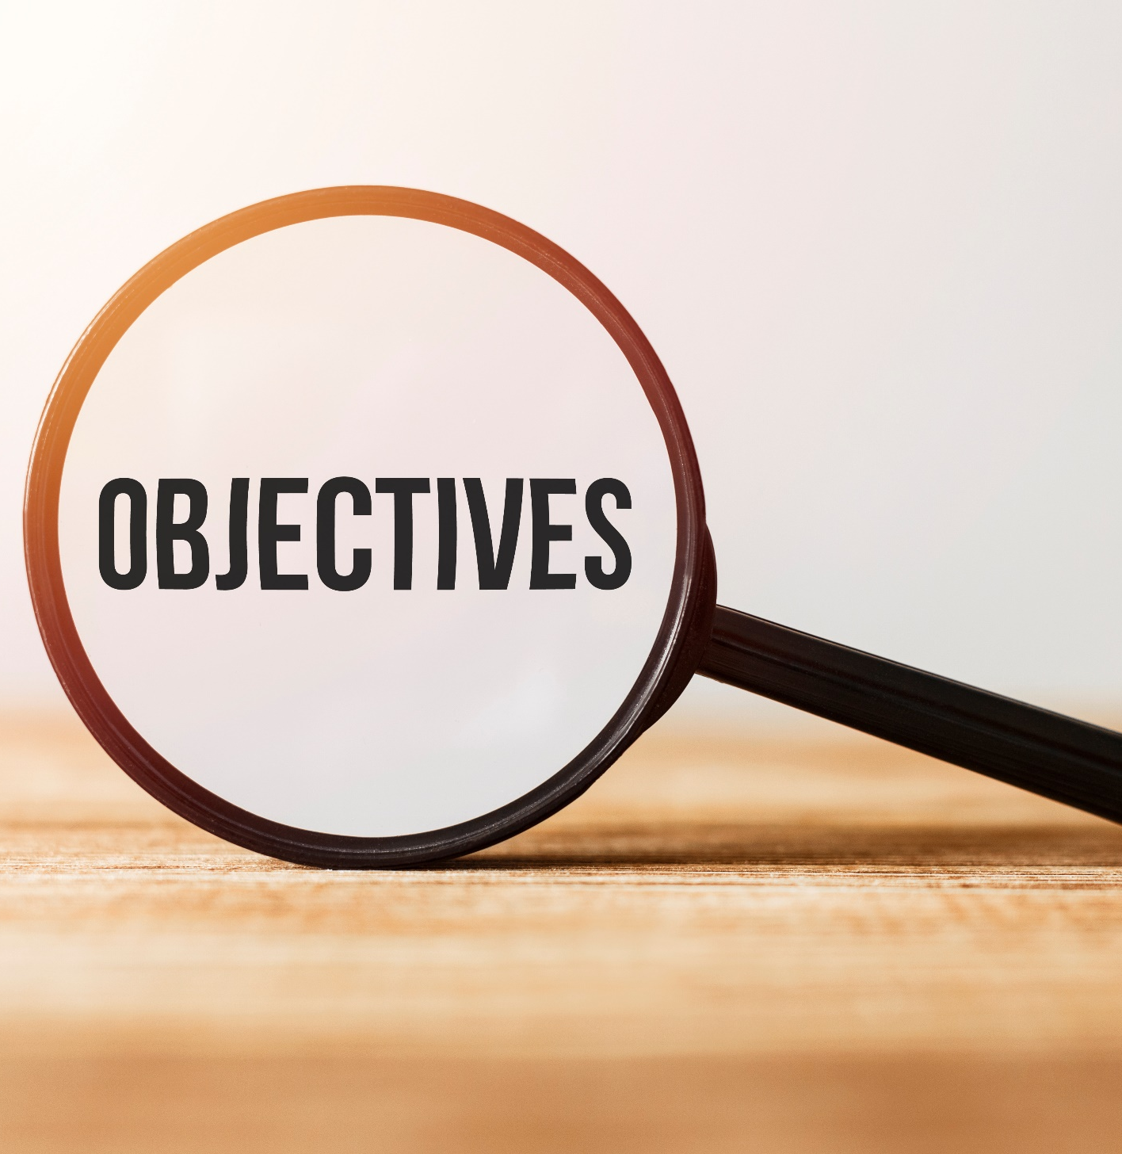
By the end of this lesson, students will be able to…
- practice reading for specific information.
- write narrative passages.

Slide 4
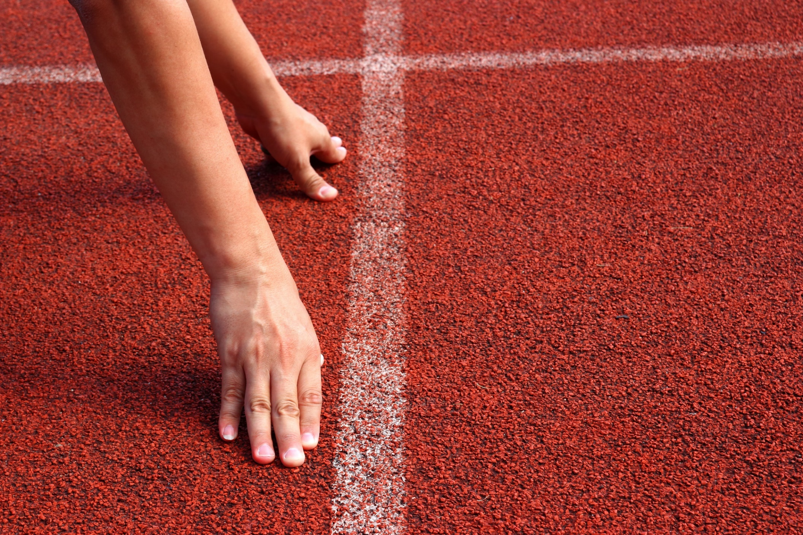
Lesson 1
WARM UP

Slide 5
Reorder the sentence to make a complete conversation
a- Liam: Amazing! What happened next?
b- Emma: You won’t believe it. I just saw something crazy!
c- Emma: I saw a strange light in the sky last night ! I think it was UFO. It was disk-shaped and had many lights.
d- Liam: Calm down! What happened?

Slide 6
Reorder the sentence to make a complete conversation
b- Emma: You won’t believe it. I just saw something crazy!
d- Liam: Calm down! What happened?
a- Liam: Amazing! What happened next?
c- Emma: I saw a strange light in the sky last night ! I think it was UFO. It was disk-shaped and had many lights.
b – d - c - a

Slide 7
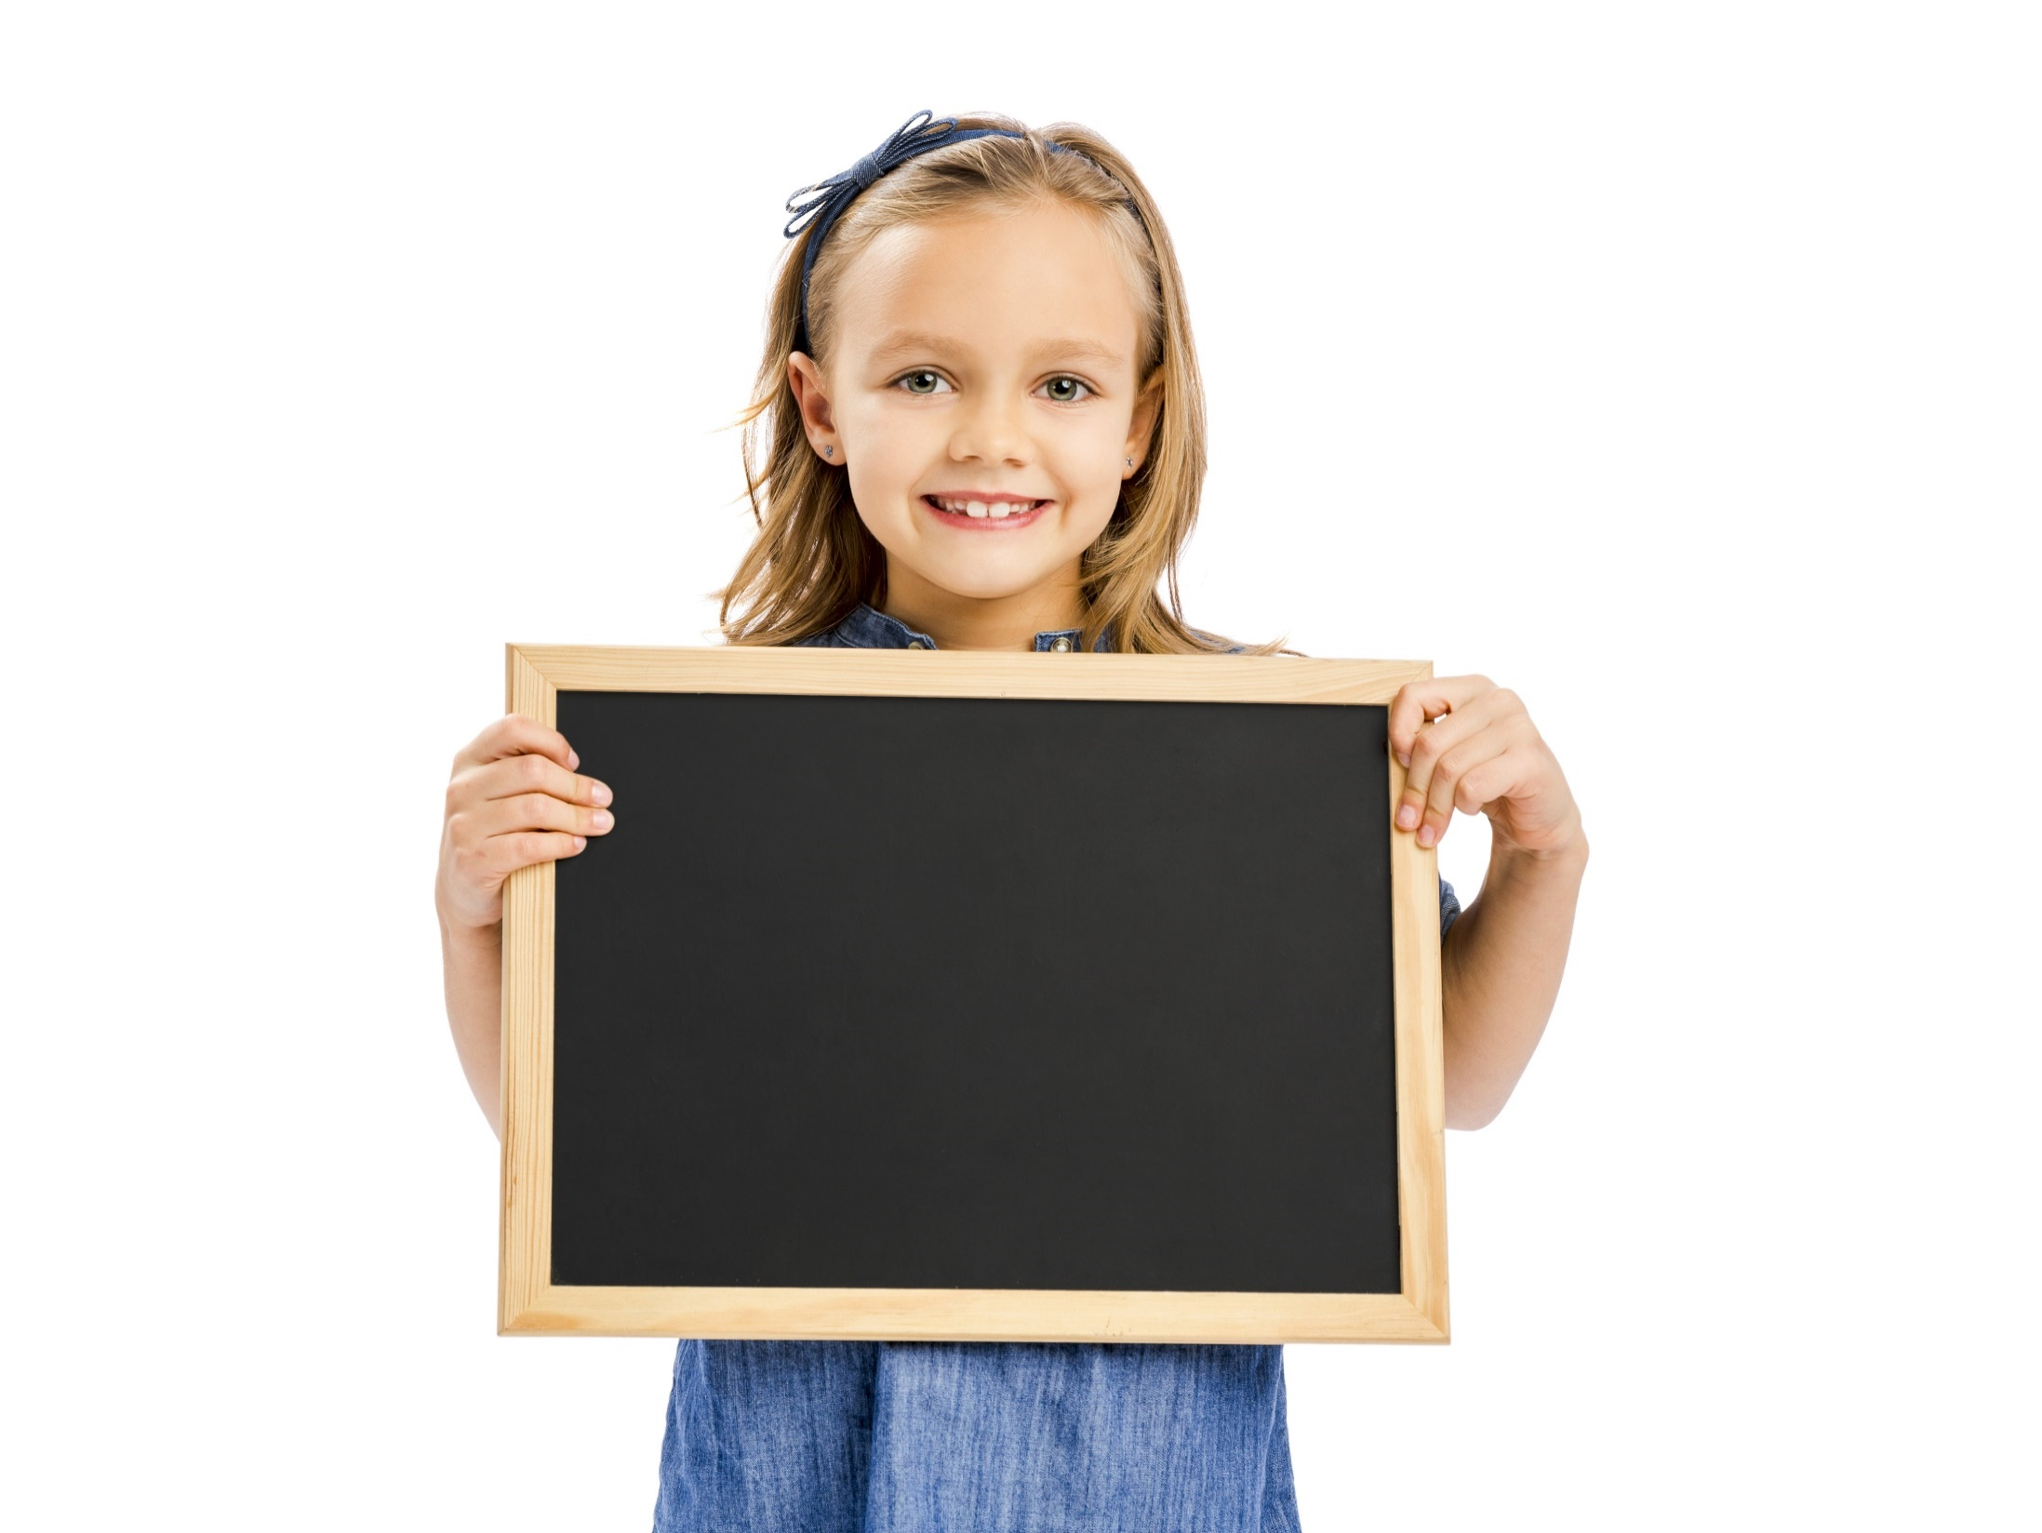
Reading

Slide 8
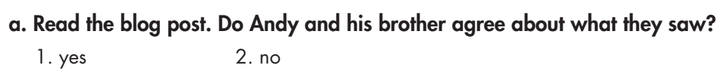
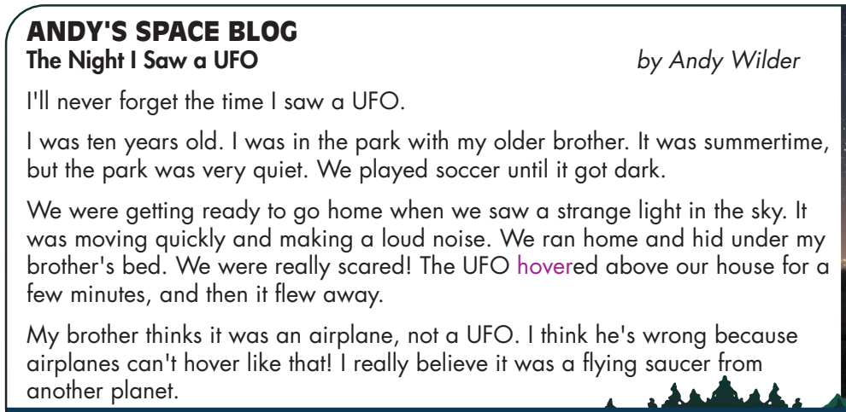
Pre-reading

Slide 9
Pre-reading
Hover /ˈhʌvɚ/ (v) to stay in one place in the air, usually by moving the wings quickly (bay lượn)

Slide 10
While-reading
Read and search the text for answers and mention relevant sections of the text.
Check if the questions are in the same order as information in the text.
Use their own knowledge and opinions of the subject.
Make a decision based only on what the text says, or doesn’t say.
What are we going to do?
Read the blog post and choose True/ False/ Doesn’t say.

Slide 11
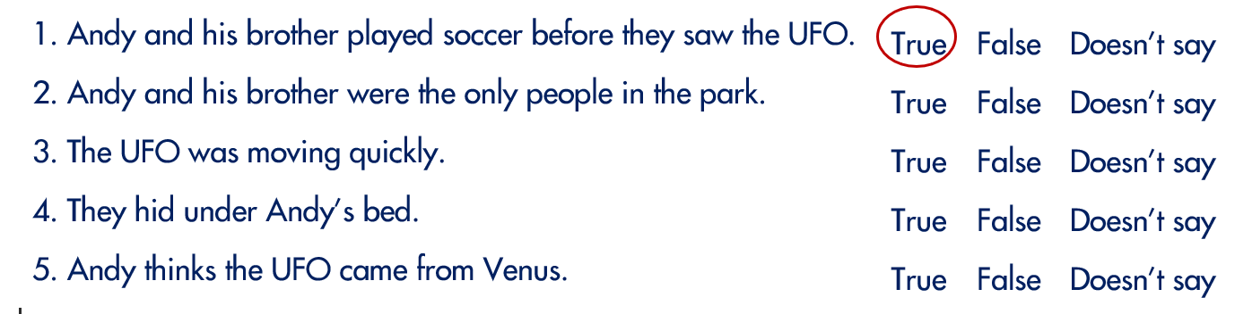
While-reading
Read the blog post and choose True/ False/ Doesn’t say.

Slide 12
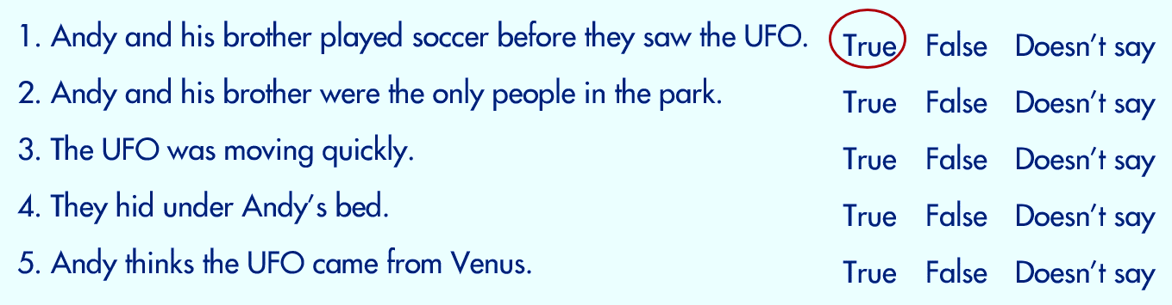

Slide 18


While-reading

Slide 19

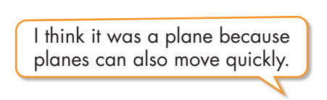
Post-reading
Work in pairs
What do you think Andy and his brother really saw? Why?

Slide 20
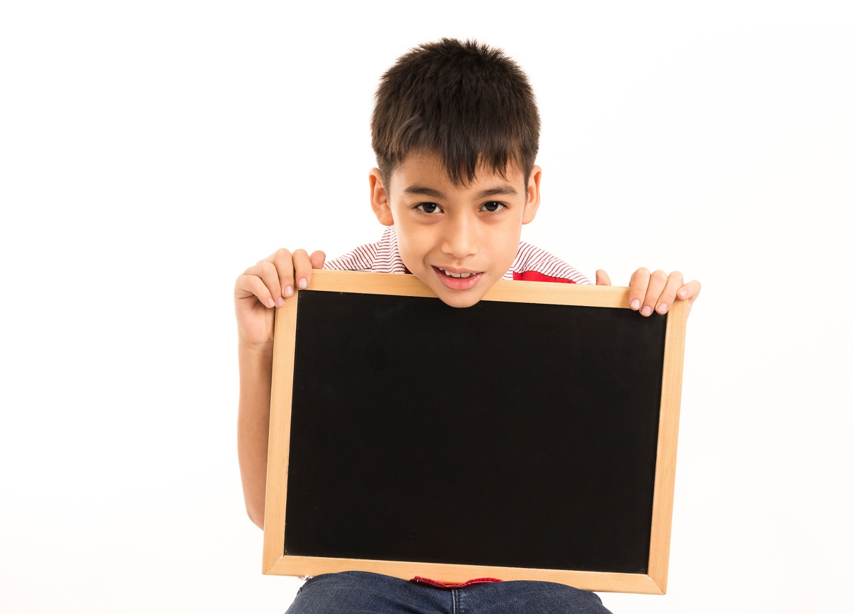
Writing

Slide 21


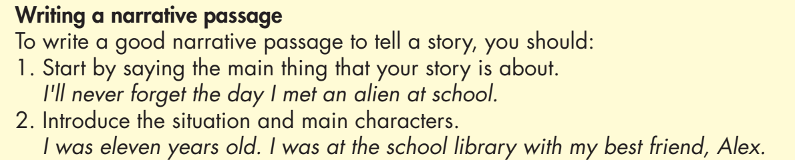

Slide 22
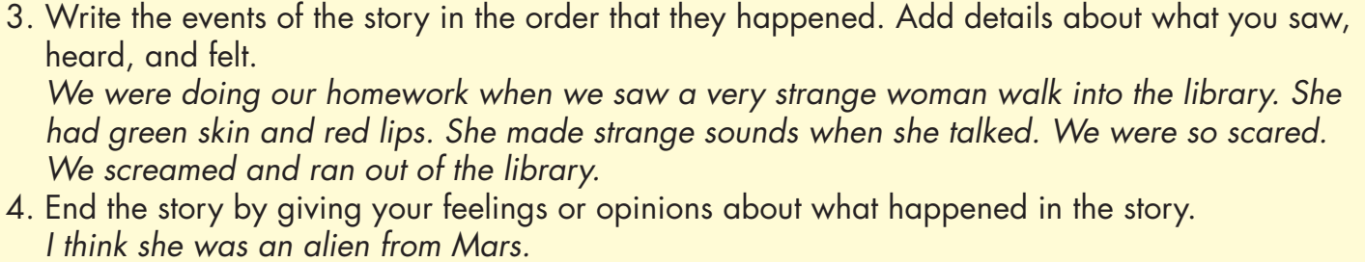

Slide 23
Then, read the blog again and underline three sentences Andy used to describe what he saw, heard, and felt.

Slide 24
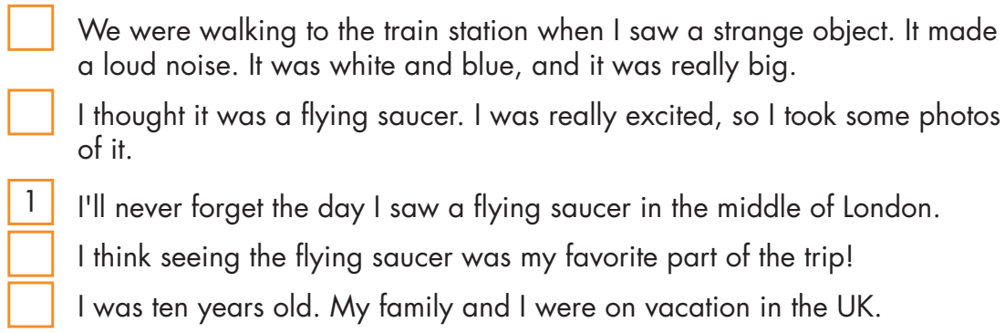
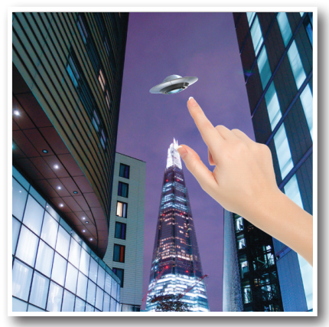
3
4
5
2

Slide 25

CONSOLIDATION

Slide 26
Complete the sentences using words used to describe what the author saw, heard, and felt.
We were walking to the train station when I _____ a strange object. It made a loud _____.
I think ______ the flying saucer was my favorite part of the trip!
It was white and blue, and it ______ really big.
I thought it was a flying saucer. I was really ______, so I took some photos of it.
saw
noise
seeing
was
excited

Slide 27

WRAP-UP

Slide 28
Today’s lesson
Reading about UFO sightings and writing on how to write a narrative.

Slide 29
Lesson 3
Homework
- Do the exercises in WB: Listening and Reading (page 36).
- Do the exercise in Tiếng Anh 8 i-Learn Smart World Notebook (page 52).
- Play the consolidation games in Tiếng Anh 8 i-Learn Smart World DHA App on www.eduhome.com.vn
- Prepare: Unit 6 - Lesson 3 – Speaking and Writing (page 63 – SB).

Slide 30

Lesson 3
Stay positive and have a nice day!

