Slide 1

Unit 6: Life on other planets
Lesson 2.3 – Pronun. & Speaking
Pages 60 & 61

Slide 2
Lesson Outline
Warm-up
Pronunciation
Speaking
Consolidation
Wrap-up

Slide 3

By the end of this lesson, students will be able to…
- practice sound changes.
- talk about possible UFO and alien sightings in the past, using Past Continuous and Past Simple.
- practice functional English - Showing interest.

Slide 4

Life on other planets - Gameshow quiz

Slide 5

Lesson 1
WARM UP

Slide 6

Presentation

Slide 7

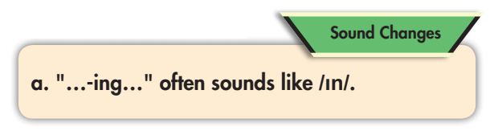

/ in /

running
moving

fishing

standing


Slide 8



Slide 9




Slide 10

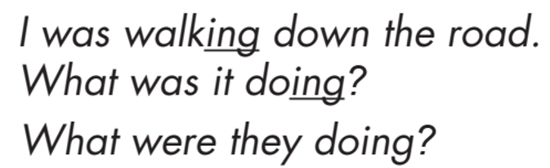

Slide 11

Practice

Slide 12
(1) Jim: You won't believe it! I just saw something crazy!
(2) Danny: Calm down. What happened?
(3) Jim: I (play) soccer earlier when suddenly I (see) a strange light in the sky.
(4) I think it (be) a UFO! It (be) big and triangular.
(5)Danny: That's strange. What (be) it doing?
(6) Jim: It (move) very quickly.
(7) Danny: What happened next?
(8) Jim: I (run) home.
(9) Danny: That sounds scary! How did you feel?
(10) Jim: I was terrified!
(11) Danny: Do you believe that it (be) from another planet?
(12) Jim: Yes, I do!

Slide 13
(1) Jim: You won't believe it! I just saw something crazy!
(2) Danny: Calm down. What happened?
(3) Jim: I was playing soccer earlier when suddenly saw a strange light in the sky.
(4) I think it was a UFO! It was big and triangular.
(5) Danny: That's strange. What was it doing?
(6) Jim: It was moving very quickly.
(7) Danny: What happened next?
(8) Jim: I ran home.
(9) Danny: That sounds scary! How did you feel?
(10) Jim: I was terrified!
(11) Danny: Do you believe that it was from another planet?
(12) Jim: Yes, I do!

Slide 14
 | Conversation 1 | Conversation 2
Jim: You won't believe it! I just saw something crazy! Danny: Calm down. What happened? Jim: I (play) soccer earlier when suddenly I (see) a strange light in the sky. I think it (be) a UFO! It (be) big and triangular. Danny: That's strange. What (be) it doing? Jim: It (move) very quickly. Danny: What happened next? Jim: I (run) home. Danny: That sounds scary! How did you feel? Jim: I was terrified! Danny: Do you believe that it (be) from another planet? Jim: Yes, I do! | I (read) a book a large object (appear) – sky it (be) a flying saucer It (be) big and disk-shaped (be) it It (make) a strange noise It (disappear) immediately I was excited it (be) Yes, I think so | We (have) a picnic I (see) two strange people – forest they (be) aliens They (have) huge eyes (be) they They (run) towards us We (call) the police I was very afraid they (be) Maybe

Slide 15
Jim: You won't believe it! I just saw something crazy! Danny: Calm down. What happened? (3) Jim: I (read) a book earlier when suddenly I (see) a large object (appear) in the sky. (4) I think it (be) a flying saucer! It (be) big and disk-shaped. (5) Danny: That's strange. What (be) it doing? (6)Jim: It (make) a strange noise Danny: What happened next? (8)Jim: It (disappear) immediately Danny: That sounds scary! How did you feel? Jim: I was excited (11)Danny: Do you believe that it (be) from another planet? Jim: Yes, I think so!

Slide 16
Jim: You won't believe it! I just saw something crazy! Danny: Calm down. What happened? Jim: We (have) a picnic earlier when suddenly I (see) two strange people in the forest. I think they (be) aliens ! They (have) huge eyes. Danny: That's strange. What (be) they doing? Jim: They (run) towards us Danny: What happened next? Jim: We (call) the police Danny: That sounds scary! How did you feel? Jim: I was very afraid Danny: Do you believe that they (be) from another planet? Jim: Maybe

Slide 17
Production

Slide 18
Reorder the sentence to make a complete conversation
a- Liam: Amazing! What happened next?
b- Emma: You won’t believe it. I just saw something crazy!
c- Emma: I saw a strange light in the sky last night ! I think it was UFO. It was disk-shaped and had many lights.
d- Liam: Calm down! What happened?

Slide 19
Reorder the sentence to make a complete conversation
b- Emma: You won’t believe it. I just saw something crazy!
d- Liam: Calm down! What happened?
a- Liam: Amazing! What happened next?
c- Emma: I saw a strange light in the sky last night ! I think it was UFO. It was disk-shaped and had many lights.
b – d - a - c

Slide 20
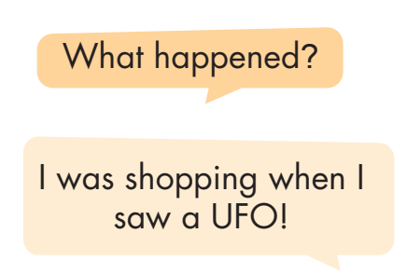
I ____________________ when ______________
Team A and Team B

Slide 21

CONSOLIDATION

Slide 22
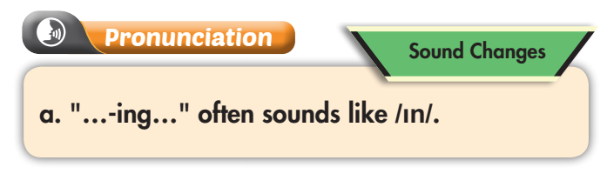
In pairs: Do you think there is life on other planets? Why (not)?

Slide 23

WRAP-UP

Slide 24
Today’s lesson
Focusing on the sound /-ɪn/.
Talking about sightings of UFOs and alien using the past tenses.

Slide 25
Lesson 3
Homework
- Make two statements and practice reading them, paying attention to the /-ɪn/ sound.
- Prepare: Lesson 3.1 – Reading & Writing (page 62).
- Review the vocabulary and grammar notes in Tiếng Anh 8
i-Learn Smart World Notebook.
- Play the consolidation games in Tiếng Anh 8 i-Learn Smart World DHA App on www.eduhome.com.vn

Slide 26

Lesson 3
Stay positive and have a nice day!

