Slide 1

Unit 6. Community Services
Lesson 2.3: Pronunciation & Speaking
Page 51

Slide 2
Lesson Outline
Warm-up
Pronunciation
Practice
Speaking
Consolidation
Wrap-up

Slide 3
Objectives
By the end of this lesson, students will be able to…
- pronounce /l/ sound correctly.
- ask and answer the way to protect the environment.
- write about how to protect the environment.

Slide 4

WARM-UP

Slide 5


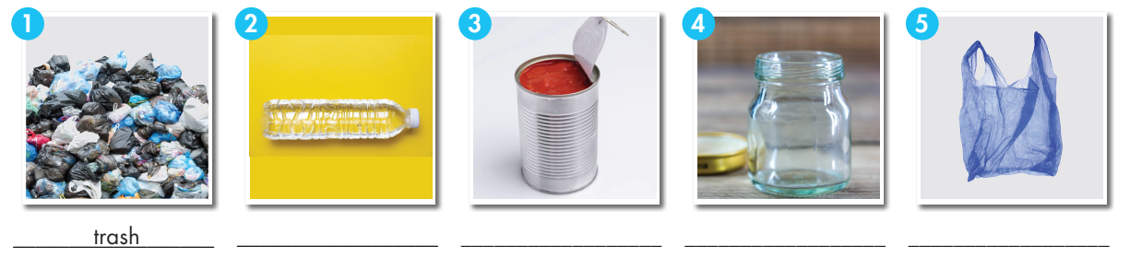
Work in pairs. Fill in the blanks.
can plastic bag trash
plastic bottle glass jar
v
Fill in the table
trash
plastic bottle
can
Glass jar
plastic bag

Slide 6
Look at the IPA and the meaning of each word to read out the word.
/træʃ/ rác
/ˈplæstɪk ˈbɒtl/ chai nhựa
/kæn/ đồ hộp
/ɡlæs dʒɑːr/ hũ thủy tinh
/ˈplæstɪk bæɡ/ túi ni lông
/ˌriːˈjuːz/ tái sử dụng
/ˌriːˈsaɪkl/ tái chế
/θrəʊ əˈweɪ/ vứt, ném
/pɪk ʌp/ nhặt
Notes:
GV click vào từng cụm nghe âm thanh

Slide 7

Presentation

Slide 8

b. Listen to the words and focus on the underlined letters.
recycle, bottle

Slide 9
c. Listen and repeat.
recycle, bottle
d. Read the words with the correct sound to a partner.

Slide 10

Practice

Slide 11
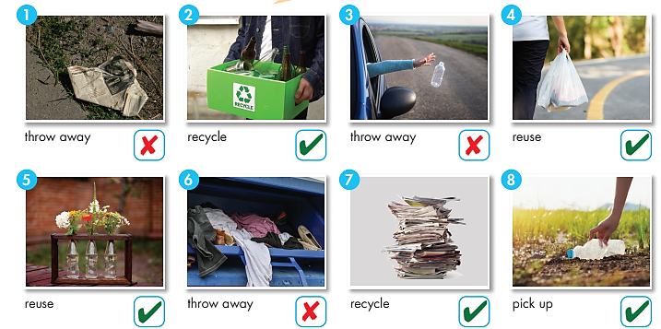
Don’t
Don’t
Don’t

Slide 12

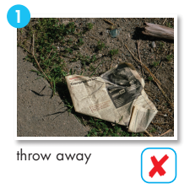
Work in pairs.
Take turns saying imperative sentences.
Don’t throw away trash.

Slide 13
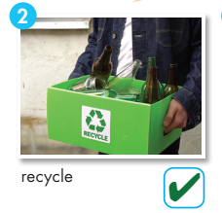
Work in pairs.
Take turns saying imperative sentences.
Recycle glass bottles.

Slide 14
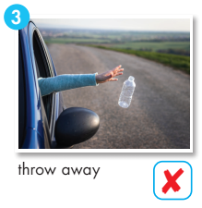
Work in pairs.
Take turns saying imperative sentences.
Don’t throw away plastic bottles.

Slide 15
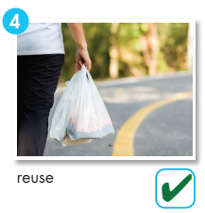
Work in pairs.
Take turns saying imperative sentences.
Reuse plastic bags.

Slide 16
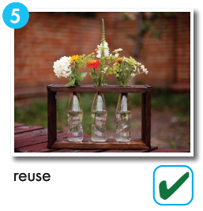
Work in pairs.
Take turns saying imperative sentences.
Reuse glass bottles.

Slide 17
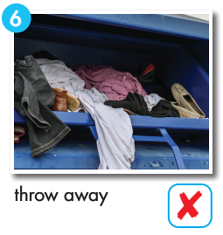
Work in pairs.
Take turns saying imperative sentences.
Don’t throw away old clothes.

Slide 18
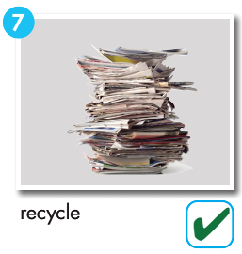
Work in pairs.
Take turns saying imperative sentences.
Recycle old newspapers.

Slide 19
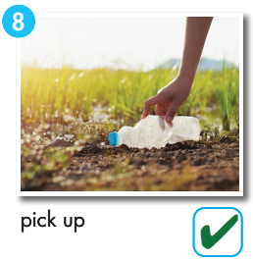
Work in pairs.
Take turns saying imperative sentences.
Pick up plastic bottles.

Slide 20

Production

Slide 21

Work in pairs.
Practice with your own ideas.
STUDENT A
STUDENT B
What should we do to protect the environment?
Recycle old papers.
What shouldn’t we do?
Throw away plastic bags.

Slide 22

Speaking

Slide 23

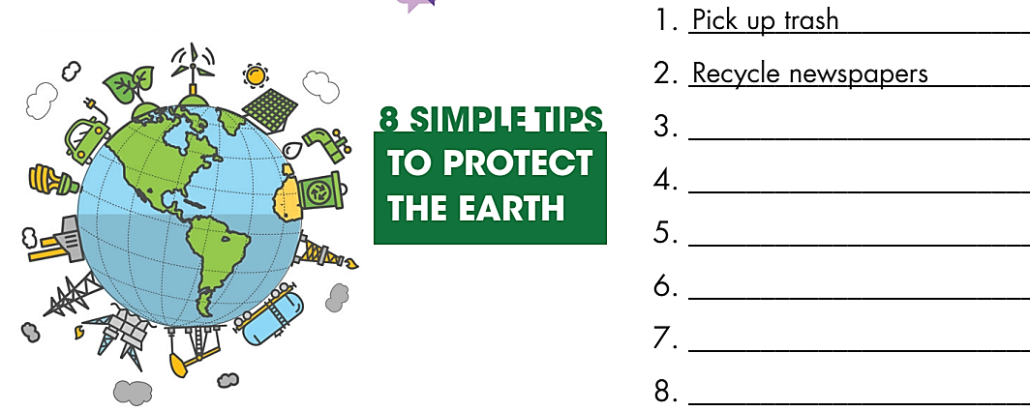
Pre-Speaking
Work in pairs.
You want to write an article about how to protect the Earth. Work in pairs. Discuss and choose six
tips to add to your notes.
What do you want to write?
→ An article about how to protect the Earth.
What are you going to do?
→ Discuss and choose six tips to add to your notes.

Slide 24

While-Speaking
1. ___________________________
2. ___________________________
3. ___________________________
4. ___________________________
5. ___________________________
6. ___________________________
7. ___________________________
8. ___________________________
Pick up trash.
Discuss and choose six
tips to add to your notes.
Recycle newspapers.
Don’t throw away old clothes.
Reuse plastic bags.
Recycle glass.
Reuse water bottles.
Don’t litter.
Reduce plastic bags.

Slide 25
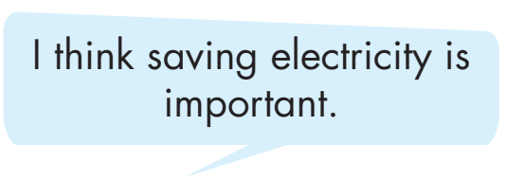
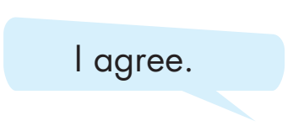
Post-Speaking
Share your ideas with another pair. Now, discuss and choose three things you can do in your home or school.
STUDENT A
STUDENT B

Slide 26

CONSOLIDATION

Slide 27
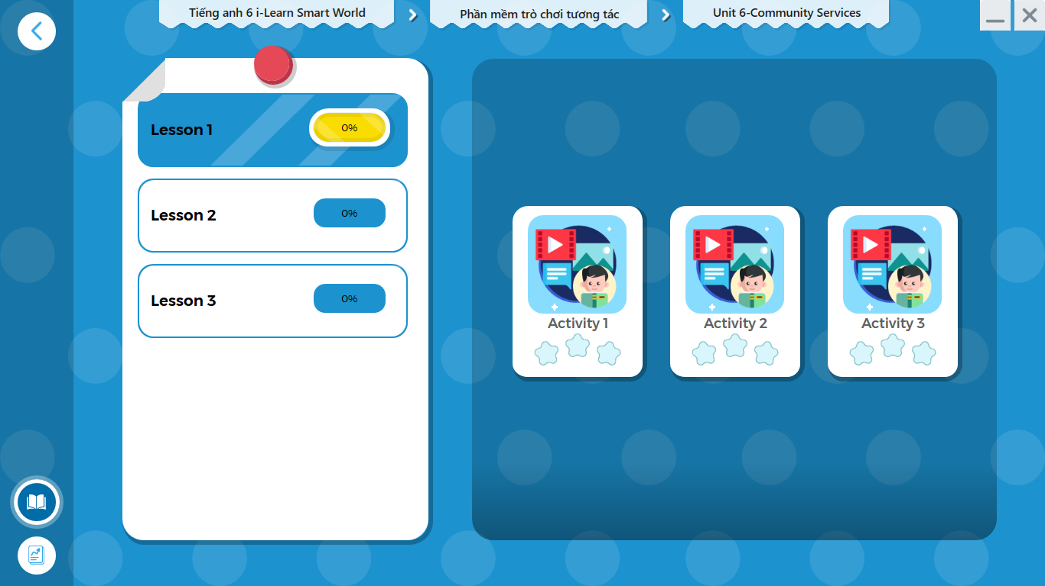
LET’S PLAY!
Click here to play the games.

Slide 28
Write about what you can do to protect the environment.
Write about 60-80 words.

Slide 29

WRAP-UP

Slide 30
Today’s lesson
- pronounce /l/ sound correctly.
- ask and answer the way to protect the environment.
- write about how to protect the environment.

Slide 31
Homework
Review the vocabularies and grammar point in the lesson.
Practice pronouncing /l/ sound correctly.
Prepare the next lesson (page 52 - SB).
Play the consolidation games in Tiếng Anh 6 i-Learn Smart World DHA App on www.eduhome.com.vn.

Slide 32

Enjoy your day!

