Slide 1

Unit 6: Life on other planets
Lesson 2.2 – Grammar
Pages 59 & 60

Slide 2
Lesson Outline
Warm-up
Grammar
Consolidation
Wrap-up

Slide 3

By the end of this lesson, students will be able to…
- practice and use the Past Continuous and the Past Simple correctly

Slide 4

Lesson 1
WARM UP

Slide 5

Presentation

Slide 6


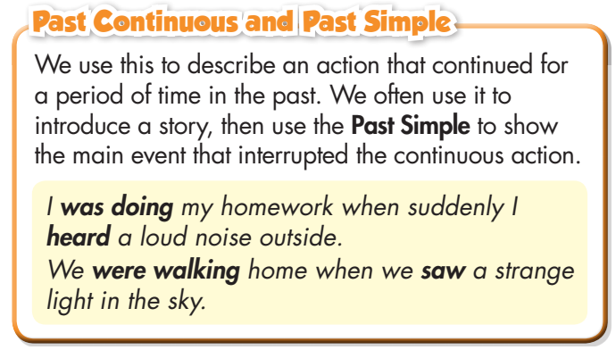
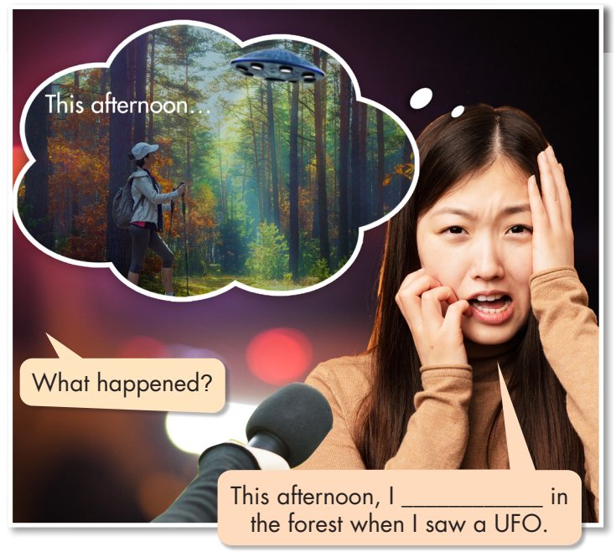

Slide 7
was walking

Slide 8




Slide 9


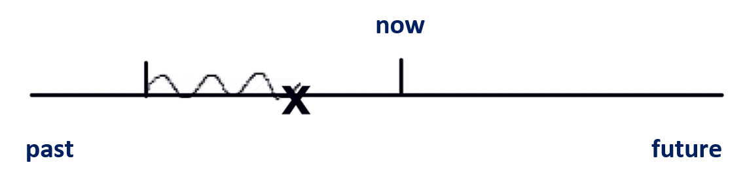
Describe an action that continued for a period of time in the past (Past Continuous).
Introduce a story, then use the Past Simple to show the main event (Past Simple) that interrupted the continuous action (Past Continuous).
Past Continuous
Past Simple
E.g.: I was doing my homework when suddenly I heard a loud noise outside.

Slide 10

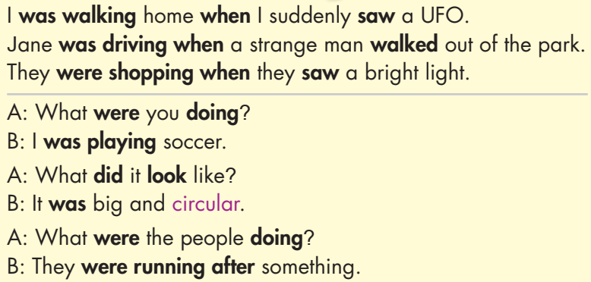

Slide 11
 | PAST SIMPLE (QKĐ) | PAST CONTINUOUS (QKTD)
Structure | (+) S + V_{ed}/V₂ (-) S + didn’t + V (?) (Wh) + did + S + V₀? | (+) S + was/were + V-ing (-) S + wasn’t/ weren’t + V_ing. (?) (Wh) + was/were + S + V_ing?
USE (Sử dụng) | Hành động đã kết thức trong quá khứ | Hành động đang diễn ra trong một khoảng thời gian, hoặc một thời điểm cụ thể trong quá khứ.
TIME MAKERS (dấu hiệu thời gian) | • yesterday • last (last week, last month, last year, etc.) • ago (three days ago, etc.) • when | at 8 p.m last night When While

Slide 12
Subject | was/ were | V_ing
I He She It | was | reading walking swimming learning working running
You We They | were

Slide 13

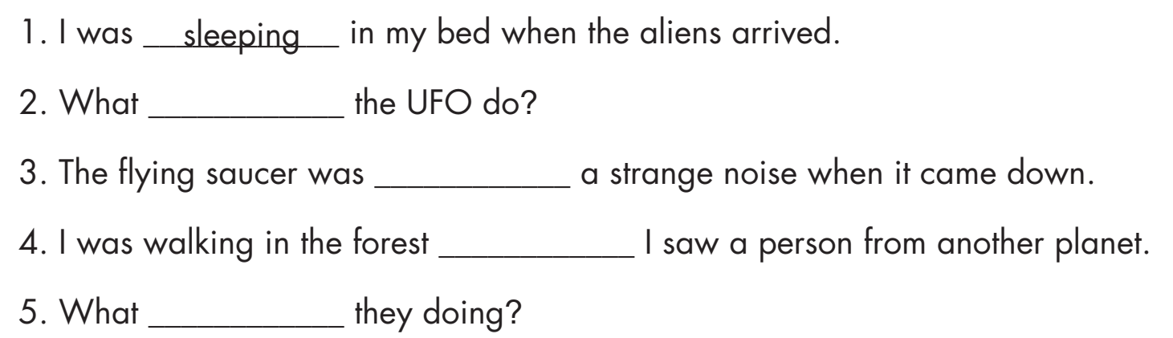
did
making
when
were

Slide 14

Practice

Slide 15
Dùng When để diễn tả một hành động chen ngang vào một hành động khác đang diễn ra trong quá khứ.
When Quá khứ đơn, Quá khứ tiếp diễn.
Eg: When I saw the teacher, students were talking.
Quá khứ tiếp diễn when Quá khứ đơn.
Eg: I was playing soccer when I saw the UFO in the sky.

Slide 16
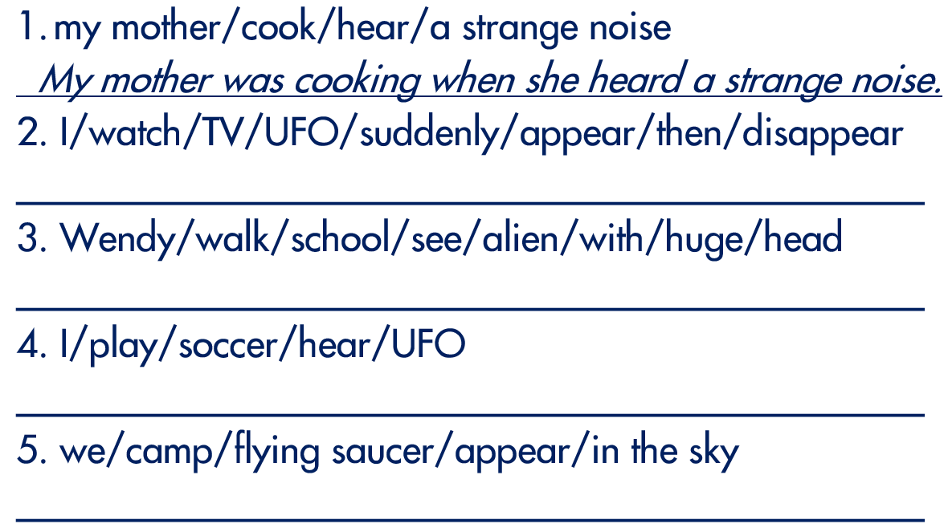
I was watching TV when a UFO suddenly appeared then disappeared.
Wendy was walking to school when she saw an alien with a huge head.
I was watching TV when a UFO suddenly appeared then disappeared.
We were camping when a flying saucer appeared in the sky.

Slide 17

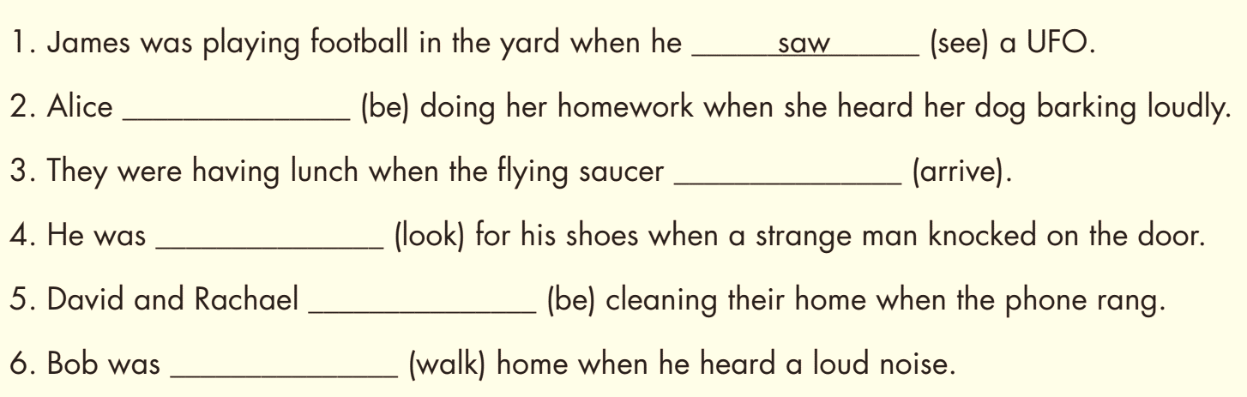
Extra Practice
WB page 35
was
arrived
looking
were
walking

Slide 18

Production:
Speaking

Slide 19

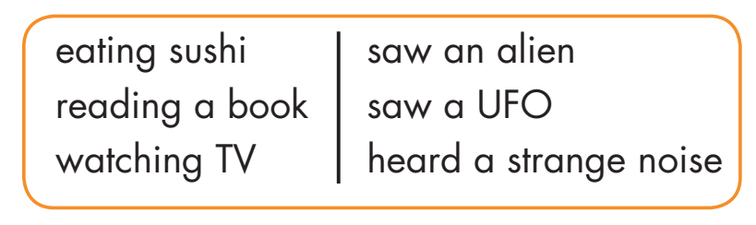
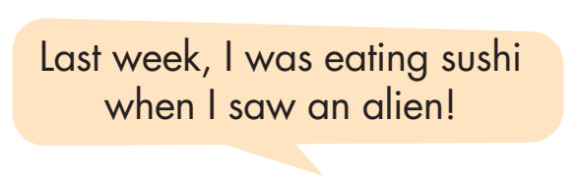

Slide 20
Share with your class!

Slide 21

CONSOLIDATION

Slide 22
WHAT WERE YOU DOING THEN?
Work in pairs.
Talk about what you saw/ felt/ did… when you were doing something yesterday.

Slide 23

WRAP-UP

Slide 24
Today’s lesson
Grammar:
Using the past continuous to describe an action that continued for a period of time in the past.
Using this to introduce a story, then use the Past Simple to show the main event that interrupted the continuous action.
Speaking:
- Making sentences using the prompts.

Slide 25
Lesson 3
Homework
- Make three sentences, using Past Continuous and Past Simple.
- Do the exercises in WB: Grammar (page 35).
- Do the exercises in Tiếng Anh 8 i-Learn Smart World Notebook (page 51).
- Play the consolidation games in Tiếng Anh 8 i-Learn Smart World DHA App on www.eduhome.com.vn
- Prepare: Lesson 2.3 – Pronunciation and Speaking (pages 60 & 61 – SB).

Slide 26

Lesson 3
Stay positive and have a nice day!

