Slide 1

Unit 6: Life on other planets
Lesson 2.1 – Vocabulary & Listening
Pages 58 & 59

Slide 2
Lesson Outline
Warm-up
Vocabulary
Listening
Consolidation
Wrap-up

Slide 3

By the end of this lesson, students will be able to…
know more words about life on other planets.
listen to and understand interviews with people talking about strange things they saw (for specific details).
know how to use functional English – Showing interests.

Slide 4

New words
alien
appear
disappear
disk-shaped
flying saucer
huge
tiny
strange
terrified
UFO

Slide 5

Lesson 1
WARM UP

Slide 6
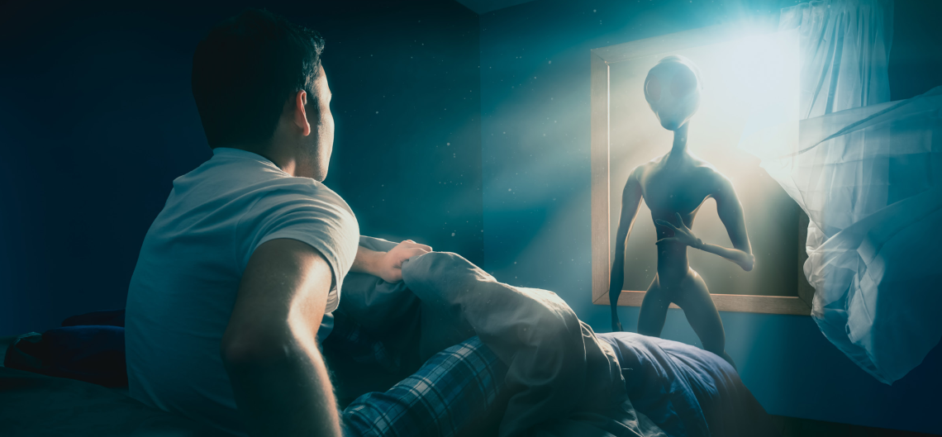
In pairs. Look at the picture. Discuss the questions.
What do you think is happening?
Where can you see or
hear about something like this?
Do you think the stories are real?

Slide 7
Option 2
Watch a video and answer the question.
Can you see someone/ something special in the video?
Top10 2023 UFO Sightings - YouTube
Aliens!

Slide 8

Pre – Listening:
Vocabulary

Slide 9

Listen and repeat. Click on each phrase to hear the sound.
alien (n) /ˈeɪliən/ người ngoài hành tinh
appear (v) /əˈpɪr/ xuất hiện >< disappear (v) /dɪsəˈpɪr/ biến mất
disk-shaped (n) / dɪsk ʃeɪpt/ hình đĩa
flying saucer (n) /ˌflaɪɪŋ ˈsɑːsɚ/ đĩa bay
huge (adj) /hjuːdʒ/ to lớn >< tiny (adj) /ˈtaɪni/ nhỏ xíu
strange (adj) /streɪndʒ/ kỳ lạ
terrified (adj) /ˈterəfaɪd/ cảm thấy khiếp sợ
UFO (n) /ˌjuːefˈoʊ/ (unidentified flying object) vật thể bay không xác định
Notes:
GV click vào từng cụm nghe âm thanh

Slide 10
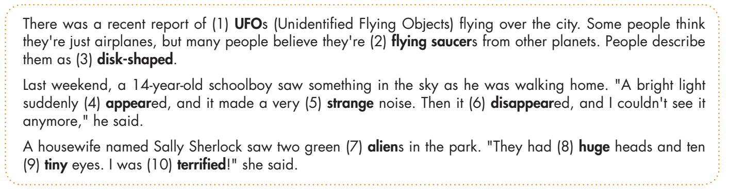
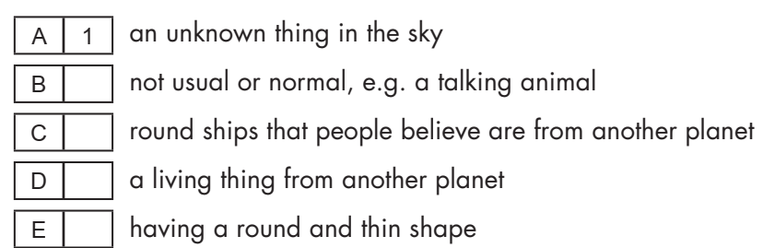
5
2
7
3

Slide 11
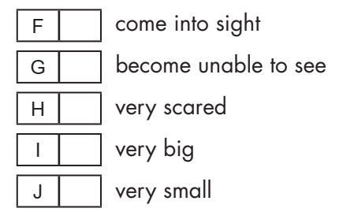
4
6
10
8
9

Slide 12

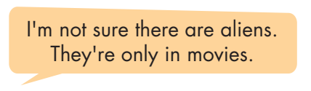
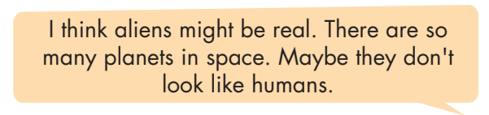
Work in pairs

Slide 13

Listening

Slide 14



Slide 15

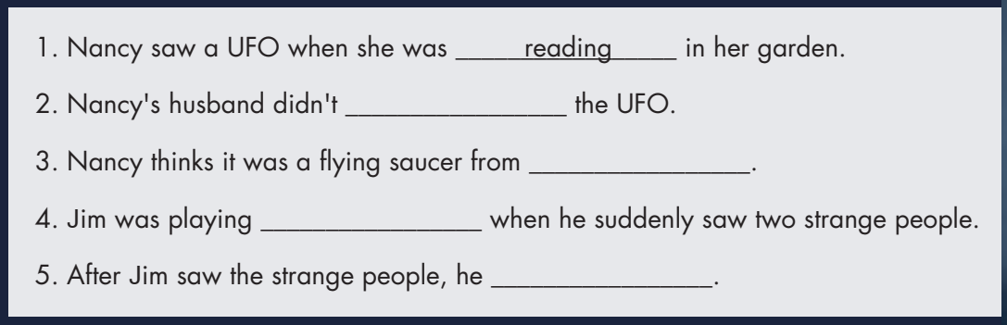
see
another planet
soccer
ran away

Slide 16

Post - listening

Slide 17

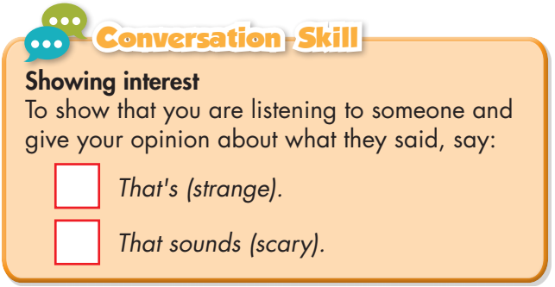

Slide 18
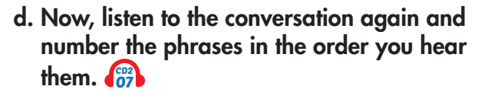
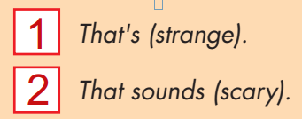

Slide 19

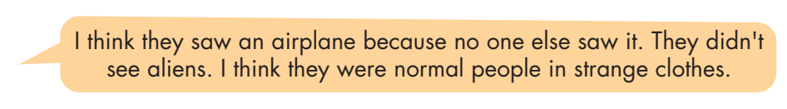
Work in pairs

Slide 20

CONSOLIDATION

Slide 21
Choose the correct word for each sentence.
1. Suddenly, a UFO appeared/ disappeared in the sky, and it made a strange sound.
2. The alien had ten huge/ tiny eyes on its head. They were so small!
3. I was walking home from school when I saw a disk-shaped/ round-shaped thing in the sky. It was round and thin.

Slide 22

WRAP-UP

Slide 23
Today’s lesson
Vocabularies
alien
appear
disappear
disk-shaped
flying saucer
huge
tiny
strange
terrified
UFO

Slide 24
Today’s lesson
Learn more words about life on other planets.
Listen to and understand interviews with people talking about strange things they saw (for specific details).
Know how to use functional English – Showing interests.

Slide 25
Homework
- Learn the new words.
- Practice talking about strange things you saw in the past.
- Do the exercises in WB: New words & Listening (pages 34 & 35).
- Do the exercises in TA 8 i-Learn Smart World Notebook, (pages 49 & 50).
- Play the consolidation games in Tiếng Anh 8 i-Learn Smart World DHA App on www.eduhome.com.vn
- Prepare: Lesson 2.2 – Grammar (pages 59 & 60 – SB).

Slide 26

Lesson 3
Stay positive and have a nice day!

