Slide 1

Unit 6: Life on other planets
Lesson 1.3 – Pronun. & Speaking
Pages 56 & 57

Slide 2
Lesson Outline
Warm-up
Pronunciation
Speaking
Consolidation
Wrap-up

Slide 3

By the end of this lesson, students will be able to…
- practice intonation for interest / opinion words.
- practice making predictions about where humans will live in the future, using Future Simple.

Slide 4

Lesson 1
WARM UP

Slide 5

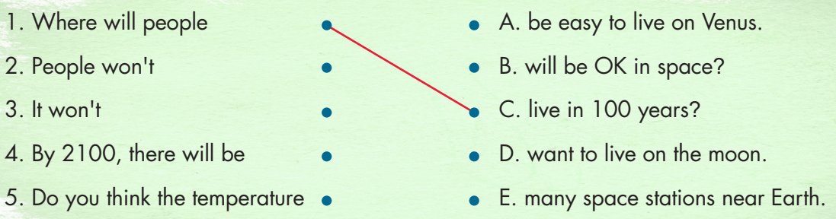

Slide 6

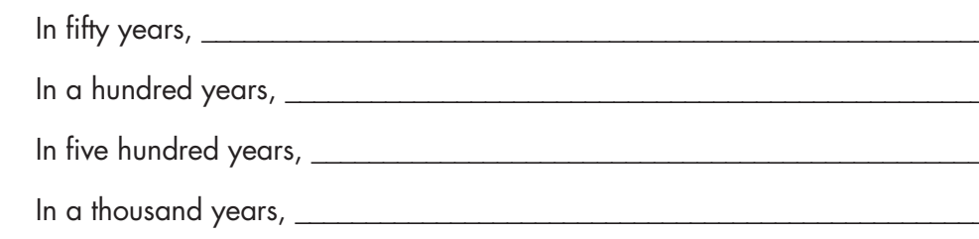
Extra Practice
WB page 33
people won’t live on Mars.
people will live on space stations near Earth.
people will not live on Earth.
people will live on all the planets.

Slide 7

Pronunciation

Slide 8

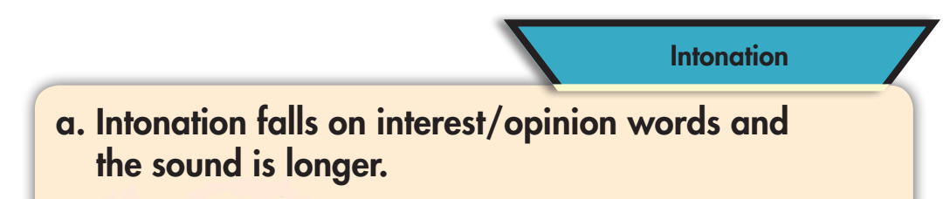


Slide 9




Slide 10
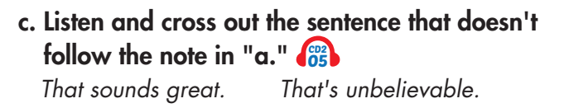
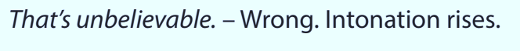

Slide 11

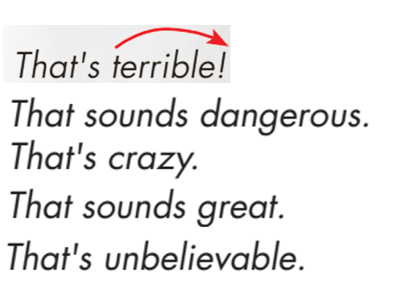

Slide 12
Practice:
Speaking

Slide 13

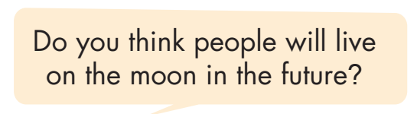
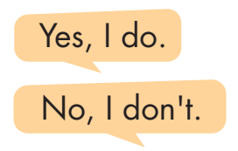

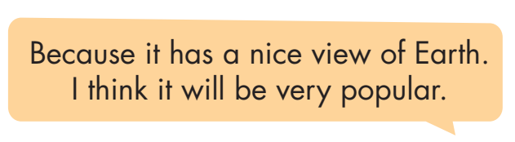
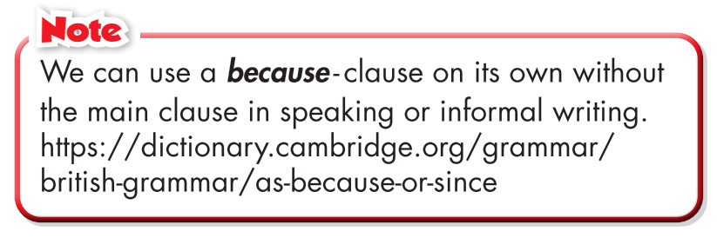
Work in pairs

Slide 14
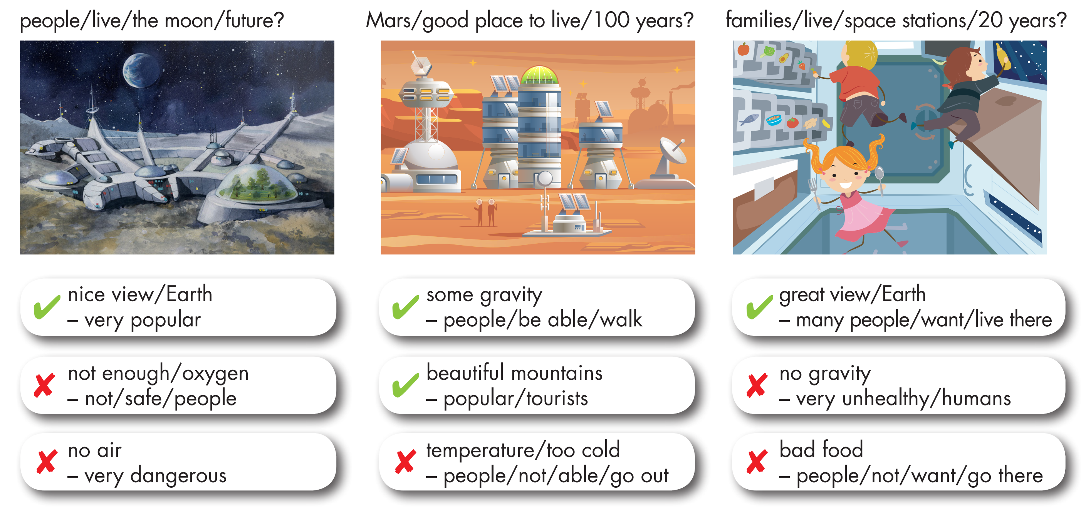
Take turns asking and answering using the prompts.

Slide 15
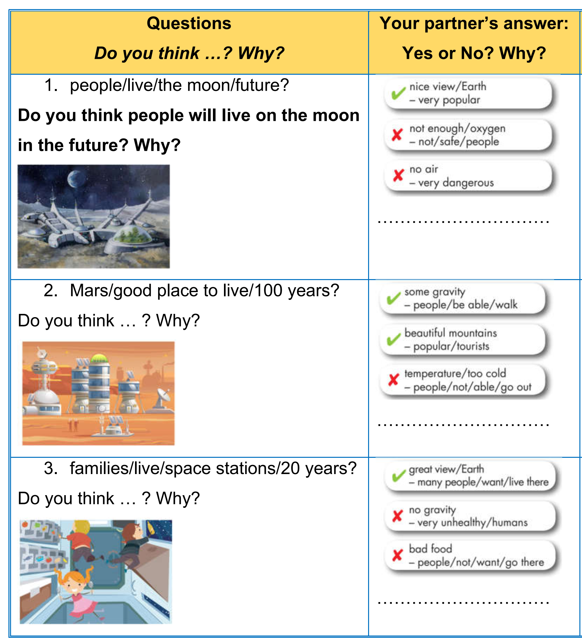
Read the following questions using the prompts. Ask your partner. Write Yes or No and the reason(s).

Slide 16
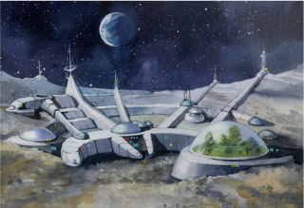
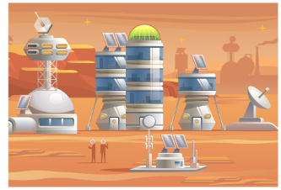
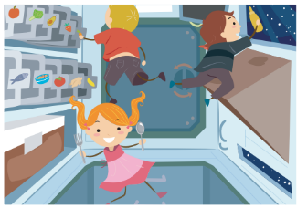

Practice with your own ideas.

Slide 17
Production:
Speaking

Slide 18


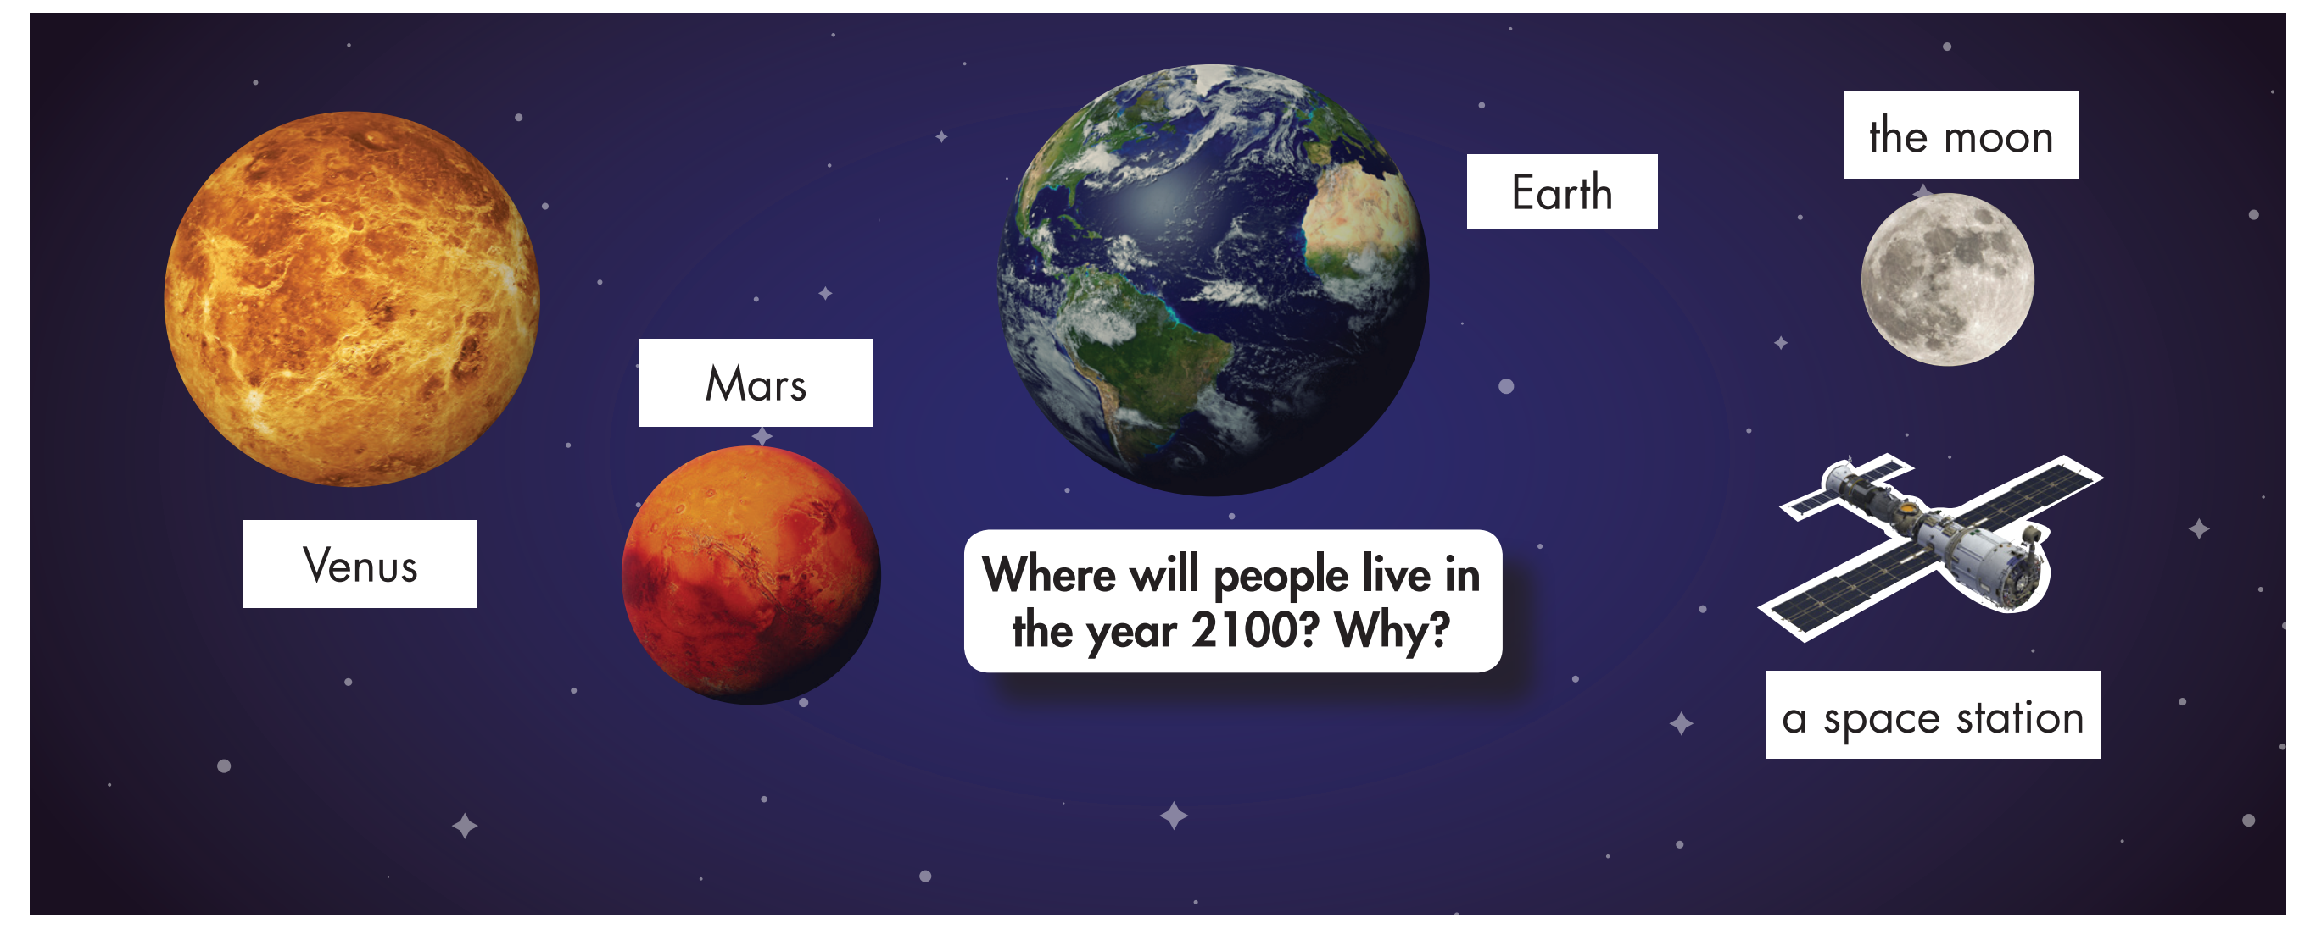
In pairs: Make predictions about where people will and won't live in 2100 and why.

Slide 19

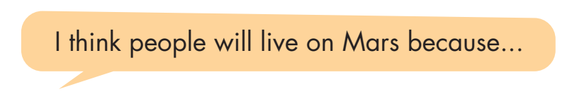
Join another pair. Take turns saying where you think people will/ won't live in the future.
Do you agree with the other pair's choices? Why (not)?

Slide 20

CONSOLIDATION

Slide 21
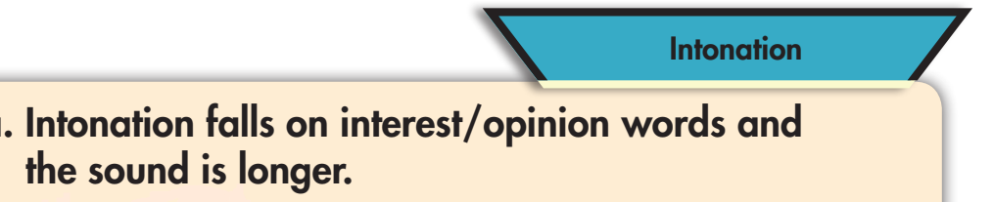

Slide 22

WRAP-UP

Slide 23
Today’s lesson
Using falling intonation for interest/ opinion words
Making predictions about where humans will live in the future, using Future Simple.

Slide 24
Lesson 3
Homework
- Practice: Write five sentences, using will regarding the reasons for where you think people will/ won’t live in the future.
- Do the exercises in WB: Writing (page 33).
- Play the consolidation games in Tiếng Anh 8 i-Learn Smart World DHA App on www.eduhome.com.vn
- Prepare: Unit 6 - Lesson 2.1 – Vocabulary & Listening (pages 58 & 59 – SB).

Slide 25

Lesson 3
Stay positive and have a nice day!

