Slide 1
Unit 6: Life on other planets
Lesson 1.1: Vocabulary & Reading
Pages 54 & 55

Slide 2
Lesson Outline
Warm-up
Vocabulary
Reading
Consolidation
Wrap-up

Slide 3
By the end of this lesson, students will be able to…
- talk about life on other planets, using phrases: live on Earth, Mars, Venus, oxygen, space station, gravity, temperature.
- practice reading and understanding general and specific information about different places people can live in the future.

Slide 4
New words
live on Earth
Mars
Venus
oxygen
space station
gravity
temperature

Slide 5
Lesson 1
WARM UP

Slide 6
Look at the picture
and answer the questions.
1 What can you see in the picture?
2 Who are they?
3 Where are they?
4 Do you think humans will live on a different planet in the future? Why (not)?

Slide 7
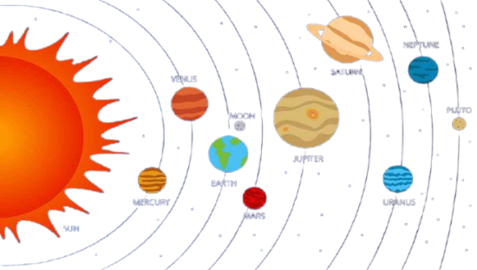
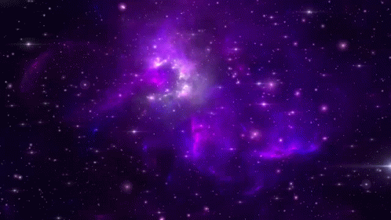

Slide 8
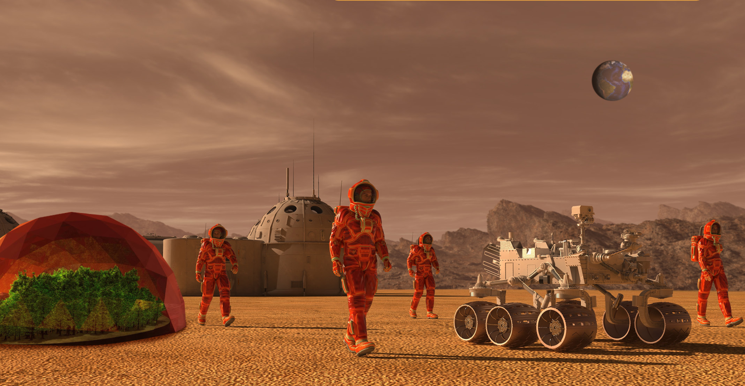
1 What can you see in the picture?
2 Who are they?
3 Where are they?
4 Do you think humans will live on a different planet in the future? Why (not)?

Slide 9
Pre – Reading
Vocabulary

Slide 10
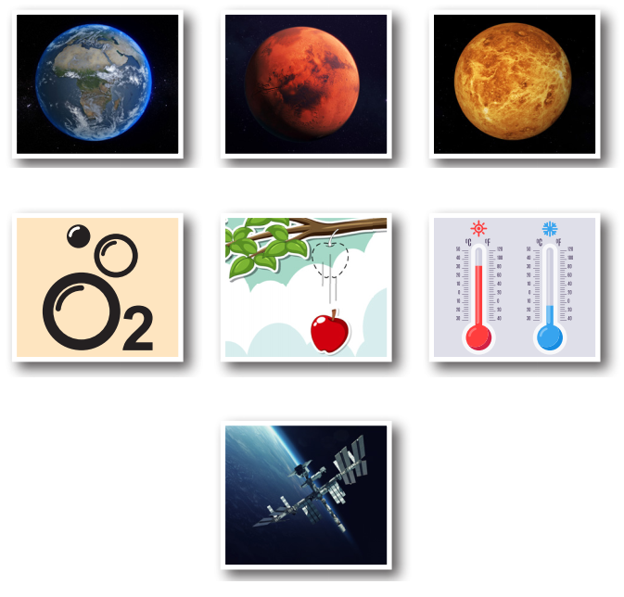
Work in pairs. What can you see in each picture?

Slide 11
Listen and repeat. Click on each phrase to hear the sound.
Earth (n) /ɝːθ/ Trái Đất
Mars (n) /mɑːrz/ sao Hỏa
Venus (n) /ˈviːnəs/ sao Kim
planet (n) /ˈplænɪt/ hành tinh
space station (np) /ˈspeɪs ˌsteɪʃən/ trạm vũ trụ
oxygen (n) /ˈɑːksɪdʒən/ ô-xy
gravity (n) /ˈɡrævəti/ trọng lực
temperature (n) /ˈtempɚətʃɚ/ nhiệt độ
Notes:
GV click vào từng cụm nghe âm thanh

Slide 12
Can you remember?
Earth
Mars
Venus
oxygen
gravity
temperature
space station

Slide 13
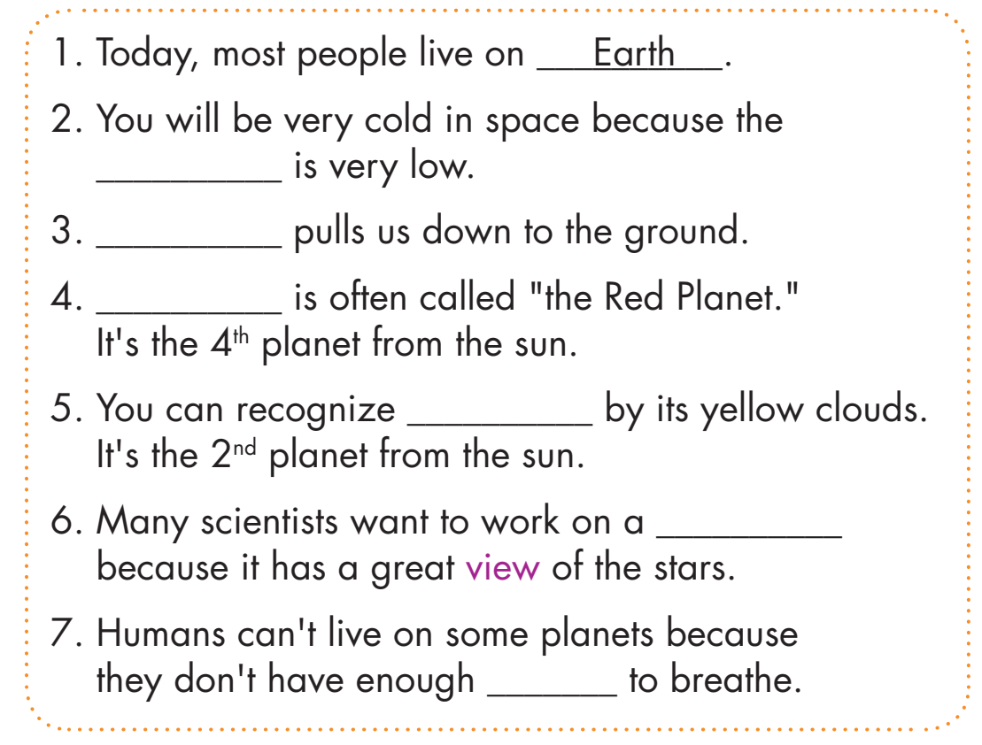
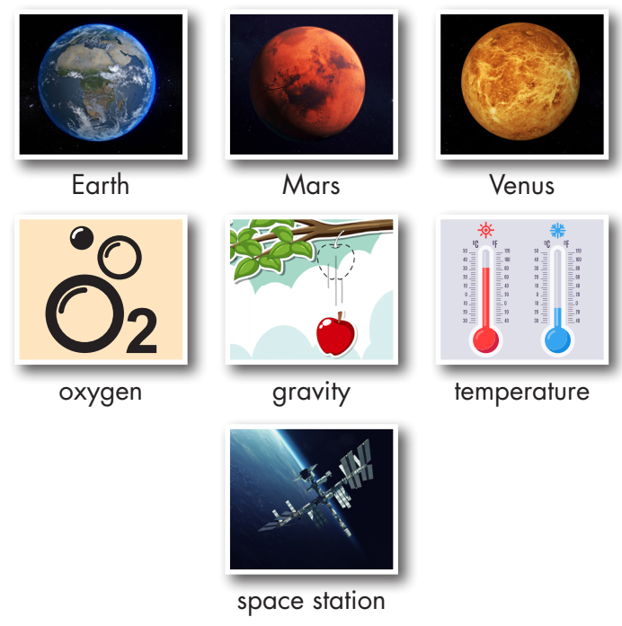
Look at the pictures and fill in the blanks.
temperature
reading comics
Gravity
Mars
Venus
space station
oxygen

Slide 14
Work in pairs
Would you like to visit another planet or a space station? Why (not)?

Slide 15
Reading

Slide 16
Pre - reading
Read the instruction quickly. Underline the key words. What are we going to do?
Read and choose the best title.

Slide 17
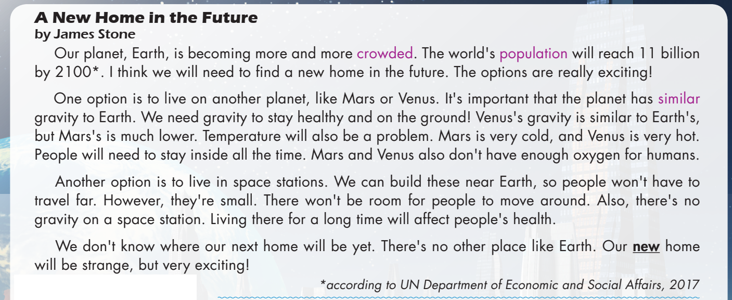
Task a
Read the magazine article. What is it about?
different places people can live in the future
why space stations will be the best places to live
Pre-reading

Slide 18
Task b
Pre-reading
Read the questions and underline the key words.
What are we going to do?
Read and answer the questions.
b. Now, read and answer the questions. According to the writer, 1. What will the world's population be by the year 2100?
2. How is Mars's gravity different from Earth’s?
3. Why will people need to stay inside on Venus?
4. Why is it good that we can build space stations near Earth?
5. The word new in paragraph 4 is closest in meaning to ______.
A. different from before B. recently made C. not known before

Slide 19
Task b
While-reading

Slide 20
What will the world's population be by the year 2100?
How is Mars's gravity different from Earth’s?
Why will people need to stay inside on Venus?
11 billion
It's much lower.
It’s very hot.
A New Home in the Future
by James Stone Our planet, Earth, is becoming more and more crowded. The world's population will reach 11 billion by 2100. I think we will need to find a new home in the future. The options are really exciting!
One option is to live on another planet, like Mars or Venus. It's important that the planet has similar gravity to Earth. We need gravity to stay healthy and on the ground! Venus's gravity is similar to Earth’s, but Mars's is much lower. Temperature will also be a problem. Mars is very cold, and Venus is very hot. People will need to stay inside all the time. Mars and Venus also don't have enough oxygen for humans.

Slide 21
4. Why is it good that we can build space stations near Earth?
5. The word new in paragraph 4 is closest in meaning to ______.
A. different from before B. recently made C. not known before
Because people won't have to travel far.
Another option is to live in space stations. We can build these near Earth, so people won't have to travel far. However, they're small. There won't be room for people to move around. Also, there's no gravity on a space station. Living there for a long time will affect people's health.
We don't know where our next home will be yet. There's no other place like Earth. Our new home will be strange, but very exciting!

Slide 22
Task c
Listen and read.
While-reading

Slide 23
Post-Reading

Slide 24
Task c
Post-reading
Work in pairs
Would you prefer to live on Mars, Venus, or a space station? Why?

Slide 25
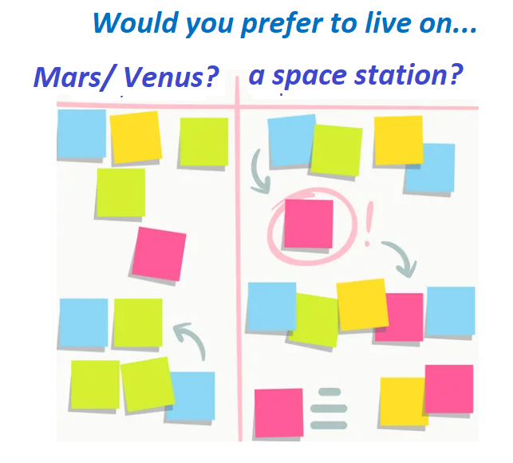
Work in pairs
Post-reading
Write down your ideas on sticky notes, then stick to the board, and talk about them.

Slide 26
CONSOLIDATION

Slide 27
Retell nouns/ noun phrases about future home.

Slide 28
WRAP-UP

Slide 29
Lesson 3
Today’s lesson
Vocabularies
live on Earth
Mars
Venus
oxygen
space station
gravity
temperature

Slide 30
Today’s lesson
Reading:
- Understanding instructions
Skimming and scanning for general and specific information
Speaking:
- Talking about where humans will live in the future

Slide 31
Lesson 3
Homework
Learn the new words.
Practice talking about future home.
Do the exercises in WB: Unit 6 - Lesson 1 - New words + Reading (pages 32 & 33).
Play the consolidation games in Tiếng Anh 8 i-Learn Smart World DHA App on www.eduhome.com.vn
Prepare Lesson 1.2 – Grammar (pages 55 & 56 – SB).
Do the exercises in Notebook (Pages 46 & 47).

Slide 32
Lesson 3
Stay positive and have a nice day!

