Slide 1
Unit 5: Science and technology
Lesson 3.2 – Speaking & Writing
Page 53

Slide 2
Lesson Outline
Warm-up
Speaking
Writing
Consolidation
Wrap-up

Slide 3
By the end of this lesson, students will be able to…
- talk about buying a new phone.
- write an email to your friend about the smartphone you chose.

Slide 4
WARM UP

Slide 5
However
so
but
and
also

Slide 6
Combine the sentences using conjunctions.
1. It has long battery life. It's very expensive.
2. It has a great screen. It has a really good speaker.
3. It has a lot of storage. It can store lots of music and photos.
Check answers
It has long battery life, but it's very expensive./
It has a great screen. It also has a really good speaker.
2. It has a great screen, and the speaker is really good./
It has long battery life. However, it's very expensive.
3. It has a lot of storage, so it can store lots of music and photos.

Slide 7
Pre-writing

Slide 8
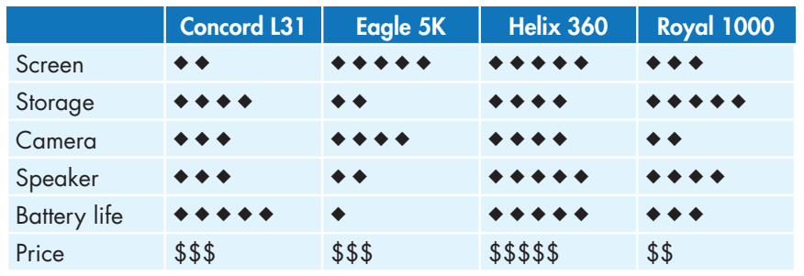
- What do you think about the Concord L31?
- Well, it has long battery life, but the screen isn't good.
- I want a phone for watching movies, so I'll get the…

Slide 9
While-writing

Slide 10
Hi, _______ ,
How are you? I hope you are doing well!
Guess what! I just came back to school after the Tet holiday, and I got a lot of lucky money. Therefore, I went to an electrics store to buy a new smartphone. The sales assistant showed me many devices. He helped me choose which smartphone I want to buy.
I want to get a smartphone for __________, and the _______ is most suitable.
[good features]
[bad features]
The best part is that _____.
However,
Can’t wait to show it to you.

Slide 11
Now, write a narrative passage to tell the story you planned in Speaking. Use the Writing Skill box and your speaking notes to help you. Write 80 to 100 words.

Slide 12
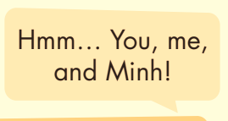
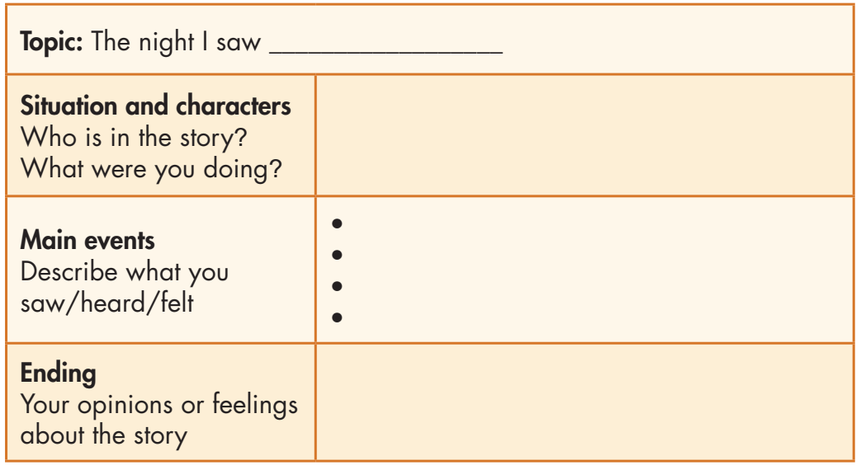
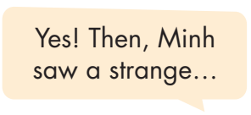
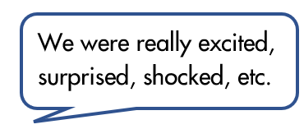
Now, imagine you want to write to a friend about the phone you chose.
In pairs: Choose and talk about two features (good or bad) of each phone. Then, choose one phone to buy and tell your partner which one you want, and why.

Slide 13
Can you remember?
What is a structure of a narrative?
How many sections are there in a narrative passage?
What do you write in the topic section?
Do you write about people in the character section?
In which section do you write about what you saw/heard/felt, the main event or the ending section?

Slide 14
Write a narrative passage.
Check your answers with a partner, using the feedback form.

Slide 15
Post-writing

Slide 16
You will have your passages assessed thanks to these criteria:
• narrative structure
• main idea and focus
• sentence fluency
• word choice
• spelling and punctuation

Slide 17
CONSOLIDATION

Slide 18
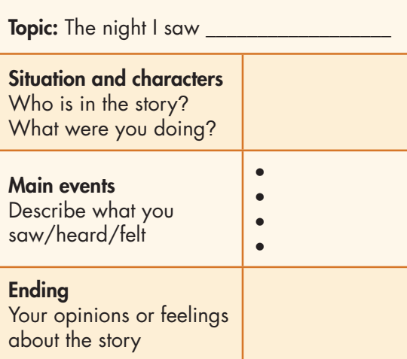
How many parts are there in a narrative passage?

Slide 19
WRAP-UP

Slide 20
Today’s lesson
Speaking: Plan the story about a strange visitor from another planet
Writing: How to write a narrative passage.

Slide 21
Homework
- Review how to write a narrative passage.
- Finish the writing part.
- Do the exercises in WB: Writing (page 37).
- Complete the grammar notes in Tiếng Anh 8 i-Learn Smart World Notebook, page 45.
- Play consolidation games in Tiếng Anh 8 i-Learn Smart World DHA App on www.eduhome.com.vn
- Prepare: Unit 6 – Review – page 98.

Slide 22
Lesson 3
Stay positive and have a nice day!

