Slide 1

Period 70.Unit 7: Transportation
Lesson 3.1: Listening & Reading
Page 58

Slide 2



LESSSON OUTLINE
Consolidation

Slide 3

By the end of this lesson, students will be able to…
practice listening and reading for main ideas and specific information.
be well-prepared for the writing activity in the next lesson.
talk about transportation.

Slide 4

WARM-UP

Slide 5
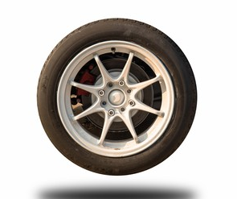
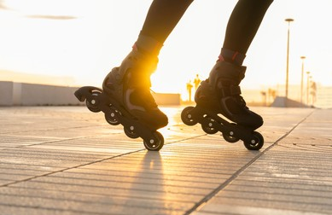
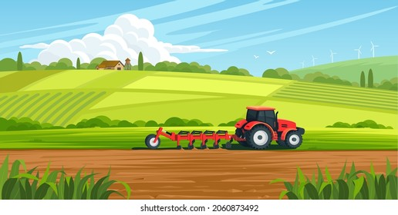
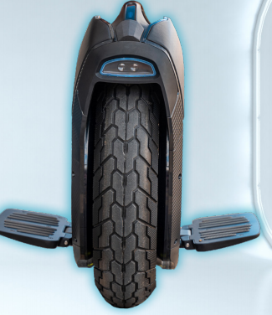
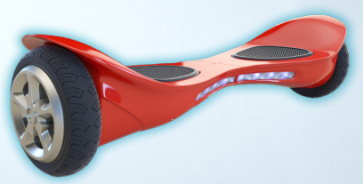
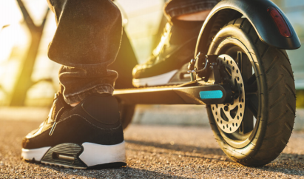
Match the word with the picture
in-line skate
hoover
wheel
countryside
one-wheeler
scooter
Notes:
https://www.shutterstock.com/search/wheel
https://www.shutterstock.com/image-vector/agriculture-concept-tractor-plowing-field-on-2060873492
https://www.shutterstock.com/image-photo/closeup-view-woman-legs-roller-skates-1923544805

Slide 6

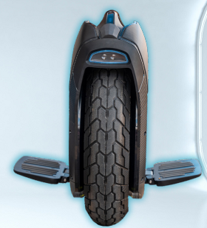
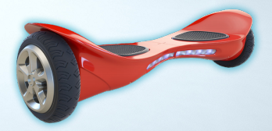
Work in pairs.
What are these two kinds of transportation?
Which would you like to try? Why?

Slide 7
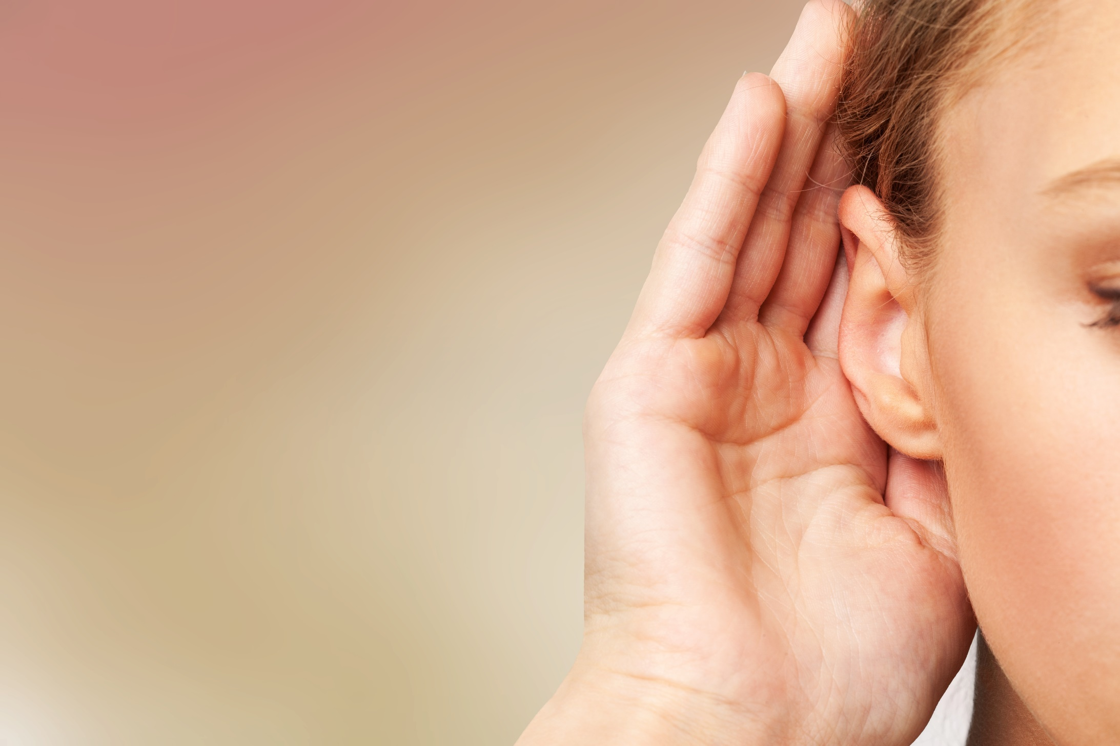

It’s listening time….

Slide 8
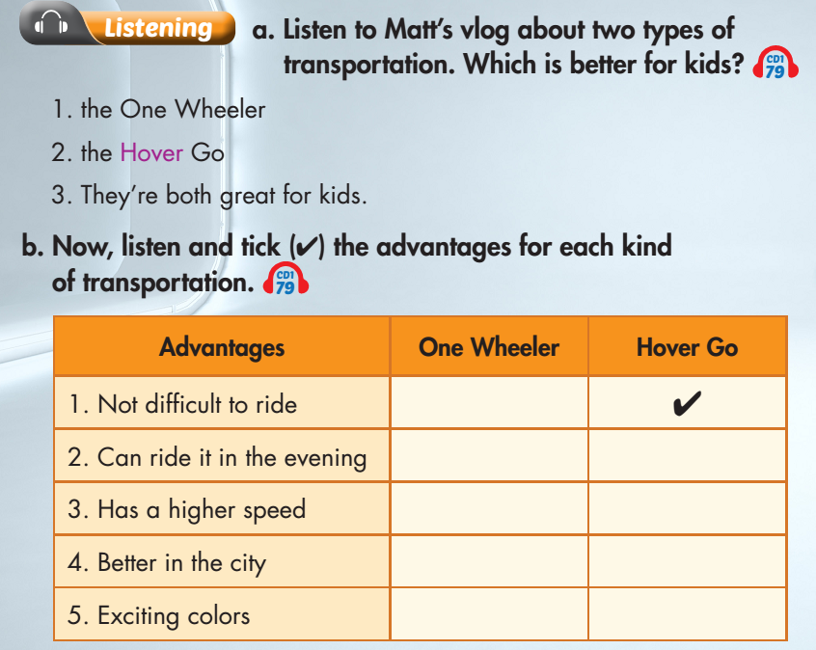

Slide 9
Pre – listening
Before listening
Read the instruction quickly. Underline the key words. What are we going to do?
Listen and choose the correct answer.
a. Listen to Matt’s vlog about two types of transportation. Which is better for kids?
The One Wheeler
The Hover Go
They’re both great for kids.

Slide 10

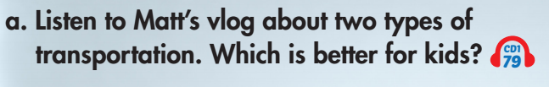

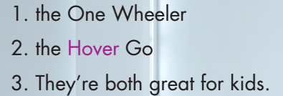
While - listening
Now listen and choose the correct answer.  FIRST TIME
☞ YOUR ANSWER?
☞ WHY?

Slide 11
While - listening
Now listen again and check.  SECOND TIME
While you are listening, focus on what Matt talked about 2 types of transportation.
Everyone can choose their favorite color because both of them come in lots of cool and fun ones. The Hover Go and the One Wheeler are both great kinds of transportation for children.
☞ YOUR ANSWER?
the One Wheeler
the Hover Go
They’re both great for kids.
☞ THE ANSWER IS …

Slide 12
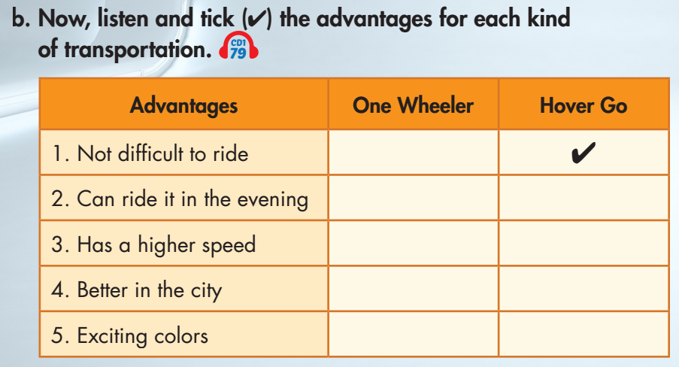
Pre - listening
b. Underline the key words. What are we going to do?

Slide 13
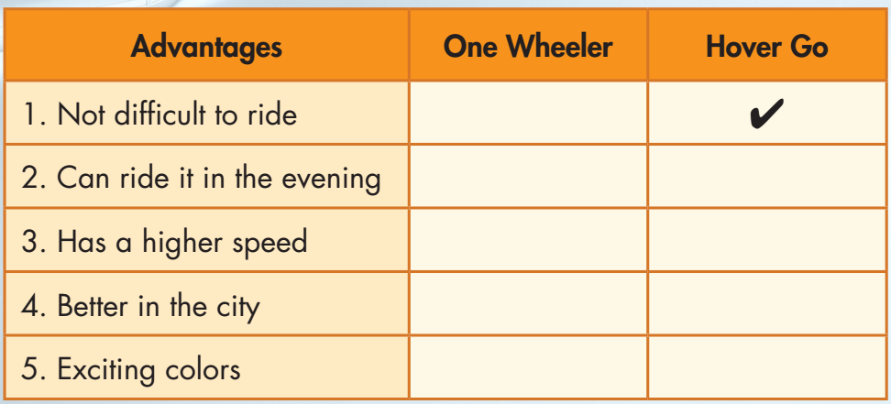
While - listening
Now listen and tick.  FIRST TIME
☞ WHAT ARE YOUR ANSWERS?

Slide 14

While - listening
Now listen again and check.  SECOND TIME
☞ WHY ARE THESE ANSWERS?

Slide 15
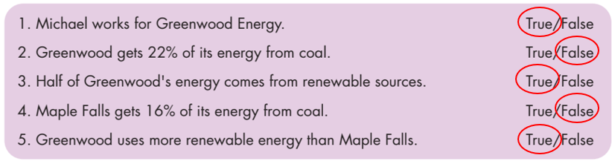
While - listening
Now listen again and check.  THIRD TIME
So today, I want to talk about the One Wheeler and Hover Go. The Hover Go is easier to ride because it has two wheels.

Slide 16
While - listening
Now listen again and check.  THIRD TIME
The Hover Go also has cool lights so you can ride at night.

Slide 17
While - listening
Now listen again and check.  THIRD TIME
The One Wheeler can ride on sand and it’s faster.

Slide 18
While - listening
Now listen again and check.  THIRD TIME
The One Wheeler is better if you live in the countryside, but the Hover Go is great for cities.

Slide 19
While - listening
Now listen again and check.  THIRD TIME
The Hover Go and the One Wheeler are both great kinds
of transportation for children.

Slide 20
Audio Scripts
Practice the talk with your partner.
Hey everyone. It’s Matt with another vlog. You know, adults can drive fun cars or cool motorcycles. But kids have to walk or ride a boring bike. It’s time for kids to have our own cool transportation. So today, I want to talk about the One Wheeler and Hover Go. The Hover Go is easier to ride because it has two wheels. The Hover Go also has cool lights so you can ride at night. The One Wheeler can ride on sand and it’s faster. The One Wheeler is better if you live in the countryside, but the Hover Go is great for cities. Everyone can choose their favorite color because both of them come in lots of cool and fun ones. The Hover Go and the One Wheeler are both great kinds of transportation for children.

Slide 21

Post - listening
Work in pairs
What is your favorite transportation? What are the advantages of that type of transportation?

Slide 22
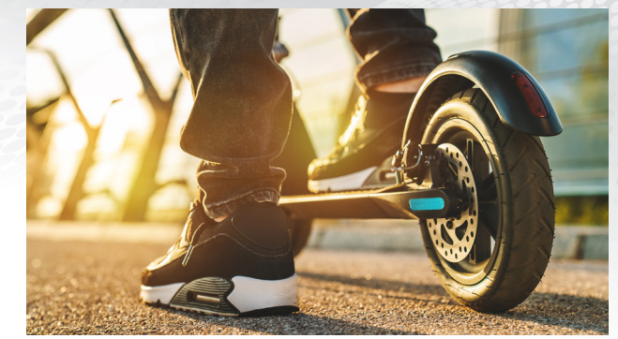
Pre - reading
- What kind of transportation is it?
- What are the advantages of this type of transportation?

Slide 23
Pre - reading
Match the word with the correct meaning
a person who sells something
creator (n)
owner (n)
to make one part lies on top of another part
seller (n)
a person who makes something
fold (v)
a person who has something

Slide 24
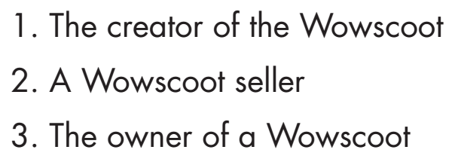
Pre - reading
Underline the keywords and guess who wrote the paragraph.

Slide 25
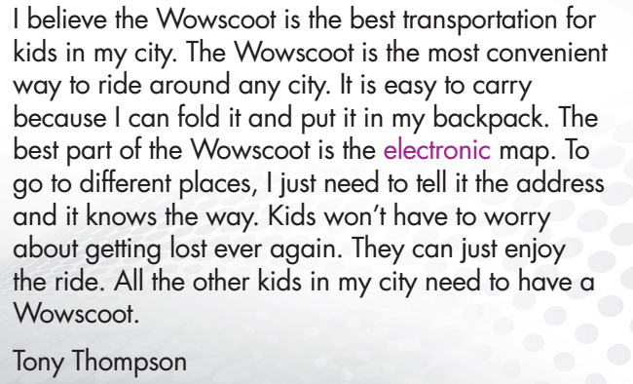
While - reading
Who wrote the paragraph?
Answer: 3. The owner of a Wowscoot

Slide 26
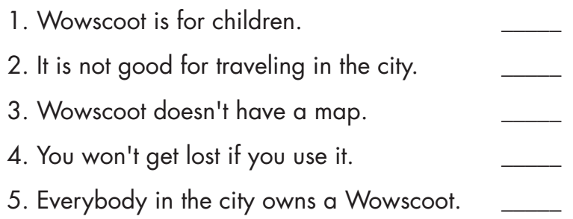
Pre - reading
Read the sentences and underline the key words.

Slide 27
While - reading
Now, read and write True or False.
1. Wowscoot is for children.
True

Slide 28
While - reading
Now, read and write True or False.
2. It is not good for traveling in the city.
False

Slide 29
While - reading
Now, read and write True or False.
3. Wowscoot doesn't have a map.
False

Slide 30
While - reading
Now, read and write True or False.
4. You won't get lost if you use it.
True

Slide 31
While - reading
Now, read and write True or False.
5. Everybody in the city owns a Wowscoot.
False

Slide 32
While - reading
Read again and fill in the blanks.
Wowscoot is the best transportation for ______.
The Wowscoots is ___________ to ride around the city.
You can __________ and put it in your backpack.
To go around, you just need to tell Wowscoot the ________.
kids
convenient
fold
address

Slide 33

Post - reading
Work in pairs
Would the Wowscoot be convenient for
where you live? Why (not)?

Slide 34

CONSOLIDATION

Slide 35
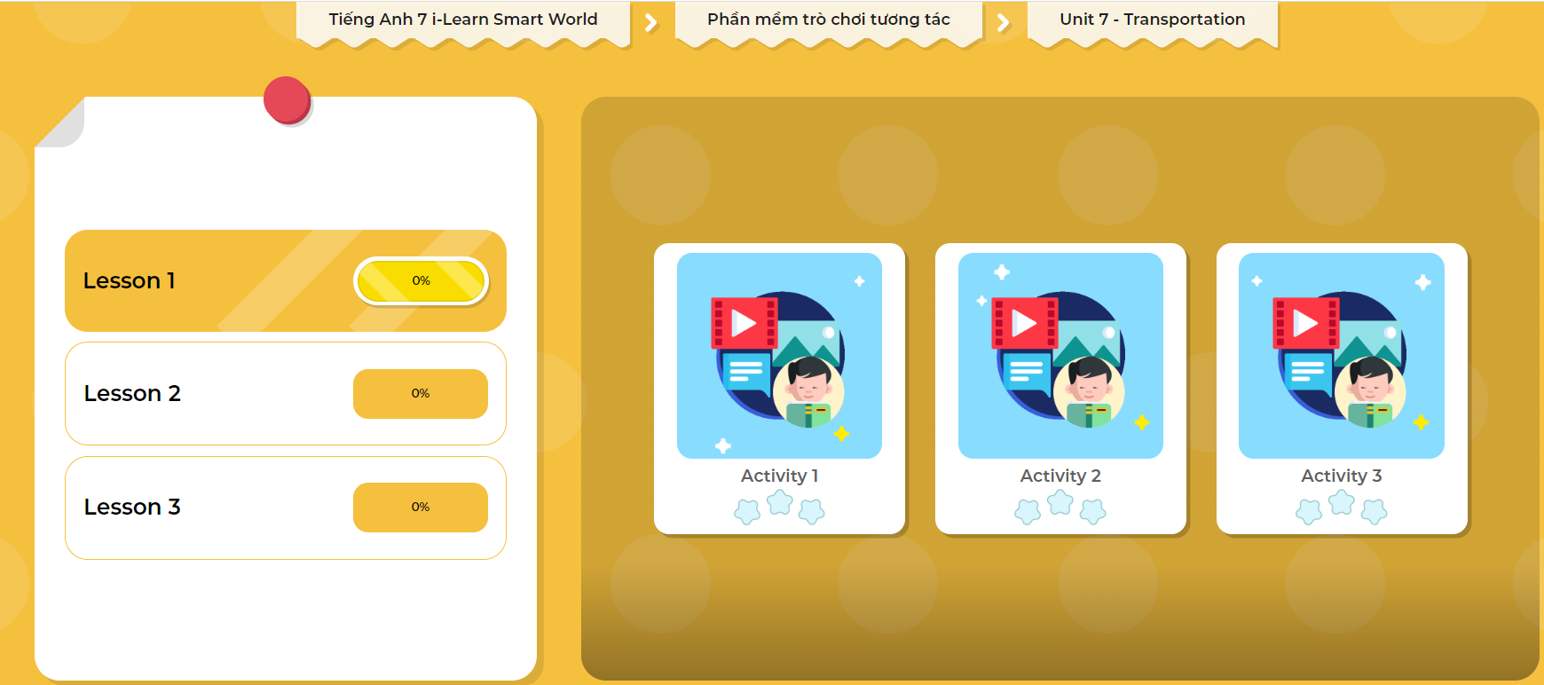
LET’S PLAY!
Click here to play the games

Slide 36

WRAP-UP

Slide 37
Today’s lesson
Practice listening and reading for main ideas and specific information.
Be well-prepared for the writing activity in the next lesson.
Talk about transportation.

Slide 38
Homework
Do the Listening and Reading exercises on page 42 WB.
Do the exercises in Tiếng Anh 7 i-Learn Smart World Notebook on page 46.
Prepare the next lesson (page 59 SB).
Play the consolidation games in Tiếng Anh 7 i-Learn Smart World DHA App on www.eduhome.com.vn

Slide 39

Lesson 3
Stay positive and have a nice day!

