Slide 1

Unit 7: Transportation
Lesson 2.2: Grammar
Page 56

Slide 2


LESSON OUTLINE
Consolidation

Slide 3

By the end of this lesson, students will be able to:
compare things using “not as…as…” if they are different or “as…as…” if they are the same.

Slide 4

(not) as…as…

Slide 5

WARM-UP

Slide 6

Work in pairs.
Compare the following pairs of things:
Watching movies at home & at the cinema
Traveling by plane & traveling by train
Study alone & study in a group
Watching movies at the cinema is more interesting than watching movies at home.

Slide 7



Slide 8
PRESENTATION
(not) as…as…

Slide 9
Lead in
Read the sentences and choose the correct words to complete the examples.
We can compare things using not as…as… if they are different or as…as… if they are the same.
e.g.
- A subway ticket is _________________ a train ticket. (The tickets are the same price.)
as expensive as b. not as expensive as
- Buses ___________ trains. (Buses are slower than trains.)
a. are as fast as b. aren't as fast as

Slide 10
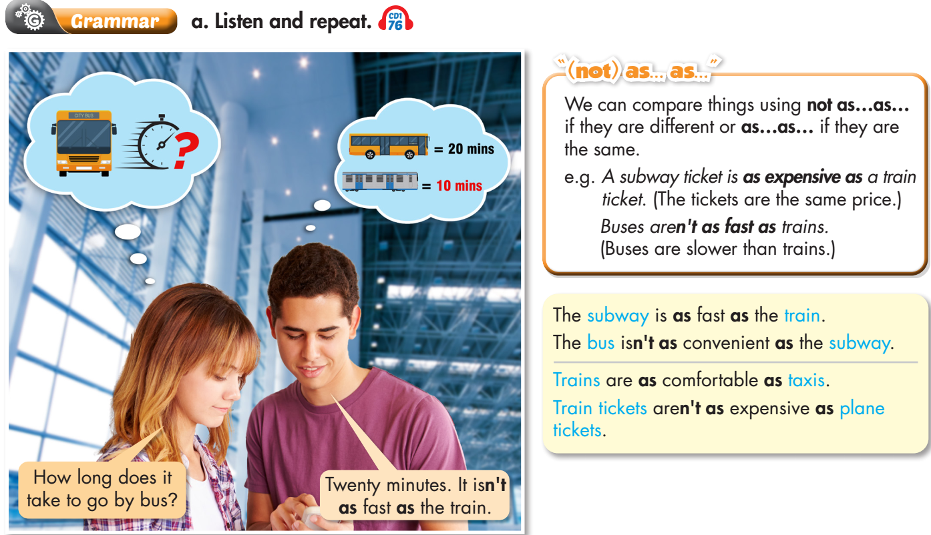


Slide 11

PRACTICE

Slide 12
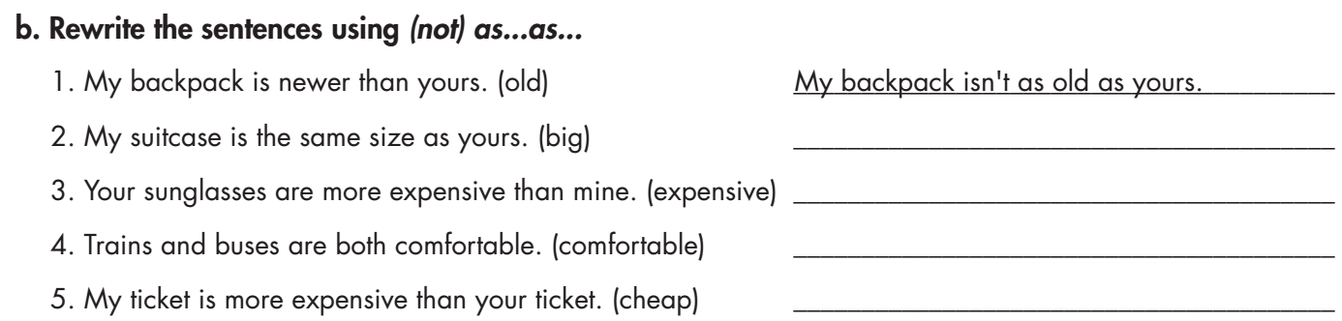
My suitcase is as big as yours.
My sunglasses aren't as expensive as yours.
Trains are as comfortable as buses./ Buses are as comfortable as trains.
My ticket isn't as cheap as yours.

Slide 13
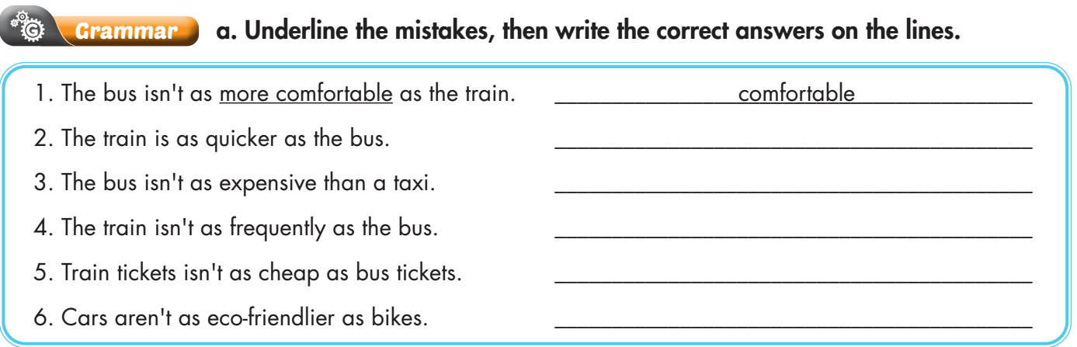
Unit 7
Extra Practice
WB, page 41
quick
as
frequent
aren’t
eco-friendly

Slide 14
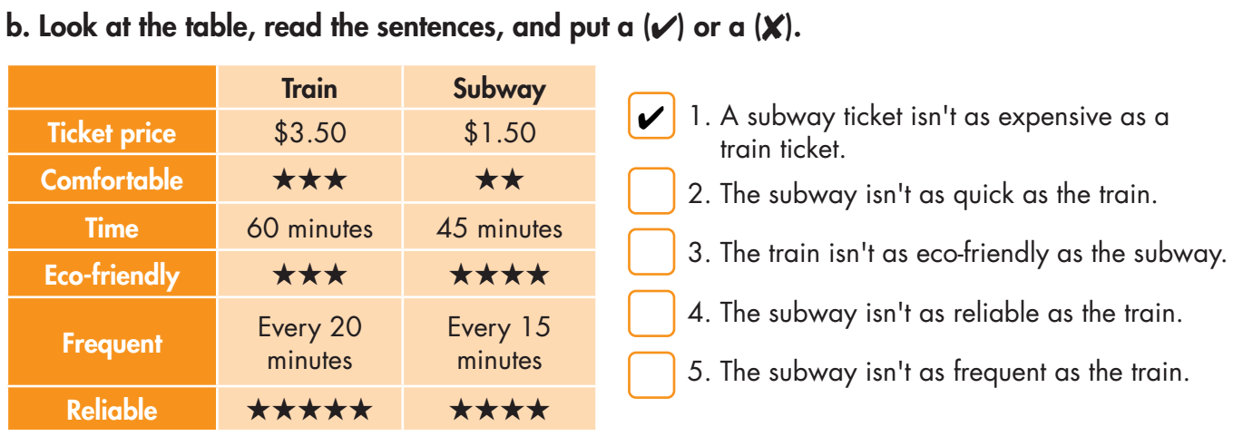


Extra Practice
WB, page 41

Slide 15
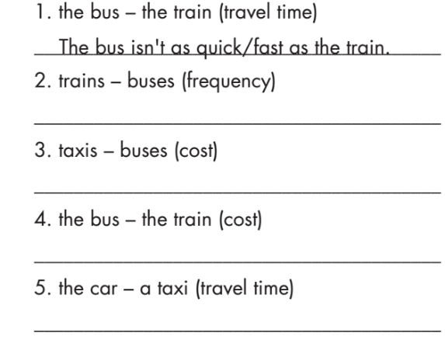
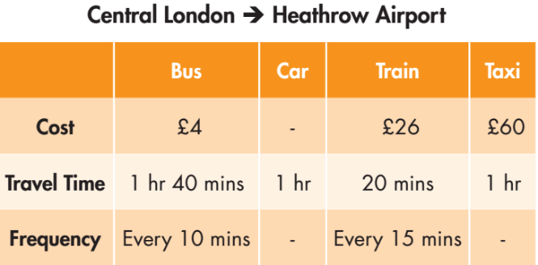
Trains aren't as frequent as buses.
Taxis aren't as cheap as buses.
The bus isn't as expensive as a train.
The car is as quick/fast as a taxi.

Slide 16

PRODUCTION

Slide 17

d. In pairs: Make more sentences about transportation from the table. Use the prompts.
e.g. The bus isn’t as fast as the car.

Slide 18

CONSOLIDATION

Slide 19
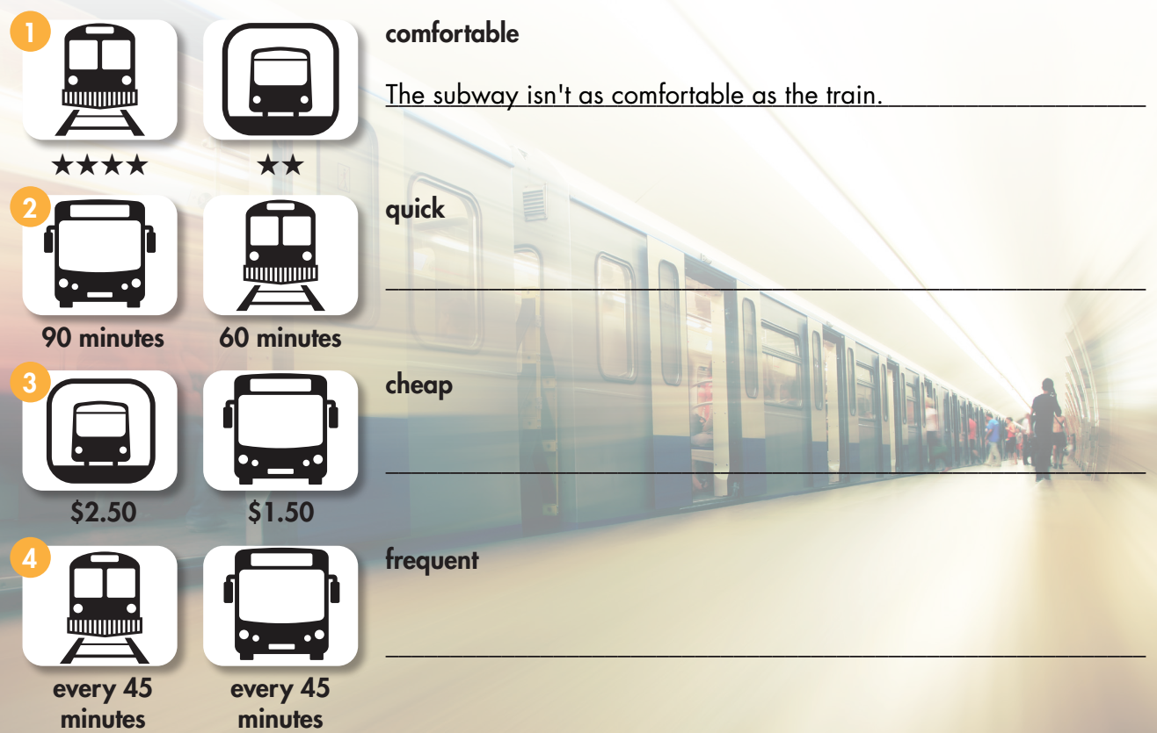





Extra Practice
WB, page 41
The bus isn't as quick as the train.
The subway isn't as cheap as the bus.
The train is as frequent as the bus.

Slide 20
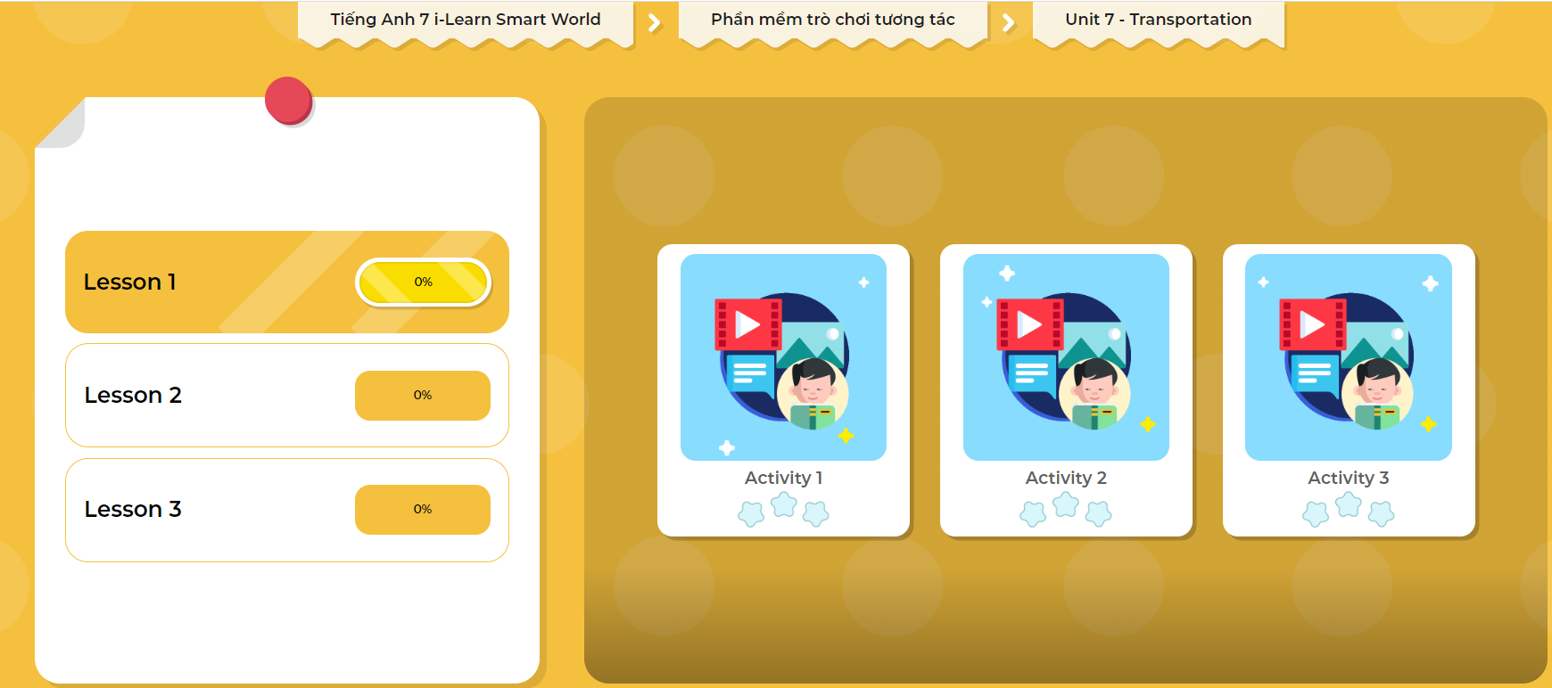
LET’S PLAY!
Click here to play the games

Slide 21

WRAP-UP

Slide 22
Today’s lesson
Grammar:
- Compare things using “not as…as…” if they are different or “as…as…” if they are the same.
Speaking & Writing:
- Compare different types of transportation.

Slide 23
Homework
Practice making sentences, using “(not) as…as…”.
Do the writing exercise in workbook page 41.
Prepare the next lesson (page 57 SB).
Play the consolidation games in Tiếng Anh 7 i-Learn Smart World DHA App on www.eduhome.com.vn
Complete the grammar notes in Tiếng Anh 7 i-Learn Smart World Notebook on page 45.

Slide 24

Lesson 3
Stay positive and have a nice day!

