Slide 1

Unit 7: Transportation
Lesson 2.1: Vocabulary & Listening
Page 55

Slide 2



LESSSON OUTLINE
Consolidation

Slide 3

By the end of this lesson, students will be able to…
learn and use vocabulary related to transportation.
practice reading for main idea and details.
use adjectives to describe different types of transportation.

Slide 4

WARM-UP

Slide 5

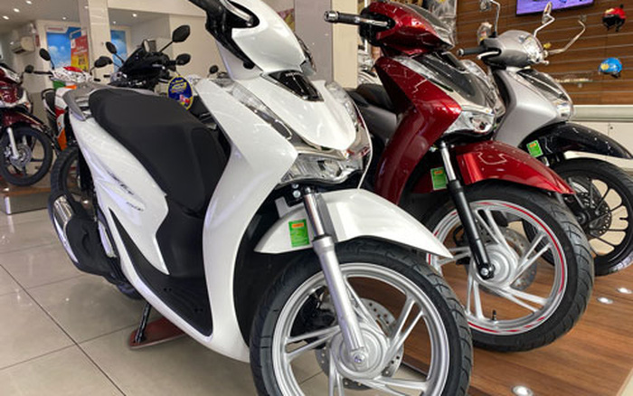
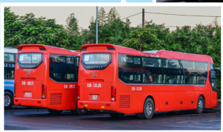
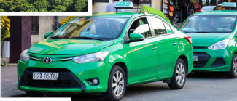
Work in pairs
- What’s the most popular type of transportation in Vietnam?
- Which is your favorite type of transportation?
motorbike
bus
taxi

Slide 6



Slide 7
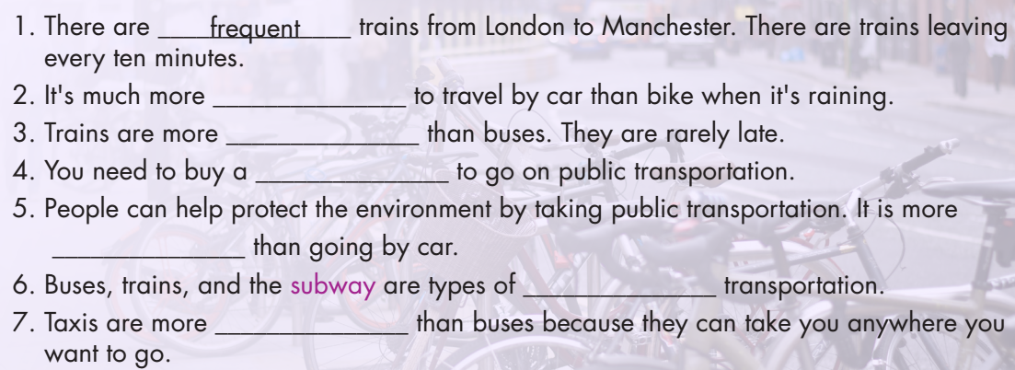
New words
frequent comfortable convenient public eco-friendly ticket reliable

Slide 8
Work in pairs. Find all types of transportation in the following text.

Slide 9
Work in pairs. Match the words with their meanings
D
frequent comfortable convenient public eco-friendly ticket reliable | that can be trusted open to everyone a small piece of paper or a card to show that you have paid for an event, journey, or activity happening often easy to do feeling relaxed not doing bad things to the environment
F
E
B
G
C
A

Slide 10
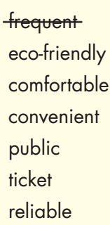
Work in pairs. Fill in the blanks.
comfortable
reliable
ticket
eco-friendly
public
convenient

Slide 11


(Click each word to hear the sound)
frequent (adj) /ˈfriːkwənt/ thường xuyên, hay xảy ra
comfortable (adj) /ˈkʌmftəbl/ thoải mái, dễ chịu
convenient (adj) /kənˈvinjənt/ tiện lợi
public (adj) /ˈpʌblɪk/ công cộng
eco-friendly (adj) /ˌiːkoʊ ˈfrendli/ thân thiện với môi trường
ticket (n) /ˈtɪkɪt/ vé
reliable (adj) /rɪˈlaɪəbl/ có thể tin tưởng
Notes:
GV click vào từng cụm nghe âm thanh

Slide 12
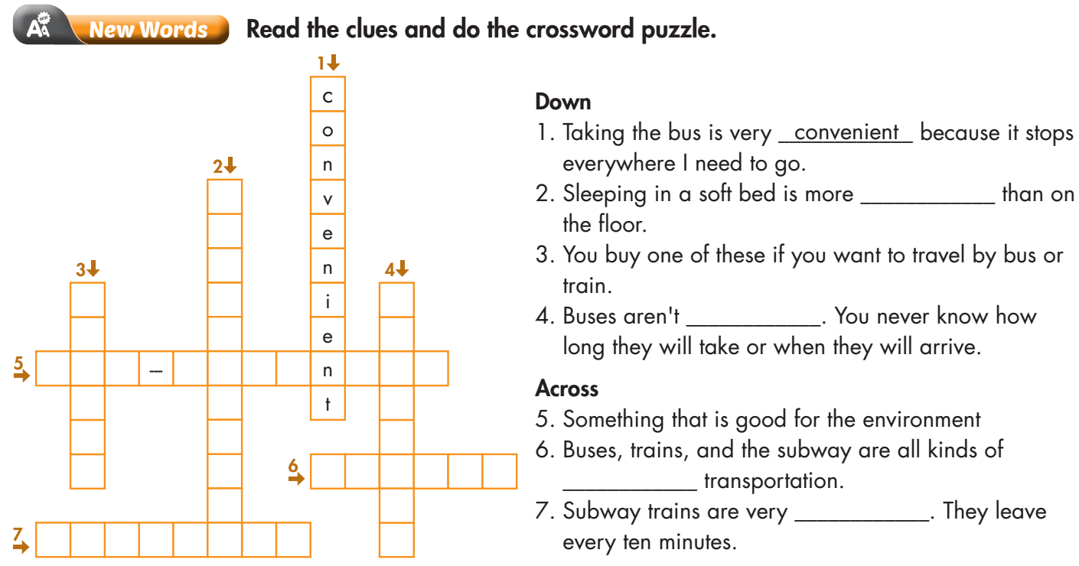
Extra Practice
WB, page 40
1
Click on each number to see the answer
2
C
O
3
M
4
T
F
R
I
O
E
5
E
C
O
F
R
I
E
D
L
Y
K
T
I
E
A
A
T
B
6
P
U
B
L
I
C
L
L
7
F
R
E
Q
U
E
N
T
E

Slide 13
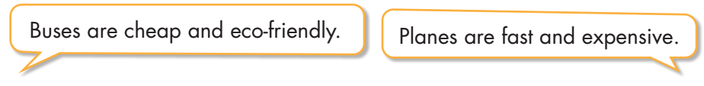

Work in pairs.
In pairs: Use adjectives to describe different types of transportation.

Slide 14

It’s reading time….

Slide 15
Pre - reading
Read the instruction quickly. Underline the key words. What are we going to do?
Read the travel guide and choose the best title.
1. The Fastest Way to Travel in Vietnam 2. Traveling in Vietnam

Slide 16
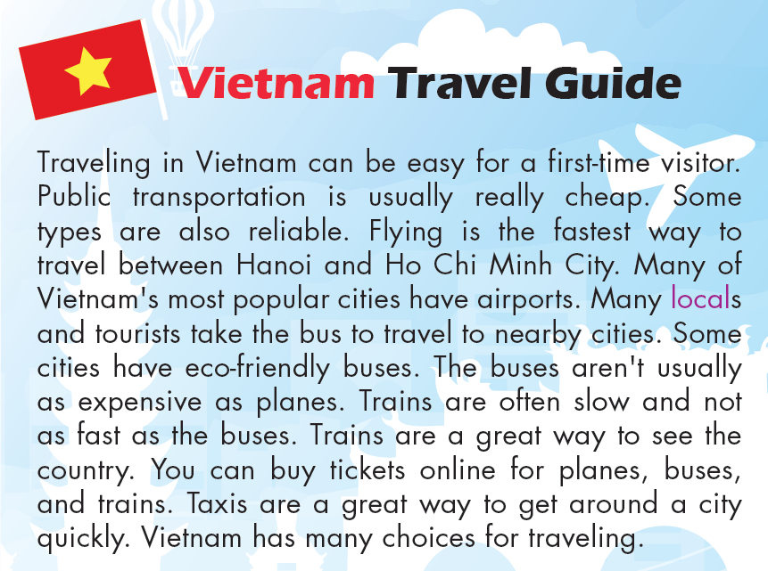
Look at the travel guide. Quickly read the information.
Choose the best title.
Pre - reading
Traveling in Vietnam

Slide 17

While - reading
Read the travel guide quickly. What are we going to do?
Read and fill in the blanks.

Slide 18

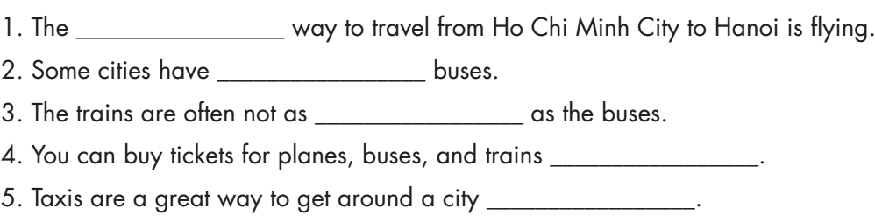

Slide 19
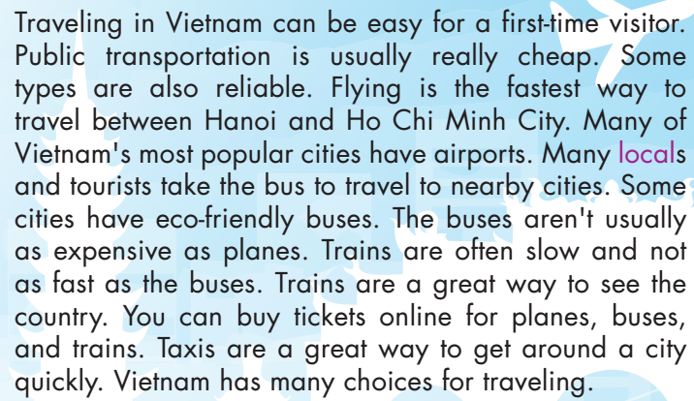
While - reading
Scan the text. Fill in the blanks.
fastest

Slide 20
While - reading
Scan the text. Fill in the blanks.
eco-friendly

Slide 21
While - reading
Scan the text. Fill in the blanks.
fast

Slide 22
While - reading
Scan the text. Fill in the blanks.
online

Slide 23
While - reading
Scan the text. Fill in the blanks.
quickly

Slide 24
Post - reading
Work in pairs
What types of transportation are there in your neighborhood?
There are many types of transportation in my neighborhood. For example, cars, motorbikes, taxis, buses, etc.

Slide 25

CONSOLIDATION

Slide 26
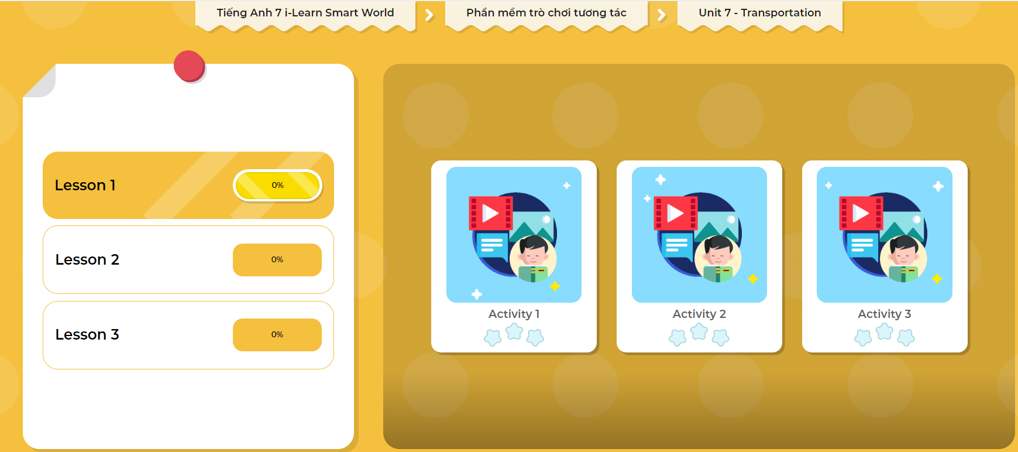
LET’S PLAY!
Click here to play the games

Slide 27
Write 5 sentences to describe different types of transportation in your neighborhood. Try to use the adjectives in this lesson.
E.g. Motorbikes are the most convenient type of transportation for people in my neighborhood.

Slide 28

WRAP-UP

Slide 29
Today’s lesson
Vocabularies
frequent
comfortable
convenient
public
eco-friendly
ticket
reliable

Slide 30
Today’s lesson
Reading:
- Understanding instructions.
Skimming and scanning for general and specific information.
Speaking:
- Describe different types of transportation.

Slide 31
Homework
Learn by hearts vocabularies and make sentences using them.
Do the exercises on page 40 WB.
Do the exercise in Tiếng Anh 7 i-Learn Smart World Notebook (page 44).
Prepare the next lesson (page 56 SB)
Play the consolidation games in Tiếng Anh 7 i-Learn Smart World DHA App on www.eduhome.com.vn

Slide 32

Lesson 3
Stay positive and have a nice day!

