Slide 1

Unit 6: Natural Wonders
Lesson 1.2: Grammar
Pages 55 & 56

Slide 2
Lesson Outline
Warm-up
Presentation
Practice
Production
Consolidation
Wrap-up

Slide 3

By the end of this lesson, students will be able to…
Learn how to use comparative structures with intensifiers correctly
Review vocabulary about natural wonders

Slide 4

WARM-UP

Slide 5
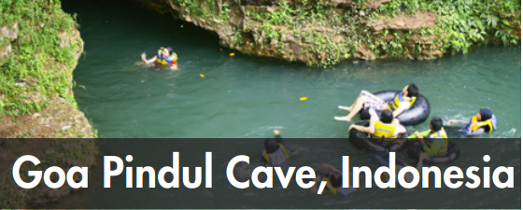
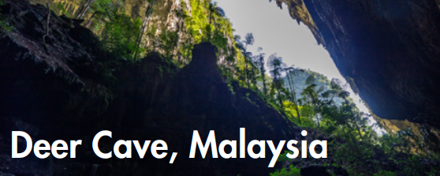
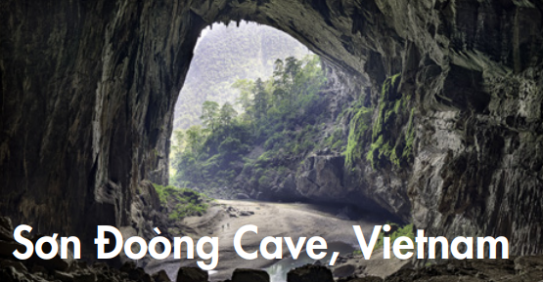
MEMORY CHECK:
Create groups/teams of 5 students.
You will choose some adjectives to talk about what you remember about these caves you studied and give the answers.
The team(s) with the most correct answers win(s).
Time limit: 5 minutes

Slide 6
accessible
difficult
big
expensive
easy
scenic
famous
EXAMPLE:
Sơn Đoòng is much more expensive to visit than the other two caves.

Slide 7


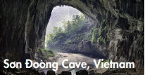
accessible
difficult
big
expensive
easy
scenic
famous
Answers
Sơn Đoòng Cave is far bigger than both the others.
Goa Pindul Cave is more famous for its river than the others.
Deer cave is a bit more difficult to reach than Goa Pindul Cave.

Slide 8
accessible
difficult
big
expensive
easy
scenic
famous
Answers
4. Sơn Đoòng Cave isn't as accessible as Deer Cave.
5. Goa Pindul Cave is easier for people to get inside and see this cave than the others.
6. Sơn Đoòng is much more scenic than most other caves

Slide 9

Presentation

Slide 10
What do you remember about these three caves?
Sơn Đoòng Cave is far bigger than Deer Cave. (big)
Goa Pindul Cave is much more famous for its river than Deer Cave. (famous)
Deer cave is a bit more difficult to reach than Goa Pindul Cave. (difficult)

Slide 11
Sơn Đoòng Cave is far bigger than Deer Cave.
Goa Pindul Cave is much more famous for its river than Deer Cave.
Deer cave is a bit more difficult to reach than Goa Pindul Cave.
Work in pairs – Look at these sentences work and answer these question
How many things do we compare?
What do we add before adjectives? What do we call them?
What do we add after short and long adjectives?

Slide 12
Answers
Sơn Đoòng Cave is far bigger than Deer Cave.
Goa Pindul Cave is much more famous for its river than Deer Cave.
Deer cave is a bit more difficult to reach than Goa Pindul Cave.
We compare two things or two people.
We add “far”, “more” and “a bit” before adjectives, we call them intensifiers. We add them to emphasize or soften the comparison.
We add “–ER” after short adjectives or MORE before long adjectives

Slide 13
What else do you remember about these three caves?
Sơn Đoòng isn't as accessible as Deer Cave
(accessible)

Slide 14
Sơn Đoòng isn't as accessible as Deer Cave
We can also use “(not) + as + adjectives + as” to compare two things or two people

Slide 15
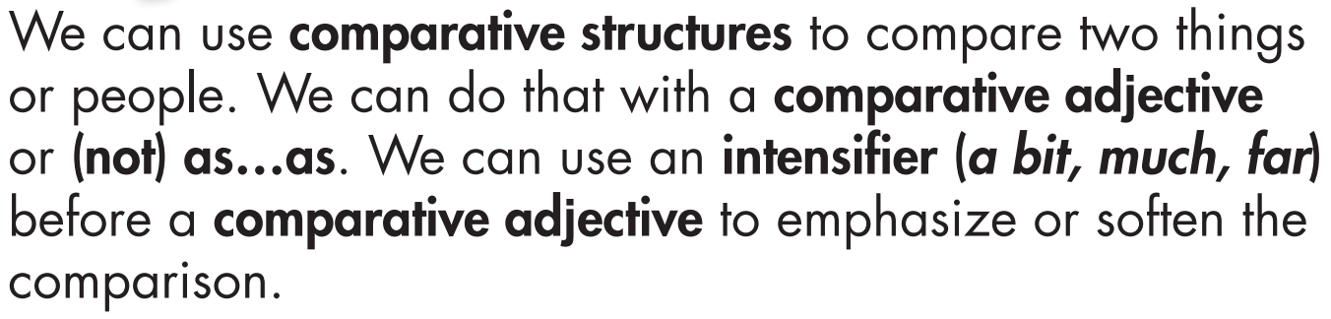

Slide 16
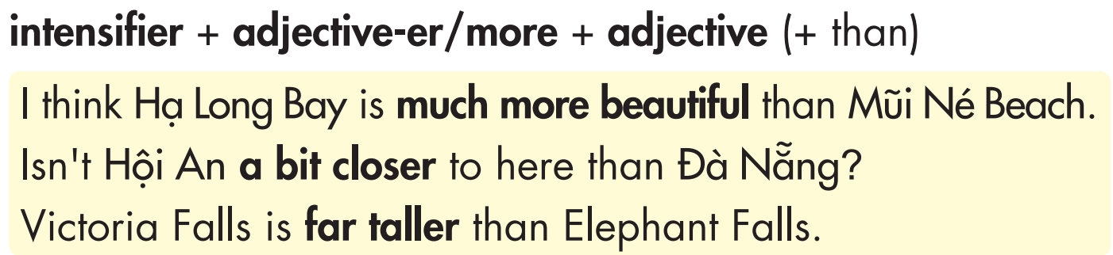

Slide 17
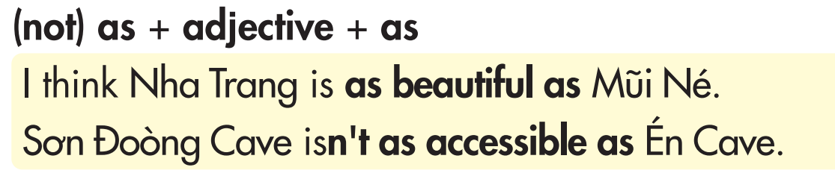

Slide 18
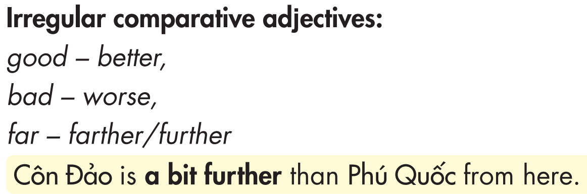

Slide 19
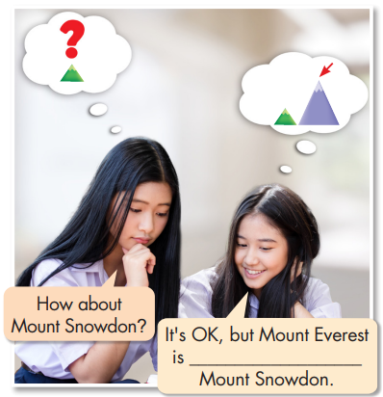

Slide 20




much taller than

Slide 21
Presentation
Practice

Slide 22
Task a.
The view from the summit of Mount Fansipan is a bit (beautiful) ____________________ than the view from Mount Langbiang.
2. The walk to the summit of the mountain is much (scenic) ____________________ than the walk through the forest to get to the beach.
3. Ninh Bình is spectacular! I think the rocky outcrops there are much (interesting) _____________________ than the ones in Hạ Long Bay.

Slide 23
Task a.
4. The rock formations in this cave are far (exciting) ___________________ than the photos online.
5. Visiting the rainforest isn't as (relaxing) ______________ as visiting the beach.
6. The beach in Vũng Tàu is nice, but the one in Nha Trang is a bit (clean) ____________, and it's much (famous) ______________.
7. I don't want to visit Sơn Đoòng Cave. I'd prefer to go somewhere that is much (accessible) _________________

Slide 24
Task a.
8. This mountain is much (tall) ______________ than the other nearby mountains and hills.
9. Suối Tranh Waterfall isn't as (big) ______________ as Bản Giốc Waterfall.
10. I think the beaches in Quy Nhơn are (spectacular) _______________________ than any other beaches in Vietnam.

Slide 25
Task a.
Answers
The view from the summit of Mount Fansipan is a bit (beautiful) ________________ than the view from Mount Langbiang.
2. The walk to the summit of the mountain is much (scenic) ____________ than the walk through the forest to get to the beach.
3. Ninh Bình is spectacular! I think the rocky outcrops there are much (interesting) ________________ than the ones in Hạ Long Bay.
more beautiful
more scenic
more interesting

Slide 26
Task a.
Answers
4. The rock formations in this cave are far (exciting) _______________ than the photos online.
5. Visiting the rainforest isn't as (relaxing) __________ as visiting the beach.
6. The beach in Vũng Tàu is nice, but the one in Nha Trang is a bit (clean) ____________, and it's much (famous) ______________.
7. I don't want to visit Sơn Đoòng Cave. I'd prefer to go somewhere that is much (accessible) _________________
more exciting
relaxing
cleaner
more famous
more accessible.

Slide 27
Task a.
Answers
8. This mountain is much (tall) ________ than the other nearby mountains and hills.
9. Suối Tranh Waterfall isn't as (big) _____ as Bản Giốc Waterfall.
10. I think the beaches in Quy Nhơn are (spectacular) ___________________ than any other beaches in Vietnam.
taller
big
more spectacular

Slide 28
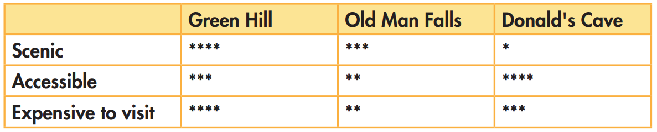
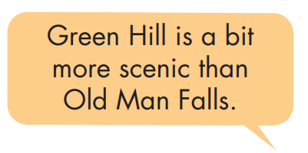
Task b.
Presentation

Slide 29
Task b.
Suggested answers
Green Hill is a bit more scenic than Old Man Falls.
Presentation
Green Hill is much more scenic than Donald's Cave.
Donald's Cave isn't as scenic as Old Man Falls.

Slide 30
Task b.
Suggested answers
Presentation
Green Hill is a bit more accessible than Old Man Falls.
Donald's Cave is a bit more accessible than Green Hill.
Old Man Falls isn't as accessible as Donald's Cave.

Slide 31
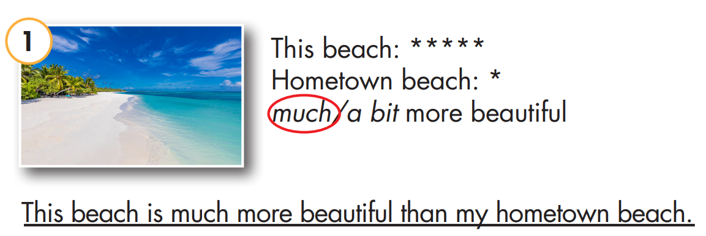
Task c.
Look at the star ratings, circle the correct intensifier, then write the sentences.

Slide 32
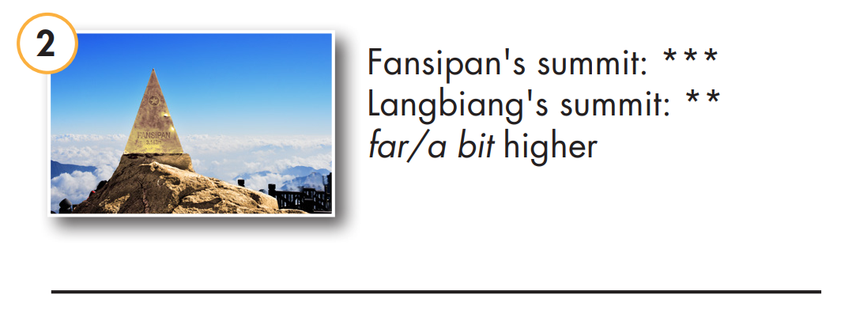
Task c.
Look at the star ratings, circle the correct intensifier, then write the sentences.

Slide 33
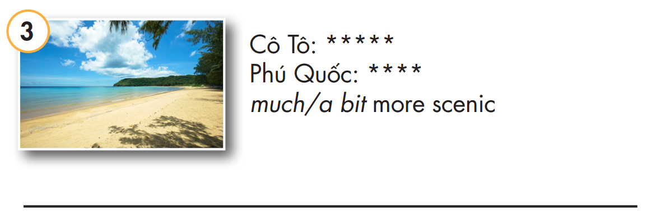
Task c.
Look at the star ratings, circle the correct intensifier, then write the sentences.

Slide 34
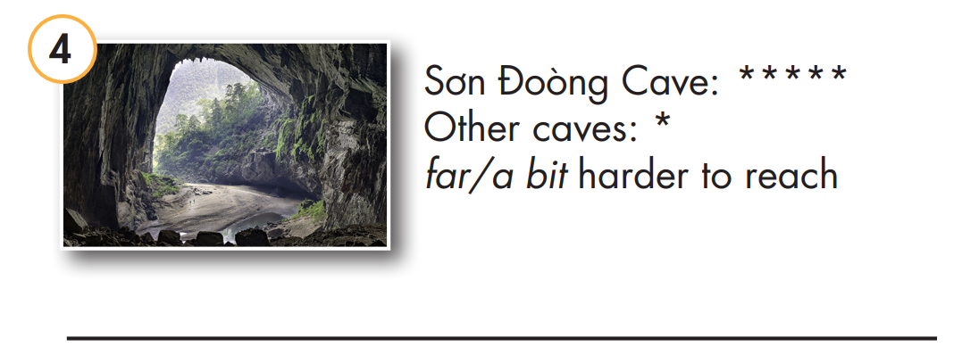
Task c.
Look at the star ratings, circle the correct intensifier, then write the sentences.

Slide 35
Answers
Fansipan's summit is a bit higher than Langbiang's summit.

Slide 36
Answers
Cô Tô is a bit more scenic than Phú Quốc.

Slide 37
Answers
Sơn Đoòng Cave is far harder to reach than other caves

Slide 38
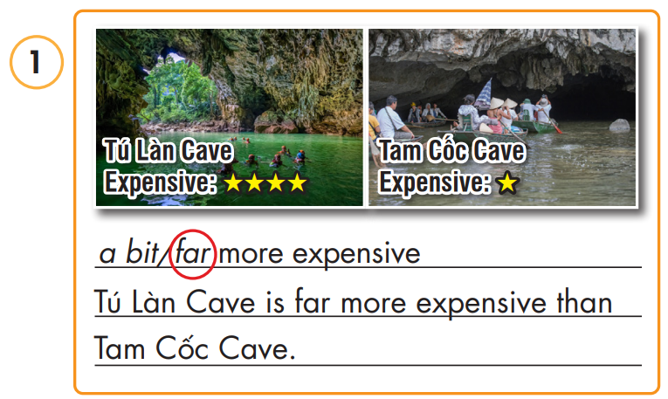
Look at the star ratings, circle the correct intensifier, then write the sentences.
Extra practice – WB

Slide 39
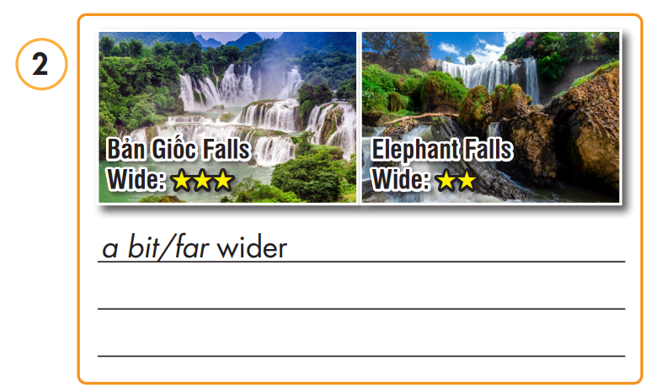
Look at the star ratings, circle the correct intensifier, then write the sentences.
Extra practice – WB

Slide 40
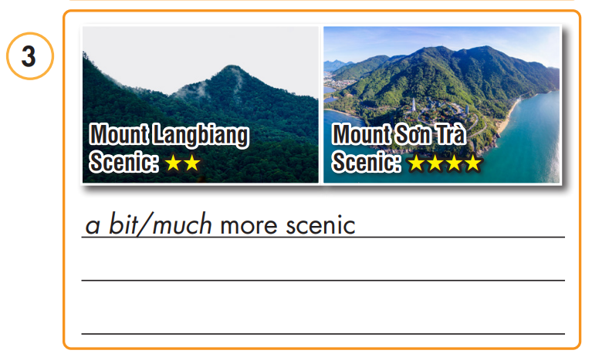
Look at the star ratings, circle the correct intensifier, then write the sentences.
Extra practice – WB

Slide 41
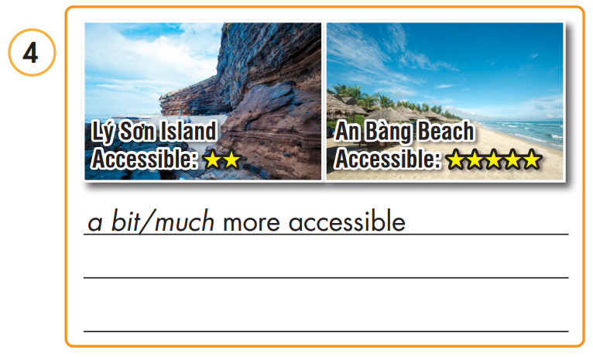
Look at the star ratings, circle the correct intensifier, then write the sentences.
Extra practice – WB

Slide 42
Look at the star ratings, circle the correct intensifier, then write the sentences.
Answer
Bản Giốc Falls is a bit wider than Elephant Falls.

Slide 43
Look at the star ratings, circle the correct intensifier, then write the sentences.
Answer
Mount Sơn Trà is much more scenic than Mount Langbiang.

Slide 44
Look at the star ratings, circle the correct intensifier, then write the sentences.
Answer
An Bàng Beach is much more accessible than Lý Sơn Beach.

Slide 45
Presentation
Production

Slide 46


In pairs: Use the information about from all places you
have studied and been and make new sentences using your own experience.
I went to Mount Sơn Trà last year and I think it’s far more scenic than Mount Bà Đen.
Presentation
And for me, I think Lý Sơn island isn’t as accessible as Bình Ba island.

Slide 47

CONSOLIDATION

Slide 48

In pairs: Talk together and share what things you studied today.

Slide 53

WRAP-UP

Slide 54
Today’s lesson
Grammar:
Learn how to use comparative structures with intensifiers correctly.
Review vocabulary about natural wonders and talk about them using comparative structures with intensifiers.

Slide 55
Homework
Review comparative structures with intensifiers.
Do exercise on page 33 – Grammar
Prepare for the next lesson (Pronunciation & Speaking - pages 56 & 57 - SB).
Play the consolidation games on www.eduhome.com.vn

Slide 56

Lesson 3
Stay positive and have a nice day!

