Slide 1

Period 64.Unit 5: Healthy Living
Review: Grammar, Pronunciation, Speaking, Writing
Pages 101 – 102

Slide 2
Lesson Outline
Grammar
Pronunciation
Speaking
Writing
Wrap-up

Slide 3

By the end of this lesson, students will be able to…
- review grammar points:
+ suggest + gerund
+ adverbial clause of concession
- improve word stress and /tr/ &
/ tʃ / sounds.
- talk about health problems
- write a summary paragraph.

Slide 4

Grammar

Slide 5

1. To offer advice.
Affirmative: suggest + gerund
My teacher suggests doing exercises everyday.
Negative: suggest + not + gerund
Doctors suggests not drinking too much alcohol.

Slide 6

➔ To introduce an idea that contrasts with the main idea.
Although / Though + clause, main clause.
Although he knows it’s bad for him, he eats a lot of junk food.
Main clause + although / though + clause.
Students still prefer to eat junk food though they have access to healthy snacks in the school's cafeteria.

Slide 7
➔ To introduce an idea that contrasts with the main idea.
Despite / In spite of + N/V-ing, main clause.
In spite of their harm, many people follow detox diets.
Main clause + despite / in spite of + N/V-ing.
Many people don't know how to cook a nourishing meal despite knowing the importance of eating healthily.

Slide 8

Rearrange the groups of words in the correct order to make complete sentences.
➔ Doctors suggest eating a healthy diet with all the nutrients you need.
➔ Many people follow detox diets though some of them are dangerous.

Slide 9
Rearrange the groups of words in the correct order to make complete sentences.
➔ Experts suggest starting school later so that children and teens get more sleep.
➔ Although there are benefits to doing exercise, people often don't do it enough.

Slide 10
Rearrange the groups of words in the correct order to make complete sentences.
➔ We often suggest cutting out soda and chips to start losing weight.
➔ Doctors suggest eating bananas, yogurt, and fatty fish to have a healthy diet.

Slide 11
Rearrange the groups of words in the correct order to make complete sentences.
➔ Though there are risks on the internet, many parents don't monitor their children.
➔ Although he wants a healthier diet, he doesn't want to eat less red meat.

Slide 12
Pronunciation

Slide 13

Task a
Circle the word that differs from the other three in the position of primary stress in each of the following questions.
/ˈmeni/ /oʊˈbiːs/ /ˈdaɪət/ /ˈækses/
/ˈkælɚi/ /ˈkemɪkəl/ /bəˈnænəz/ /ˈnuːtriənt/

Slide 14
Task b
Circle the word that has the underlined part pronounced differently from the others.
/oʊˈbiːs/ /ˈdiː.tɑːks/ /ˈækses/ /sliːp/
/ˈvaɪrəs/ /ˈnɝːɪʃɪŋ/ /rɪsk/ /əˈdɪktɪd/

Slide 15
In the real world

Slide 16

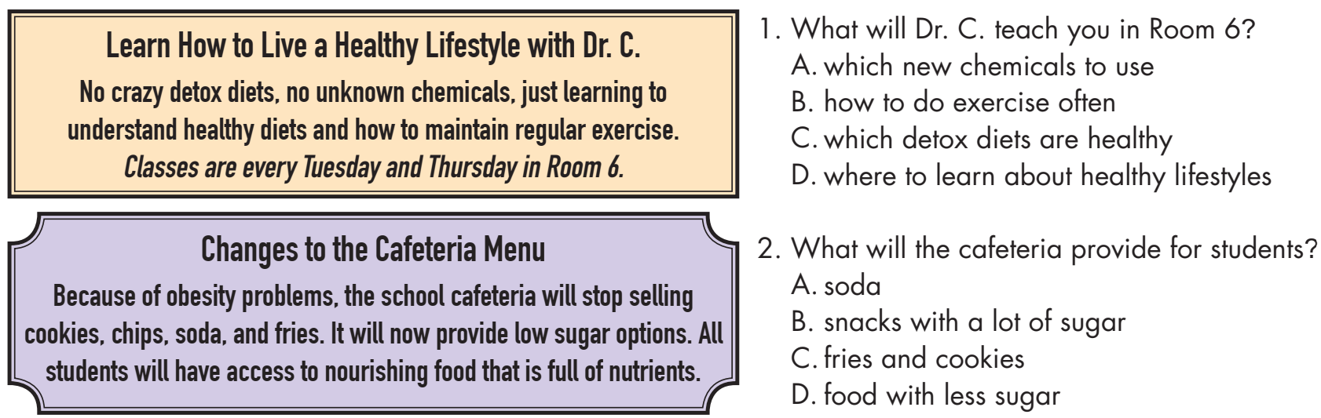
Look at the signs. Choose the best answers.

Slide 17

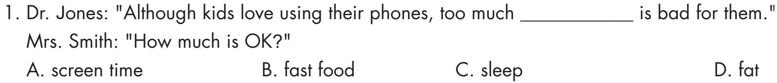
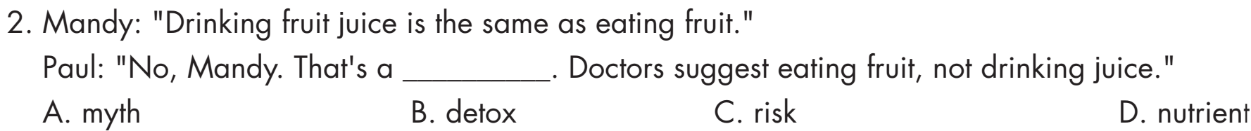
Choose the correct answer (A, B, C, or D).

Slide 18
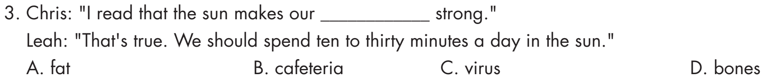
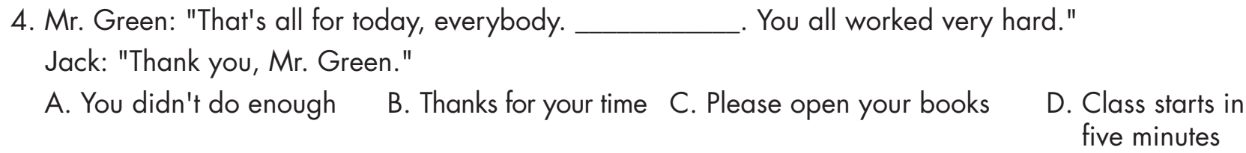
Choose the correct answer (A, B, C, or D).

Slide 19
Speaking

Slide 20

In pairs: Discuss and choose five pieces of health advice that you think all teenagers should follow. Share your ideas with another pair. Discuss whether any of the pieces of advice are myths.
Suggested answers:
Maintain 60 minutes of exercise a day
Get enough sleep
Reduce fast food and junk food
Get enough water a day
Manage screen time (less than 2 hours a day)

Slide 21


Though doctors suggest teens maintain 60 minutes of exercise a day, most teens are lazy to follow it.
Yeah, I agree. I think school should start later and give students less homework.
WRITING

Slide 22
Writing

Slide 23

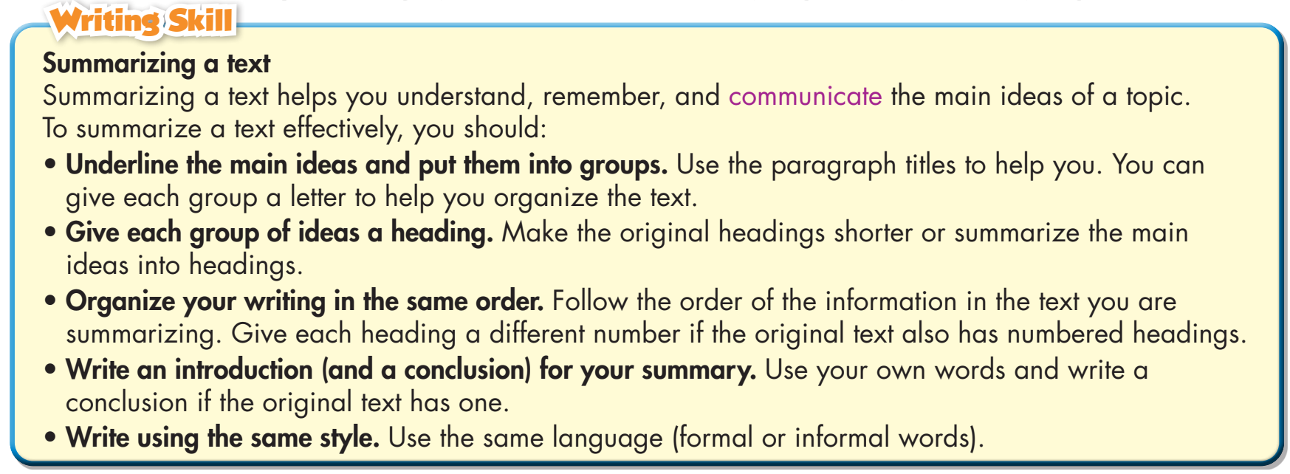
Write about ways to stay healthy and which ones you do. Write 100 to 120 words.

Slide 24
Suggested answer:
1. Maintain 60 minutes exercise a day
Many people are lazy to work out ever day. They spend too much time on sitting. It's important for more people to understand how exercises help us in good health and stay in shape.

Slide 25
2. Check health regularly
Even if you feel OK, you should check your health often. Only some people do this now. Technology makes it easier to check for health problems.
3. Get enough water a day
Water makes up about 50% to 70% of your body weight. It’s commonly recommended that you drink eight 8-ounce (237-mL) glasses of water per day.

Slide 26

CONSOLIDATION

Slide 27

WRAP-UP

Slide 28
Today’s lesson
Grammar: Review
Suggest + gerund
Adverbial clauses/phrases of concession
Pronunciation:
Review /tr/ and /tʃ/ sounds .
Review word stress.

Slide 29
Today’s lesson
Speaking: Talk about health myths / facts, health problems and advice.
Writing:
Review how to write a summary about how to stay healthy.

Slide 30
Homework
Review Grammar points and writing skills.
Prepare for the next lesson (Unit 6: Vocabulary & Listening – pages 54 & 55 - SB)
Play the consolidation games on www.eduhome.com.vn

Slide 31

Lesson 3
Stay positive and have a nice day!

