Slide 1

Unit 7: Transportation
Lesson 1.3: Pronunciation & Speaking
Page 54

Slide 2



LESSON OUTLINE
Consolidation

Slide 3
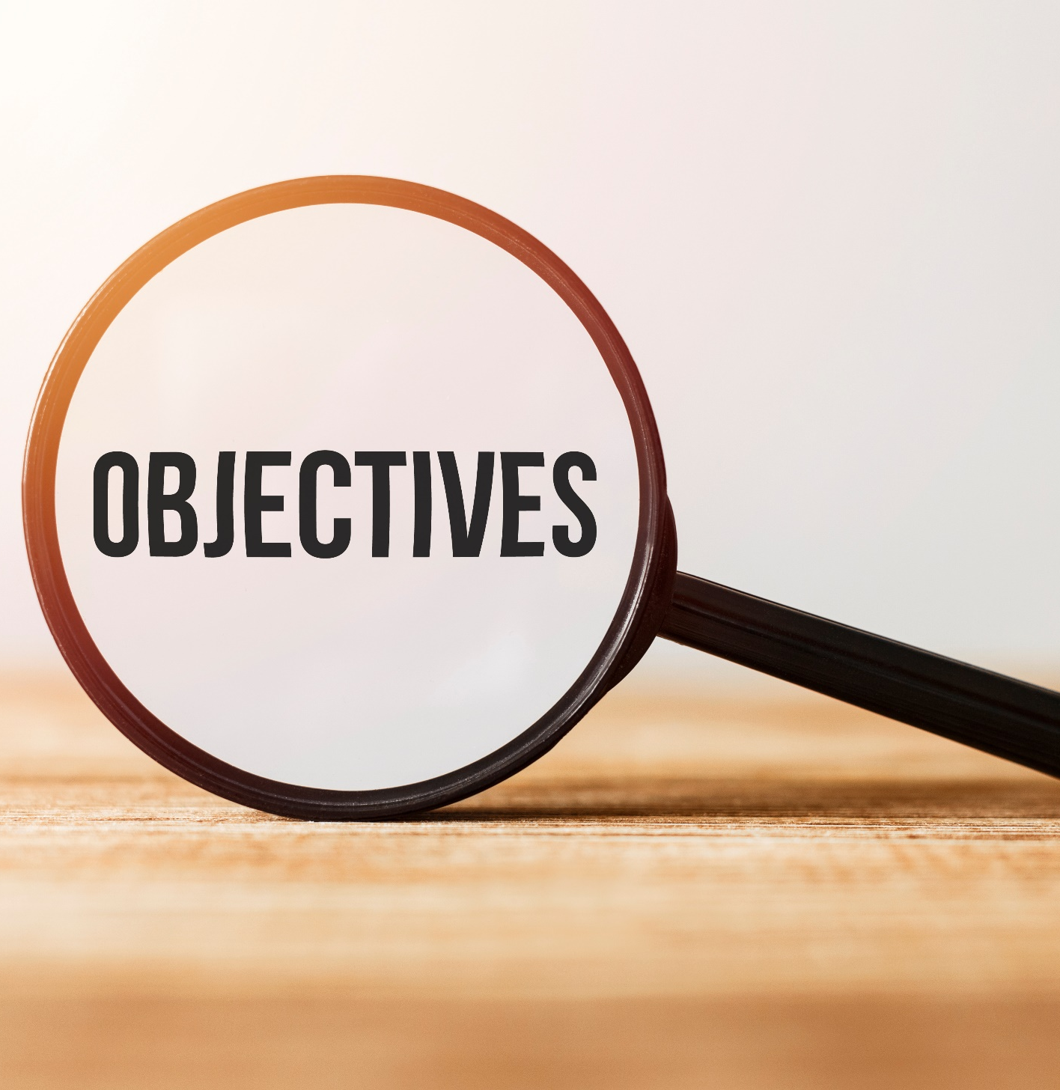
By the end of this lesson, students will be able to…
- stress the first syllable for most two-syllable nouns.
- ask for confirmation.

Slide 4

WARM-UP

Slide 5

Work in pairs.
Choose the word whose main stress is placed
differently from the others.
1. A. traditional B. temporary C. reliable D. convenient
2. A. upset B. friendly C. crunchy D. local
3. A. delighted B. comfortable C. annual D. talented
/trəˈdɪʃənl/
/ˈtempəreri/
/rɪˈlaɪəbl/
/kənˈvi:niənt/
/ʌpˈset/
/ˈfrendli/
/ˈkrʌntʃi/
/ˈloʊkl/
/dɪˈlaɪtɪd/
/ˈkʌmftəbl/
/ˈænjuəl/
/ˈtæləntɪd/

Slide 6
Work in pairs.
Choose the word whose underlined part is
pronounced differently from that of the other words.
1. A. city B. tourist C. setting D. prize
2. A. backpack B. suitcase C. passport D. transport
3. A. buses B. choices C. tourists D. boxes
/ˈsɪti/
/ˈtʊrɪst/
/ˈsetɪŋ/
/praɪz/
/ˈbækpæk/
/ˈsu:tkeɪs/
/ˈpæspɔ:rt/
/ ˈtrænspɔːrt/
/ˈbʌsɪz/
/ ˈtʃɔɪsɪz/
/ˈtʊrɪsts/
/ˈbɑ:ksɪz/

Slide 7

Work in pairs.
What do you want to buy for your study in the future?
I want to buy a large new pink laptop.

Slide 8
Teacher asks some students to describe the belongings of their friends in a class. The whole class will guess the owners of those belongings.
My friend has a big old black backpack.
My friend is wearing pink shoes and a white watch.

Slide 9



Slide 10
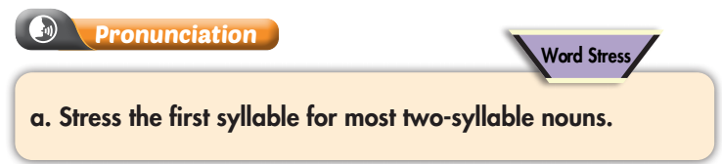
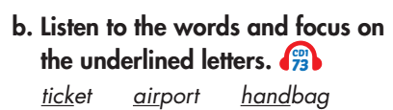


Slide 11
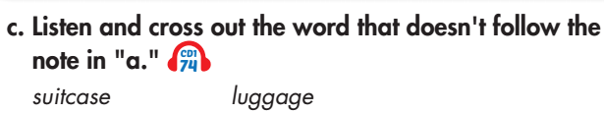

Wrong. The stress is on the second syllable.

Slide 12


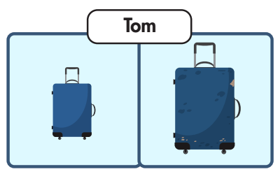




Slide 13
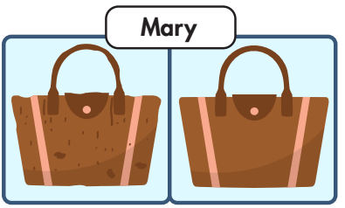
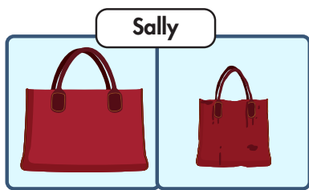
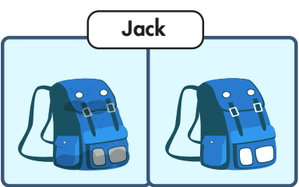
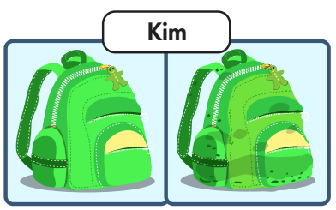
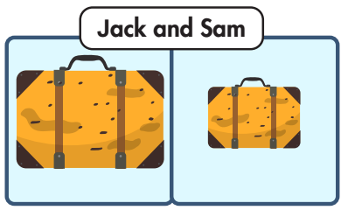
Do the same
What luggage do / does …….. have?
He / She has ……………./
They have……………..
Is this his / hers / theirs?
Yes, it is.

Slide 14
Do the same
What luggage do / does …….. have?
He / She has ……………./
They have……………..
Is this his / hers / theirs?
Yes, it is.

Slide 15
Do the same
What luggage do / does …….. have?
He / She has ……………./
They have……………..
Is this his / hers / theirs?
Yes, it is.

Slide 16
Do the same
What luggage do / does …….. have?
He / She has ……………./
They have……………..
Is this his / hers / theirs?
Yes, it is.

Slide 17
Do the same
What luggage do / does …….. have?
He / She has ……………./
They have……………..
Is this his / hers / theirs?
Yes, it is.

Slide 18
Do the same
What luggage do / does …….. have?
He / She has ……………./
They have……………..
Is this his / hers / theirs?
Yes, it is.

Slide 19

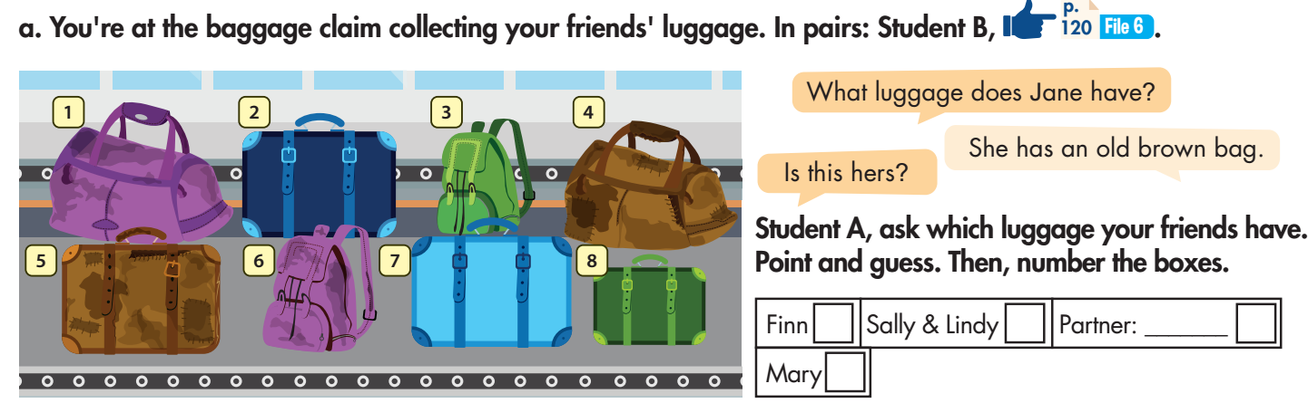
A: What luggage does Finn have?
B: He has a new dark blue suitcase.
A: Is this his?
B: Yes, it is.
2

Slide 20
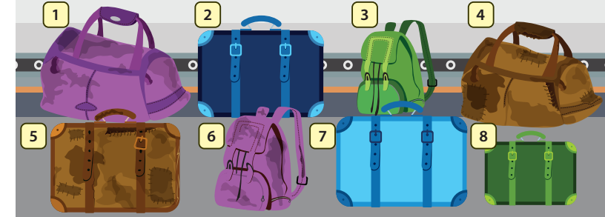
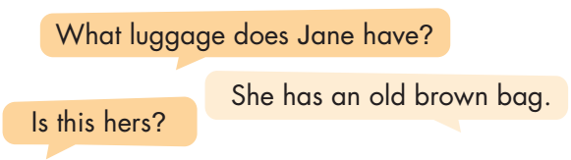
4
B: Yes, it is.

Slide 21
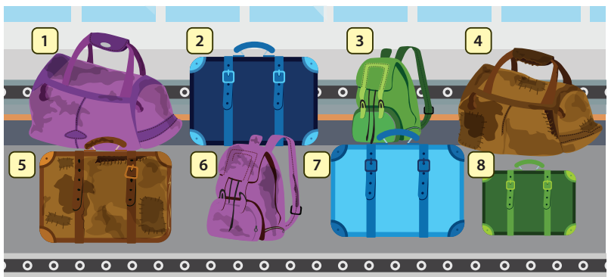
Information exchange - work in pairs.
Student A: After your discussion in the previous exercise, write the owners of the luggage in the pictures and ask student B to confirm the information. Student B looks at activity file 6, p.120). Complete the table with the name of the owner of the luggage.
Luggage number | Owners | What my friend (B) confirms
1 | Mary | Mary
2
3
4
5
6
7
8
Student A
A: Does Mary have an old purple handbag?
B: Yes, she does.

Slide 22
Swap roles and repeat
Student B: After your discussion in the previous exercise, write the owners of the luggage in the pictures and ask student A to confirm the information. Student A looks at activity file 7, p.121). Complete the table with the name of the owner of the luggage.
Luggage number | Owners | What my friend (A) confirms
1
2
3
4 | Jane | Jane
5
6
7
8
Student B
B: Does Jane have an old brown bag?
A: Yes, she does.

Slide 23

CONSOLIDATION

Slide 24
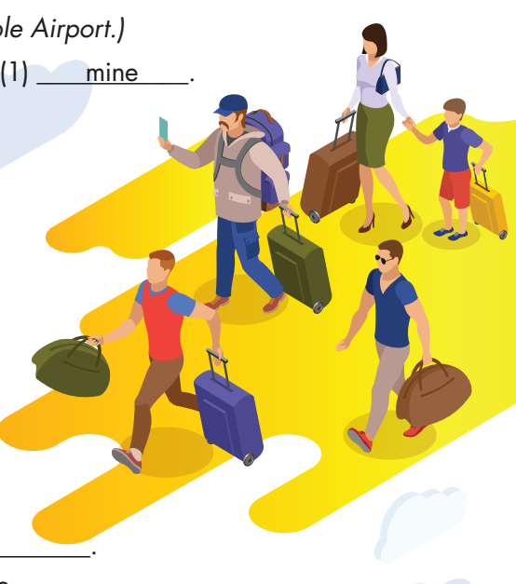
Hoa
Please write 4 sentences to ask and answer about the luggage of the people in the picture.
E.g.
A: Quan has a big blue backpack and a large grey suitcase.
B: Is this his?
A: Yes, it is.
Quan
Tuan
Minh
Kha

Slide 25
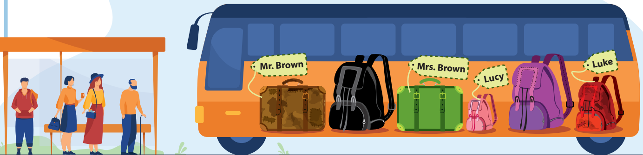
Pair work:
Student A chooses the bags that you think may belong to Mr. Brown and Mrs. Brown. Then describe the bag to Student B. Student B guesses the bag and asks for confirmation.
e.g. A: Mr. Brown has an old brown bag.
B: Is it luggage number 1?
A: Yes, it is.
Student B chooses the bags that you think may belong to Lucy and Luke. Then describe the bag to Student A. Student A guesses the bag and asks for confirmation.
2
5
1
3
6
4

Slide 26

WRAP-UP

Slide 27
Today’s lesson
Speaking:
Stress the first syllable for most two-syllable nouns.
Ask for confirmation.

Slide 28
Homework
Practice pronouncing two-syllable nouns.
Review the vocabulary and grammar notes in Tiếng Anh 7 i-Learn Smart World Notebook (pages 42 & 43).
Prepare the next lesson (page 55 SB).
Play the consolidation games in Tiếng Anh 7 i-Learn Smart World DHA App on www.eduhome.com.vn.

Slide 29

Lesson 3
Stay positive and have a nice day!

