Slide 1
Unit 6: Life on other planets
Lesson 2.1 – Vocabulary & Listening
Pages 58 & 59

Slide 2
Lesson Outline
Warm-up
Vocabulary
Listening
Consolidation
Wrap-up

Slide 3
By the end of this lesson, students will be able to…
know more words about life on other planets.
listen to and understand interviews with people talking about strange things they saw (for specific details).
know how to use functional English – Showing interests.

Slide 4
New words
alien
appear
disappear
disk-shaped
flying saucer
huge
tiny
strange
terrified
UFO

Slide 5
Lesson 1
WARM UP

Slide 6
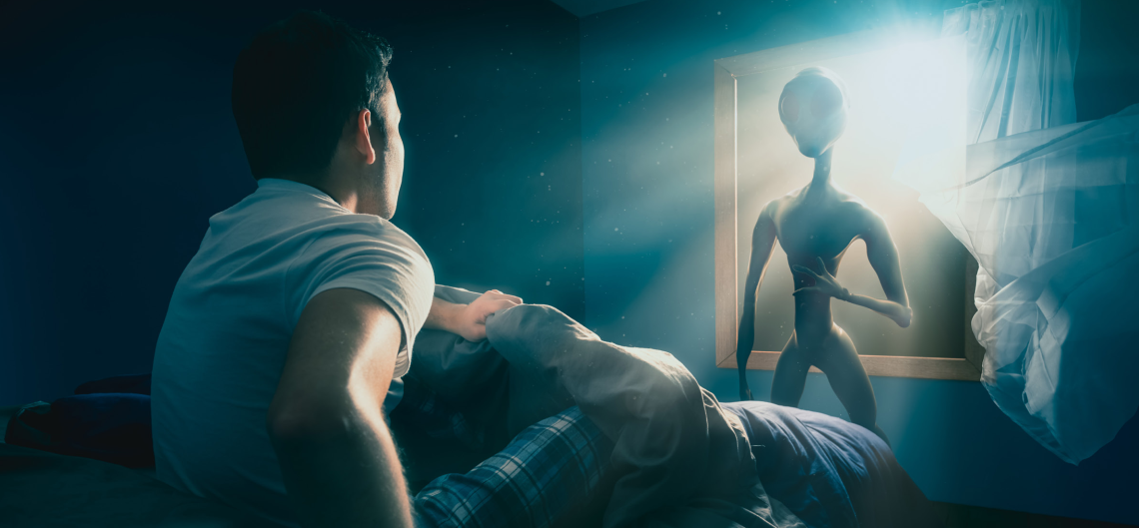
In pairs. Look at the picture. Discuss the questions.
Option 1
What do you think is happening?
Where can you see or hear about something like this?
Do you think the stories are real?

Slide 7
Option 2
Watch a video and answer the question.
Can you see someone/ something special in the video?
Aliens!

Slide 8
Pre – Listening:
Vocabulary

Slide 9
Listen and repeat. Click on each phrase to hear the sound.
alien (n) /ˈeɪliən/ người ngoài hành tinh
appear (v) /əˈpɪr/ xuất hiện >< disappear (v) /dɪsəˈpɪr/ biến mất
disk-shaped (n) / dɪsk ʃeɪpt/ hình đĩa
flying saucer (n) /ˌflaɪɪŋ ˈsɑːsɚ/ đĩa bay
huge (adj) /hjuːdʒ/ to lớn >< tiny (adj) /ˈtaɪni/ nhỏ xíu
strange (adj) /streɪndʒ/ kỳ lạ
terrified (adj) /ˈterəfaɪd/ cảm thấy khiếp sợ
UFO (n) /ˌjuːefˈoʊ/ (unidentified flying object) vật thể bay không xác định
Notes:
GV click vào từng cụm nghe âm thanh

Slide 10
Practice saying these words with a partner.
alien (n) /ˈeɪliən/ người ngoài hành tinh
appear (v) /əˈpɪr/ xuất hiện >< disappear (v) /dɪsəˈpɪr/ biến mất
disk-shaped (n) /dɪsk ʃeɪpt/ hình đĩa
flying saucer (n) /ˌflaɪɪŋ ˈsɑːsɚ/ đĩa bay
huge (adj) /hjuːdʒ/ to lớn >< tiny (adj) /ˈtaɪni/ nhỏ xíu
strange (adj) /streɪndʒ/ kỳ lạ
terrified (adj) /ˈterəfaɪd/ cảm thấy khiếp sợ
UFO (n) /ˌjuːefˈoʊ/ (unidentified flying object) vật thể bay không xác định
Notes:
GV click vào từng cụm nghe âm thanh

Slide 11
5
2
7
3

Slide 12
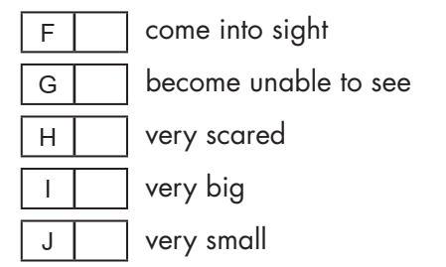
4
6
10
8
9

Slide 13
Work in pairs

Slide 14
Listening

Slide 16
see
another planet
soccer
ran away

Slide 17
Post - listening

Slide 19
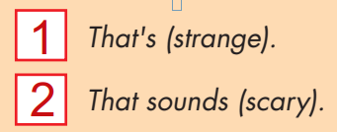

Slide 20
Work in pairs

Slide 21
CONSOLIDATION

Slide 22
Choose the correct word for each sentence. 1. Suddenly, a UFO appeared/ disappeared in the sky, and it made a strange sound. 2. The alien had ten huge/ tiny eyes on its head. They were so small! 3. I was walking home from school when I saw a disk-shaped/ round-shaped thing in the sky. It was round and thin.

Slide 23
WRAP-UP

Slide 24
Today’s lesson
Vocabularies
alien
appear
disappear
disk-shaped
flying saucer
huge
tiny
strange
terrified
UFO

Slide 25
Today’s lesson
Learn more words about life on other planets.
Listen to and understand interviews with people talking about strange things they saw (for specific details).
Know how to use functional English – Showing interests.

Slide 26
Homework
- Learn the new words.
- Practice talking about strange things you saw in the past.
- Do the exercises in WB: New words & Listening (pages 34 & 35).
- Do the exercises in TA 8 i-Learn Smart World Notebook, (pages 49 & 50).
- Play the consolidation games in Tiếng Anh 8 i-Learn Smart World DHA App on www.eduhome.com.vn
- Prepare: Lesson 2.2 – Grammar (pages 59 & 60 – SB).

Slide 27
Lesson 3
Stay positive and have a nice day!

