Slide 1
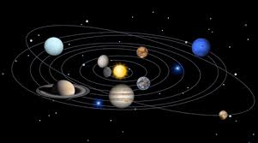

Slide 2
SUN
MERCURY
VENUS
EARTH
MARS

Slide 3
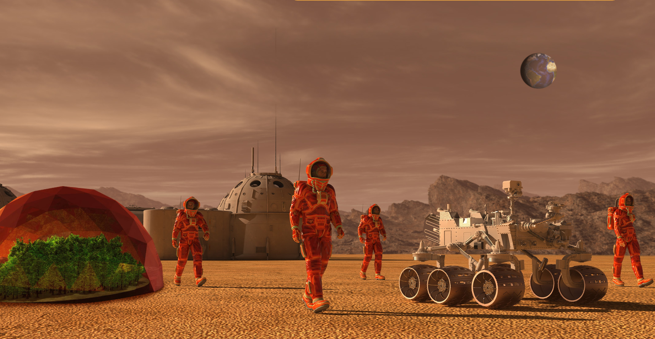
In pairs: Look at the picture.
1. Where do you think the people are?
2. Do you think humans will live on a different planet in the future? Why (not)?

Slide 4
Unit 6: Life on other planets
Period 65.Lesson 1.1: New words & Reading
New words:

Slide 5
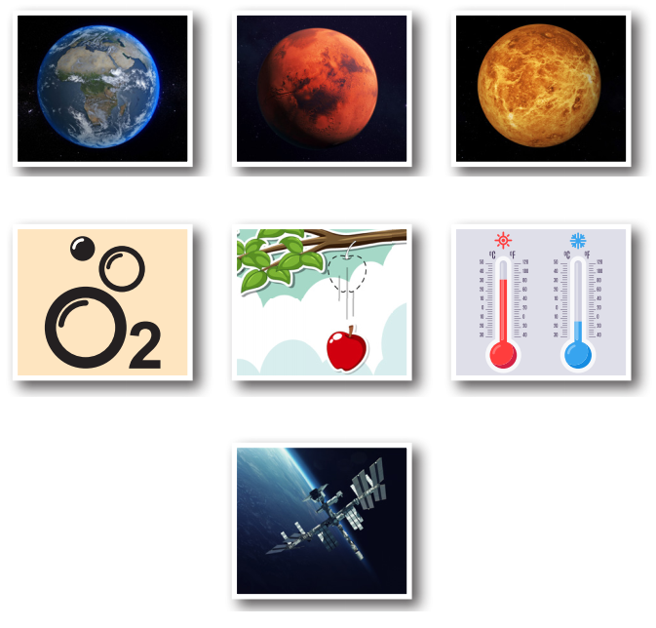
What can you see in each picture?
Earth
Mars
Venus
1
2
3
oxygen
gravity
temperature
4
5
6
7
space station

Slide 6
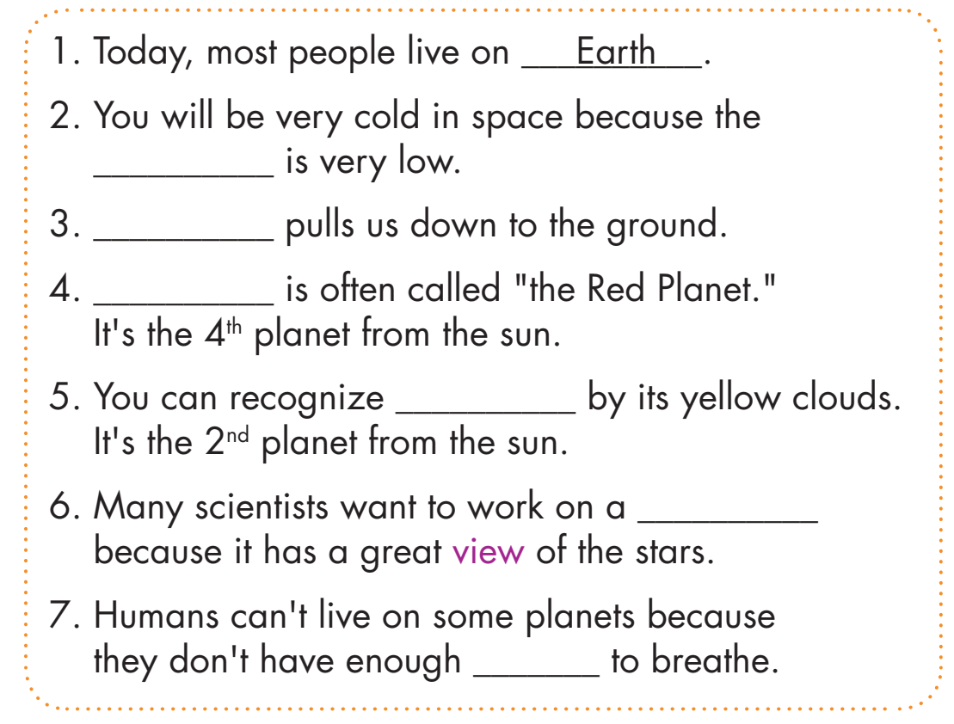
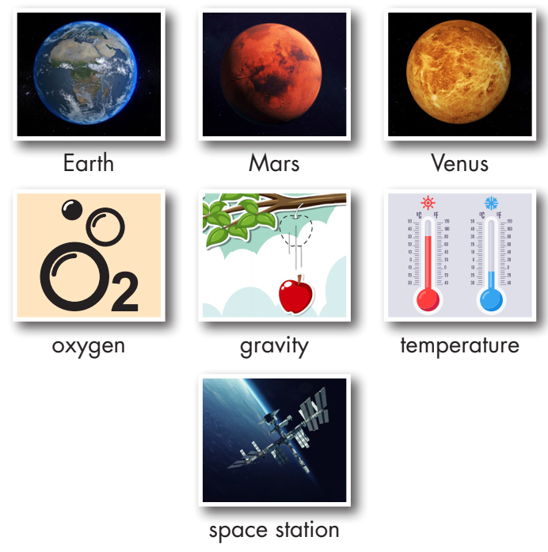
Look at the pictures and fill in the blanks. Listen and repeat
temperature
reading comics
Gravity
Mars
Venus
space station
oxygen

Slide 7
Work in pairs
Would you like to visit another planet or a space station? Why (not)?

Slide 8
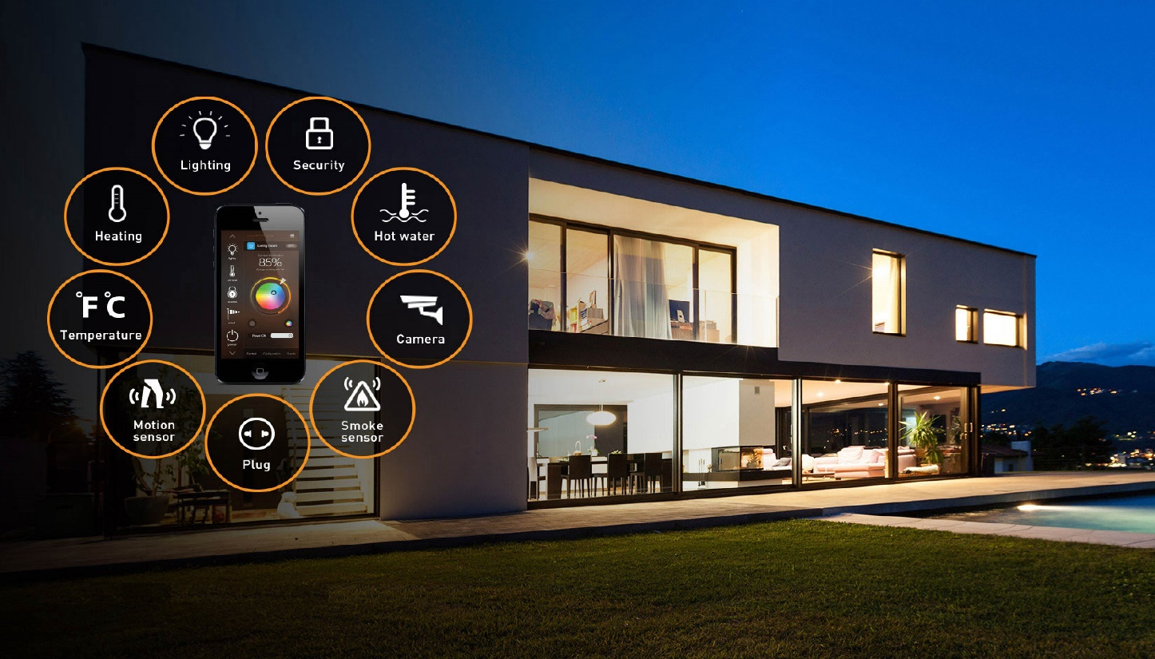
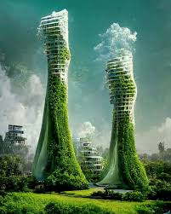
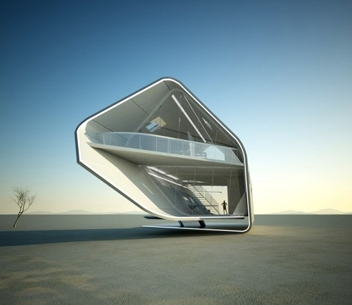
Look at the pictures.
1.What can you see in the pictures?
2. What will your future home
look like? Where will it be?

Slide 9
Unit 6. LIFE ON OTHER PLANETS
Period 65. Lesson 1.1. <New words + Reading>

Slide 10
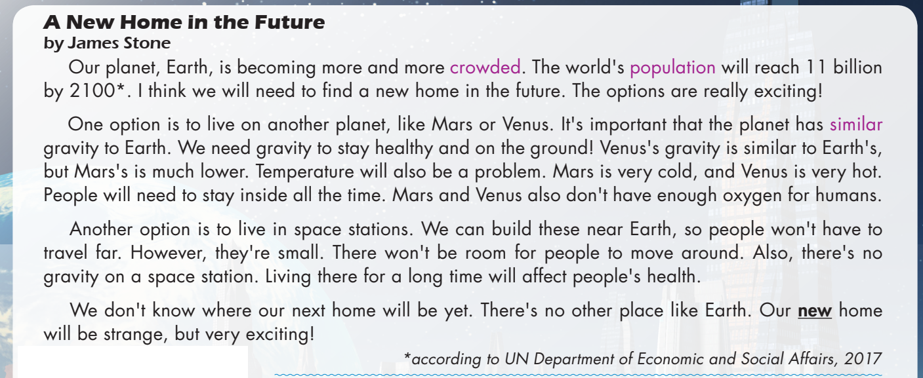

Slide 11
Task a
Read the magazine article. What is it about?
different places people can live in the future
why space stations will be the best places to live

Slide 12
Task b
b. Now, read and answer.
According to the writer, 1. What will the world's population be by the year 2100?
2. How is Mars's gravity different from Earth’s?
3. Why will people need to stay inside on Venus?
4. Why is it good that we can build space stations near Earth?
5. The word new in paragraph 4 is closest in meaning to ______.
A. different from before B. recently made C. not known before

Slide 13
Task b

Slide 14
What will the world's population be by the year 2100?
How is Mars's gravity different from Earth’s?
Why will people need to stay inside on Venus?
11 billion
It's much lower.
It’s very hot.
A New Home in the Future
by James Stone Our planet, Earth, is becoming more and more crowded. The world's population will reach 11 billion by 2100. I think we will need to find a new home in the future. The options are really exciting!
One option is to live on another planet, like Mars or Venus. It's important that the planet has similar gravity to Earth. We need gravity to stay healthy and on the ground! Venus's gravity is similar to Earth’s, but Mars's is much lower. Temperature will also be a problem. Mars is very cold, and Venus is very hot. People will need to stay inside all the time. Mars and Venus also don't have enough oxygen for humans.

Slide 15
4. Why is it good that we can build space stations near Earth?
5. The word new in paragraph 4 is closest in meaning to ______.
A. different from before B. recently made C. not known before
Because people won't have to travel far.
Another option is to live in space stations. We can build these near Earth, so people won't have to travel far. However, they're small. There won't be room for people to move around. Also, there's no gravity on a space station. Living there for a long time will affect people's health.
We don't know where our next home will be yet. There's no other place like Earth. Our new home will be strange, but very exciting!

Slide 16
Task c
Would you prefer to live on Mars, Venus, or a space station? Why?

Slide 17
Homework:
Read the article and redo the exercises
Practice talking about where you would like to live
Do exercises: New words a,b,c (workbook)
Prepare: Grammar: Future simple p55,56

Slide 18
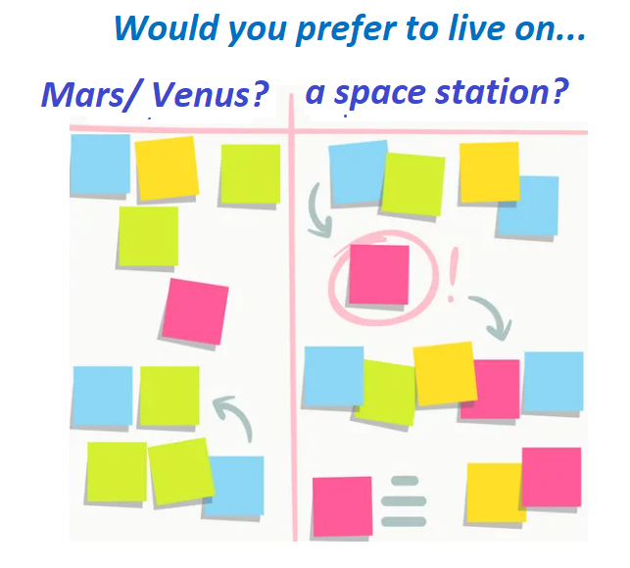
Work in pairs
Post-reading
Write down your ideas on sticky notes, then stick to the board, and talk about them.

Slide 19
CONSOLIDATION

Slide 20
Retell nouns/ noun phrases about future home.

Slide 21
WRAP-UP

Slide 22
Lesson 3
Today’s lesson
Vocabularies
live on Earth
Mars
Venus
oxygen
space station
gravity
temperature

Slide 23
Today’s lesson
Reading:
- Understanding instructions
Skimming and scanning for general and specific information
Speaking:
- Talking about where humans will live in the future

Slide 24
Lesson 3
Homework
Learn the new words.
Practice talking about future home.
Do the exercises in WB: Unit 6 - Lesson 1 - New words + Reading (pages 32 & 33).
Play the consolidation games in Tiếng Anh 8 i-Learn Smart World DHA App on www.eduhome.com.vn
Prepare Lesson 1.2 – Grammar (pages 55 & 56 – SB).
Do the exercises in Notebook (Pages 46 & 47).

Slide 25
Lesson 3
Stay positive and have a nice day!

