Slide 1
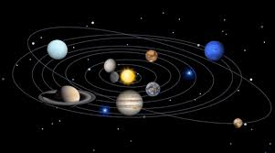
Unit 6: Life on other planets
Lesson 1.2: Grammar
Pages 55 & 56

Slide 2
SUN
MERCURY
VENUS
EARTH
MARS

Slide 3
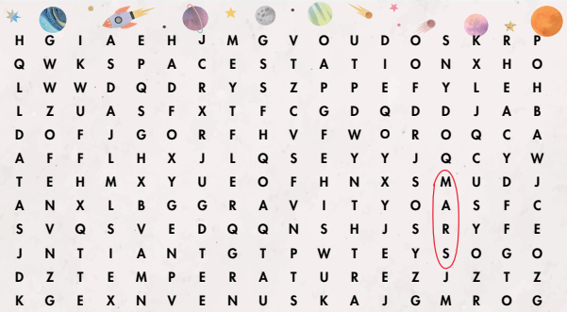
Wordsearch
Find six more words.

Slide 4
Work in pairs. Find a mistake in each sentence below.
What people will do when there are too many people on Earth?
I think people will to live on another planet.
What will people do when there are too many people on Earth?
I think people will live on another planet.
What tense are we using?
→ FUTURE SIMPLE

Slide 5
Unit 6: Life on other planets
Period 66. Lesson 1.2: Grammar

Slide 6
Read the box and answer the question below.
What can we use will for?

Slide 7
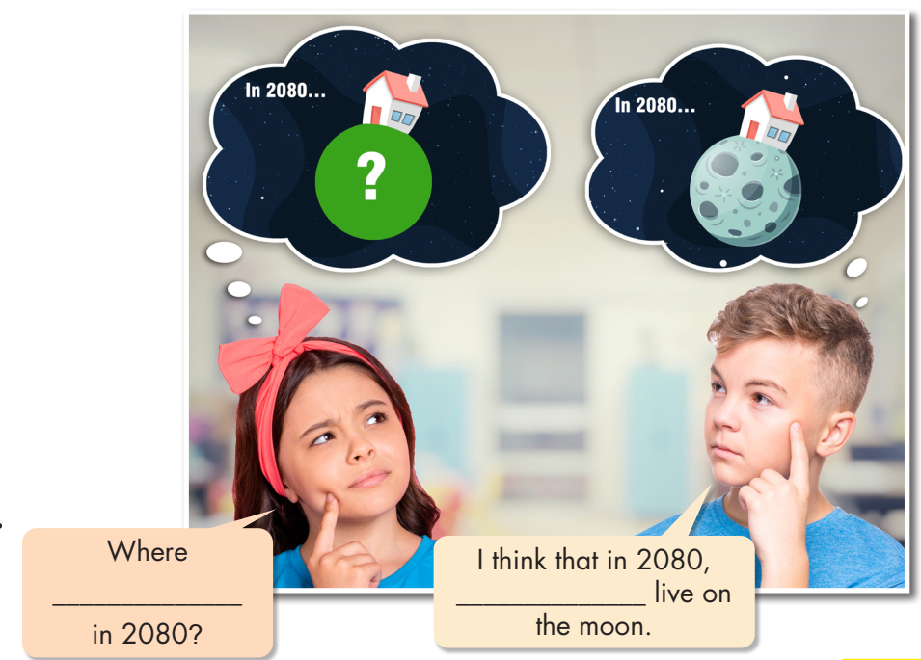
Read about Future simple
and fill in the blank

Slide 8
Read the examples:
I think that in 2150, people will live on Mars.
In 30 years, Earth will be more crowded.
Humans won’t live on the moon.
Life won’t be very boring on Mars.
A: Where will people live in the future?
B: I think they will live on Venus.
A: Why will they live on Venus?
B: Because Venus’s gravity is similar to Earth’s.
A: Do you think people will live on space stations?
B: Yes, I do
C: No, I don’t. It will be too difficult to get food on space stations.

Slide 9
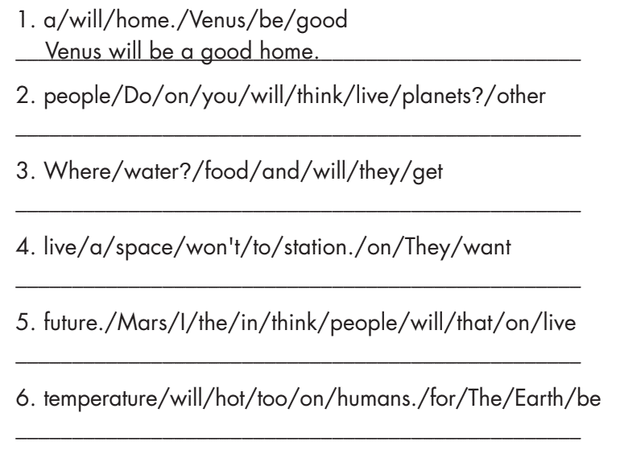
a. Unscramble the sentence. P56
Do you think people will live on other planets?
Where will they get food and water?
They won't want to live on a space station.
I think that people will live on Mars in the future.
The temperature on Earth will be too hot for humans.

Slide 10
b.Fill in the blanks with the words from the box.
will have – won’t live – won’t be – will live – will be
I think that in two hundred years, some people……………….on Mars.
Do you think other planets……………………..cities in the future?
I think that in the future, everyone will live on Venus. They……………………….on Earth.
By 2100, there……………………….more space stations near Earth. Will you live on one?
I don’t think we’ll live on other planets because there …………..……. enough oxygen or gravity.
will live
will have
won’t live
will be
won’t be

Slide 11
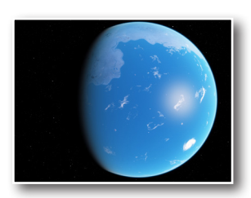
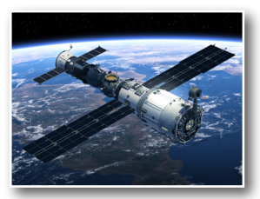
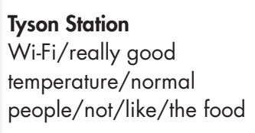
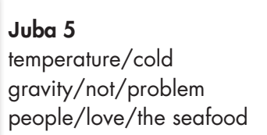
c

Slide 12
I think that in 2150, people
will live on Mars.
S + will + Vo
S + will not / won’t + Vo
Future simple
Humans won’t live on the moon.
Will + S+ Vo?
Will people live on Venus in the future?
Wh- + will + S + Vo?
Why will they live on Venus?

Slide 13
*Homework:
Redo the exercises a,b,c
Learn Future simple by heart
Do exercises a,b,c p32 (workbook)
Prepare: Pronunciation + Speaking

Slide 14
CONSOLIDATION

Slide 15
Find a mistake in each sentence below.

Slide 16
WRAP-UP

Slide 17
Today’s lesson
Grammar:
Using the Future Simple, we may predict the future based on our own beliefs and experiences.
Speaking:
Make predictions about the places.

Slide 18
Lesson 3
Homework
- Make four sentences using will/ won’t.
- Do the exercises in WB: Grammar (page 33).
- Complete the grammar notes in Tiếng Anh 8 i-Learn Smart World Notebook (page 48).
- Play the consolidation games in Tiếng Anh 8 i-Learn Smart World DHA App on www.eduhome.com.vn
- Prepare: Lesson 1 – Pronunciation and Speaking (pages 56 & 57 – SB).

Slide 19
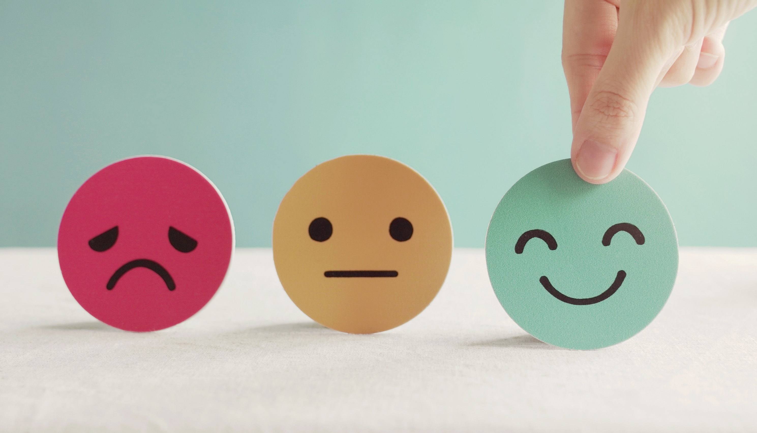
Lesson 3
Stay positive and have a nice day!

