Slide 1

Hello everyone !!!

Slide 2
* Game: JUMBLED SENTENCES
* Work in groups
1. books / I / science / read /.
2. house / They/ their / clean/ every day.
3. Mark / he / usually/ har-working / is/ gets/; therefore,/good marks/
4. Mai / bought / I /,for / many books /she/reading/likes/.
5. learn / words / every day / You / should / the / new /.
* Answer key:
1 . I read science books.
2. They clean their house every day.
3. Mark is hard-working; therefore, he usually gets high scores on exams.
4. Mai bought many books, for she likes reading.
5. You should learn the new words every day

Slide 3
* Game: JUMBLED SENTENCES
* Answer key:
1 . I read science books.
2. They clean their house every day.
3. Mark is hard-working; therefore, he usually gets high scores on exams.
4. Mai bought many books, for she likes reading.
5. You should learn the new words every day
* Questions:
- Which sentence is simple sentence ?
- which sentence is compound sentence?

Slide 4

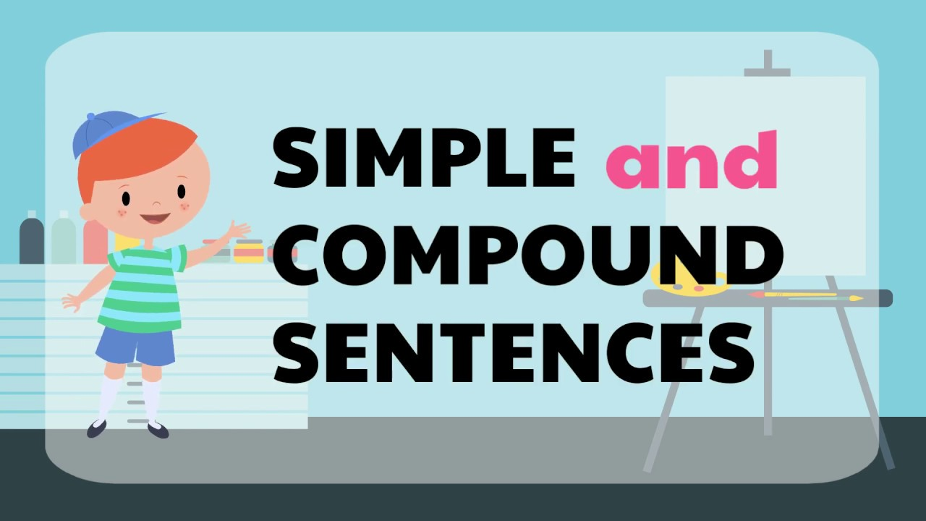
Unit
3
TEENAGERS
LESSON 3: A CLOSER LOOK 2

Slide 5
* Grammar
Simple sentences
& Compound sentences
Eg1: Minh has some problems with his schoolwork.
Eg2: Mark is hard-working; therefore, he usually gets high scores on exams.
s
v
s₁
v₁
s₂
v₂
connector

Slide 6
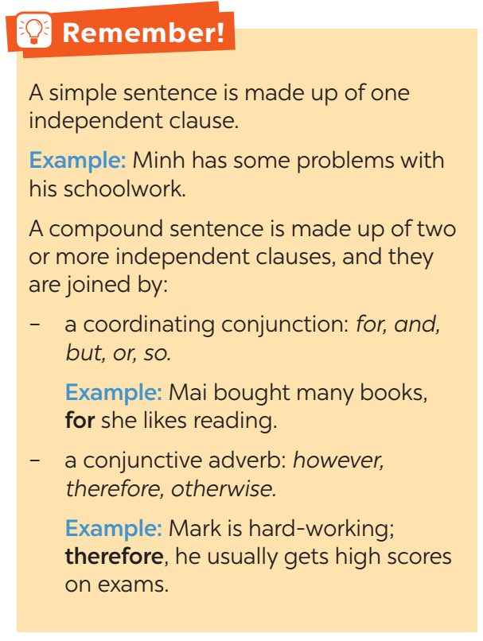

Slide 7
*Grammar: SIMPLE SENTENCES & COMPOUND SENTENCES
(Câu đơn & câu ghép)
- Một câu đơn gồm một mệnh đề độc lập.
Eg1: Minh has some problems with his schoolwork.
s
v
- Một câu ghép bao gồm hai hay nhiều mệnh đề độc lập, và chúng được liên kết bởi:
+ liên từ nối: for (vì), and (và), but (nhưng), or (hoặc), so (vì vậy)
Eg2 : Mai bought many books, for she likes reading.
s₁
v₁
s₂
v₂
+ một trạng từ liên kết: however (tuy nhiên), therefore (vì vậy), otherwise (ngược lại)
Eg3: Mark is hard-working; therefore, he usually gets high scores on exams.
s₁
v₁
s₂
v₂

Slide 8

1
Tick the simple sentences.
We work together on different projects.
Teens need good friends and tolerant teachers at school.
She plays chess very well, and she won the first prize last year.
Sports activities at school help me relax.
Teens should learn teamwork, and they should also have
communication skills.

Slide 9
2
Write S for simple sentences and C for compound sentences.
____ 1. Teenagers are often very active and talkative.
____ 2. He often chats with his friends on Facebook Messenger.
____ 3. She is a smart student, and she is an active member of our club.
____ 4. My friends and I joined a sports competition last year.
____ 5. He is a club member, but he never participates in any of the activities.
S
S
C
S
C

Slide 10
3
Choose the correct answer A, B, or C.
1. Parents should give teens some freedom,______ they should also set limits.
A. for B. so C. but
2. We don’t cheat on exams, ______ it is a wrong thing to do.
A. or B. for C. and
3. Lan wants to join the school music club; ______, she can’t sing or play any instruments.
A. however B. otherwise C. therefore
4. Schoolwork causes teens a lot of pressure, ______ they also feel pressure from their parents.
A. and B. but C. or
5. She wanted to prepare for the exam; ______, she turned off her mobile phone.
A. however B. otherwise C. therefore
6. English is very difficult to learn, ______ it is useful for you.
A. for B. so C. but
Game

Slide 11
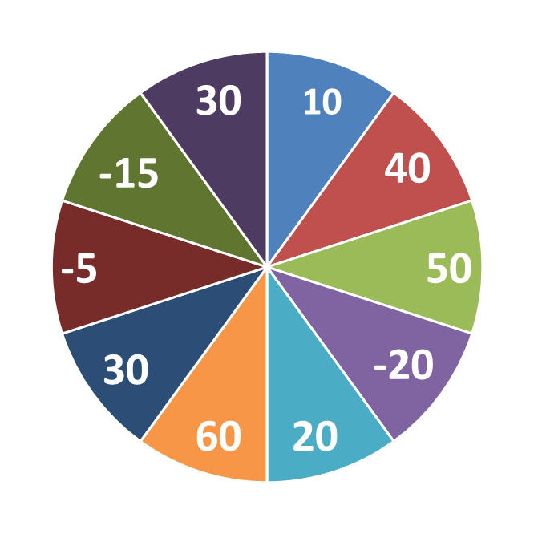
THE BIG WHEEL GAME
QUESTIONS
1
4
2
5
3
6

Slide 12
3
Choose the correct answer A, B, or C.
1. Parents should give teens some freedom,______ they should also set limits.
A. for B. so C. but

Slide 13
3
Choose the correct answer A, B, or C.
2. We don’t cheat on exams, ______ it is a wrong thing to do.
A. or B. for C. and

Slide 14
3
Choose the correct answer A, B, or C.
3. Lan wants to join the school music club; ______, she can’t sing or play any instruments.
A. however B. otherwise C. therefore

Slide 15
3
Choose the correct answer A, B, or C.
4. Schoolwork causes teens a lot of pressure, ______ they also feel pressure from their parents.
A. and B. but C. or

Slide 16
3
Choose the correct answer A, B, or C.
5. She wanted to prepare for the exam; ______, she turned off her mobile phone.
A. however B. otherwise C. therefore

Slide 17
3
Choose the correct answer A, B, or C.
6. . English is very difficult to learn, ______ it is useful for you.
A. for B. so C. but

Slide 18
3
Choose the correct answer A, B, or C.
1. Parents should give teens some freedom,______ they should also set limits.
A. for B. so C. but
2. We don’t cheat on exams, ______ it is a wrong thing to do.
A. or B. for C. and
3. Lan wants to join the school music club; ______, she can’t sing or play any instruments.
A. however B. otherwise C. therefore
4. Schoolwork causes teens a lot of pressure, ______ they also feel pressure from their parents.
A. and B. but C. or
5. She wanted to prepare for the exam; ______, she turned off her mobile phone.
A. however B. otherwise C. therefore
6. English is very difficult to learn, ______ it is useful for you.
A. for B. so C. but

Slide 19
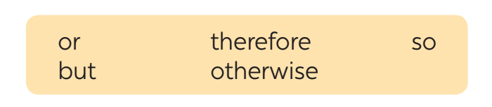
4
Combine the two sentences to make compound sentences, using the words from the box.
1. Phong has to study harder. He may fail the exam.
___________________________________________________
2. She is very sensitive. Don’t comment on her new hairstyle.
___________________________________________________
Phong has to study harder; otherwise, he may fail the exam.
She is very sensitive; therefore, don’t comment on her new hairstyle.

Slide 20
3. Mi wants to have more friends. She doesn’t connect well with others.
__________________________________________________________
4. Students can work in groups. She can work in pairs.
___________________________________________________
5. My friend likes showing off her new things. She often posts pictures on social media.
___________________________________________________
_____________________
Mi wants to have more friends, but she doesn’t connect well with others.
Students can work in groups, or they can work in pairs.
My friend likes showing off her new things, so she often posts
pictures on social media.

Slide 21
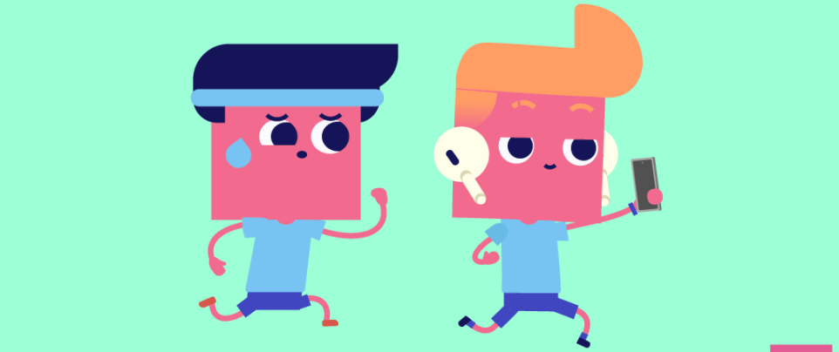
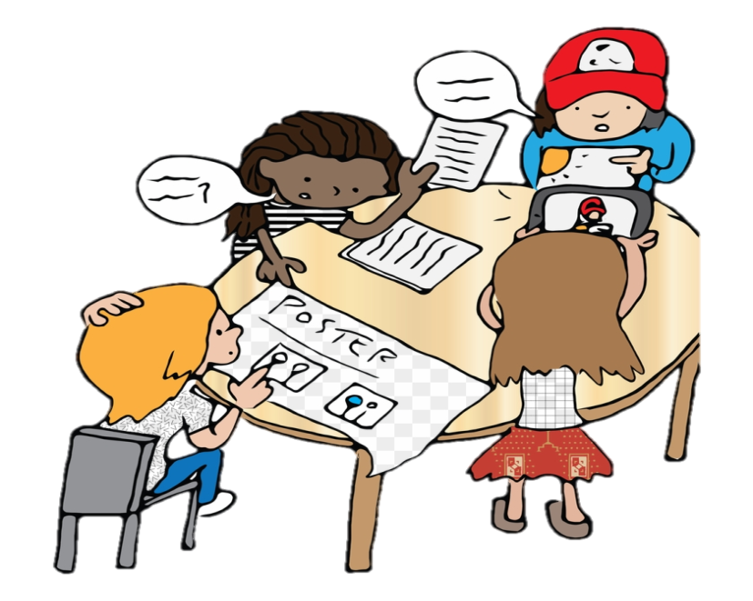
* PRODUCTION
GAME: SENTENCE RACE
Which group has the most sentences?
Work in groups. Each group makes as many compound sentences as possible. The group with the most correct sentence is the winner.

Slide 22

* HOME WORK
- Do exercises in the workbook.
- Prepare lesson 4 ( communication)
- Do exercise in the workbook.

Slide 23

Goodbye.
See you again.

